Slide 1
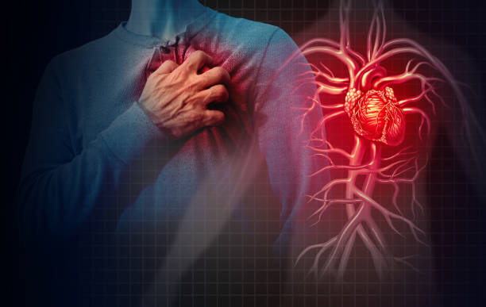
HDDCDRS
HEART DISEASE DETECTION USING CRUCIAL DATA AND RECOMMENDATION SYSTEM
A Decision Support System for Doctors
TEAM: ENIGMA

Slide 2
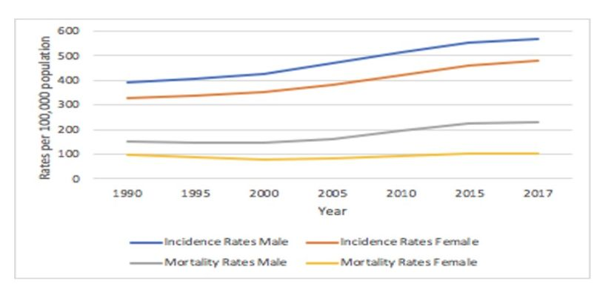
PROBLEM DOMAIN
Time consuming Research
Lack of Decision support system in Medical system
Tedious to take aid from previous similar disease case with in files
Medicine Recommendation
Common reoccurring chronic diseases can be treated by doctors easily while rare cases might confuse them, hence risk factor
Fig: Trend in CVD mortality and incidence Rates by gender (Reference: Cardiovascular Disease Trends in Nepal- An Analysis of Global Burden of Disease Data 2017)

Slide 3
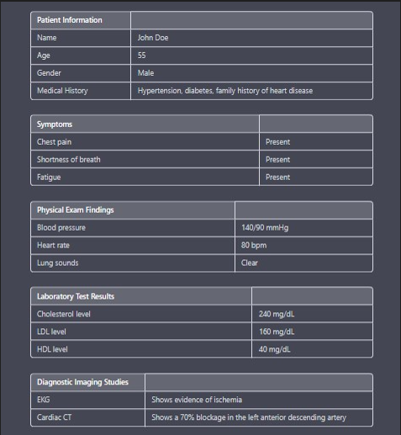
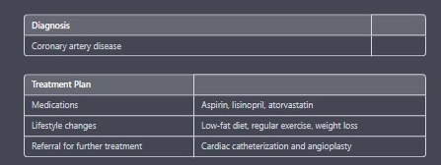
OUR APPROACH TO TACKLE THE PROBLEM
Analyze different parameters from patients report
Feed the data in ml model
Make medical field more advance
Basically, a time Saviour and life savior decision support system.

Slide 4
IMPLEMENTATION

Slide 5
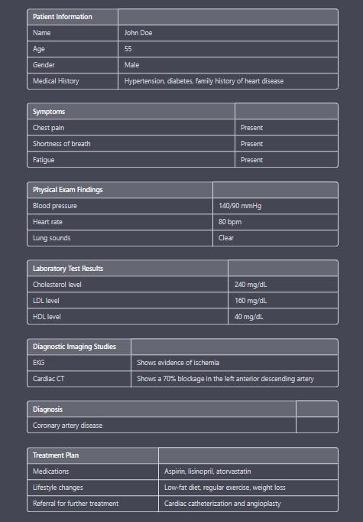
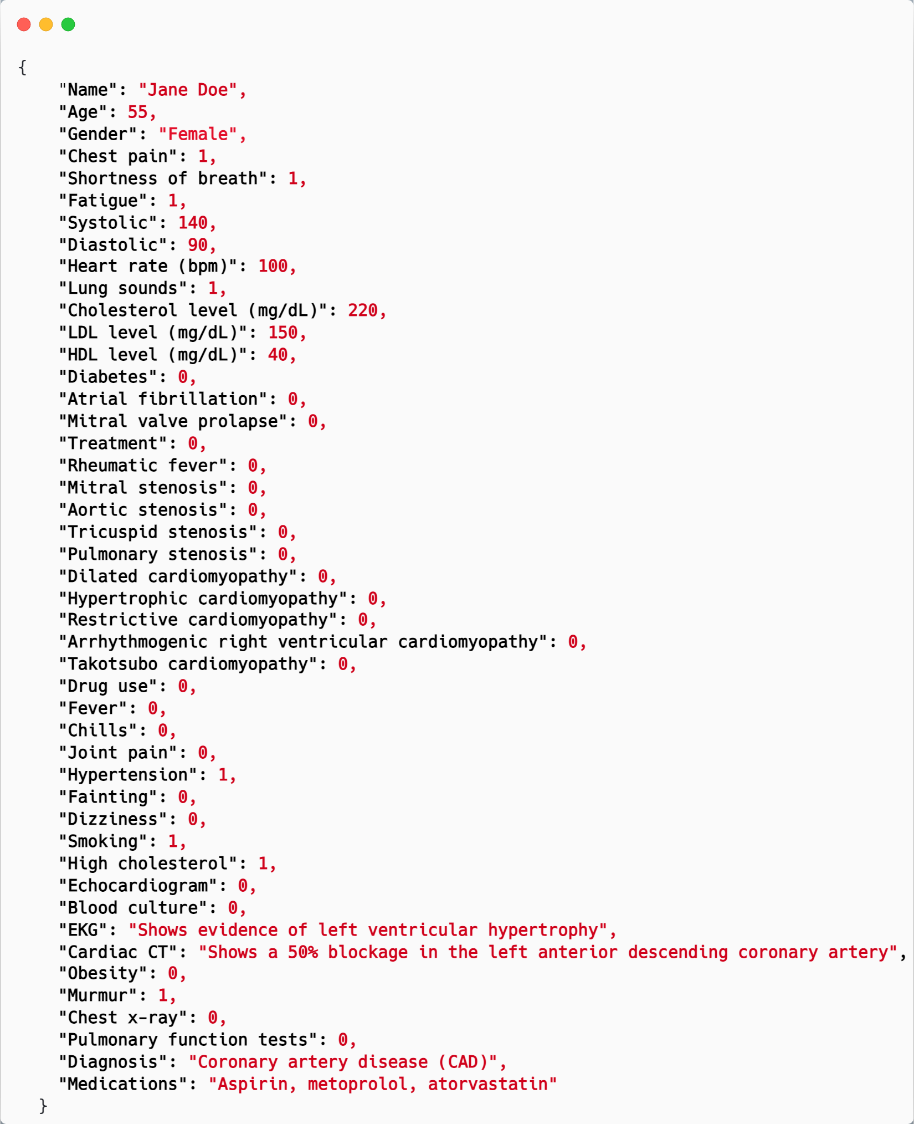
DATASET SAMPLE

Slide 6
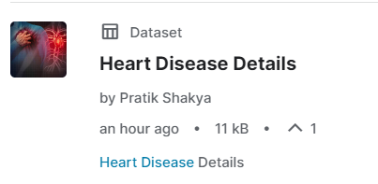
List of Heart Disease in the system
Coronary artery disease (CAD),
Mitral regurgitation,
Mitral stenosis,
Aortic stenosis,
Tricuspid stenosis,
Pulmonary stenosis,
Dilated cardiomyopathy,
Hypertrophic cardiomyopathy,
Restrictive cardiomyopathy,
Arrhythmogenic right ventricular cardiomyopathy,
Takotsubo cardiomyopathy,
Thoracic aortic aneurysm,
Abdominal aortic aneurysm,
Proximal aortic aneurysm,
Infrarenal aortic aneurysm,
Thoracoabdominal aortic aneurysm, ...
335 patient data with 45 different parameters with medication and treatment of 31 Diseases

Slide 7







What have we Implemented ?
An excel sheet where the medical officials feeds the data,
Label encoding for utilizing full potential of dataset
ANN model that trains the provided dataset
Random forest classifier
Two step working
Disease detection
Display medication and recommended treatments

Slide 8
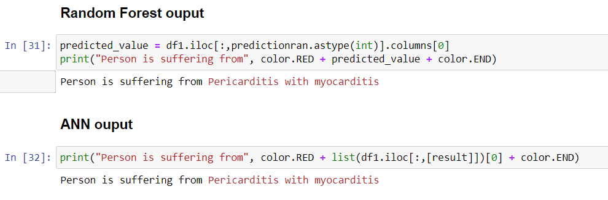
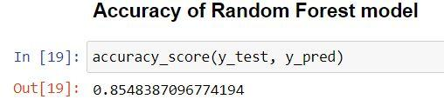
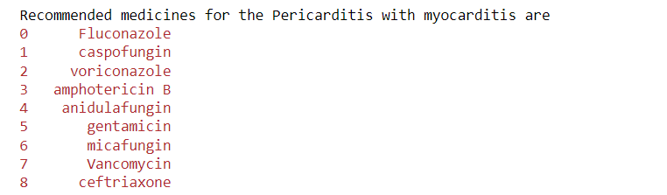
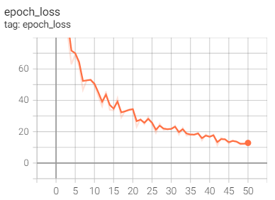

Slide 9
​FUTURE ENHANCEMENT
The medicines and treatments can be given according to the previous successful cases.
Implementing in real life scenario with more interactive UI/UX and more dataset for more efficiency
Detect multiple records at once and display most crucial disease at the top.
Not only heart diseases , but it can also be implemented to any other disease in the human body.

Slide 10
THANK YOU

