Slide 1
ISM 6225 Distributed Information Systems
HTML, CSS, JavaScript files

Slide 2
HTML, CSS, JavaScript (files)
All web browsers render html
Hence, all web applications render html
A quick intro to html and css follows
Based on Shawn Calvert tutorial
Essential piece of internet history
NCSA – A beginner’s guide to html
http://main.put.com/HTMLPrimer.html (accessed Feb 2019)

Slide 3
HTML, CSS, JavaScript (files)
Web pages may be seen as having three aspects that make them useful
Aspect | Mechanism | Introduced | Used for
Structure | HTML | 1990, Tim Berners Lee, CERN | Content hierarchy
Presentation | CSS | Hakon Wium Lie, Opera, 1996 | Layout, images, resizing
Interactivity | JavaScript | Brendan Eich, Netscape, 1995 | On click, change, form submission

Slide 4
Getting the files
Files are available at Github
https://github.com/ISM6225/HTML-CSS-Introduction
Connect Visual Studio to Github (log into Github in Team Explorer)
Fork the project in Github
Open in Visual Studio
Clone the project
This is a simple set of files, so there is no solution file
URL also in module on Canvas

Slide 5
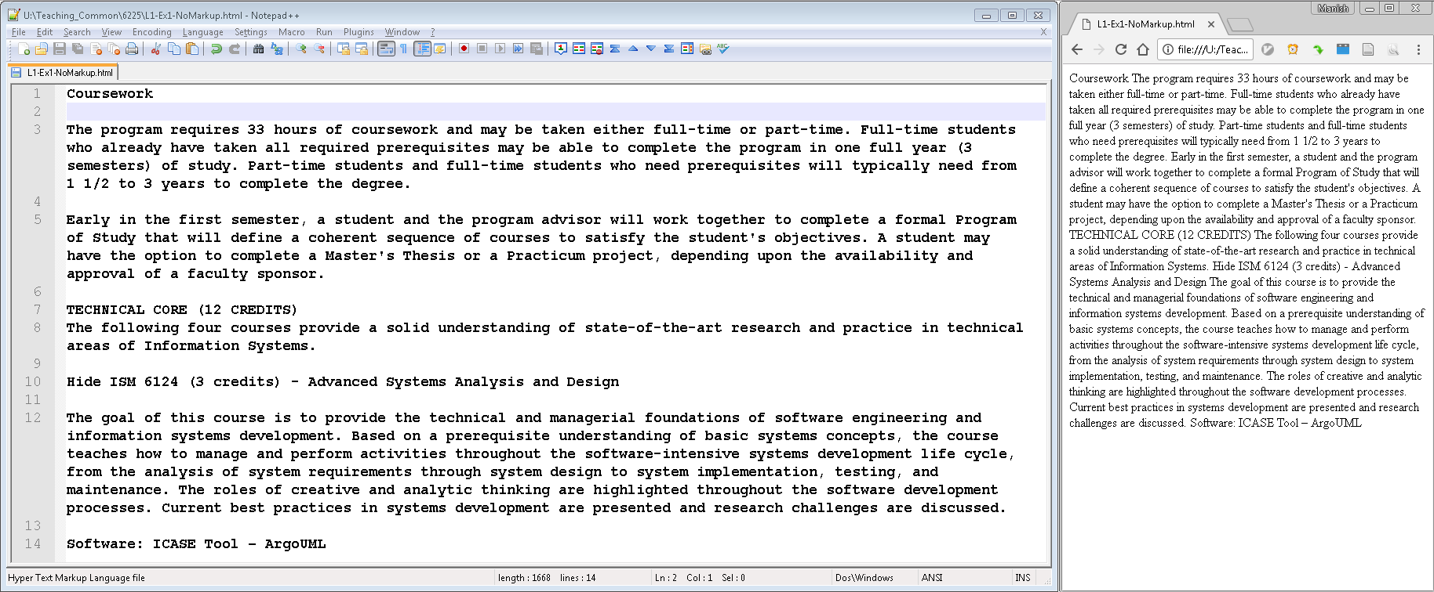
HTML
Combines two features:
Hypertext: Links to other pages
Markup language: Content labeling for rendering
increasingly used to indicate meaning and relationship to other content on the page
Semantics
Text rendered in browser without markup (Ex1 file)

Slide 6
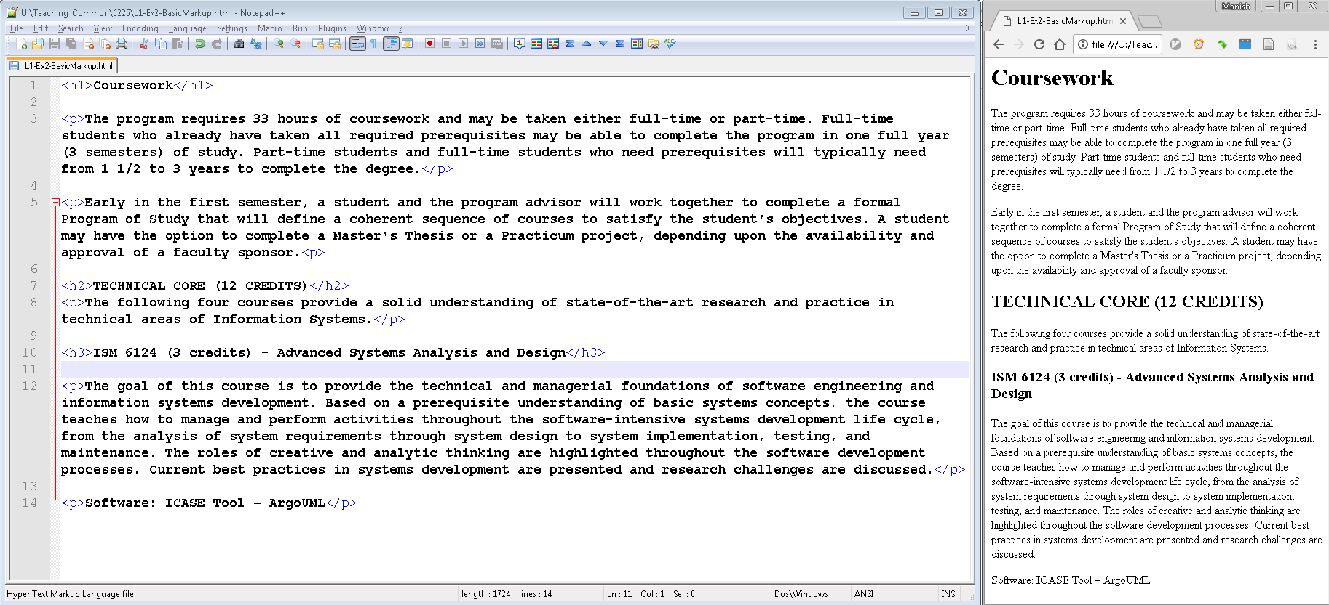
HTML (contd.)
Text rendered with basic markup (Ex2 file)
Browsers have built-in display styles for basic markup tags

Slide 7
HTML page basic structure
<html>
<head>
<!-- Comment: non printable content -->
</head>
<body>
<!-- Comment: printable page content-->
</body>
</html>

Slide 8
HTML element relationships
HTML page elements are viewed as being related to each other as part of one big family
Used extensively in JavaScript and JQuery
<parent a>
<child 1 parent a sibling of 2></child>
<child 2 parent a sibling of 1></child>
</parent>

Slide 9
Key html elements
Document
Html, head, body
Head
link, title, meta (popular with earlier search engines)
Body
h1 – h6, p, br, div, a, img, ul, ol, li

Slide 10
Html element content and attributes
Html elements typically have content
And optionally, can have attributes
To specify additional information
Commonly id or class
Used in JavaScript or css
E.g.
<div class="leftNav" style="display: block">Menu</div>
The content of this div element is “Menu”
This content will be rendered on the page
The element has two attributes
The class attribute is leftnav, typically for use with CSS stylesheets
The style attribute specifies that the element should be displayed as a block
Not a good example, since style should be specified in CSS

Slide 11
CSS
Cascading style sheets
Styles: Define how html page content should look
Sheets: Individual css files
Cascading: CSS rules cascade, i.e. the order of the rules matter
https://developer.mozilla.org/en-US/docs/Learn/CSS/Introduction_to_CSS/Cascade_and_inheritance
In descending priority (highest first)
Importance: prevails over all other rules, unless overruled by another !important tag
Specificity: selectors that can match fewer elements have higher priority
Source order:
Later rules in a file over-ride earlier rules in the same file
Author (developer) rules override user-agent (browser default) rules

Slide 12
CSS inheritance
CSS rules can also inherit to simplify development
https://developer.mozilla.org/en-US/docs/Web/CSS/Reference
Font rules are typically inherited by all elements in a container
Spacing rules are typically not inherited by elements in a container
Thus, the final appearance of an element depends upon
Cascading rules and
Inheritance rules

Slide 13
CSS rules
Style definitions are written as CSS rules
Syntax for each rule is:
selector { property: value; [property: value;]… }
E.g.
h1 {
color: maroon;
margin-left: 40px;
}
Selectors may be simple element names
Style applies to all elements

Slide 14
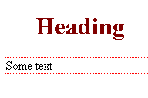
Using css – inline (Ex3)
<!DOCTYPE html>
<html>
<head>
<style>
h1 { color: maroon; margin-left: 40px; }
p { font-size: 16px; border: 1px dotted red; }
</style>
</head>
<body>
<h1>Heading</h1>
<p>Some text</p>
</body>
</html>

Slide 15
CSS usage
Inline CSS is not scalable
Needs to be repeated in every file
Hence, CSS (and JavaScript) is saved as external files
And referred to using the link tag in the page head

Slide 16
CSS linking (Ex4)
<head>
<link rel="stylesheet" type="text/css" href="l1-ex4-css-linked.css">
</head>
l1-ex4-css-linked.css (saved in same folder as html file):
h1 {
color: maroon;
margin-left: 40px;
}
p {
font-size: 16px;
border: 1px dotted red;
}

Slide 17
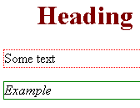
CSS rules – (contd.)
CSS rules may be more specific
Style applies to matching elements
Selectors (Ex5)
<div id="ex1">
<p class="test1">Example</p>
</div>
div#ex1 .test1 {font-style: italic; border: 1px solid green;}

Slide 18
CSS rules – wildcards
CSS selectors support wildcards
https://www.w3.org/TR/css3-selectors/#attribute-substrings
https://stackoverflow.com/questions/5110249/wildcard-in-css-for-classes
Example
div[class^="tocolor-"], div[class*=" tocolor-"] {
color: red;
}
div[class^="tocolor-"]
Any div with a class name starting with tocolor-
div[class*=" tocolor-"]
Any div with a class name that includes tocolor- (with a preceding space)

Slide 19
CSS rules – specifics vs descendents
https://css-tricks.com/multiple-class-id-selectors/
Specific
#header.callout {}
Applies to elements with id header AND class callout
Descendent
#header .callout {}
Applies to elements with class callout that are descendants of element with id header
A space can make a significant difference in the style definition

Slide 20
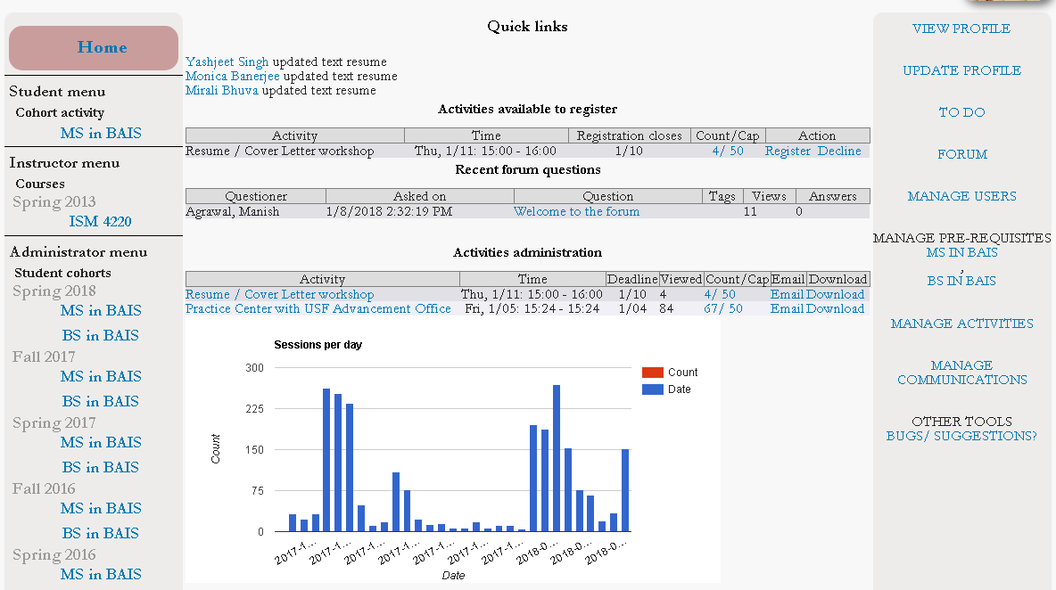
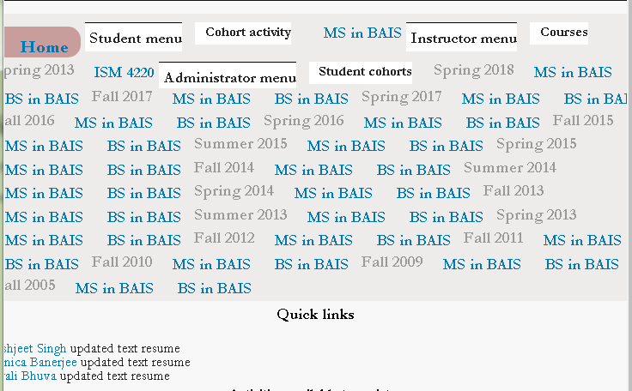
Responsive sites
The introduction of mobile devices added challenges to web pages
Small screens not suitable for traditional 1200px-wide pages
Responsive sites use html and CSS to be appropriately usable on all devices
Viewport
<meta name="viewport" content="width=device-width, initial-scale=1.0">
Media queries
Applies CSS rules only when certain conditions are true

Slide 21
Media queries (Ex6)
@media only screen and (max-width: 600px) { /* For mobile phones*/
.leftMenu, .rightMenu, .mainBody {
width: 100%;
}
}
@media only screen and (min-width: 600px) and (max-width: 768px) { /* For tablets */
.leftMenu, .rightMenu, .mainBody {
width: 80%;
}
}
@media only screen and (min-width: 912px) {/* For desktops */
.leftMenu {
width: 26%;
}
.mainBody {
width: 50%;
}
.rightMenu {
width: 24%
}
}

Slide 22
Media queries (Ex6)
Best practices
https://www.uxpin.com/studio/blog/best-practices-examples-of-excellent-responsive-design/
Design for mobile first
Helps prioritize important content
Avoid fixed widths
Select appropriate breakpoints
Large clickable areas

Slide 23
Layouts
Good resource (used as basis for this content)
https://developer.mozilla.org/en-US/docs/Learn/CSS/CSS_layout/Introduction
Flexbox
https://developer.mozilla.org/en-US/docs/Learn/CSS/CSS_layout/Flexbox
Display: block/ inline
Several elements are block elements by default
E.g. div, li
Display: flex
Applies to child elements

Slide 24
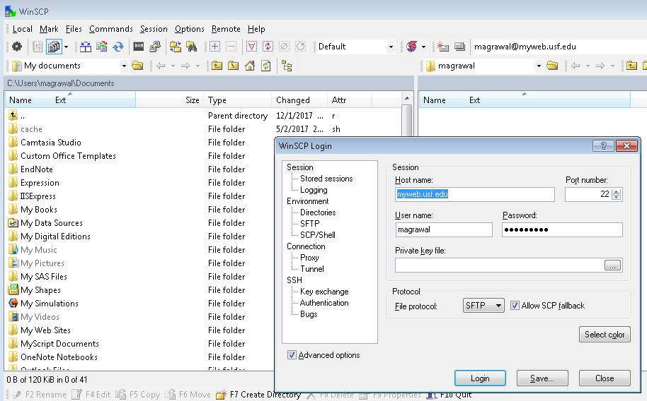
USF public web pages
Everyone at USF has a public web page
Accessible at http://myweb.usf.edu/~<netid>
WinSCP is my preferred client
Use screenshot as reference
Use your USF login credentials
Populate content in your public_html folder
And view it as your public page

Slide 25
HTML, CSS exercise
Look at your dream employer’s home page
Build a responsive web page that replicates the 5 most visible (or easy to replicate) elements of the organization’s home page
Make the site responsive to at least
1 mobile viewport (portrait mode)
1 tablet viewport (landscape mode)
1 desktop
Upload the page to myweb
Submit the URL to the page on Canvas

Slide 26
References
https://www.slideshare.net/shawncalvert/html-csspresentation
W3 Schools

