Slide 1
Predicting injuries in crashes in Chicago
Richard Raybon

Slide 2
Data
Data contains information about every traffic crash in the jurisdiction of Chicago Police Department
Data spans between early 2013 and late 2022
Contains several columns, including number of injuries, type of injuries, posted speed limit, weather/light/road condition, crash type, latitude/longitude, etc.
Total data dimensions were 49 x 672276
Decided to do a Classification Decision Tree model in Spark with MLLib with a 70/30 split
Created column that contained y/n depending on if TotalInjuries value was greater than 0 for model to predict

Slide 3
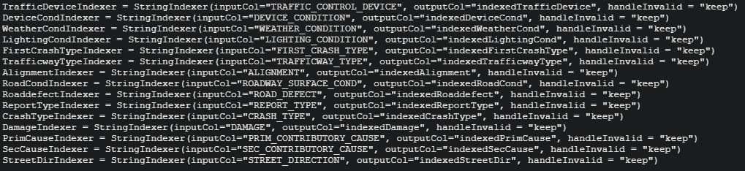
String Indexers for Categorical Variables

Slide 4
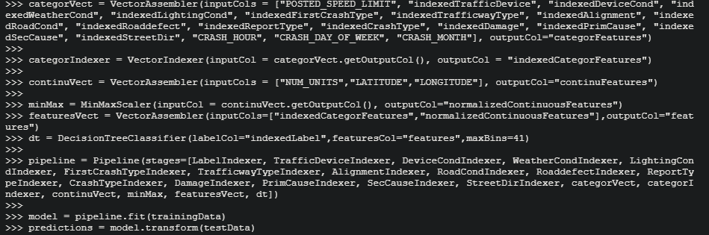
Creating features, pipeline, and model

Slide 5
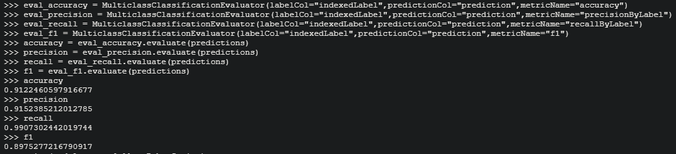
Overall accuracy of model

Slide 6
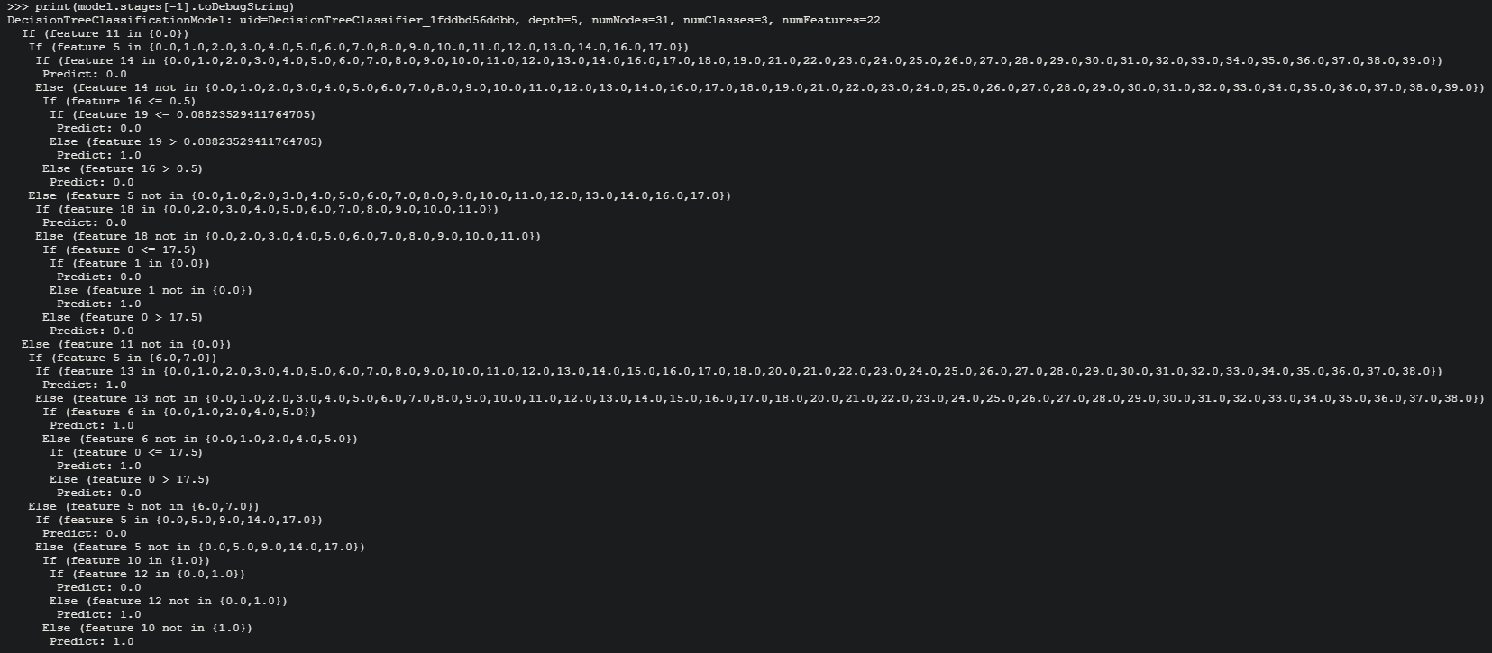
Raw Classification Tree

Slide 7
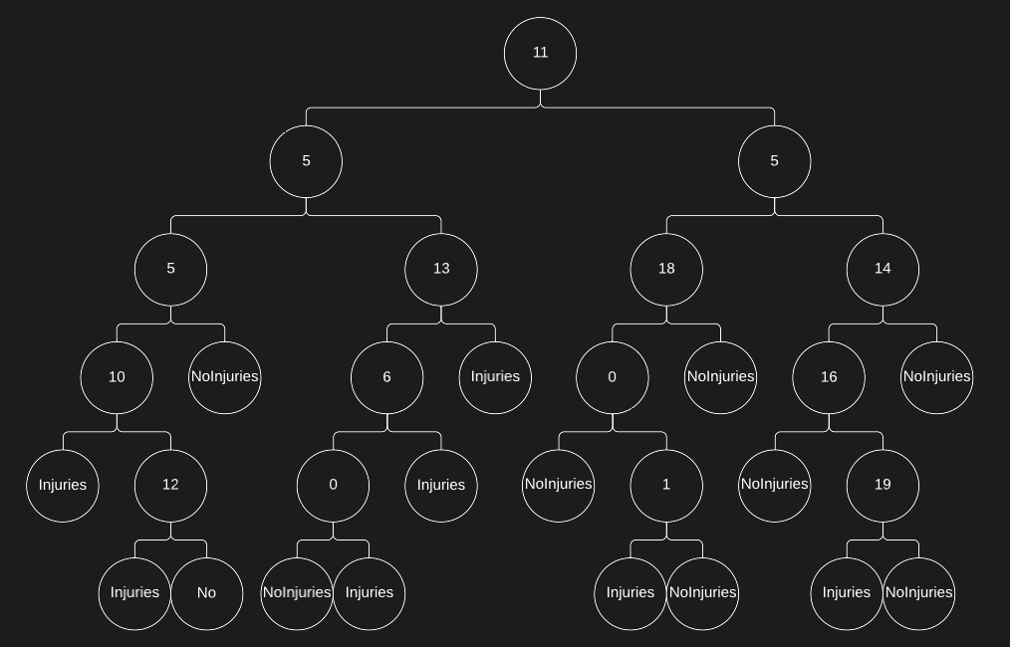
Graphic Representation

Slide 8
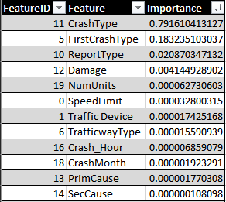
Feature Importance

Slide 9
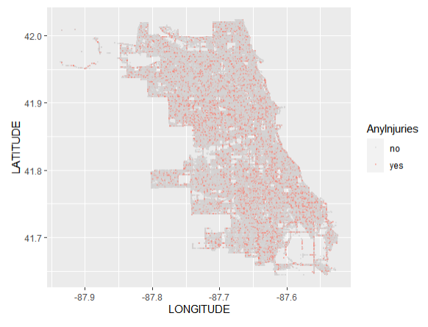
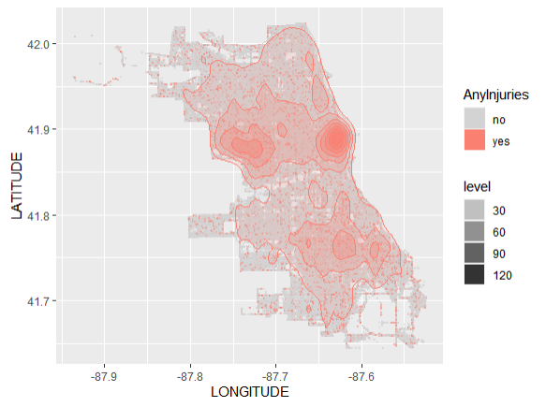
Mapping crashes with/without injuries by latitude/longitude w/ density plot overlay in RStudio for fun

