Slide 1
PQRS
Reporting Physician Performance

Slide 2
Performance / Payment year Adjustment
2014 performance year 2016 payment year
2015 performance year 2017 payment year
2016 performance year 2018 payment year
Last adjustment under current PQRS/VM
Starting 2017 performance year 2019 payment year…
Payment adjustments for quality reporting and other factors will be made under MIPS, as required by MACRA

Slide 3
New in 2016?
In 2016, 281 individual measures for PQRS; 23 cross-cutting measures
Added 3 new measures groups: Multiple Chronic Conditions; Cardiovascular Prevention (Million Hearts); and Diabetic Retinopathy (total of 25 Measure Groups)
Adding the Qualified Clinical Data Registry (QCDR) reporting option for GPRO in 2016
18 Measures for GPRO Web Interface (17 measures in 2015)

Slide 4
Changes to PQRS
CY2018 payment adjustments, based on PY2016 reporting: -2.0% MPFS
Changes to PQRS
Definition of eligible professional (EP) for purposes of participating in PQRS
Changes to the requirements for the qualified clinical data registry (QCDR) and qualified registries
QCDRs and qualified registries have more time in which to self-nominate
Revised auditing requirements for entities submitting PQRS quality measures data (qualified registries, QCDR, direct EHR, or direct Data Submission Vendor [DSV] product)

Slide 5
Changes to PQRS Reporting Criteria
Changes to group practice reporting option (GPRO):
New QCDR reporting option
Optional Consumer Assessment of Healthcare Providers and Systems (CAHPS) reporting for groups of 25-99 EPs
Required CAHPS reporting for groups of 100 or more EPs regardless of reporting mechanism
Changes for QCDR Vendors ‒Support tax identification number (TIN)-level reporting
New process for self-nomination and attestation
Revised auditing requirements
Changes Registry Vendors
New process for self-nomination and attestation
Revised auditing requirements
EHR ‒Revised auditing requirements

Slide 6
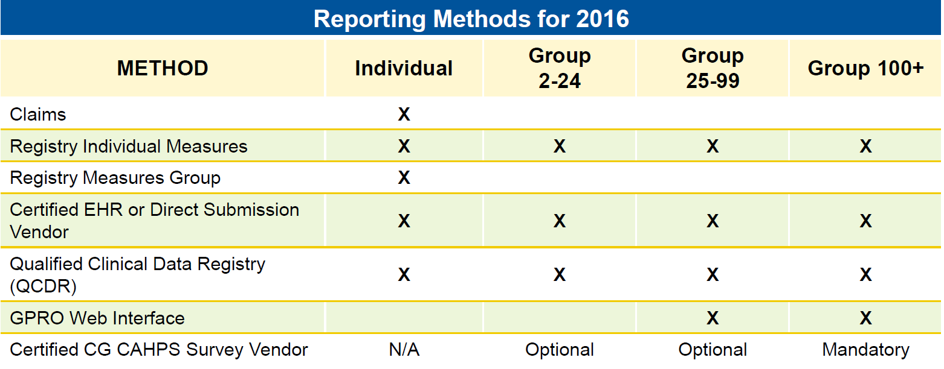
Methods for Reporting
Img Src : http://mpqhf.com/

Slide 7
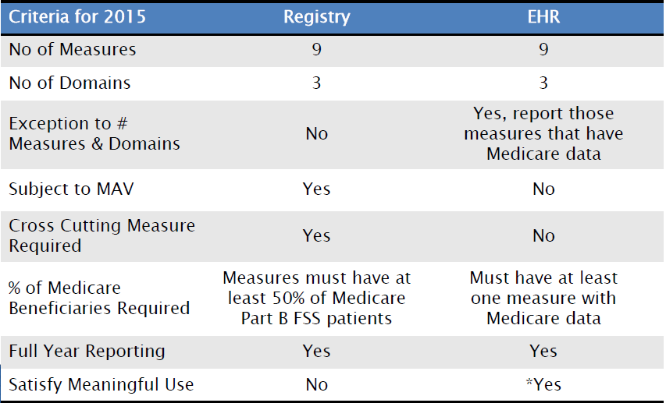
Identifying Requirements for Measure Reporting

Slide 8
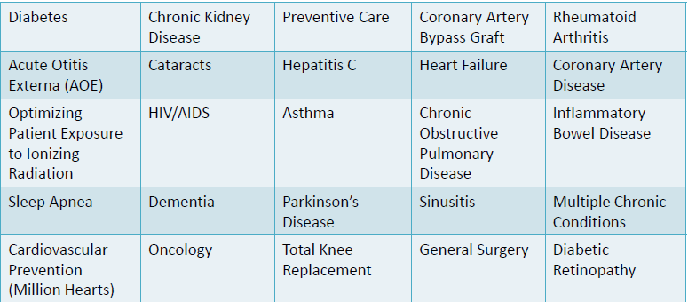
2016 Measure Groups
A measure group is defined as a subset of 6 or more PQRS measuresthat have a particular clinical condition or focus in common
All applicable measures within the group must be reported for all patients in the sample seen by the EP during the reporting period

Slide 9
Individual Reporting
Available reporting mechanisms for 2016 program year:
Claims
Registry
EHR (Direct or Data Submission Vendor)
QCDR

Slide 10

CMS collaboration with Specialty Societies on Measure Sets
Measures accurately reflect a particular clinical area.
Not required measures—a Guide to selection
The following were established in 2015
Cardiology
Emergency Medicine
Gastroenterology
General Practice/Family
Internal Medicine
Multiple Chronic Conditions
Obstetrics/Gynecology
Oncology/Hematology
Ophthalmolo
Pathology
Radiology
Surgery
CMS is adding the following specialty measure sets in 2016:
Dermatology
Physical Therapy/Occupational Therapy
Mental Health
Hospitalist
Urology

