Slide 1

Final Project VoltDB
Ballenger, Ryan
CSCI E-63 Big Data Analytics
2016
Harvard University Extension School
Prof. Zoran B. Djordjević

Slide 2

Introduction - The Problem to Solve
The problem that I am solving is helping the New England Patriots determine statistical insights from a large dataset including all 2014 NFL plays. Typical NFL stats include a quarterback's completion rate and total yards, but there are more patterns in the data that could help the Patriots and are only accessible to a data scientist.
The Patriots want to know total and average yards to the player types that Tom Brady throws to including wide receivers, running backs, tight ends and more. They want to completion rate to the top receivers. I help them solve these questions and more.

Slide 3
The Technology - VoltDB
VoltDB is an in memory database that is built for speed. Most databases use disk storage making reads and writes slower and more computationally expensive. Memory sizes are increasing rapidly and VoltDB utilizes this much faster storage to run a database.
VoltDB is also user-friendly and designed for MySQL-type users to convert to VoltDB. I download the enterprise trial version for Mac.
VoltDB is a cutting edge databases that recently got $23+ million in funding and is gaining momentum and customers including HP, Nokia, and more.

Slide 4
The Technology - VoltDB continued
It processes more quickly than disk-based systems and is the first database designed to operate solely on memory.
Each query or process includes a stop-watch illustrating how quickly the database functions such as loading the NFL dataset in only a few seconds.
It features an SQL executable file sqlcmd to access the database with .sql files and similarly has a local-host console and Java API as well. My project begins with directing a .sql file to the sqlcmd executable and then does the data processing through a Java program and Java API.

Slide 5
The Dataset
My data set is NFL play-by-play data from 2014. All plays during the NFL season are extracted into tuples in a table. There are over 60 columns of data per row including the offensive and defensive teams, passer, runner, yards gain, and much more.
The entire dataset is approximately 14 megabytes and 32,000 rows corresponding to the number of plays in the NFL season.
The dataset is from spreadsheet-sports.com and my tests confirm it is complete by calculating aggregated player statistics. The benefit of this dataset is that NFL statistics can be determined that are not usually available.

Slide 6
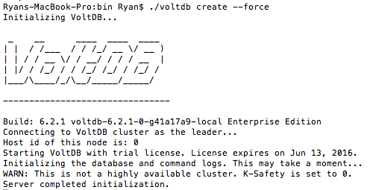
Installation and Configuration
Visit the following URL and download the right version of VoltDB for the system. This includes giving VoltDB your name and business and confirming your email. http://learn.voltdb.com/DLSoftwareDownload.html
After a few steps, the voltdb create command uses the executable voltdb to make a new database. --force is optional but will remove and replace an already running database if needed.
Ryans-MacBook-Pro:Desktop Ryan$ ./voltdb create --force
The database is
accessible through
the console, a local
host site, or with APIs
including one designed
for Java.

Slide 7
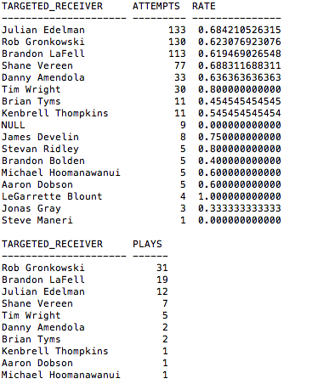
Results
The results of my analysis determine 5 major measurements that are
shown in the form of tables.
Tom Brady’s top receivers are
determinated along with the
total throws and the completion
rate to each.
The most targeted receivers
for deep balls over 20 yards
are determined.
Three other measurements
are done including yards per
type of receiver (WR, TE, etc)
and stats by team opponent.

Slide 8
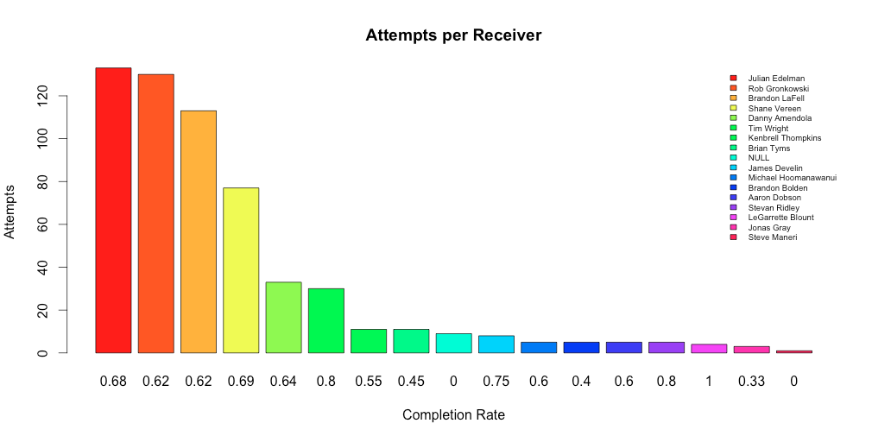
Results
Some of the results are visualized in R, specifically the ones where plots and graphs add perspective to the results. Here the attempts to each receiver who is specified by color and the completion rate listed below each bar is shown.
Converting the Java-based results was easy because the API provides convenient access to the data. The comma separated version of the results is attained, stored as a CSV, and loaded by R for visualization.

Slide 9
What worked, what didn’t, and more feedback
Getting the voltdb database installed and running quickly along with loading and querying the data all worked well. VoltDB is designed to be a compelling and user-friendly option for database users to switch to.
The python API did not work but still consumed a lot of user time, as I tried to focus on it to complete the necessary tasks. The API is newer and less developed than the Java version.
I learned that teaching myself a new database system is not as difficult as I imagined. The companies like VoltDB have extensive user support and documentation since they are trying to get customers to convert their system.
VoltDB is exciting to try and I recommend it. It is cutting edge database, has recently acquired $23+ million in funding, and represents the evolution happening in this field and the high quality products available to all users.

Slide 10
YouTube URLs, Last Page
Two minute (short):
https://www.youtube.com/watch?v=ZXKmVCBwlgo
https://youtu.be/ZXKmVCBwlgo
15 minutes (long):
Images: Self taken, free logos, or from Wikipedia

