Slide 1
Digital Portfolio
STUDENT NAME: BHAVITHRA.R REGISTER NO AND NMID: 2428B0216 / ASBRU3J2428B0216 DEPARTMENT: B.Sc COMPUTER SCIENCE WITH DATA ANALYTICS
COLLEGE/UNIVERSITY:TIRUPPUR KUMARAN COLLEGE FOR WOMEN /BHARATHIYAR UNIVERSITY

Slide 2
PROJECT TITLE
RADIOLOGY-PORTFOLIO

Slide 3


AGENDA
Problem Statement
Project Overview
End Users
Tools and Technologies
Portfolio design and Layout
Features and Functionality
Results and Screenshots
Conclusion
Github Link
3/21/2024 Annual Review

Slide 4

PROBLEM STATEMENT
Users often face difficulty selecting a single option among multiple choices in applications. Without a clear interface, this leads to confusion and poor user experience. A Radio List provides a simple, efficient solution for single-option selection.

Slide 5

PROJECT OVERVIEW
Enhancing Radiology Services through Clinical and Technological Integration

Slide 6

WHO ARE THE END USERS?
Patient Care: This project aims to improve patient care by optimizing radiology services, ensuring timely and precise diagnosis. Diagnosis: The project targets improving the accuracy and speed of diagnostic imaging interpretation. Clinical Projects: Clinical initiatives in the project include the development and validation of new imaging protocols and interventional procedures under radiologist

Slide 7

TOOLS AND TECHNIQUES
• Programming Languages: HTML, CSS, JavaScript / Python (Tkinter)
• IDE: VS Code / Jupyter Notebook
• Version Control: GitHub

Slide 8
Tools and Technologies
X-ray Radiography: It is quick and widely used for fractures, infections, and chest Examinations Computed Tomography (CT): It is used for trauma, tumour detection, vascular and soft tissue assessment, and guiding biopsies. Magnetic Resonance Imaging (MRI): Utilizes magnetic fields and radio waves to produce detailed images of soft tissues, brain, spinal cord, and joints without radiation exposure and more.

Slide 9
Portfolio design and Layout
Commitment to Specialty: Include evidence of significant exposures such as taster weeks, research projects, electives Academic Achievements: List publications, presentations, and research projects related to radiology. Prizes and Awards: Recognitions that highlight excellence in the specialty.

Slide 10
POTFOLIO DESIGN AND LAYOUT
The Radio List is designed with a clean interface.
It includes:
• A title header
• A list of radio button options
• A submit button
The layout ensures clarity and responsiveness.
10

Slide 11
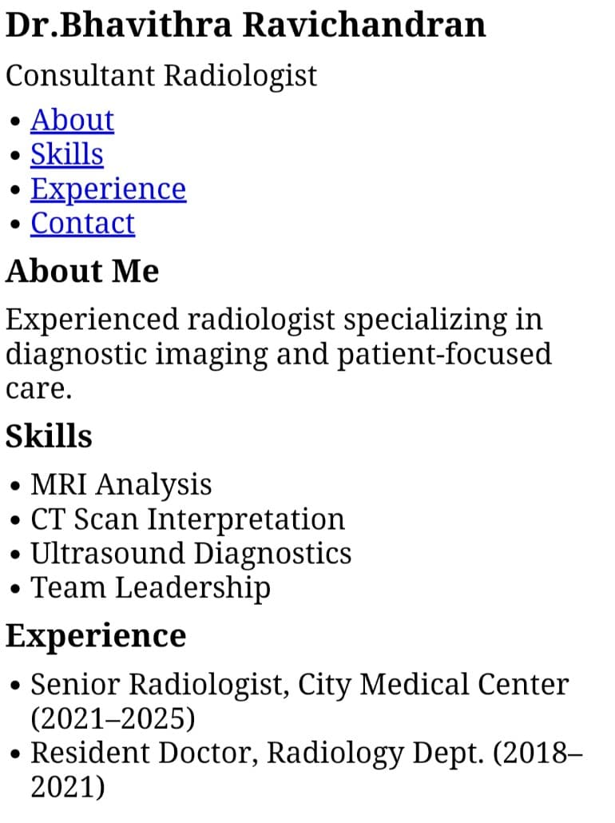
Results and Screenshots

Slide 12
Conclusion
Radiology is the summary section of a radiology report where the radiologist interprets the findings and provides the most important diagnostic insights. It is the key part for clinicians because it concisely answers the clinical question, highlights significant abnormalities, and may suggest further tests or follow-up if needed.

