Slide 1
Copilot - a Coprocessor-based Kernel Runtime Integrity Monitor
Nick L. Petroni, Jr. npetroni@cs.umd.edu
Timothy Fraser tfraser@umiacs.umd.edu
Jesus Molina chus@cs.umd.edu
William A. Arbaugh waa@cs.umd.edu

Slide 2
Copilot Kernel Integrity Monitor
  Compatible
    - works on commodity GNU/Linux x86 PCs
  Effective
    detected tampering by 12 real-world rootkits
    check every 30 seconds = 1% performance penalty
  Isolated
    - implemented on its own PCI add-in card
  Independent
    - operates even if host kernel is compromised

Slide 3
Integrity Threat Example
Host RAM
kernel text
1. Attacker gains entry
kernel page tables
system call
vector
IDT
2. Attacker inserts/modifies code
other kernel data
and process pages
3. Attacker gets his code executed

Slide 4
Copilot Integrity Protection
kernel text
CPU/
cache
system call
vector
system call vector modified
IDT
bridge/
memory
controller
other kernel data
and process pages
Copilot
Admin Station
PCI local bus

Slide 5
Copilot Protection Strategy
Copilot currently uses the following traditional methods:
  Hash of Linux kernel text
  Linux system call vector
  Linux interrupt descriptor table
  Linux module list
  Hash of Linux module text
Compare the above with a “known-good” state
Adding hashing/jump table targets simple
Copilot improves these methods by providing an isolated & independent platform for kernel monitoring

Slide 6
PCI add-in card requirements
  Unrestricted access to bus
    - EBSA-285 has bus mastering capability
  Independence from host
    - EBSA-285 has a mode that ignores host commands
  Sufficient processing power, memory
    - StrongARM SA-110 CPU, 16MB RAM
  Independent communication channel for reporting
    - RS-232 serial port
Notes:
There are two types of devices on the PCI bus– targets and masters. We need master
EBSA can access memory without the CPU’s help via DMA.
EBSA can report independently via the serial port. We are now using a new card that has a 10/100 Ethernet interface to use for management and reporting.

Slide 7
Architecture/OS Requirements
All kernel data structures must be available to monitor
  Linux provides virtual addresses for data structures
  Linux x86 virtual address translation easy to replicate
  Linux kernel memory is never paged out of RAM
  PC PCI bus addresses, physical addresses identical
  PC PCI bus can address all of physical memory

Slide 8
Virtual memory translation
virtual addresses used by kernel:
physical addresses used during DMA:
0xc0000000
high_memory
0xfe000000
0x00000000
end of RAM
linear map
kernel text,
page tables
vmalloc area,
module cores
nonlinear map via page tables
Notes:
This slide shows the layout of the highest gigabyte of virtual memory. On x86, Linux uses a 3GB/1GB split for userspace/kernel space, so everything about the 0xc0000000 address belongs to the kernel. As we mentioned previously, copilot operates on physical addresses, but the host processor uses virtual addresses. Fortunately for Copilot, there is a region of virtual addresses that map linearly to a range of physical addresses. Within this range lies all of static kernel text and page tables necessary for translating the rest of virtual memory. Dynamically allocated kernel memory such as kernel module text and data come from the vmalloc area shown on the diagram and must be found by translating virtual to physical addresses.
Where high_memory is depends on how much physical RAM you have. You can have all of kernel memory easily accessible if you have enough RAM.

Slide 9
Experimental Results
Typical rootkit implementation:
  An LKM that interposes on the system call vector:
  Adore, rial, rkit, synapsis, modhide1, phide, kbd, linspy…
More sophisticated, more stealthy:
  SucKIT - loads via /dev/kmem instead of LKM
  Phantasmagoria - modifies kernel text, not syscall vector
Insecurity by Obscurity:
  Taskigt - adds a hook to /proc filesystem
  Knark - adds inet protocol handler

Slide 10
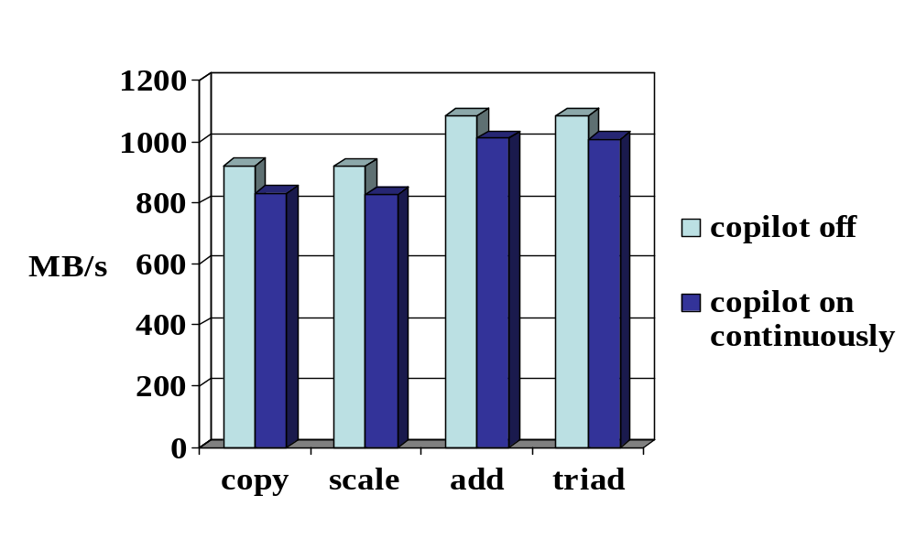
STREAM memory throughput benchmarks
Penalty: 10% 10% 7% 7%
Notes:
STREAM is a benchmark for memory bandwidth designed by John McCalpin for use in high performance memory architectures. It has also been used on PCs to compare memory bandwidth.
Because copilot accesses main memory, we predicted there would be some contention for that resource, resulting in a performance hit on the host.
4 large vector operations (all bigger than the largest cache). all were tested while the copilot monitor was off or running continuously. It can be seen that about a 10% penalty is experienced when copilot is running continuously.

Slide 11
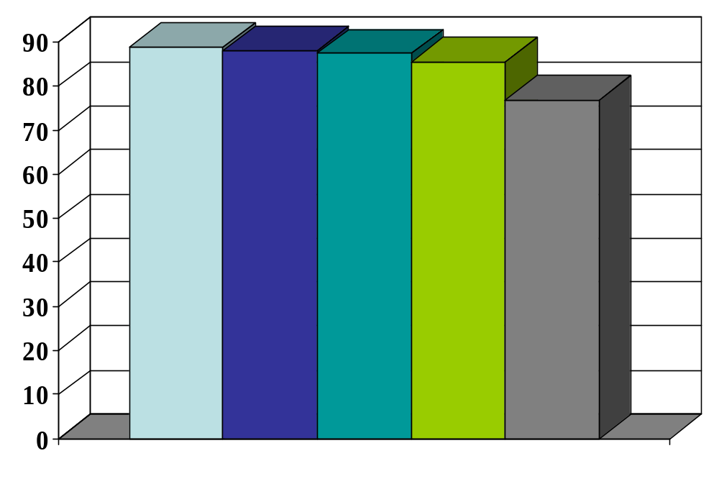
WebStone HTTP throughput benchmark
MB/s
Cycle (in seconds): off 30 15 5 continuous
Penalty: 0% 1% 2% 4% 14%
Notes:
In addition to the microbenchmark for main memory, we chose to use an application macrobenchmark to see how copilot affects the overall system. We used the WebStone HTTP throughput benchmark in a 90-client configuration, running copilot at various frequencies. As you can see form the chart, there was a 14% penalty for running the monitor continuously, but only a 1% penalty for checking the system’s integrity every 30 seconds. Since rootkits are designed for attackers to return hours, days, or weeks later, it is completely reasonable to check the system every 30 seconds or less for that particular threat.
One interesting thing to note is the higher penalty for the continuous case of the macrobenchmark than the microbenchmark. We have a hypothesis to explain this case. Since the WebStone benchmark utilizes a PCI add-in NIC, contention for main memory and the bus are increased because there are now three entities vying for main memory and two for the bus. Previously, Copilot had exclusive access to the bus and only competed with the processor for memory. The NIC needs access to main memory because the driver being used utilizes DMA.

Slide 12
Related Work
Existing approaches:
Userspace tools
  Tripwire, AIDE, chkrootkit, checkps, Rkscan…
Kernel space tools
  Saint Jude (St. Michael), KSTAT, Carbonite, Samhain
Challenge-response protocols for remote genuinity
  Kennell/Jamieson, SWATT
Other hardware approaches
  TCG-based approaches

Slide 13
Limitations and Future Work
Problems with a PCI-based approach
  Inability to monitor execution
  Relocation/cache attacks
  Memory race conditions
Future directions
  In-memory image prediction from trusted binary
  Extending coverage to most (all?) jumps
  Data/non-text auditing (e.g. process table, open files…)
  Protect host-kernel-resident protection mechanisms

Slide 14
Copilot Summary
  Proven effective in lab tests:
    Detected the 12 rootkits listed on earlier slide
    30-second detection window
    Less than 1% application performance penalty
  Advantages over existing technologies:
  - Applicable to commodity GNU/Linux x86 hosts
    - No reliance on host software for correctness
    - Plugs into unmodified commodity host
    - Can be extended to support dynamic data

