Slide 1
Win Prediction Analytics
DATA SCIENCE PRODEGREE PROJECT FROM IMARTICUS LEARNING
Jyoti Singla
Rishabh Raibhandar

Slide 2
Content
Data gathering and Problem Statement
Profiling Report
Preparing the Data
Train the Data
Model Selection
Hyperparameter tuning
Prediction
Business Insights

Slide 3
Gathering of Data and Problem Statement
Your Organization puts in a lot of effort in bidding preparation with no indications whether it will be worth it. With multiple bid managers and SBU Heads willing to work on every opportunity, it becomes difficult for the management to decide which bid should be given to which bid manager and SBU Head. You are hired to help your organization identify the best bid manager-SBU Head combination who can convert an opportunity to win with the provided data points.
Objective 1: Predictive Analytics - Build a ML model to predict the probability of win/loss for bidding activities for a potential client.
Objective 2: Prescriptive Analytics - Identify variable/s that are most likely to help in converting an opportunity into a win.

Slide 4
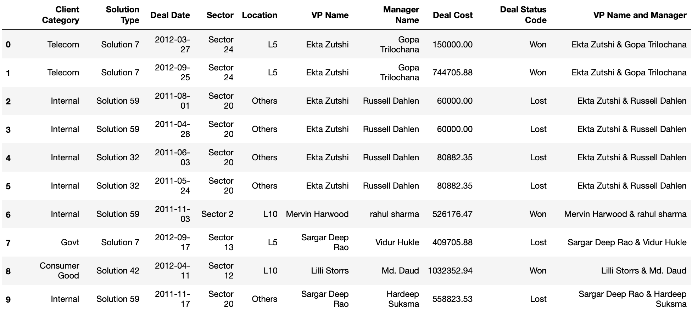
Dataset

Slide 5
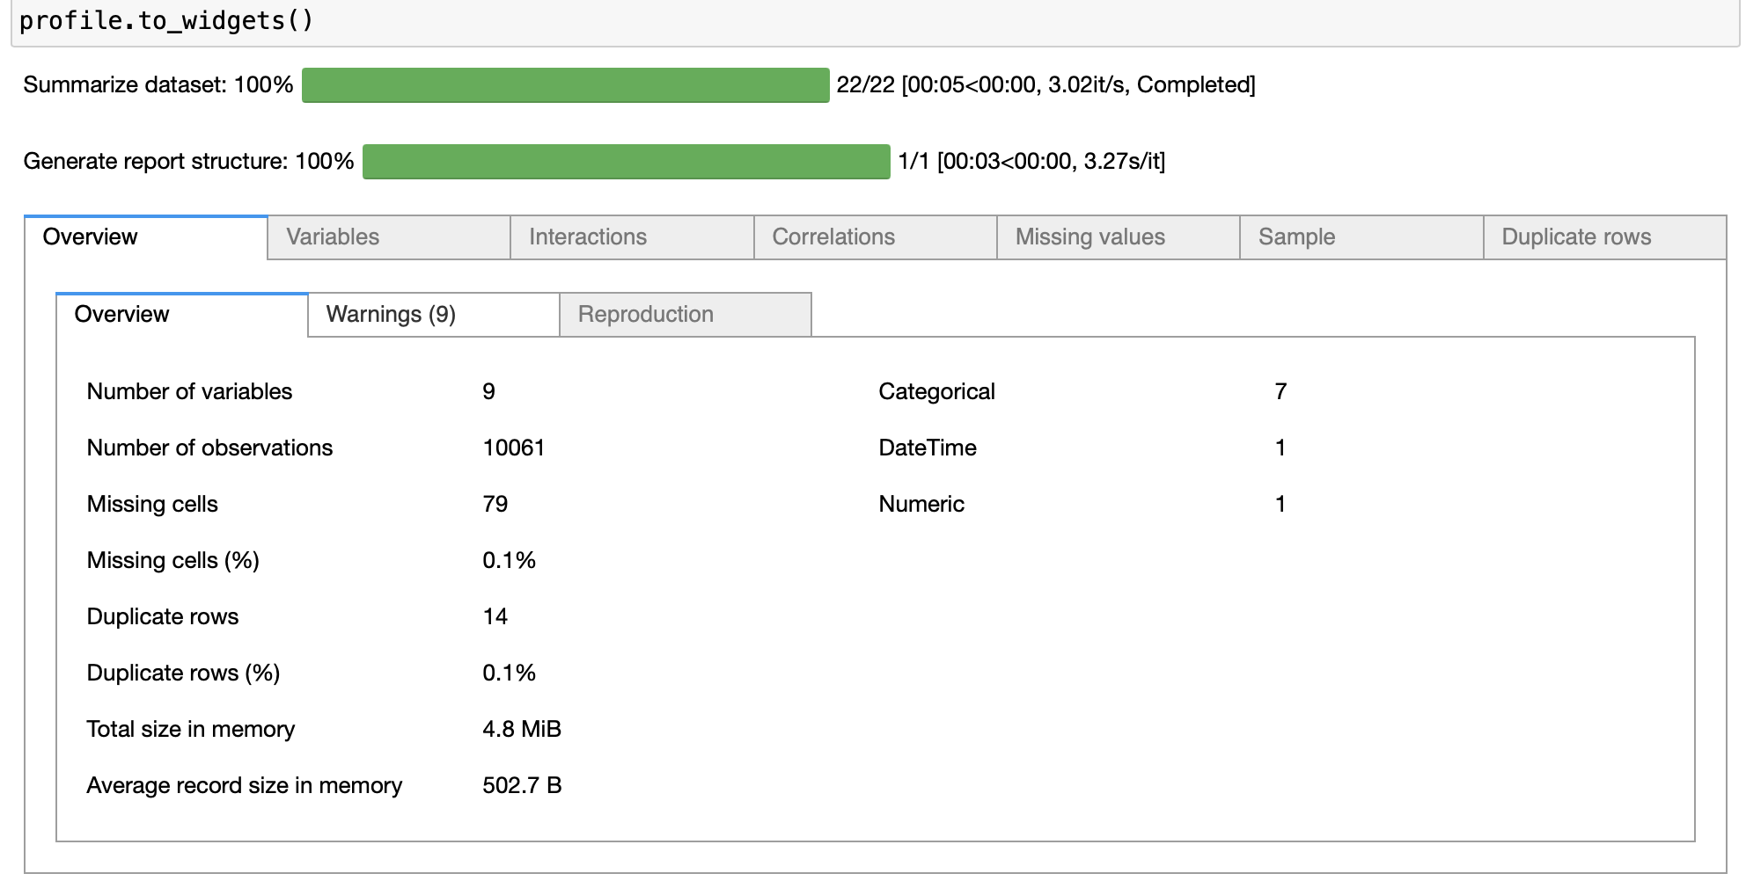
Profiling Report

Slide 6
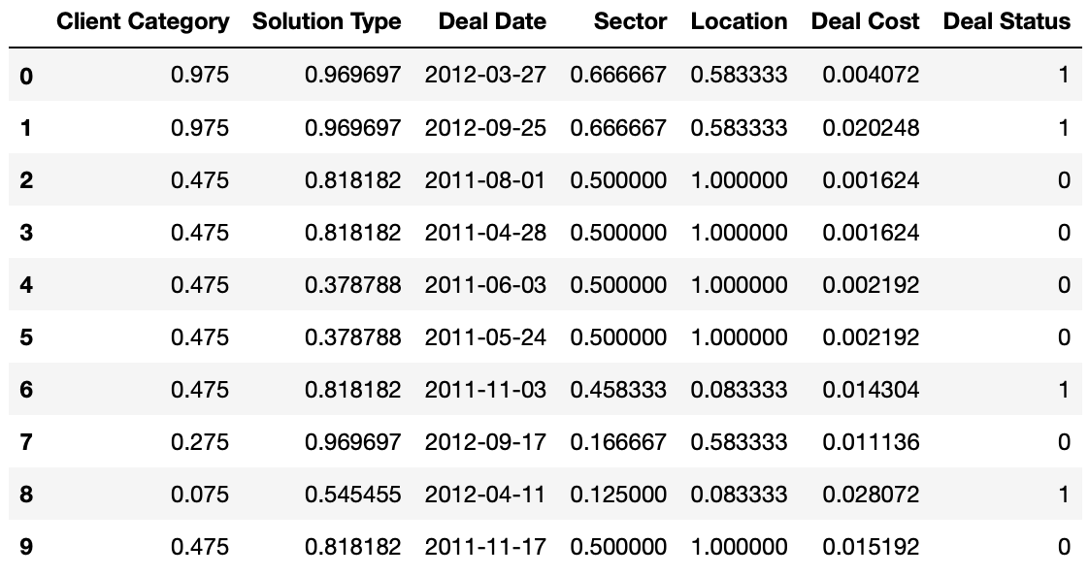
Preparing that Dataset
Prepare Profile
Report
Visualisation and Feature Engineering
Data Cleaning
Data analysis,
Review data and EDA (Exploratory Data Analysis)

Slide 7
Ratio of Test to Train Data Split
Training Data 75%
Testing Data
25%
Command used:
X_train, X_test, Y_train, Y_test = train_test_split(X, Y, random_state=0, test_size = 0.25)

Slide 8
Model Selection
According to data this is a Classification problem using multiple Classification models.
KNN (K – Nearest Neighbor) Classifier
SVM (Support Vector Machine)
Decision Tree Classifier
Random Forest Classifier
Model Selection | Model Accuracy
KNN (K – Nearest Neighbor) Classifier | 73%
SVM (Support Vector Machine) | 61%
Decision Tree Classifier | 67%
Random Forest Classifier | 74%
Randomized search CV (Random Forest) | 80%
* Using Cross validation and hyperparameter tuning.
* Randomized search CV (Cross Validation).

Slide 9
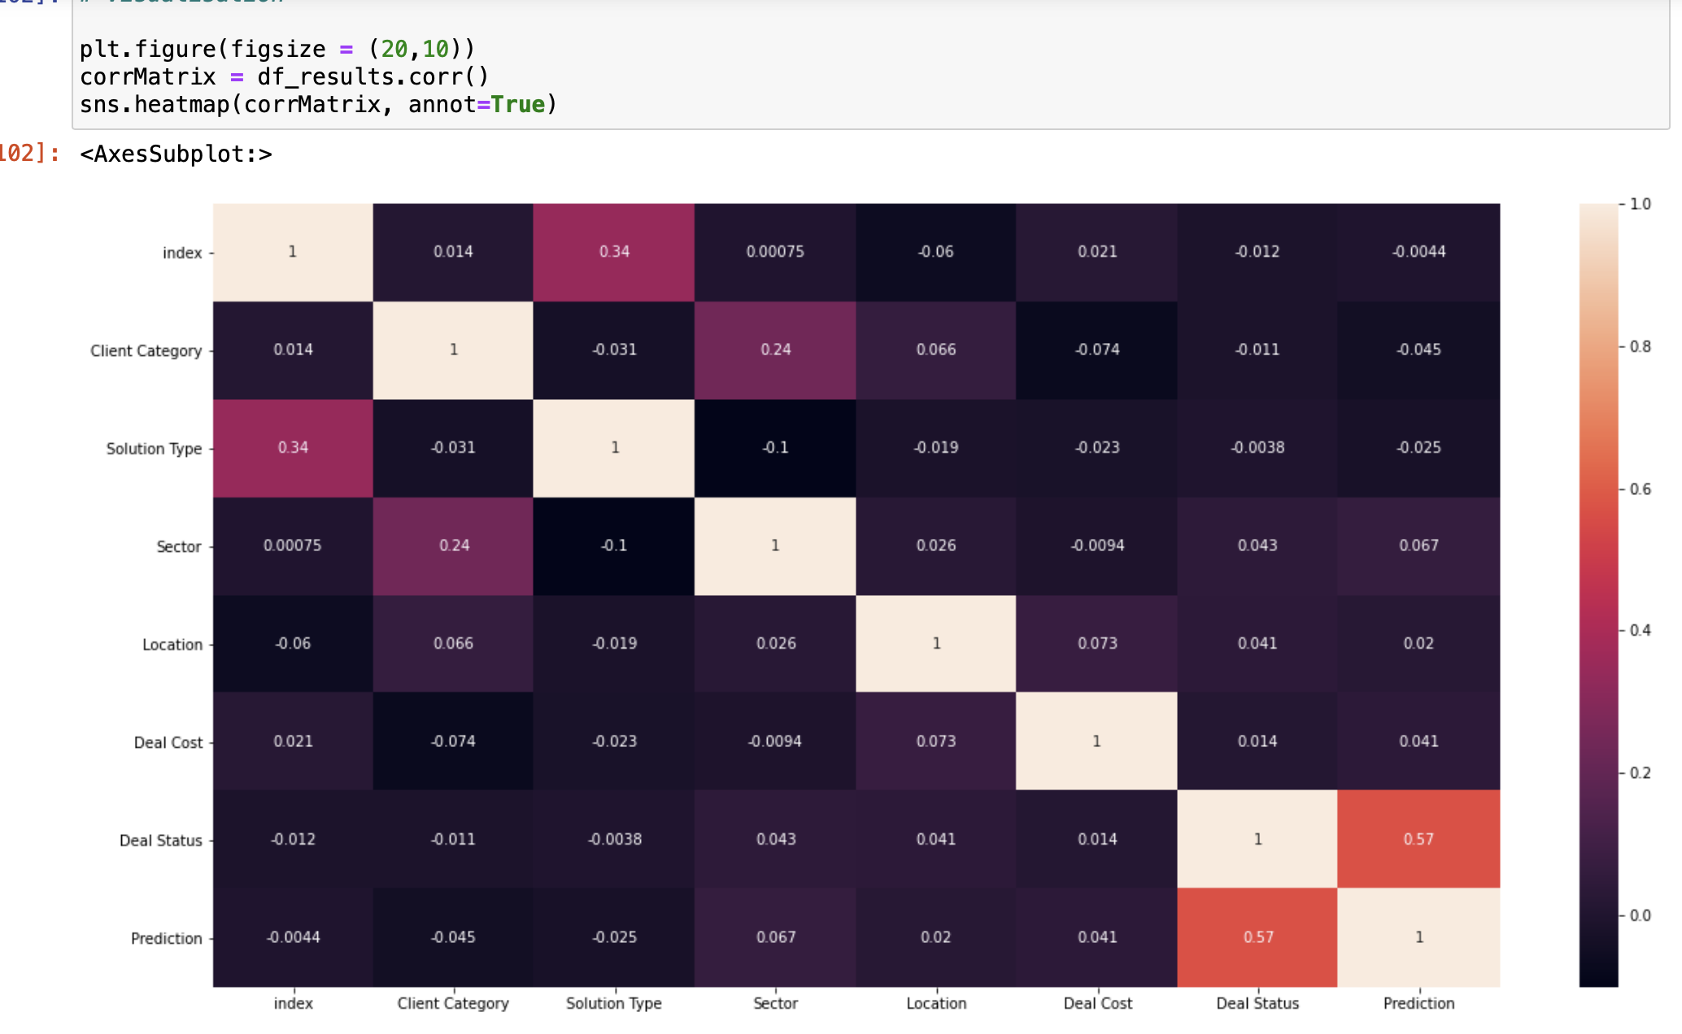
Correlation matrix Visualization

Slide 10
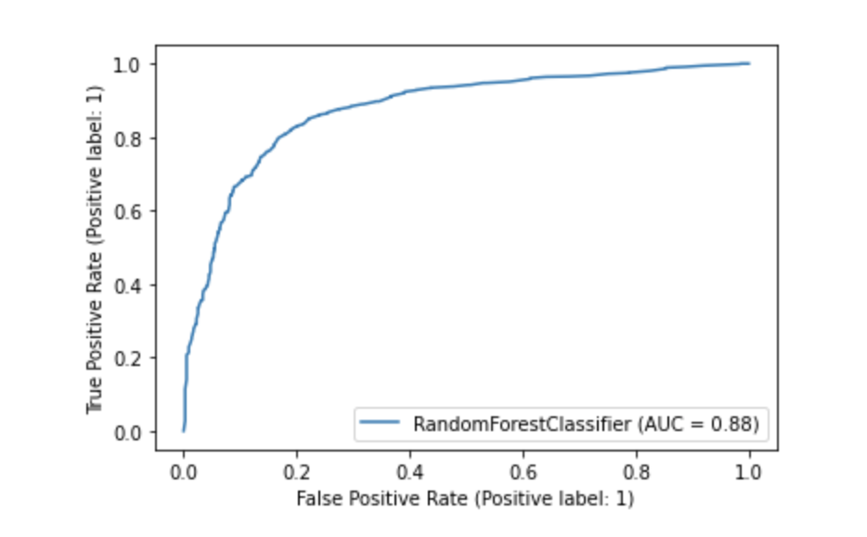
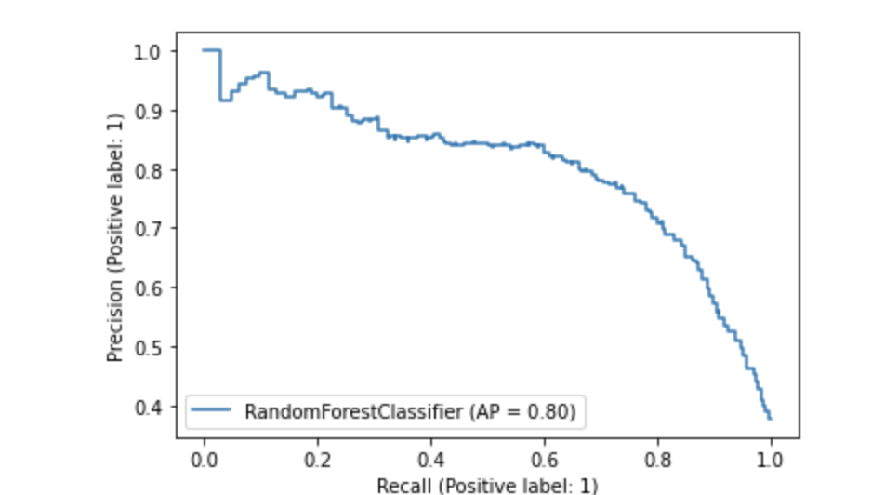
AUC (Area Under the Curve) & Precision Recall

Slide 11
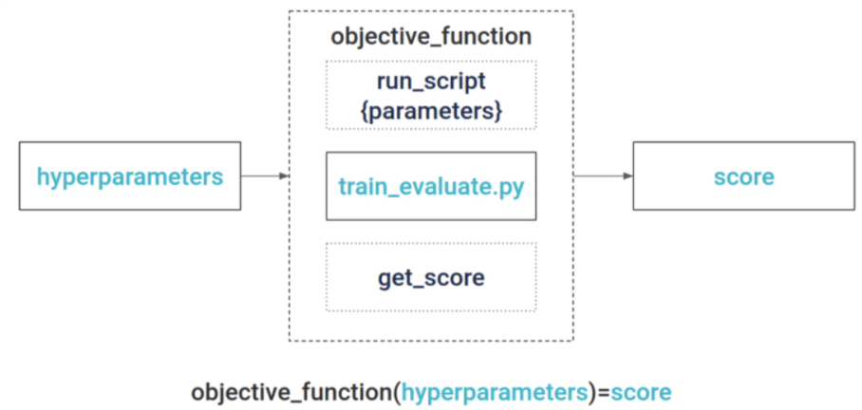
Hyperparameter Tuning

Slide 12
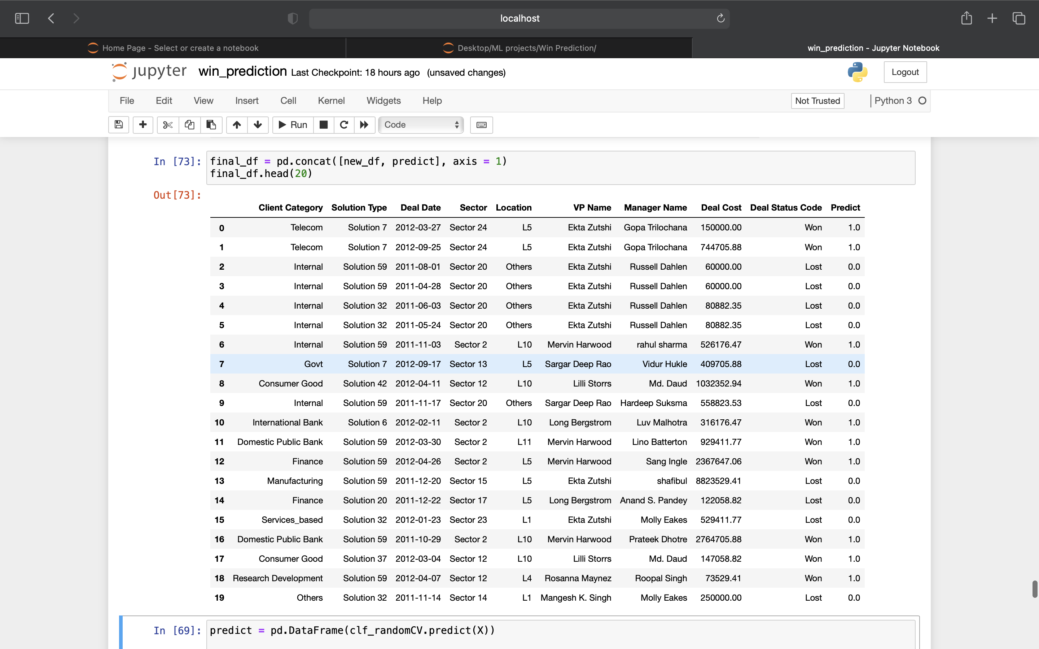
Prediction

Slide 13
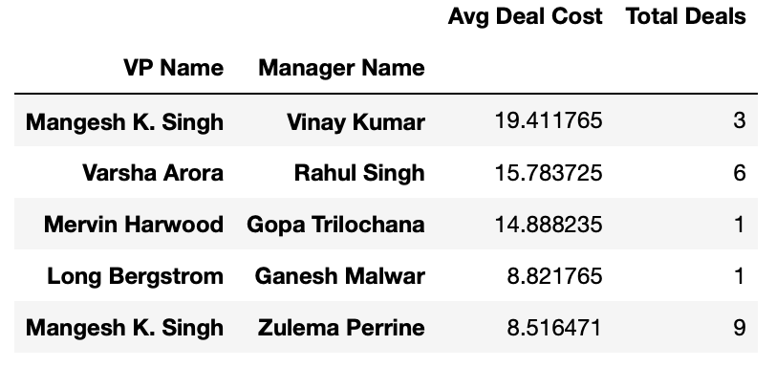
Business Insight
For win situation many factors should be known:
For winning deal member analysis:
We can see from data that deal cost is very high where VP and Manager have no prior bidding experience.
Some winning bid members with low prior experience have high deal cost resulting in win deal status.
Some members have decent deal cost and more number of deals won by them.

Slide 14
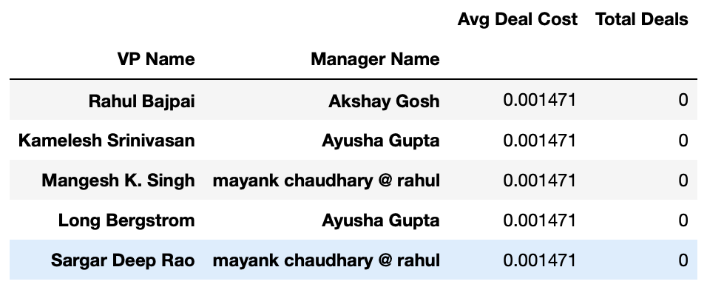
Business Insight
For lost deals member analysis:
By analysis we can see lost deal are more as compare to win (difference is more than half)
After analysis we get to know cost is higher in lost deals as compare to win deals
Then we can analyse prior projects experience is zero in lost deals

Slide 15
Comparing on basis of other factors
When comparing with other factors:
Solution type is solution group that client require accordingly if we compare both lost and win and then major part is about the solution required
So we can observe people who already did work according ‘Client category’, ‘Solution type’, 'Sector’, 'Location' with prior experience manager then we have chances to win.
Loss will be less when:
Members who already worked with similar ‘Location’, ’Client category’, ‘Solution type’, ‘Sector' dealing will more chance to win
Members who have no prior experience can work with prior experience people who got the deal and can overcome from the loss
They can also work on strategy and reduce the dealing cost

