Slide 1
Win Prediction Analytics
DATA SCIENCE PRODEGREE PROJECT FROM IMARTICUS LEARNING
Amit Mahajan
Narsimha Venkata
Jyoti Singla
Rishabh Raibhandar
Suriya Subramani

Slide 2
Content
Understanding the problem and Objectives
Understand the data develop and some business sense
EDA (Exploratory Data analysis), Data cleaning and Feature Engineering
Hyperparameter tuning
Model Selection
Testing and correlation
Recommending top 5 combination of VP and Manager names
Calculate Lost Prediction counts
Result, recommendation and visualizations

Slide 3
Understand the Problem and Objectives
Your Organization puts in a lot of effort in bidding preparation with no indications whether it will be worth it. With multiple bid managers and SBU Heads willing to work on every opportunity, it becomes difficult for the management to decide which bid should be given to which bid manager and SBU Head. You are hired to help your organization identify the best bid manager-SBU Head combination who can convert an opportunity to win with the provided data points.
Objective 1: Predictive Analytics - Build a ML model to predict the probability of win/loss for bidding activities for a potential client.
Objective 2: Prescriptive Analytics - Identify variable/s that are most likely to help in converting an opportunity into a win.
Objective 3: Recommending top five combination of VP and Manager names
Objective 4: Calculate Lost Prediction counts

Slide 4
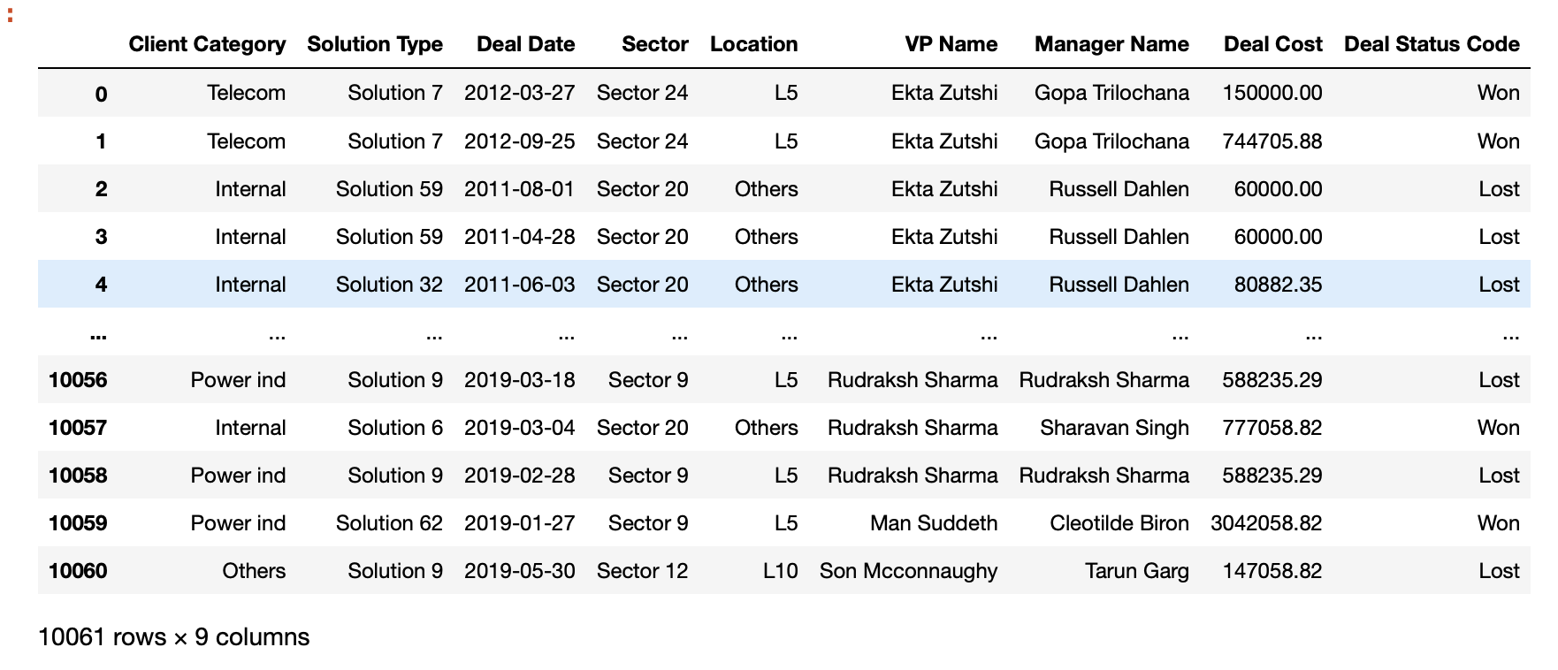
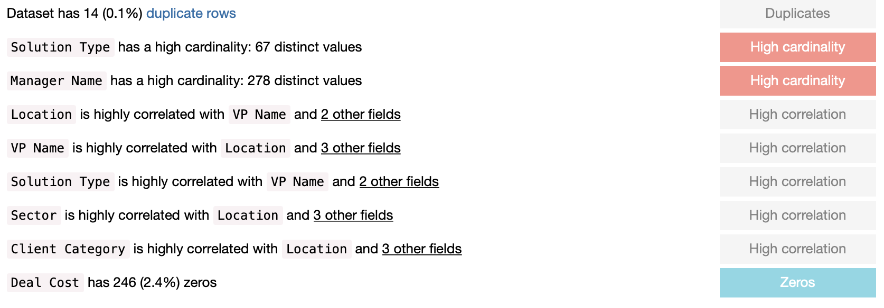
Understand the data develop and some business sense
Columns : 9
Rows : 10061
Business Sense : According to the dataset like Different locations , sectors , solution, VP name, Manager name, and deal cost because they have a correlation between them. According to business sense these are the most important columns to predict win or lost.
Note :We have 7 columns is categorical, 1 is numerical and 1 is date.

Slide 5
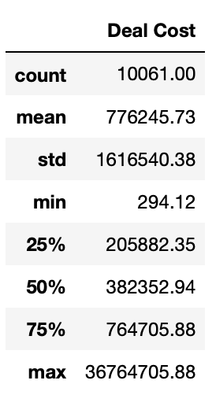
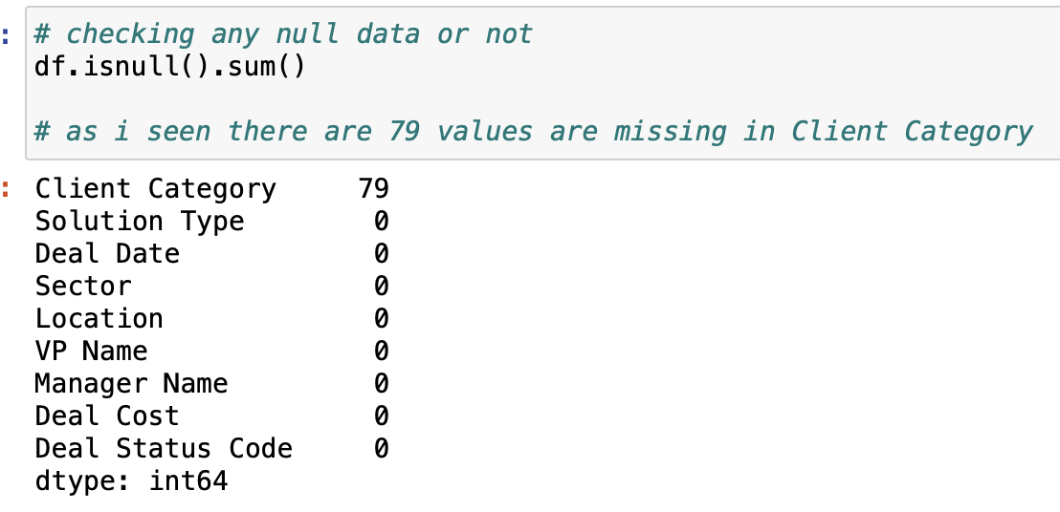
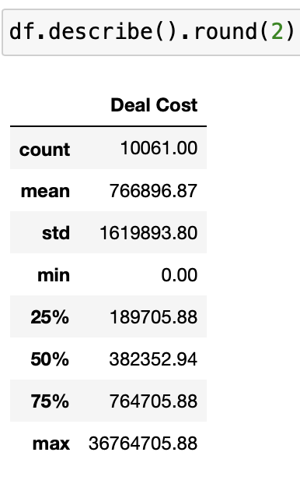
EDA (Exploratory Data analysis)
In EDA, The data with the help of describe mean, median, mode, standard deviation ,checking the outlier, fillna values with meaning full data.
After the completion of the EDA (Exploratory Data analysis) :
Check the null values
Check the mean, median, mode , Standard deviation, minimum value and maximum value.

Slide 6
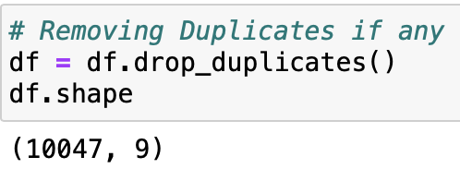
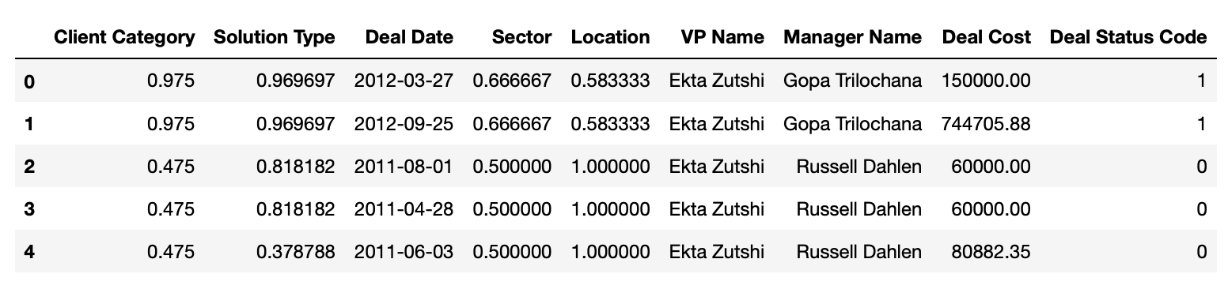
Data Cleaning or Data Cleansing
In Data cleaning, we can remove the duplicate values, scale the data, check the quality and analysis on it.
Note : As we see we have a categorical data also so first we transform the column into numerical data and then we scale the data with the help of MinMaxScaler.
with duplicate values : 10061 without duplicates values : 10047

Slide 7
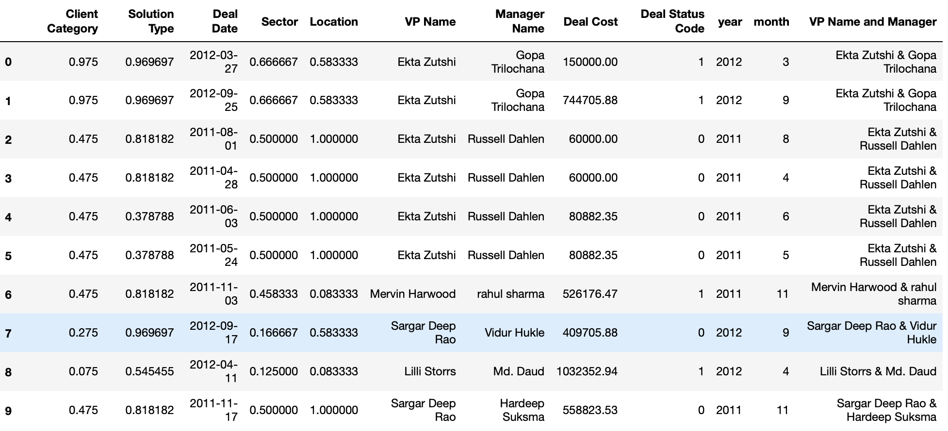
Feature Engineering And Feature Selection
In Feature Engineering, we have Remove, Add, Update columns and rows in the data and analysis on it.
In Feature Selection:
what type of category is important the cost is change according to the category.
Solution type have different values is also a important variable.
Sector, location, VP name and Manager.
Note : We have added a new feature in the Dataframe with the help of VP name ,managers and Date column. First we use datetime package to separate the date column into month and year, second we combine VP name and Manager.

Slide 8
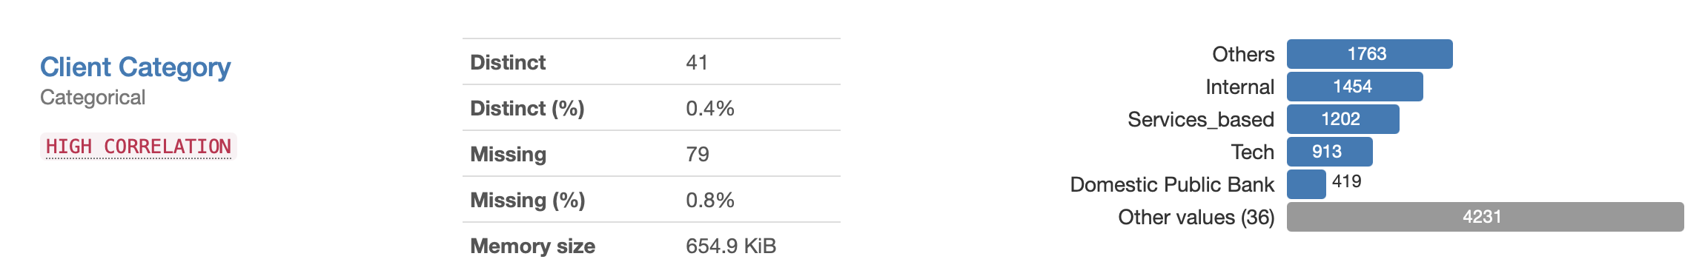
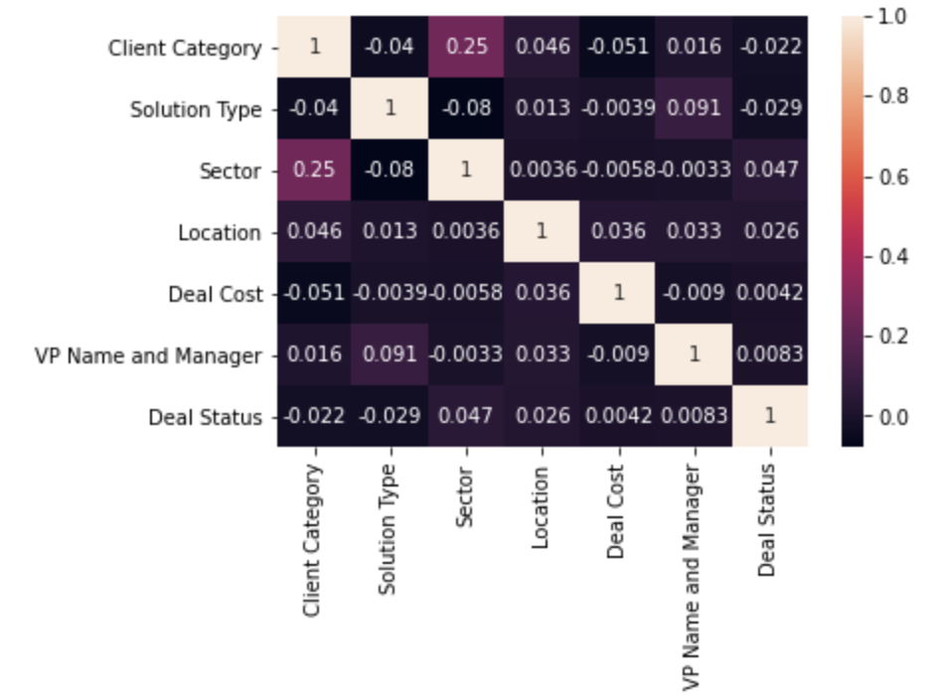
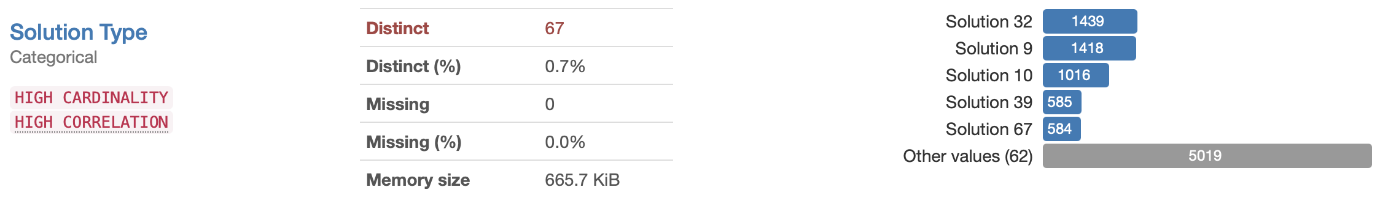
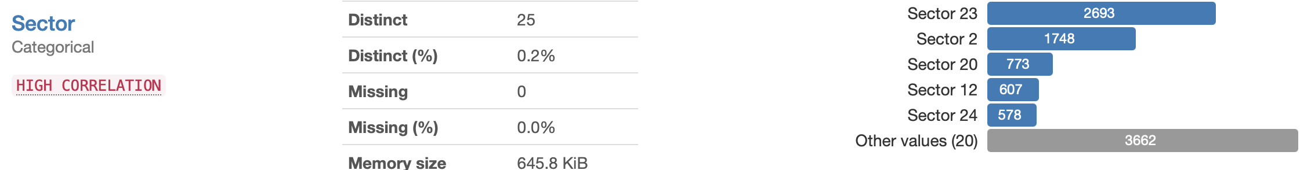
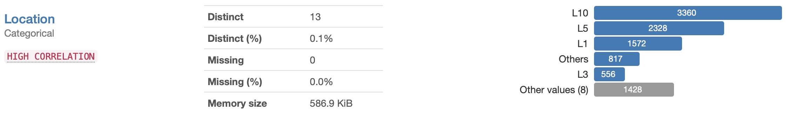
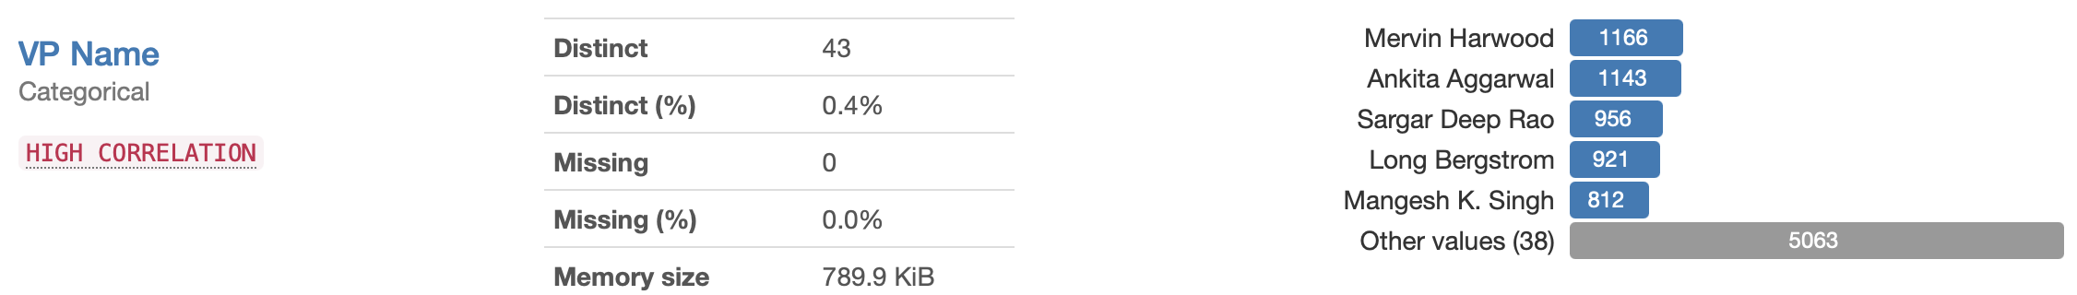
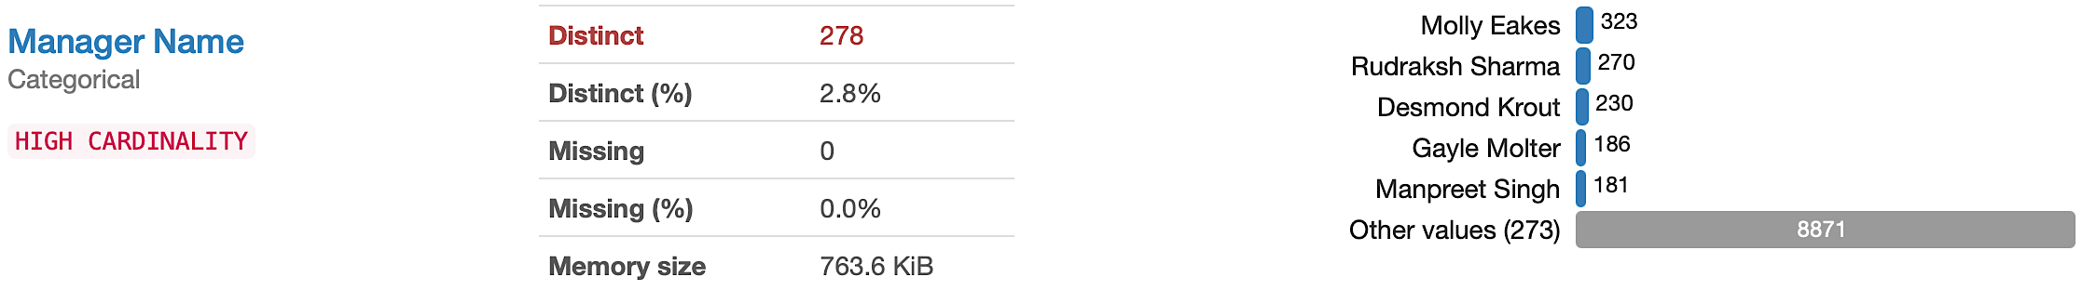
Testing and Correlation
We also create a heatmap between all the columns.
Note : According to the profiling report we can see who is the highly correlated.
We test and analysis the variables one by one and use in our model building

Slide 9
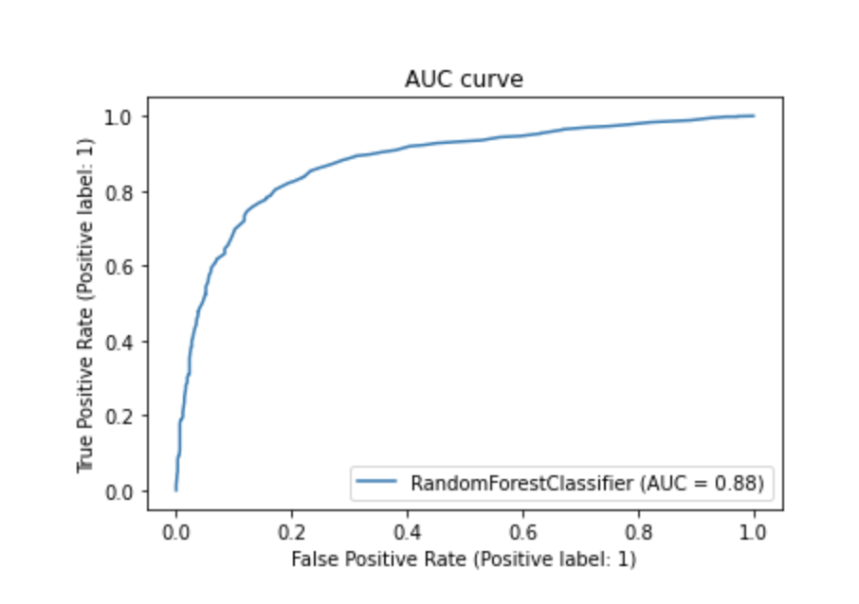
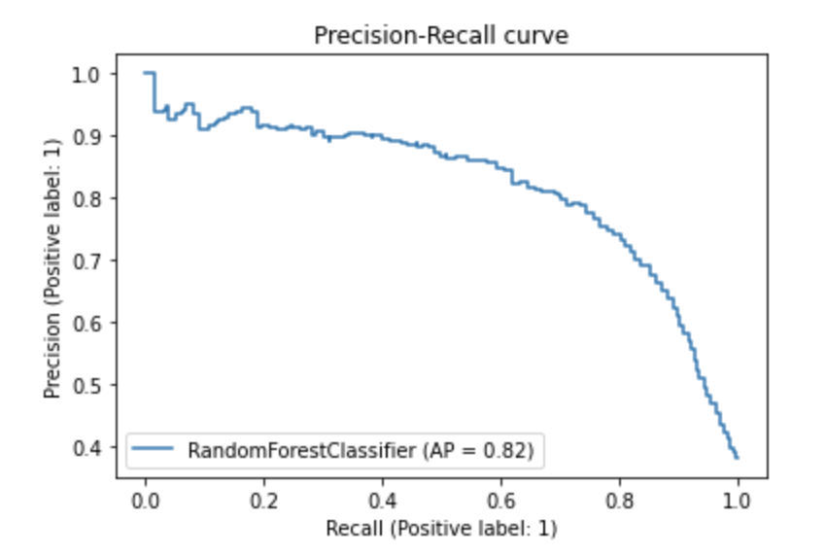
AUC (Area Under the Curve) & Precision-Recall on Random forest classifier model.

Slide 10
Ratio of Test to Train Data Split
Training Data 75%
Testing Data
25%
We split the 100% data into training 75% and test 25%.
Command used:
X_train, X_test, Y_train, Y_test = train_test_split(X, Y, random_state=0, test_size = 0.25)

Slide 11
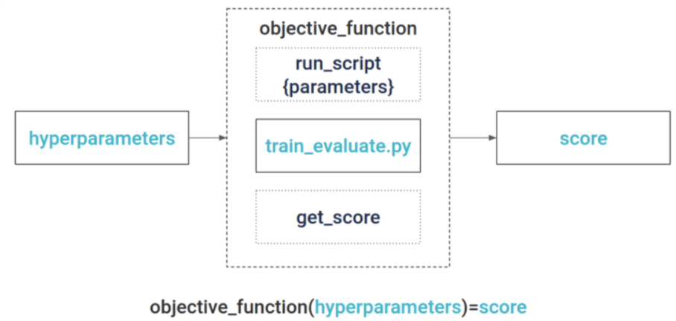
Hyperparameter Tuning
A hyperparameter is a parameter whose value is used to control the learning process. By contrast, the values of other parameters are derived via training. This is process of hyperparameter tuning.

Slide 12
Model Selection
Model Selection | Model Accuracy
KNN (K – Nearest Neighbor) Classifier | 74.77%
SVM (Support Vector Machine) | 62.98%
Decision Tree Classifier | 69%
Random Forest Classifier | 78%
Randomized search CV (Random Forest) | 81%
According to data this is a Classification problem using multiple Classification models.
Logistic Regression (logistic have less accuracy as compared with others) 62%
KNN (K – Nearest Neighbor) Classifier
SVM (Support Vector Machine)
Decision Tree Classifier
Random Forest Classifier
* Using Cross validation and hyperparameter tuning.
* Randomized search CV (Cross Validation).
* AUC (Area Under the curve) is 88% for Random Forest classifier.
* Precision is 86% for Random Forest classifier.
* Recall is 58% for Random Forest classifier.

Slide 13
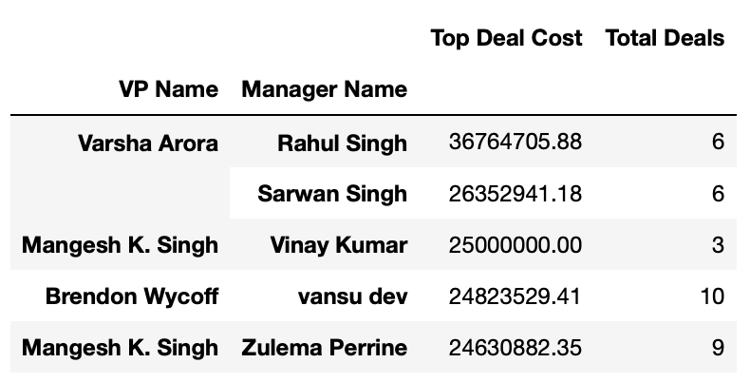
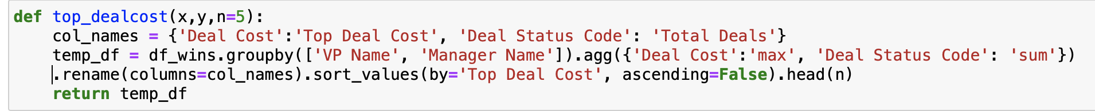
Recommending top 5 combination of VP names and Manager
Top 5 combinations of VP names and Managers
Firstly, we create a new Dataframe for only who is win the deal status. After we create a function for top 5 combination of SBU head-bid manager. We used aggregate function maximum values on Deal cost and sort the value in the descending order. Here we add an image how we did the code.
NULL
Note : According to this function we also calculate the top lost combination of VP names and Manager

Slide 14
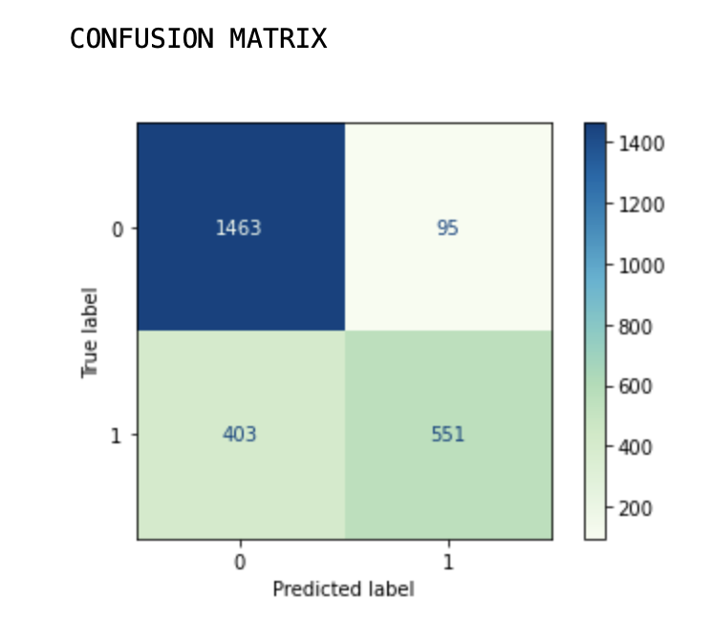
Calculate Lost Predictions Counts
Case I : We are replacing zero’s (count 246) with the median value.
Confusion matrix
Here check the false predictions :
According to the Confusion matrix, We check if deal status code is 1 means deal is won and prediction is 0 means is lost the deal
And if deal status code is 0 means deal is lost and prediction is 1 means deal is won. The count is 498 is the lost deal on the Dataframe.
In this Confusion matrix:
True label 1 and predicted label 0 count is 403.
True label 0 and predicted label 1 count is 95.

Slide 15
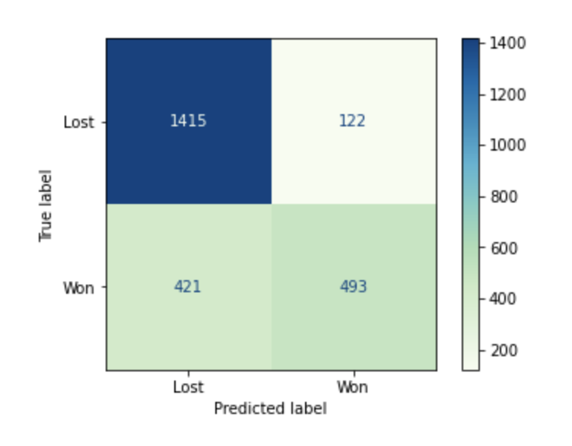
Calculate Lost Predictions Counts
Case II : We are removing all the zero’s.
Confusion matrix
Here check the false predictions :
According to the Confusion matrix, We check if deal status code is 1 means deal is won and prediction is 0 means is lost the deal
And if deal status code is 0 means deal is lost and prediction is 1 means deal is won. The count is 543 is the lost deal on the Dataframe.
In this Confusion matrix:
True label 1 and predicted label 0 count is 421.
True label 0 and predicted label 1 count is 122.

Slide 16
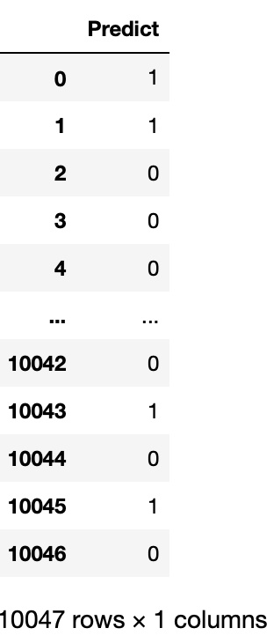
Result
Result: Here is the final result which our model predict the values according to the training data. (1 is stands for Won ), (0 is stands for Lost ).

Slide 17
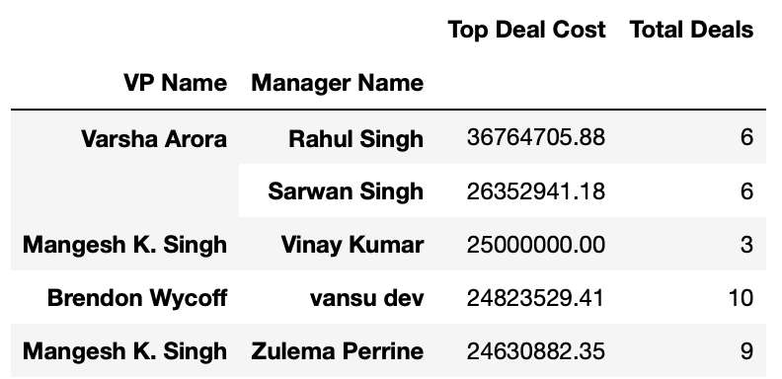
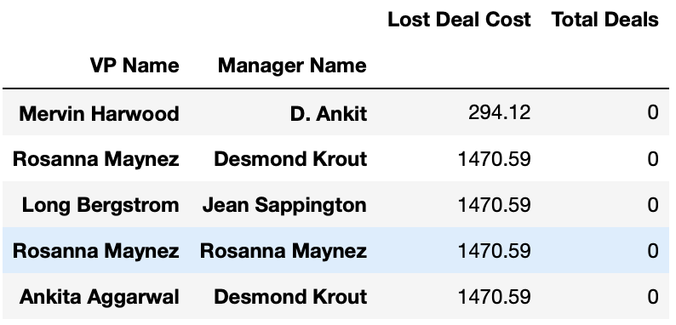
Recommendation
For win situation many factors should be known:
For winning deal member analysis:
We can see from data that deal cost is very high where VP and Manager have no prior bidding experience.
Some winning bid members with low prior experience have high deal cost resulting in win deal status.
Some members have decent deal cost and more number of deals won by them.
NULL
For lost deal member analysis:
By analysis we can see lost deal are more as compare to win (difference is more than half).
After analysis we get to know cost is higher in lost deals as compare to win deals.
Then we can analyse prior projects experience is zero in lost deals.

Slide 18
Comparing on basis of other factors recommendation
When comparing with other factors:
Solution type is solution group that client require accordingly if we compare both lost and win and then major part is about the solution required.
So we can observe people who already did work according ‘Client category’, ‘Solution type’, 'Sector’, 'Location' with prior experience manager then we have chances to win.
Loss will be less when:
Members who already worked with similar ‘Location’, ’Client category’, ‘Solution type’, ‘Sector' dealing will more chance to win.
Members who have no prior experience can work with prior experience people who got the deal and can overcome from the loss.
They can also work on strategy and reduce the dealing cost.

Slide 19
THANK YOU
FOR YOUR ATTENTION

