Slide 1
Explainable and Fair Credit Card
Fraud Detection
1.85M
transactions
0.858
Technical presentation
final test PR-AUC
Ryan Rey Corpin
Postgraduate Diploma in Artificial Intelligence and Machine Learning
October 2026
Notes:
Project source: local capstone repository. Final test metrics: deliverables/04_model_implementation/final_test/final_test_summary.json.

Slide 2
Fraud triage under severe class imbalance
Business question
Binary transaction classification with a ranked risk score
Primary metric: average precision because fraud represents about 0.5% of records
Operational measures: recall, precision, fraud-value capture and false-positive burden
Fairness measures: protection and service quality across available demographic groups
Which transactions should enter a limited review queue so that fraud capture rises without imposing excessive customer friction?
PR-AUC
Assumed 1%
Temporal
model selection
analyst capacity
evaluation design
Problem framing and success criteria
2
Notes:
Source: deliverables/01_problem_framing/problem_framing.md.

Slide 3
Dataset and temporal evaluation protocol
1,852,394
9,651
0.521%
23
transactions
fraud cases
overall prevalence
raw columns
Development
Validation
Final test
1,037,340 rows
Jan 2019 to Mar 2020
259,335 rows
Mar to Jun 2020
555,719 rows
Jun to Dec 2020
Synthetic Sparkov data supports reproducible benchmarking. It cannot establish production performance at a real institution.
Sparkov dataset · chronological splits prevent future information from guiding model choice
3
Notes:
Dataset source: https://www.kaggle.com/datasets/kartik2112/fraud-detection. Profile: deliverables/02_data_understanding/data_understanding.md.

Slide 4
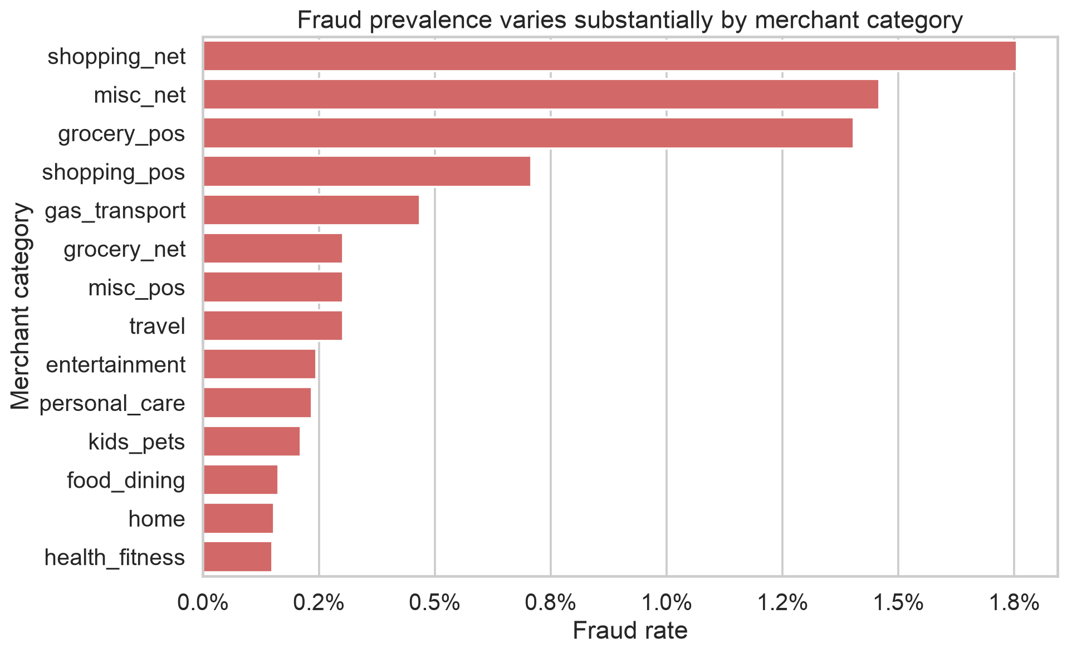
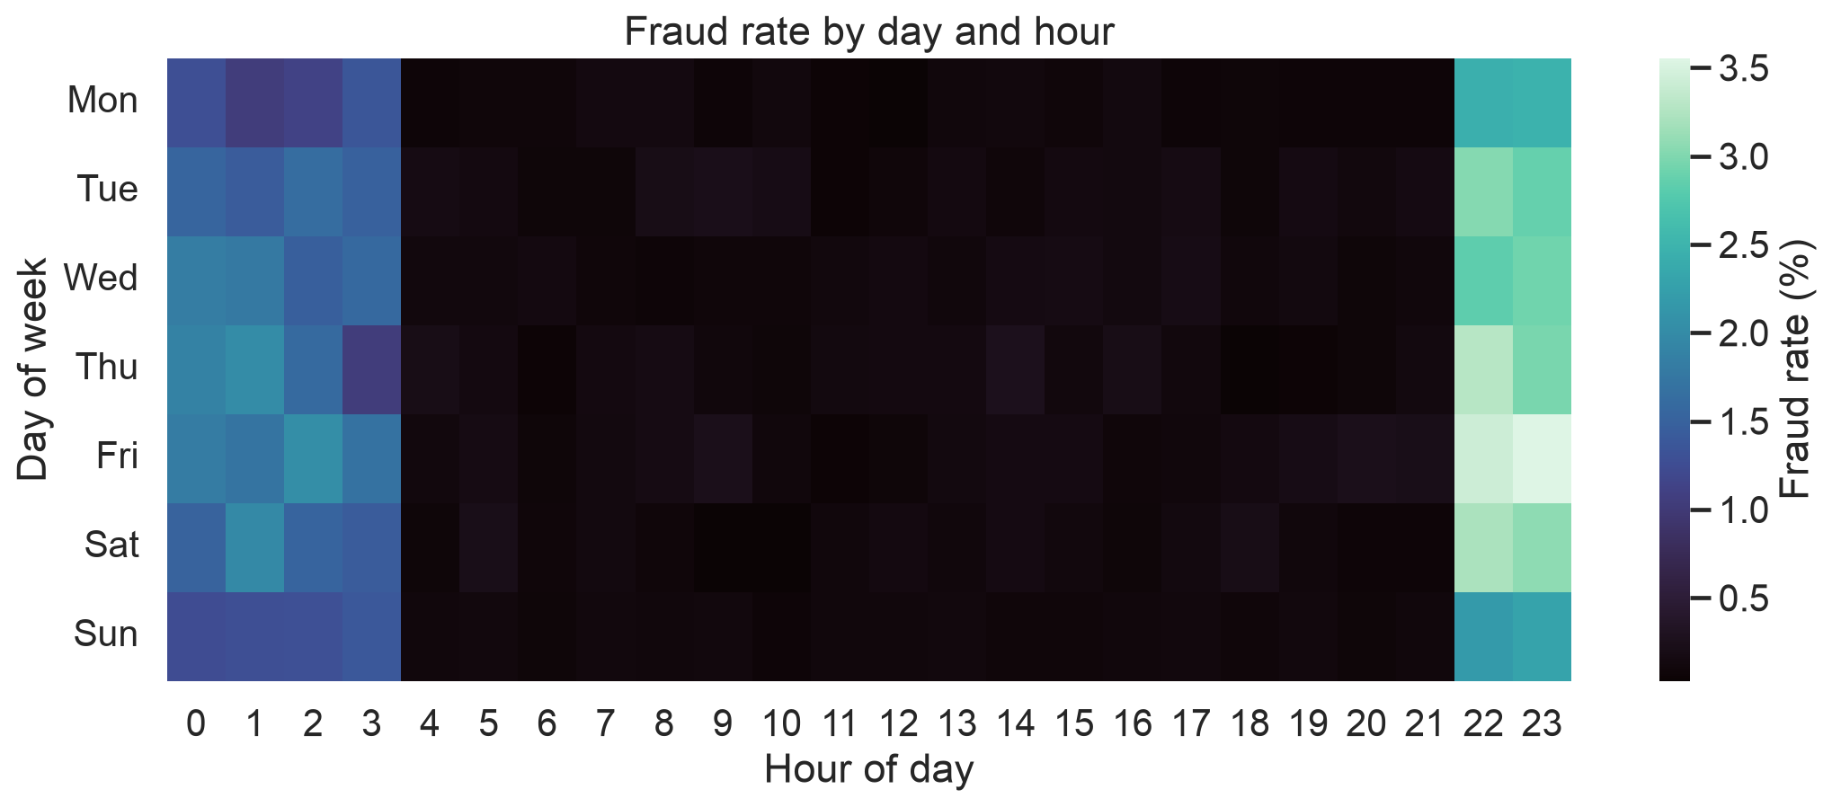
Applied EDA reveals temporal and category concentration
Fraud concentrates around 22:00–03:00
shopping_net leads observed category fraud rate at 1.76%
Descriptive associations guide features; they do not establish causal fraud drivers.
Development-period EDA · time and merchant category provide strong operational context
4
Notes:
Source images: deliverables/03_preprocessing_eda_features/figures/05_day_hour_fraud_heatmap.png and 04_category_fraud_rate.png.

Slide 5
Feature engineering and leakage controls
Signal added
Controls applied
Cyclical hour and weekday features
Amount, population and behavioral log transforms
Customer-to-merchant distance
Prior transaction count, timing and amount behavior
Merchant, city, ZIP and occupation frequency
History uses strictly earlier timestamps
Equal timestamps never enter one another's history
Names, street, transaction ID and card number excluded
Gender and age reserved for auditing
Preprocessing fitted on development data only
Post-review outer validation
98 features · PR-AUC 0.9166
Post-review outer validation
retuned 25 features · PR-AUC 0.8906
PCA rejected: weak compression and separation
Reproducible preprocessing and feature selection
5
Notes:
Source: deliverables/03_preprocessing_eda_features/eda_feature_engineering_report.md and feature_manifest.json.

Slide 6
Model experiment design
Eight controlled experiments
Selection and tuning
Dummy prior establishes the no-skill benchmark
Two regularized logistic regressions provide interpretable baselines
Two pruned decision trees test nonlinear thresholds
Random forest tests bagged interactions
Two histogram boosting variants test stronger nonlinear capacity
Highest PR-AUC; top families tuned on an earlier chronological inner split
Class imbalance
Balanced class weights during fitting. Validation prevalence remains unchanged.
Reproducibility
Seed 42, versioned JSON configs, serialized models, automated tests; random early stopping removed in the enhancement.
Candidate families, tuning scope and selection rule
6
Notes:
Source: configs/step4_models.json, configs/step4_enhancements.json and enhancements/reviewer_response.md.

Slide 7
Original Step 4 comparison: 25-feature HGB leads
Selected
Original Step 4 protocol · 25-feature branch · flexible HGB PR-AUC 0.8914
7
Notes:
Source: deliverables/04_model_implementation/tables/model_comparison.csv. Flexible histogram boosting PR-AUC 0.891410.

Slide 8
Final test performance remains strong under temporal shift
0.8584
final test PR-AUC
1,985
fraud cases found at 1%
$1.118M
fraud value captured
Test prevalence fell to 0.386%. Precision of 35.71% is 92.5% of the 38.6% theoretical ceiling at a 1% queue.
Assumed 1% analyst capacity · cost sensitivity favours a smaller queue; frozen policy unchanged
8
Notes:
Source: deliverables/04_model_implementation/final_test/final_test_summary.json and final_test_capacity_metrics.csv.

Slide 9
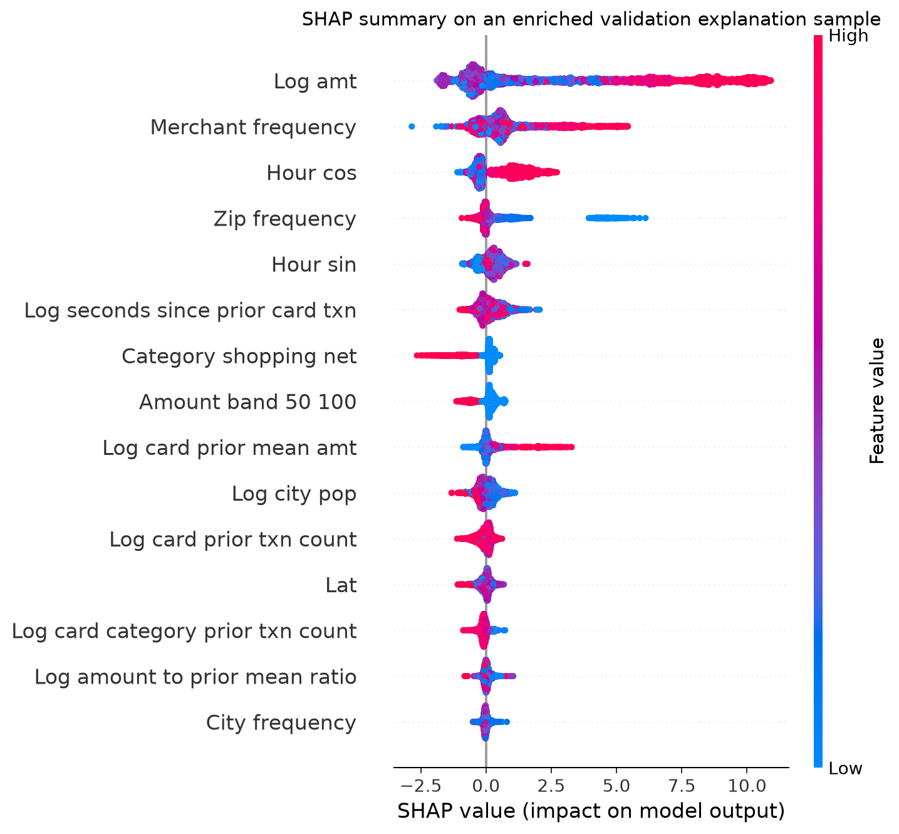
Amount, frequency and time dominate model explanations
Transaction amount is the leading global contribution
Merchant and ZIP frequency capture recurring context and possible proxy risk
Time of day and prior card behavior create nonlinear interactions
A $607 legitimate transaction shows how high amount and timing can produce a false positive
Explanations describe model behavior. They do not establish causal fraud drivers
TreeSHAP sample: 1,500 fraud + 1,500 legitimate validation transactions
TreeSHAP, partial dependence, ICE and local explanations
9
Notes:
Source image: deliverables/05_explainability_ethics_fairness/figures/01_shap_summary.png. Source table: shap_global_importance.csv.

Slide 10
The final test confirms a gender protection gap
7.17 pp
test TPR gap
0.898
test disparate-impact ratio
Validation intersections span 69.00% to 97.32% recall. Race and socioeconomic status cannot be audited because the data lacks valid attributes.
Validation-derived cutoffs reduced the test TPR gap to 1.08 pp, but worsened parity and precision gaps. Mitigation rejected.
Gender and age excluded from model inputs but retained for auditing
10
Notes:
Validation source: deliverables/05_explainability_ethics_fairness/audit_summary.json. Test source: deliverables/04_model_implementation/final_test/tables/final_test_gender_metrics.csv.

Slide 11
Critical limitations and mitigation findings
Model risk
Responsible AI
PR-AUC declines from 0.8914 validation to 0.8584 final test
Later-slice isotonic calibration cuts Brier loss 26%, but slightly reduces PR-AUC
Full features win post-review; fresh out-of-time confirmation is still required
Synthetic entities and patterns may overstate real generalization
Gender recall disparity persists on final test
Equal review rates do not fix unequal protection
Equal-opportunity thresholds create new burden and precision gaps
Missing race and socioeconomic attributes limit audit coverage
Recommended controls
Shadow mode, human review, score calibration, drift monitoring, subgroup alerts and rollback criteria before customer-facing action.
Strong predictive performance does not establish production readiness
11
Notes:
Source: deliverables/05_explainability_ethics_fairness/bias_fairness_analysis.md and final_test_report.md.

Slide 12
Conclusion
The model is technically promising and operationally useful as a ranked review aid. The evidence supports a governed shadow pilot, not automated declines.
Validate performance and cost on real transactions
Calibrate scores on a later, separate period
Investigate subgroup errors and training-time mitigations
Define monitoring, escalation and rollback gates
0.8584
92.54%
98.61%
final test PR-AUC
fraud recall at 1%
fraud-value recall
Reproducibility: configs, source, serialized models, generated artifacts and automated tests
12
Notes:
Conclusion sources: final_test_report.md, bias_fairness_analysis.md, and repository README.md.

