Slide 1
Session - 1

Slide 2
Agenda
Basics of Assembly
System calls
Registers
Memory Mapping
Stack
Gdb
Buffer Overflows
Bit of reversing

Slide 3
Before we start
Please download all the code files and scripts from the below repository:
https://github.com/rrd7/vctm-session

Slide 4
Assembly Language
It is a low level programming language which communicates with the processor directly.
We will be dealing with Linux 32 bit intel assembly.
Different for Intel and ARM.
Even Intel architecture is divided into 2:
IA 32
IA 64
Here we will be specifically dealing with IA 32 LINUX assembly.

Slide 6
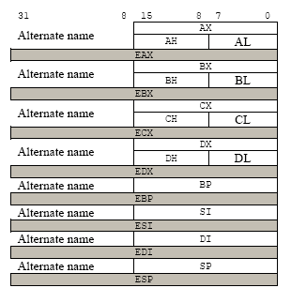
Registers

Slide 7
EAX – Will contain system calls
EBX – First argument for system calls
ECX – Second argument for system calls
EDX – Third argument for system calls
ESI and EDI – We can use arbitrarily or for the remaining arguments
EIP – Holy grail of shellcoding. Will contain the address of the next instruction to be executed. (32 bit)
ESP – Will point to top of the stack.
Note: - Apart from the usage mentioned in this slide, the registers have other usage as well.

Slide 8
Memory Model
Kernel Space
Stack (Function args + Local variables)
Shared libs
Heap
BSS (Uninitialized data)
Data (Initialized data)
Text (Initialized data)

Slide 9
System Calls
Leverage OS for tasks
Provides a simple interface for user space programs to the kernel
Int 0x80 to invoke a system call
/usr/include/i386-linux-gnu/asm/unistd_32.h”
For write system call
mov eax, (system call number)
mov ebx, (file descriptor for stdout)
mov ecx, (pointer to the what has to be written)
mov edx, (length)
int 0x80

Slide 10
Installation instructions
apt-get install nasm
apt-get install build-essential make libglib2.0-dev

Slide 11
Assembly Syntax
Global _start
Section .text
_start:
----
----
Section .data
----
Section .bss
-----

Slide 12
MOV, LEA and XCHG instructions
mov eax, 0x4
mov ebx, eax
mov eax, [example]
lea ebx, [eax]
lea eax, [example]
xchg eax, ebx

Slide 13
Let’s run our first program
nasm -f elf32 -o code.o code.nasm
ld –o code code.o
./code

Slide 14
Data Types
Byte – 8 bits
Word – 16 bits
Double Word – 32 bits
Quad Word – 64 bits
Double Quad Word – 128 bits

Slide 15
GDB
- Run time analysis
- Debugging
- Changing program flow
Commands:
gdb –q code
set disassembly-flavor intel
disassemble
shell cat $file

Slide 16
break _start
Info registers
Info functions
Info breakpoints
print/x $register
help x
x/4xb memory_address or $register
continue
define hook-stop
Print/x $eax
x/4xb $esp
Disassemble $eip, +10
end

Slide 17
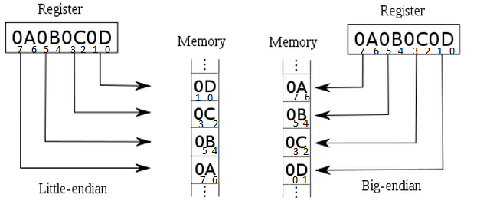
Little Endian
- Least significant bit goes to the lower memory address and most significant bit goes to the higher memory address.

Slide 18
Stack
Stores local variables
Return addresses
LIFO data structure
Grows from higher to lower memory
PUSH – pushes a value onto Stack
POP – Removes the topmost value from the stack
ESP – Point to the top of the stack

Slide 19
Jump Instructions
Unconditional jump – JMP
Conditional jumps
Uses flags to determine jumps
For example a decrement situation led to 0
jz, jnz

