Slide 1
Webscraping with XPATH, Scrapy and Selenium
Rahul Desai – 10/24/16

Slide 2
Why not just BS4?
Extensibility (scrapy)
Ease of use
need for interaction (selenium)

Slide 3
XPATH
Why?
Same syntax can be used across packages
specific & flexible, multiple ways to access a certain element
How does it work?
Elements arranged like a computer file system
/ – finds element, searches from root node
./ – continues search from current position
// – finds all elements

Slide 4
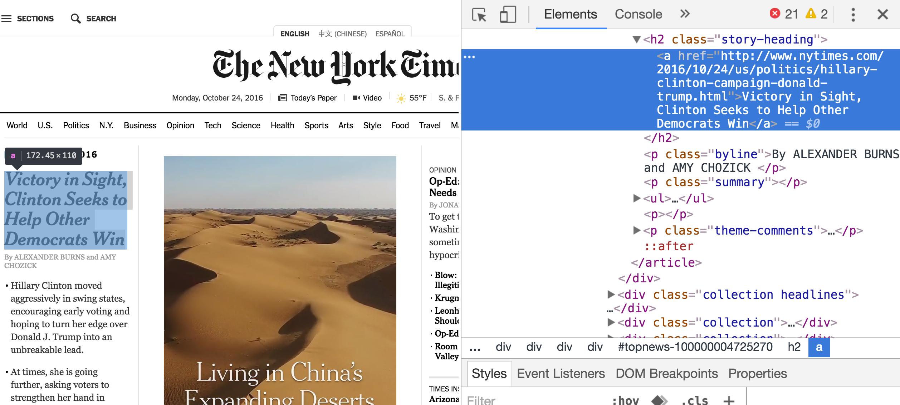
headlines = ‘//h2[@class=“story-heading”]/a/’

Slide 5
Scrapy Features & Benefits
Shell
Kind of like iPython
Speed (concurrency, generators)
Can adjust all features manually
Rate limit (per domain)
Concurrent requests
Headers
Can stand alone but also compatible with BS4 & Selenium
Clean code

Slide 6
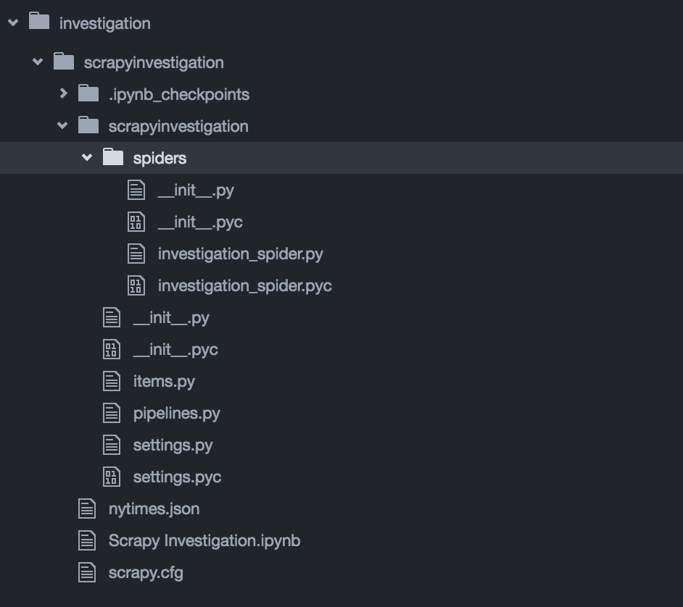
Scrapy Structure

Slide 7
Scrapy Structure

Slide 8
Writing a Spider
Start URLs
Yield a request object for each, define a callback function
Callback function
Extracts information from response
Can yield additional urls
Can have multiple callbacks within one script
Can yield an item object to another callback

Slide 9
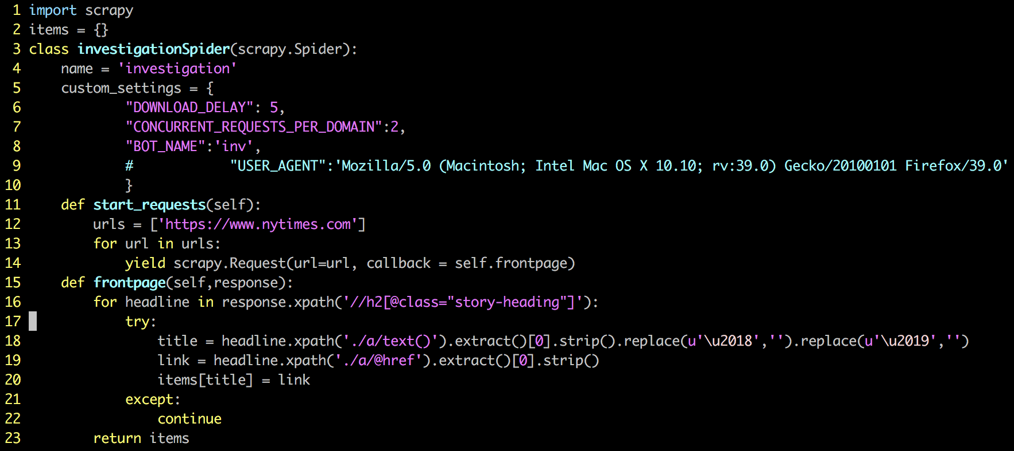

Slide 10
Other (probably) useful features
Jobs
Can pause and resume scraping for larger projects
Items
Allow you to pre-define fields to be scraped, can ensure data types are correct
Good for complicated projects; keeping items grouped across pages/spiders
Pipelines
Process scraped data
Crawl Depth

Slide 11
Selenium
Web Browser Automation
Useful when the information isn’t easily accessible
Page doesn’t load immediately
Information loading is conditional on some action
Need to select/download files or features
Can be used within the scrapy framework

Slide 12
Tutorials & Resources
http://bgrva.github.io/blog/2014/03/04/scrapy-after-tutorials-part-1/
http://blog.siliconstraits.vn/building-web-crawler-scrapy/
https://doc.scrapy.org/en/latest/intro/tutorial.html
More to come

