Slide 1

TB 1300 - SAP Business One SDK Introduction
July, 2019
Notes:
Welcome to the SDK introduction course topic.

Slide 2

Agenda
Deployment model and Technology
The SAP Business One SDK
Introduction to DI API
Introduction to Service Layer
Introduction to UI API
Notes:
In this unit we will cover the following topics:
Deployment model and Technology
The SAP Business One SDK
Introduction to DI API
Introduction to Service Layer
Introduction to UI API
Let us start with the first item on the list - deployment model

Slide 3
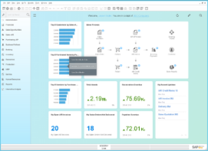
Compatibility Mode Solutions: HANA and MSSQL
COMPATIBILITY
MODE SOLUTIONS
HTTPS
Service Layer
UI API
B1 Business Logic
Script Engine
ODBC
B1 HANA DB
SAP Business One Client
ODBC
DI API
ODBC
B1 Business Logic
B1 MSSQL DB
Notes:
In the graphics you can see a diagram of the compatibility mode solutions.
This diagram illustrates the solution, where all components are located in one environment. The Add-on solution can use the DI and the UI API on Microsoft SQL and SAP HANA database environments.
The add-on can be extended with the functionality to operate with data using the SAP Business One Service Layer as well. The Service Layer can work only for SAP Business One, version for SAP HANA.
In general, there can be only one single version of add-on operating on these supported platforms.

Slide 4



Tightly Coupled Solutions: HANA only
COMPATIBILITY
MODE SOLUTIONS
UI API
HTTPS
HTML5 / FIORI
DI API
XSJS, ODATA, NODEJS
Service Layer
TIGHTLY COUPLED
SOLUTIONS
B1 Business Logic
Script Engine
B1 Business Logic
ODBC
ODBC
B1 HANA DB
Notes:
A tightly coupled solution means that the extensibility is strongly connected to the environment and deployed as a HTML based extension on top of the SAP HANA XS engine.
This diagram displays a module of a tightly coupled addon.
The solution consumes the SAP Business One data using the SAP Business One service layer technology.
The solution can be consumed by any kind of device using web browser, in mobile and desktop.

Slide 5





Loosely Coupled Solutions: HANA only
COMPATIBILITY
MODE SOLUTIONS
HTML5 / FIORI
XSJS, ODATA, NODEJS
ML
VORA
Apple SDK
IoT
LOOSELY COUPLED
SOLUTIONS
HANA DB
UI API
SAP Cloud Platform (Cloud Foundry)
HTTPS
HTML5 / FIORI
DI API
XSJS, ODATA, NODEJS
Service Layer
TIGHTLY COUPLED
SOLUTIONS
B1 Business Logic
Script Engine
B1 Business Logic
ODBC
ODBC
B1 HANA DB
When possible The loosely coupled option is recommended over the tightly coupled integration with B1 client Please refer to the blog and YouTube video series.
Notes:
In the loosely coupled model the solution runs in the SAP Cloud Platform and it interacts with the SAP Business One using the service Layers technologies.
This kind of solution is completely independent from the SAP Business One live cycle management.
On the Cloud, the solution has a wide range of technologies in order the communicate with the other external services.
The loosely coupled solution runs in a separated environment while the digital core (a.k.a SAP Business One) stays vanilla, with no or small customization.

Slide 6
Partner Solution Implementations
COMPATIBILITY
MODE SOLUTIONS
HTML5 / FIORI
XSJS, ODATA, NODEJS
ML
VORA
Apple SDK
IoT
LOOSELY COUPLED
SOLUTIONS
HANA DB
UI API
SAP Cloud Platform (Cloud Foundry)
HTTPS
HTML5 / FIORI
DI API
XSJS, ODATA, NODEJS
Service Layer
TIGHTLY COUPLED
SOLUTIONS
B1 Business Logic
Script Engine
B1 Business Logic
ODBC
ODBC
B1 HANA DB
Notes:
Usually in real life the architecture is more complex then the one we saw on the previous slides.
The customer implementation requires various extensions based on the exact business model and available partner Add-On or Solution offerings.
If the customer requires some additional feature to the digital core, then it is achieved by using the compatibility solutions on top of the UI API, DI API or using the Service Layer service as an interaction with the UI API.
The best option to run the local web services is deploying the extension solution in a tightly coupled way, directly into the SAP HANA XS Engine.
When communication to external services should to be performed then the loosely coupled solution can be the best option (like, payment gateways, delivery companies, maps services, etc.)

Slide 7
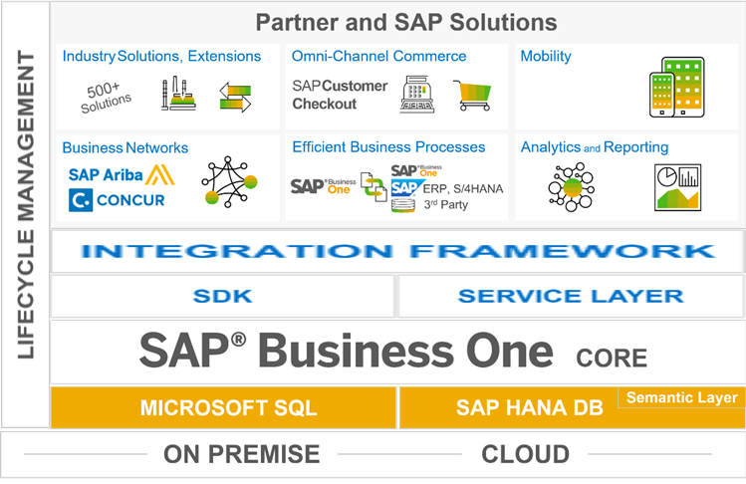
SAP Business One: Business Platform
Low cost of ownership and support
Expands the solution scope
Robust integration and collaboration
Extensibility
Interface for SAP HANA apps
Covers all standard business processes
Runs on in-memory
technology
Deployment flexibility
Notes:
The SAP Business One is shifting from ERP system model to Business Platform model. This model can connect multiple entities and integrate them into a single system.
SAP Business One can be deployed in Cloud or OnPremise.
It offers two types of database environments, the Microsoft SQL Server and the SAP HANA Database. The latest one comes with in-memory technology to merge the analytical and transactional requirement in one place.
SAP Business One offers several alternatives to extend the current solution – SDK, Integration Framework and Service Layer. The Service Layer is available only for SAP HANA.
On top of the extensibility layer it is possible to build various solutions, like third-party add-ons, mobile app, analytics app and reports. You can also perform some additional integration with SAP and non SAP products.

Slide 8
SAP Business One: Technology and Interfacing
SAP® Business One
Ease of Use
Continuous and integrated solution
Windows look & feel (SAP style)
Simple navigation
Ability to drill down to details
“Drag and relate” feature
Client
GUI
SDK (COM)
Product
Architecture
Two-tier client-server architecture (fat client)
Microsoft Windows 32 based, 64 Bit supp.
Microsoft SQL Server / HANA Server
Server
Adaptations
Customizing
Form Settings
Queries / Reports
User-Defined Tables and Fields
Linkage of input fields to queries
User-Defined Objects (UDOs)
Interfaces
Integration
Microsoft SQL Server /HANA
SDK (COM)
Services
SDK (DI Server)
MS Office Integration
Microsoft Excel, Word (out)
Microsoft Outlook (in / out)
Email
RDBMS
Backup
License
Interfaces
File-based (built-in)
SOAP (HTTP/XML)
APIs (COM, web services (SOA) starting)
User-Defined objects (UDOs)
Integration (not only) to SAP systems
Notes:
SAP Business One has implemented as a two-layer architecture. The system is based on a HANA database/ Microsoft SQL Server where data is stored centrally. The business logic is mostly processed on the client software (fat client).
In detail, the client software consists of a graphical user interface and the business object classes connecting to the database.
There are several built-in integration capabilities, interfaces and customization features (see “Adaptation”, “MS Office Integration” and “Interfaces”)
Besides all the adaptation capabilities accessible for customers, SAP Business One SDK enables partners to implement a solution extending SAP Business One using APIs and other features.
The DI Server, for example, enables partners to use SAP Business One data in a Browser without the need to install any SAP Business One component on the client or the application server of the web-based application.
The UDO feature is a further step to ease creation of additional functionality inside SAP Business One.
Licenses are also managed centrally. Partners can use the mechanism for own purposes.

Slide 9
Agenda
Deployment model and Technology
The SAP Business One SDK
Introduction to DI API
Introduction to Service Layer
Introduction to UI API
Notes:
Now we will have a closer look to the next topics, which is The SAP Business One Software Development Kit (SDK).

Slide 10

Introducing SAP Business One SDK: Topic Objectives
After completing this topic, you will be able to
Describe purpose and components of the SDK
Explain in high level about the SDK packages and licenses
Find further information and use the community to ask questions and get answers
Notes:
The objectives for the current topic are:
Describe purpose and components of the SDK
Explain in high level about the SDK packages and licenses
Find further information and use the community to ask questions and get answers

Slide 11

SAP Business One SDK - Motivation
SAP
Add-Ons
Partner
Add-Ons
Customization capabilities are powerful!
However the customization capabilities cannot solve every requirement
The Source code of SAP Business One is not accessible
SAP
Business One
Therefore you can use the SDK to develop the required solution.
Software
Development Kit
Notes:
So why use the SDK?
The SDK has powerful customization capabilities. You can change the existing system behavior and you can modify the user interface in SAP Business One client using the UI API technology.
The data related changes can be performed using the DI API and Service Layer.
However not all objects can be changed using these technologies, that’s why it cannot answer all requirements.
The SAP Business One source code is not accessible, it is not an open source software, where you can change the source code directly.
SAP delivers the SAP Business One as a digital core. The SDK can be used for customizing the digital core. The SDK ensures the data integrity and the seamless look of your solution.
You can use several Add-Ons solution which had been created by SAP, but if the implementation requires some industry specific features, then you can use the SDK to integrate it to the digital core.

Slide 12
SAP Business One SDK – Components Overview
Client
Server
3rd Party Application
SAP Business One Database
SAP Business One
User Interface API
Data Interface API
DI Server
Java Co
Server
License
Service
UDO
Notes:
On the current slide you can see the basic architectural diagram for SAP Business One components related to the SDK.
The different application programming interfaces (APIs) included in the SDK use open Microsoft standards that allow access to a lot of business objects provided by SAP Business One.
API runtimes are installed with the SAP Business One client application – except for the DI Server which is part of the SAP Business One Server Tools installation
You can access SAP Business One
on business data level through the Data Interface API (DI API). Most SAP Business One business objects are exposed in this API. They can be accessed by external programs. If you prefer using Java, use “Java Connector” to access DI API.
on business data level through Data Interface Server (DI). DI Server is a DCOM service that runs on the SAP Business One server and accepts XML data packed in SOAP (Simple Object Access Protocol) “envelopes”.
on user interface level: The User Interface API (UI API) provides access to a running application where you can add or modify forms, and provide your own event handlers to actively influence the existing business logic.
In addition to that, you can define your own business objects, User-Defined Objects (UDO), that are joined to the SAP Business One business object collection.

Slide 13
SAP Business One SDK – Terminology and Packaging
SDK Installation
Development package for partners – includes SDK help, code samples, tools and SAPBusinessOneSDK.dll
Runtime:
Only one runtime is available for development and productive usage.
The runtimes (DI API + UI API) are installed together with the SAP Business One client application
DI API can be installed stand-alone (separate installer package available)
Notes:
With the SAP Business One installation you will get:
The official documentation for SDK, UI API , DI API, database table reference and additional help documents.
Code samples for C# and Visual Basic demonstrating the usage of UI, DI API and DI Server.
Additional tools like the Add-On and Extension Registration Data Generator.
SAPBusinessOneSDK.dll - This is a combination of DI API and UI API libraries. You can only add this reference instead of separated COM libraries into your add-on solution.
There is only one set of APIs – no debug or release.
By installing the SAP Business One client, the runtime for the UI and DI API is installed as well.
For productive and development usage, only the SAP Business One client installation is needed.
If you would like to create a pure DI API based solution, then the SAP Business One client installation is not required, because the DI API has a standalone installation as well.

Slide 14
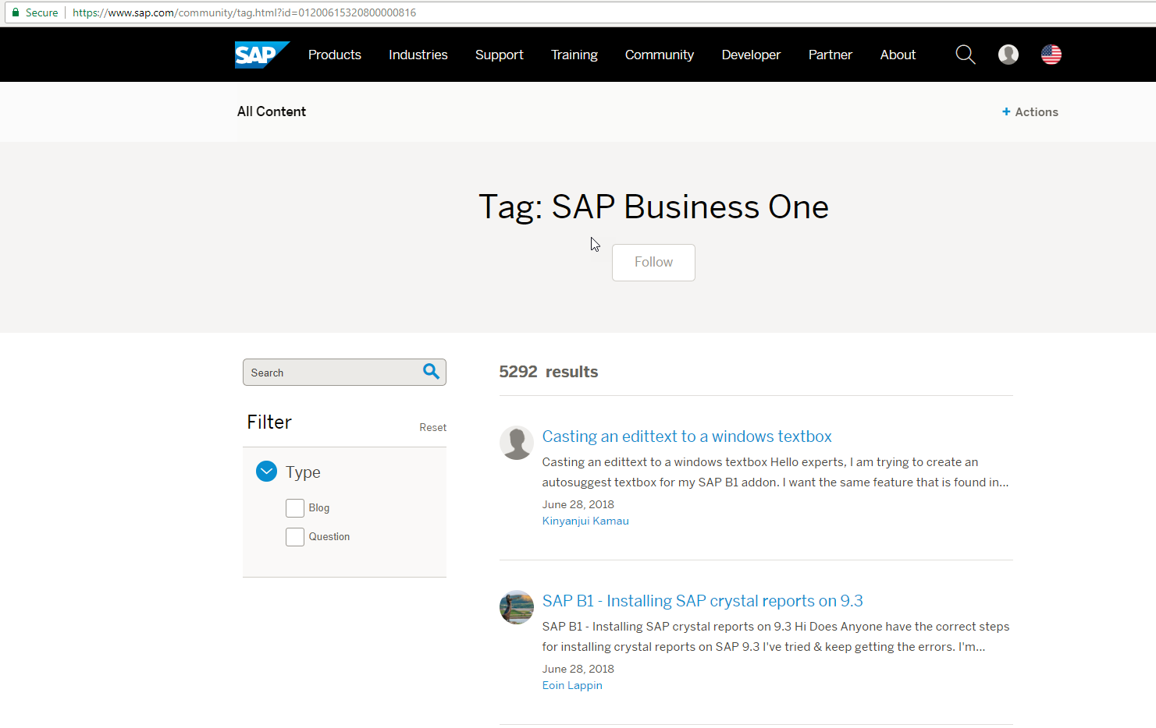
What You Can Find on SAP Community Network: People like you...
The most important source of information for developers (SAP Community Network):
https://www.sap.com/community/topics/business-one.html
Notes:
In the SAP Business One is the SAP Community Network, you can raise your own question to the community or browse among existing questions and answers.
This is a general SAP Business One forum that also includes SDK.
You can access it via sap.com.
Use the search option to find the topics relevant for you.

Slide 15
Agenda
Deployment model and Technology
The SAP Business One SDK
Introduction to DI API
Introduction to Service Layer
Introduction to UI API
Notes:
It’s time to have a look into the introduction to the DI API.

Slide 16
Introducing Data Interface API (DI API) : Topic Objectives
After completing this topic, you will be able to
Explain what DI API is in high-level
Tell how DI API is used
Explain about DI Server in high level
Notes:
The objectives for the current topic are:
Explain what DI API is in high-level
Tell how DI API is used
Explain about DI Server in high level

Slide 17
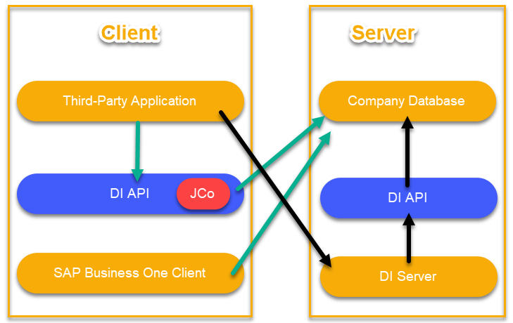
SAP Business One SDK – Data Interface API / DI Server
Provides objects and methods (add, update etc.) to work on data level.
Installing the SAP Business One client application is not required
Provides access to business objects
e.g. master data, transactional data and services
Performs the same validations as the SAP Business One client application
Links existing third-party solutions “as-is”
Use COM capable development tools
e.g. Microsoft Visual Studio
Notes:
The DI API and the DI Server simply allow data related operation on top of the SAP Business One environment.
These are the main features:
It exposes the database tables, which are organized to objects and services structure, which contains the methods and properties.
The data integrity is performed in this level, because it executes the same validations as the SAP Business One client.
It can be used for integration with existing third-party solution by mapping the data between the two environments.
You can create your add-on using the COM capable development tools, like to Microsoft Visual Studio.
The DI API is designed to be used on the client side. The third-party application connects to the DI API, which manages the communication with the company database.
This process is demonstrated in the diagram with the green arrows.
The DI Server is designed to be used on the server side. The web application connects to the DI Server.
The DI Server communicates with the DI API instance that is deployed on the server side and finally the DI API manages the low level communication with the company database.
This process is demonstrated in the diagram with the black arrows.

Slide 18
Data Interface API – Use cases
Data level integration of existing applications
Data import / export scenarios
Handling data in an add-on that uses UI API
Notes:
There are a couple of scenarios where Data Interface API is engaged:
Data level integration of existing applications - when it is needed to read or write data from or to SAP Business One.
Data import / export scenarios which are not covered by SAP tools and where the functionalities of the SAP Business One application are not sufficient. Nevertheless, depending on the architecture of the overall solution, you might consider to use DI Server.
Handling data in an add-on that uses UI API (see next unit) beyond UI API‘s capabilities. by default, writing data to the SAP Business One database requires usage of DI API. Even though other techniques may be faster when it comes to reading data from the database, DI API is often a better choice in terms of usability (no need to request additional credentials etc.). In addition, data coherence is las better for example when the required data is stored in various tables.

Slide 19
SAP Business One SDK – DI Server
The DI Server is designed to run on a server machine and supply a light-weight SOAP-based access layer
Based on the DI API technology but functions as a “Server” (as a service)
Supports all business objects that are exposed by the DI API
Enables developing SOAP-based solutions
Potential solution to heavy duty operations (e.g. batch)
Can support larger number of clients working at the same time.
Notes:
The DI Server is designed to run on a server machine and supplies a light-weight SOAP-based access layer
DI Server uses the same XML format as DI API – just wrapped in a SOAP „envelope“. In addition it gets a SOAP response.
Based on the DI API technology but acts as a “Server” (as a service)
Supports all business objects that are exposed by the DI API
Enables to develop SOAP-based solutions
Potential Solution to heavy duty operations (e.g. batch)
Can support larger number of clients working at the same time.
The DI Server implements a connection pooling mechanism to enhance performance and scalability of the server.
As the DI Server is a SOAP-based interface, it does not limit the client to a COM interface, but allows a wide range of possible client technologies.
There are 2 limitations to working with a DI server:
First, meta data operations are not supported
Global Transactions are not supported
Refer to the DI Server helpfile for more details.

Slide 20
Agenda
Deployment model and Technology
The SAP Business One SDK
Introduction to DI API
Introduction to Service Layer
Introduction to UI API
Notes:
The next chapter is about the SAP Business One Service Layer.

Slide 21
Introducing Service Layer: Topic Objectives
After completing this topic, you will be able to
Describe in high level the Service Layer fundamentals and architecture
List the OData key points
Notes:
The objectives for the current topic are:
Describe in high level the Service Layer fundamentals and architecture
List the OData key points

Slide 22


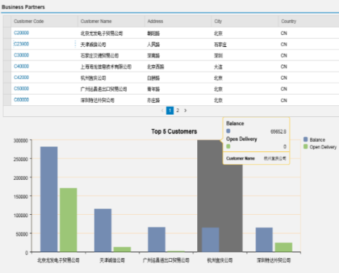



SAP Business One Service Layer - Extensibility for Next Generations Apps
New generation of extension API for consuming SAP Business One data and services.
SAP UI5
Equivalent BO coverage to DI API
built on core protocols such as HTTP and OData
highly scalable (parallel-processing)
high availability (load balancing)
Value Proposition
Cater customer needs of using mobile and web apps
High volume to support new customer segment and industries
One Box for OLTP, OLAP and DEV platform
SAP Business One Service Layer
Physical Tables
SAP HANA SERVER
Notes:
The Service Layer is available only for SAP Business One, version for SAP HANA.
Using this technology you can create new generation of extensions for consuming SAP Business One data and services.
The service layer is using the same business object structure as the DI API with small naming differences.
It is designed for core protocols like HTTP and oData.
This architecture allows parallel processing that means it is highly scalable. You might have multiple Service Layer services for the same environment.
In addition, the built-in Load Balance feature provides high availability.
The Service Layer provides a new architecture for the extensibilities. Now it is easier than before to create mobile and web based solutions that can leverage the OLTP, OLAP and development platform in One Box.
This opens a door to other customer segments and industries.

Slide 23

B1 Service Layer Architecture
SAP UI5
HTTPs/OData
SAP Business One Service Layer
OData Parser
DI Core
…
Session Manager
OBServer
C++ business object
C++ business object
…
C++ business object
ODBC
ODBC
Physical Tables
SAP HANA SERVER
Notes:
SAP Business One Service Layer has a 3-tier architecture: the clients communicate with the Web server using HTTP/OData, and the Web server relies on the database for data persistence.
The SAP HANA server contains the database engine, where the physical tables are located and the Service Layer service. The communication between them is managed over the ODBC technology.
OBServer is the body of business logic dealing with the actual work, for example, tax calculation, posting, and so on. Service Layer achieves high performance and scalability by leveraging multi-processing.
The DI Core is the interface for accessing SAP Business One objects and services, the same one that is used by SAP Business One DI API
The session manager implements session stickiness, working with the Service Layer load balancer, so that requests from the same client will be handled by the same Service Layer node.

Slide 24
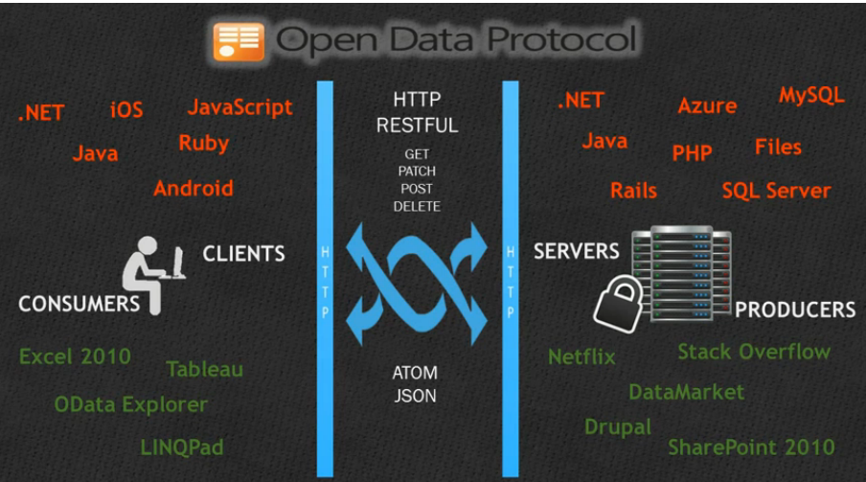
OData - Key points
Just HTTP
Data as resources, HTTP methods to act on it
Uniform operations
GET, POST, PATCH, PUT, DELETE always mean the same
Uniform way of representing structured data
Atom
JSON
Uniform URL conventions
Navigation, filtering, sorting, paging, etc.
Any OData client can access data provided by any OData data source.
Notes:
The OData Parser looks at the requested URL and HTTP methods (GET/POST/PATCH/DELETE), translates them into the business objects to be operated on, and calls each object's respective method for create/retrieve/update/delete (CRUD) operations. In reverse, the OData Parser also receives the returned data from business objects, translates them into HTTP return code and JSON data representatives, and responds to the original client.
The OData has:
HTTP based communication channel
Uniform action or methods, like GET/POST/PATCH/DELETE
Uniform data structure – Atom and JSON
Uniform URL conventions - Navigation, filtering, sorting, paging, joins, etc.

Slide 25
Agenda
Deployment model and Technology
The SAP Business One SDK
Introduction to DI API
Introduction to Service Layer
Introduction to UI API
Notes:
The next chapter is about the SAP Business One Service Layer.

Slide 26
Introducing User Interface API (UI API): Topic Objectives
After completing this topic, you will be able to :
Explain what UI API is in high-level
Tell how UI API is used
Notes:
The objectives for the current topic are:
Explain what UI API is in high-level
Tell how UI API is used

Slide 27
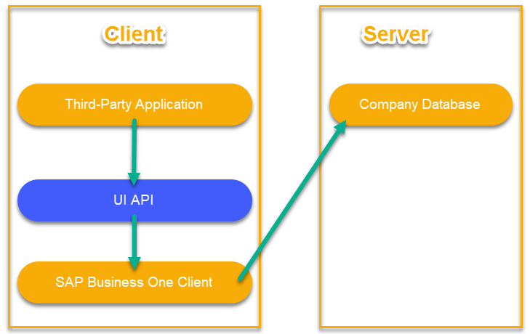
SAP Business One SDK – User Interface API
Provides objects and methods to access screen objects of the User Interface
Provides access to internal system events of the user interface
Provides ability to modify or add menus, windows, or fields
Provides one integrated user interface
Notes:
To use UI API, you must use a development environment and programming language that supports Microsoft COM (component object model) technology.
The UI API has no Java libraries. Often you also use DI API and UI API in the same Add-On / 3rd party application
The UDO feature is supported by UI API.
The UI API:
Provides objects and methods to access screen objects of the User Interface
It access to internal system events of the user interface
It Enables modifying or adding menus, windows, or fields
And provides one integrated user interface

Slide 28
User Interface API – Use Cases
Visual Elements Customization
Manipulate SAP Business One standard functionality
Notes:
User Interface API is usually used to:
Achieve a seamless integration of additional functionality with SAP Business One (usually requested by customers) including:
hooking on SAP Business One standard processes
adding own GUI elements into SAP Business One standard forms
adding own forms and plugging the corresponding data behind
Manipulate SAP Business One standard functionality, when standard options do not meet the customer‘s processes, including:
hiding SAP Business One GUI elements
blocking SAP Business One events

