Slide 1

TB 1300 - SAP Business One SDK Additional SAP Business One Components
July, 2019
Notes:
Welcome to the Additional SAP Business One Components course topic.

Slide 2

Additional SAP Business One Components: Topic Objectives
After completing this topic, you will be able to
Describe the purpose and features of the Integration Framework for SAP Business One
Explain in high level about SAP Business One, version for SAP HANA
Explain in high level about SAP Business on Cloud
Describe the purpose, features and functions of the Data Transfer Workbench
Notes:
After completing this topic, you will be able to
Describe the purpose and features of the Integration Framework for SAP Business One
Explain in high level about SAP Business One, version for SAP HANA
Explain in high level about SAP Business on Cloud
Describe the purpose, features and functions of the Data Transfer Workbench

Slide 3

Agenda
Integration Framework for SAP Business One
SAP Business One on SAP HANA
SAP Business One on Cloud
Data Transfer Workbench
Notes:
In this unit we will cover the following topics:
Integration Framework for SAP Business One
SAP Business One on SAP HANA
SAP Business One on Cloud
Data Transfer Workbench
Let us start with the first item on the list - Integration Framework for SAP Business One

Slide 4



Integration Framework for SAP Business One Platform Capabilities
The integration framework for SAP Business One connects SAP Business One with other applications, services and devices to:
Transform SAP Business One CORE processes and functionality
Support SAP Business One with other applications
Connect subsidiaries, branches and business networks
Notes:
The integration framework for SAP Business One integrates the digital core to other applications, devices and services.
By using this solution it is possible to completely transform the SAP Business One core processes and functionality.
It is possible to connect the digital core to other third-party applications and create automatic communication between them.
The Integration Framework also provides a good solution for connecting between subsidiaries, branches and business network.

Slide 5









Integration Framework for SAP Business One Platform Capabilities
Business Application Integration Scenarios
Business Extension Integration Scenarios
Country Specific Integration Scenarios
Intercompany Integration Scenarios
Subsidiary Integration Scenarios
Payroll HR for Germany
Electronic Invoicing for Mexico
Nota Fiscal Electrônica for Brazil
Document Approval for Portugal
Electronic evidence of Sales for Czech
Master Data Replication
Service Contract and Customer Equipment Card Replication
UDFs and UDTs Replication
Intercompany Trade
Expenses Allocation among Branch Subsidiaries
A/P Service Invoice Allocations
Scenarios to integrate headquarters running
SAP ECC
SAP BW
S/4HANA
SAP Business One
Mobile
Request for Quotation
Dashboards
Notes:
Now let’s have a look into the capabilities of the integration framework for SAP Business One.
SAP delivers out of the box integration scenarios in order to synchronize data between SAP Business One and other solutions like: SAP Customer Checkout, SAP Ariba, SAP Hybris and SAP Concur.
Another type of integration scenarios coming from SAP are related to business extensions, that can be used for the Mobile solution, Dashboards and Request for Quotation.
The various localization requires different country specific integration scenario, for example managing automated integration to country specific authorities. Many countries require this automatic communication like, Germany, Hungary, Mexico, Brazil, Portugal and Czechia. This country specific integration scenario is delivered by the Integration Framework of SAP Business One.
The SAP Business One Intercompany solution relies fully on this solution to manage various integration scenarios between multiple branches, like Master Data replication between multiple SAP Business One entities.
With scenario packages delivered for subsidiary integration it is possible to setup the connection between the headquarter running S/4 HANA/ SAP ECC/ SAP BW to the SAP Business One subsidiary.

Slide 6

Key Aspects of the Integration Framework
Connects SAP and non-SAP systems
Supports SAP HANA platform and Microsoft SQL database
Expanding the scope of SAP Business One: - Various use cases - Best practice scenarios
All integration aspects covered in one product: - Supports Business Process Management Notation (BPMN) - Programming language addresses integration requirements
Two deployment options available: On premise and Cloud
For more information, please visit Integration Framework for SAP Business One – Central Blog
Notes:
The key aspects of the Integration Framework are:
Integrate SAP products to SAP and non-SAP system.
The product deployment can work on SAP HANA and Microsoft SQL database engine as well. It is possible to deploy the solution on single board computer as well, then the MySQL database engine is used.
This framework can be considered as additional platform where the SAP Business One digital core can be extended.
The solution contains the Business Process Management feature as well, where it’s possible to create automated flows extended by manual actions.
It is possible to deploy it on premise and in the cloud.
For more information, please visit Integration Framework for SAP Business One – Central Blog, where you can learn more about the integration framework for SAP Business One.

Slide 7
Agenda
Integration Framework for SAP Business One
SAP Business One on SAP HANA
SAP Business One on Cloud
Data Transfer Workbench
Notes:
Now we will have a closer look to the next topics, which is the SAP Business One on SAP HANA.

Slide 8
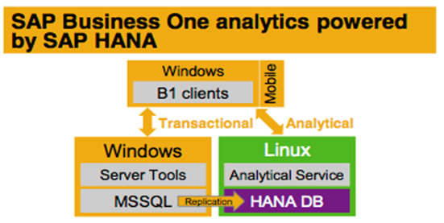
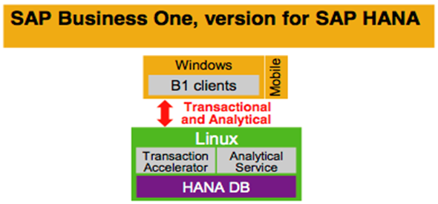
SAP Business One Products on SAP HANA
Key benefits
Speed and flexibility with analytics based on an in-memory database side-by-side with a transactional server
Key benefits
Performance and innovation with a transactional system running on an in-memory database on one appliance
Notes:
Currently SAP offers two products for SAP HANA:
The SAP Business analytics powered by SAP HANA - extends the SAP Business One environment running on top of the Microsoft SQL server with the analytical feature. This a side-by-side solution which automatically synchronizes the analytical data into the in memory SAP HANA database.
The SAP Business One, version for SAP HANA merge the analytical features and the transaction data into one single database. In the previous case the performance was increased only for analytics, but for SAP Business One, version for SAP HANA the performance is significant also for transactional operations.
We recommend selecting the SAP Business One, version for SAP HANA option, mainly since in memory computing opens new horizons for the digital core.
In addition, In terms of simplification, it is better to have the OLTP and OLAP data in one in-memory database.

Slide 9

SAP Business One, Version for SAP HANA
Leverages the power of SAP HANA in-memory computing to transform your business to run smarter, faster, and simpler in a digital world.
Agile: Get real-time business information at the moment you need it so that you can clearly define and focus on the right priorities.
Insight: Leverage a single platform for analytics and transactions to get unprecedented insight-to-action capabilities. Take advantage of real-time apps for cash flow and other processes to solve “un-solvable” problems.
Efficiency: Empower employees with information search capabilities and interactive analysis tools to help them become more productive and independent of IT staff.
Value: Maintain a simplified IT landscape with a solution priced for small businesses and designed for scalability.
Notes:
Let us see, what additional benefits and aspects are coming with the SAP Business One, version for SAP HANA.
It leverages the power of SAP HANA in-memory computing to transform your business to run smarter, faster, and simpler in a digital world.
With SAP Business One, version for SAP HANA you benefit:
Agile - You get real-time business information at the moment you need it so that you can clearly define and focus on the right priorities.
Insight: Leverage a single platform for analytics and transactions to get unprecedented insight-to-action capabilities. Take advantage of real-time apps for cash flow and other processes to solMaintain a simplified ve “un-solvable” problems.
Efficiency: Empower employees with information search capabilities and interactive analysis tools to help them become more productive and independent of IT staff.
Value: IT landscape with a solution priced for small businesses and designed for scalability.

Slide 10
Capabilities and Solutions in SAP Business One, version for SAP HANA
User Experience
Fiori-Style Cockpit
Enterprise Search
Analytical Portal
SAP Business One Sales Mobile Native App
SAP Business One Service Mobile Native App
Embedded Real-time Apps
Cash Flow Forecast
Advanced Available to Promise (ATP)
Intelligent Forecast
Delivery Schedule Management
Analytics
Pervasive Analytics
Customer 360°
Interactive Analysis
Excel Reports
Sales Recommendation
Platform Extensibility
App Framework for Custom Development
Service Layer
Semantic Layer
Notes:
SAP Business One, version for SAP HANA provides many features and functionalities:
In terms of User Experience, the Fiori-Style Cockpit, the Enterprise Search and the Analytical Portal are offered. SAP Business One offers some additional mobile apps, which can work only on this architecture.
Many analytical content are provided as well like Pervasive Analytics, Customer 360 degrees and Interactive Analysis.
With the in-memory technology, it is possible to add features, like Embedded Real-time Apps, Cash Flow Forecast and Advanced Available to Promise (ATP).
The Extensibility Platform brings new technologies into the game. SAP Business One, version for SAP HANA comes with App Framework, known also as XS Engine for developing new breed of apps.

Slide 11
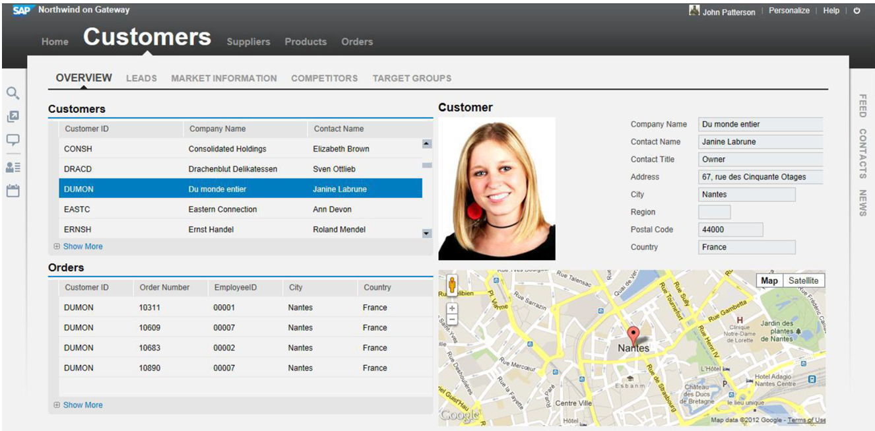
App Framework for SAP Business One, version for SAP HANA
Empower SAP Business One ecosystem to build easy to extend, lightweight, web-based, analytical applications providing business insights
Enrich traditional add-ons by web-based analytical applications on the new light-weight framework & embed them into add-ons;
Leverage the built-in strengths of SAP HANA and XS with integrated SAP Business One services to develop apps in a low cost of development on a lean stack with big data processing; explorer new businesses
Optimize the efficiency of business processes
Run directly on SAP HANA appliance with minimized TCO and excellent performance
Notes:
The App Framework for SAP Business One, version for SAP HANA has many advantages.
These advantages allow you to:
Empower SAP Business One ecosystem to build easy to extend, lightweight, web-based, analytical applications providing business insights
Enrich traditional add-ons by web-based analytical applications on the new light-weight framework & embed them into add-ons;
Leverage the built-in strengths of SAP HANA and XS with integrated SAP Business One services to develop apps in a low cost of development on a lean stack with big data processing; explorer new businesses
Optimize the efficiency of business processes
Run directly on SAP HANA appliance with minimized TCO and excellent performance

Slide 12
Agenda
Integration Framework for SAP Business One
SAP Business One on SAP HANA
SAP Business One on Cloud
Data Transfer Workbench
Notes:
It is time to have a look at the SAP Business One on Cloud topic.

Slide 13
SAP Business One Cloud Options
Two aspects of The SAP Business One Cloud :
Deployment options*
SAP hosted
Partner hosted
SAP Business One Cloud Provider
* For more detailed information see the Sales Play: SAP Business One Cloud presentation
2. Cloud Control Center for SAP Business One
SAP Business One Cloud solution = Cloud Control Center + SAP Business One
The Cloud Control Center is a web application that enables cloud operators to manage the SAP Business One Cloud Landscape.
Notes:
There are two main aspects in SAP Business One.
The first is the Deployment options.
Currently there are three models of deployment for SAP Business One:
SAP hosted - where the infrastructure and the live cycle management is delivered by SAP and the level 1 and 2 support and implementation is done by selected SAP Business One Partners within the region.
SAP Business One partner hosted
And a hybrid model, where the SAP Business One partner is managing the SAP Business One related activities and the Cloud services are provided by a third-party company, with deep expertise in the infrastructure related tasks.
The second aspect is a web application related to Cloud. It is called Cloud Control Center for SAP Business One. It is a separated product, which helps to administrate the SAP Business One in the Cloud environment.
The Cloud Control Center has a web interface, which makes the SAP Business One Cloud Landscape management easy and user friendly. We will have a look at the Cloud Control Center later on.

Slide 14
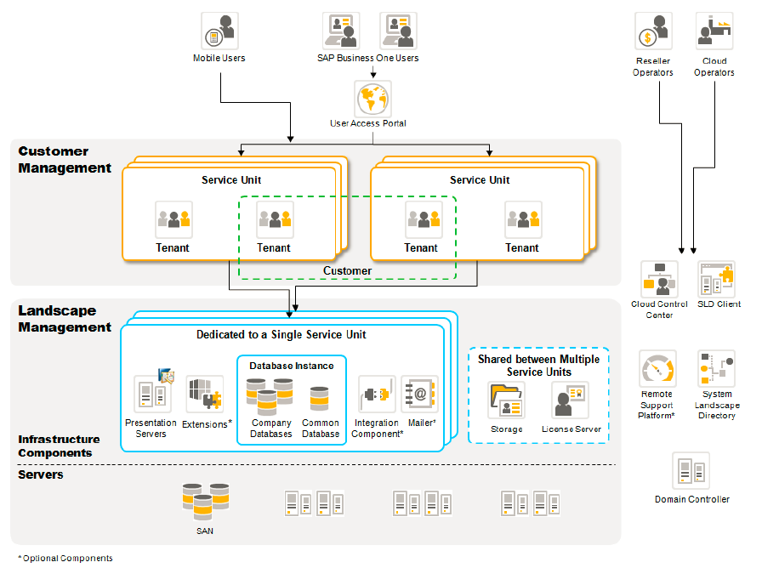
SAP Business One Cloud Landscape
Notes:
The image illustrates the SAP Business One Cloud Landscape.
The customer is using the User Access Portal in order to start using a SAP Business One client and other tools and components.
The customer is assigned to a tenant, which represents a company database in the on premise world.
The tenants are organized into Service Units. The Service Units connects together the customers, tenants and SAP Business One software components with all the services.
Only the storage and the license service can be common for the Service Units.
One Service Unit can run only one specific release and patch of SAP Business One.
On the lower level you can find the hardware, network and virtualization layer.

Slide 15
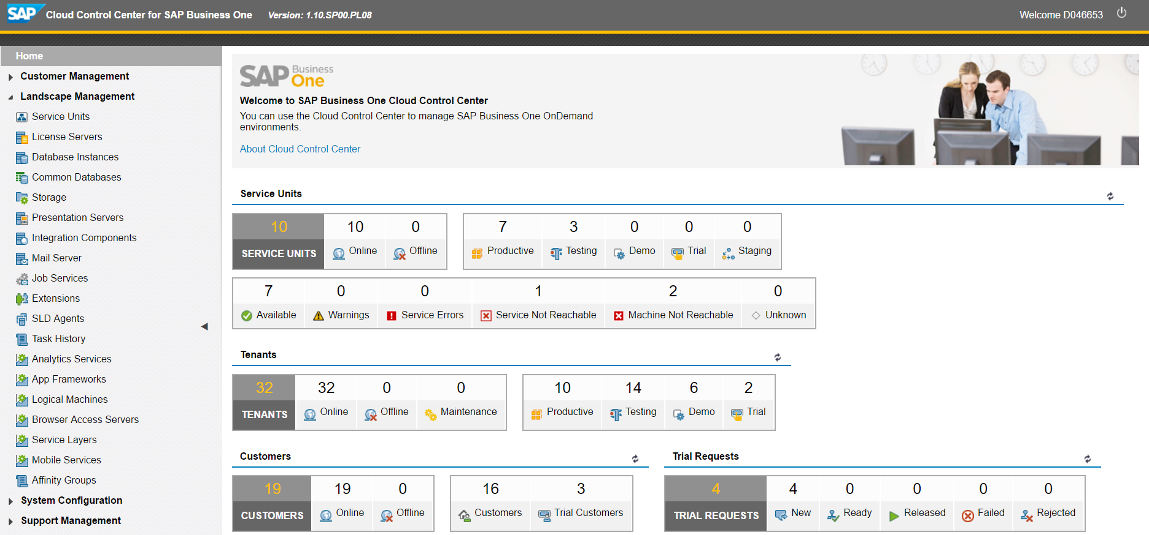
Cloud Control Center for SAP Business One Overview Screen
Notes:
The Cloud Control Center for SAP Business One comes with a web application user interface.
This is the administration center for the whole SAP Business One Cloud landscape that enables customer and tenant management, and managing the whole Service Unit.
Only the Cloud and Reseller Operators have access to this interface.

Slide 16
Agenda
Integration Framework for SAP Business One
SAP Business One on SAP HANA
SAP Business One on Cloud
Data Transfer Workbench
Notes:
The next chapter is about the Data Transfer Workbench.

Slide 17
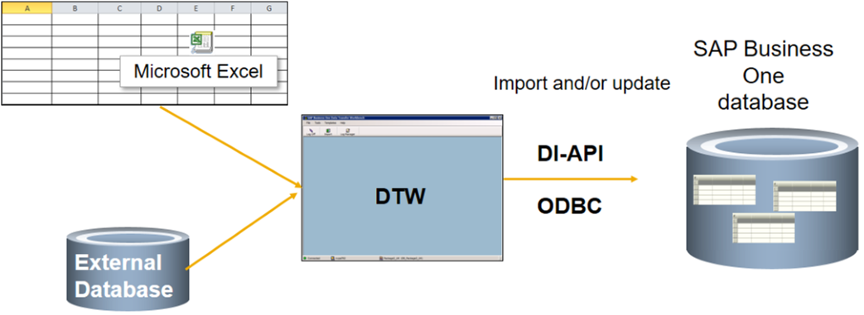
Data Transfer Workbench (DTW)
Purpose
Data Transfer Workbench (DTW) is a tool provided with SAP Business One for importing data into SAP Business One objects using predefined Microsoft Excel templates.
Features
Predefined data file templates, which you can use to fill in your own data
Easy-to-use wizard that imports data into SAP Business One
Recording of all import activities so that you can track the data migration process
Notes:
Data Transfer Workbench (DTW) is a tool provided with SAP Business One for importing data into SAP Business One objects using predefined Microsoft Excel templates. The DTW is designed primarily for bulk import or update of master data, setup data, chart of accounts, journal entries and open sales, purchasing, production and service documents.
To import data, you use predefined Excel template files where you enter your data.
This file is then imported using a simple to use wizard. This wizard uses a log to display the imported data records or errors that emerged during the import process.
The DTW uses the DI API to access the SAP Business One database.

Slide 18
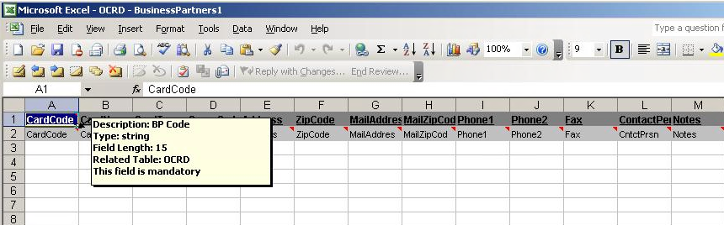
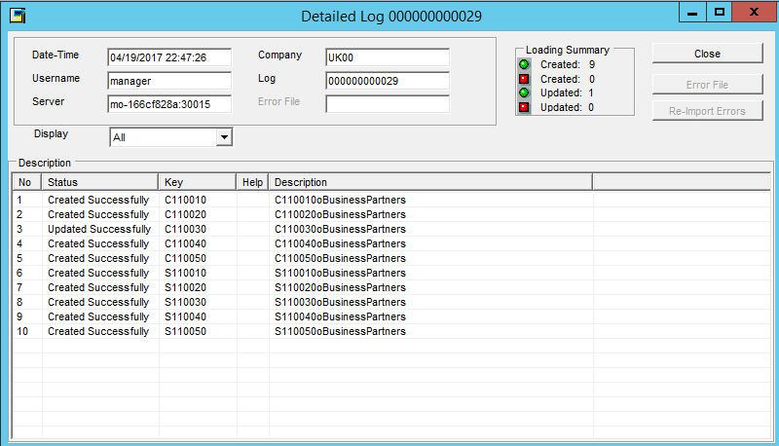
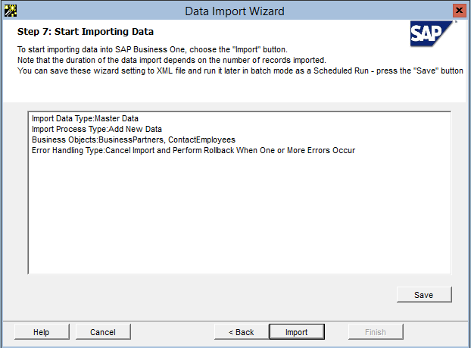
Data Transfer Workbench – Data Import Process
Preparing the
Source Data
Importing the Source Data
Checking Results and Tracking Errors
Notes:
After DTW is installed, the DTW executable folder contains the predefined Microsoft Excel templates
These templates include a column for every field in the table that is exposed to the DI API.
The user chooses the relevant template according to the type of data to import and add records to the template.
Then the user imports the data files by using the DTW wizard. In this wizard the user chooses the source file to upload, then locates the relevant business object and validates the mapping correctness of the imported fields data.
After that, the user can run an import simulation before the actual import. The simulation will point out any errors but will not import any data.
The final step is the import of data. A log is produced for each record imported successfully into the database. For failed records, the log will display information to help you debug the error.

Slide 19

Useful Links
SAP Business One
https://partneredge.sap.com/en/products/business-one/about/sbo.html
SAP Business One, version for SAP HANA
https://partneredge.sap.com/en/products/business-one/about/sbo-hana.html
SAP Business One analytics powered by SAP HANA
https://partneredge.sap.com/en/products/business-one/about/sbo-analytics.html
SAP Business One Cloud
https://partneredge.sap.com/en/products/business-one/about/sbo-cloud.html
SAP Business One Mobile Applications
https://partneredge.sap.com/en/products/business-one/about/sbo-mobile.html
Integration Products for SAP Business One
https://partneredge.sap.com/en/products/business-one/about/sbo-hana.html
Notes:
Please visit the SAP PartnerEdge sites, to get more information about the product listed on the slide.
Note that the PartnerEdge is restricted to the SAP Business One Partners only.
You will need to have an S user account in order to see the content.

