Slide 1

TB1300 - SAP Business One SDK Data Interface API – Business Objects
July, 2019
Notes:
Welcome to the Data Interface API Business Objects course topic.

Slide 2

Business Objects: Topic Objectives
After completing this topic, you will be able to:
Describe what business objects are
List the most important methods of business objects
Explain how to read or write a business object from or to an XML file
Design a transaction involving more than one business object
Explain how to get notified on changes in business objects
Notes:
After completing this topic, you will be able to
Describe what business objects are
List the most important methods of business objects
Explain how to read or write a business object from or to an XML file
Design a transaction involving more than one business object
Explain how to get notified of changes to business objects

Slide 3
Business Objects: Overview
Business objects:
Represent the functionality of SAP Business One application.
Follow appropriate business logic and will not compromise data integrity.
Any data access using business objects is platform and release-independent.
Notes:
Business objects represent the functionality of an SAP Business One application and make it possible to add, update, find, and remove data from the business tables of the company database.
This is the recommended method for accessing data within an SAP Business One company database:
The business objects perform authorization checks
The business objects follow appropriate business logic and will not compromise data integrity
Any data access using business objects is platform and release-independent. An external client program that accesses data using the business objects assures adaptability with future versions of SAP Business One.

Slide 4
Business Objects: Architecture
Object:
<Business Object>
Methods:
+Add
+GetByKey
+Remove
+SaveXML
+Update
Add a new Object
Get the object by key
Remove the object (if possible)
Save the object as XML file
Update the object
Sets or returns the customer or vendor name
Allows navigation/browsing over records
A collection of fields objects, which are user defined fields
Represents the line entries of a document
Properties:
+ CardCode
Child Objects:
+ Browser
+ UserFields
+ Document_Lines
Notes:
It’s time to have a look at the business object architecture.
The object has the methods, which make it possible to perform actions with the object, such as add, get, update, and delete.
The additional part of the object is the properties. Properties are a special kind of object element, an intermediate functionality between a file and a method.
The last part of the business object is the child objects. These objects store information in multiple tables.
Examples of business objects include the following:
Item master data
Business partner master data
Product tree objects
Documents (for example, Sales and Purchasing documents)
Payments object
The SaveXML method lets you extract an object and save it as an XML file. XML data can also be imported using the company object.

Slide 5
Business Objects: Architecture – Child Objects
Object:
<Child Object>
Methods:
+Add
+SetCurrentLine
+Delete
Add a new record
Set the current line
Delete a record (available for most part of objects)
Properties:
…
Notes:
Business objects often refer to child objects.
Examples of Line objects include the following:
Addresses of business partners (BPAddresses)
ItemWarehouseInfo contained in items
Document lines (Document_Lines object)
Payment accounts (Payments_Accounts object)
Almost all line objects have the following methods:
Add (add a new line object, for example, an alternative address for a business partner)
SetCurrentLine (set the current line within the collection of line objects). The count starts from zero

Slide 6

Business Objects: Business Partners
Represents the business partners record in SAP Business One
Use this object to add, find or update business partners
You can use it also to handle additional user-defined fields
Notes:
BusinessPartners is a business object that represents the business partner master data in the Business Partners module.
This object enables you to:
Perform authorization checks
Follow appropriate business logic that will not compromise data integrity
Add a business partner record
Retrieve a business partner record through its key
Update a business partner record
Remove a business partner record
Save the object in XML format
You can use it also to handle additional user-defined fields related to the BusinessPartners object.
In the slide, you can see that the BusinessPartners object is a collection of additional subobjects (or child objects) related to the business partner master data, such as addresses, employees, payment methods, and so on.

Slide 7
Business Objects: Example – Add Business Partner
'First connect to database (see Log on sample)
…
'Some variables:
Dim oBP As SAPbobsCOM.BusinessPartners Dim lRetCode, lErrCode As Integer
Dim sErrMsg As String
‘Prepare empty oBP Object:
oBP = oCompany.GetBusinessObject(SAPbobsCOM.BoObjectTypes.oBusinessPartners)
oBP.CardCode = "C08154711" oBP.CardName = "James Tiberius Kirk" oBP.CardType = SAPbobsCOM.BoCardTypes.cCustomer '…
‘Add the new BP to the database
lRetCode = oBP.Add()
If lRetCode <> 0 Then
oCompany.GetLastError(lErrCode, sErrMsg)
MessageBox.Show("Error: " sErrMsg + “; Code: “ + lErrCode)
End If
Notes:
Let’s have a look at a source code example, written in Visual Basic language, that creates a new business partner master record.
As a first step, you need to create an instance of the business partner object. For this purpose, you use the GetBusinessObject method of the company object.
You can then enter the properties of the business partner. You need to provide at least the mandatory properties. In this case, you have to provide the CardCode property. The built-in auto-complete procedure completes the default values of the other properties.
In the last step, you call the add method to create a new business partner record in your company database.
Please note that GetBusinessObject returns a generic “object” that needs to be casted to the real object class in other (non-VB!) programming languages.

Slide 8
Business Objects: Example – Child Object
'First connect to database (see Log on sample)
'…
‘Variables:
Dim oBP As SAPbobsCOM.BusinessPartners = _
oCompany.GetBusinessObject(SAPbobsCOM.BoObjectTypes.oBusinessPartners)
Dim lRetCode As Integer
If oBP.GetByKey(“C08154711”) = True then ‘here we use an existing record…
‘First line is always prepared (in any business object that has lines…)
oBP.ContactEmployees.Name = "John Cash“
‘Prepare / declare 2nd line… (automatically positions on new line)
oBP.ContactEmployees.Add() ‘No in DB here – therefore will work always…
oBP.ContactEmployees.Name = “John Walker“
‘Please note: In case you need to position on particular line…
‘oBP.ContactEmployees.SetCurrentLine(<0-based line no.>)
‘Write changes to DB now…!
lRetCode = oBP.Update()
If lRetCode <> 0 Then
…
End If
Else
MessageBox.Show(„Business Partner C08154711 not found!“)
End if
Notes:
Here, we have an example of a child object of the BusinessPartners object.
You can add several contact employees to a business partner record.
To do so, you first have to add a contact employee row, using the corresponding add method.
In the second step, you set the current line in the contact employees array.
Then you can enter the contact employee properties.

Slide 9
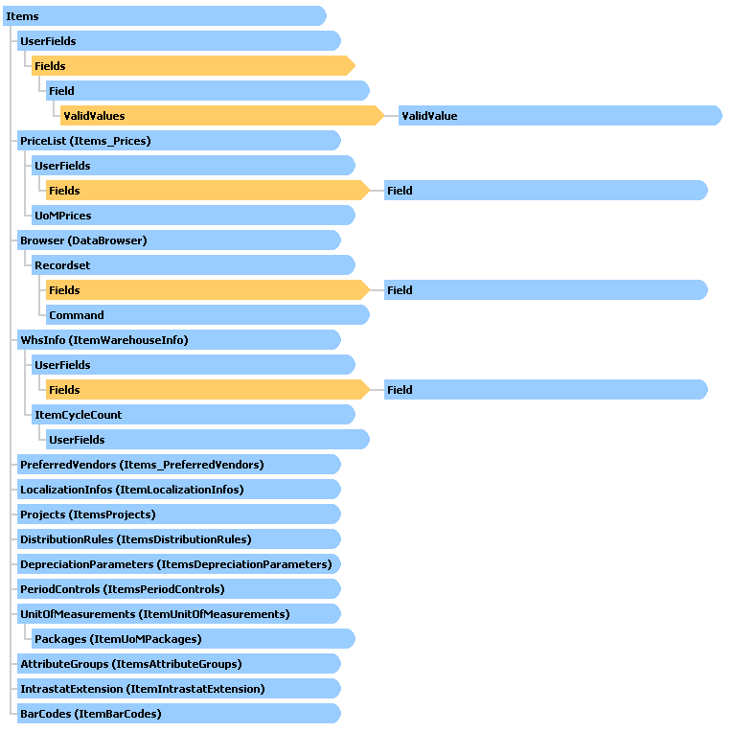
Business Objects: Items
Represents Master Inventory Items record
Enables you to add, update, or find item records
Notes:
The next highly often-used business object is the Items object, which represents the master inventory items record in SAP Business One.
The methods you use to manipulate the Items data are similar to those for the BusinessPartners business object described above in SAP Business One.
In this business object, a wide variety of child objects is assigned to store the item master data information in a single object hierarchy.

Slide 10
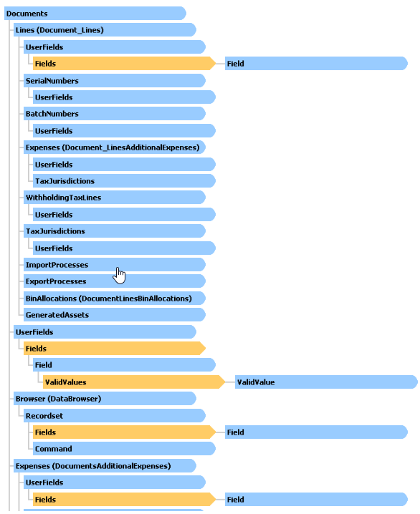
Business Objects: Documents
The Documents object represents the header of SAP Business One Sales and Purchasing documents.
It contains the master header data for the document such as CardCode, Address, Document Date, Document Total etc.
Notes:
In the previous slides, we saw the master data type of business objects.
Documents is a business object that represents the header data of documents in the Marketing Documents and Receipts modules and the Inventory and Production modules of the SAP Business One application.
It contains the header master data of the document, such as card code, address, document date, document total, and so on.
The Documents object stores the information in more than 25 database tables. The child object content is arranged accordingly.

Slide 11
Documents: Example – Create an Order
Dim oOrderDoc as SAPbobsCOM.Documents
oOrderDoc = oCompany.GetBusinessObject _
(SAPbobsCOM.BoObjectTypes.oOrders)
' set the business partner code
oOrderDoc.CardCode = "C20000"
' set the documents due date - mandatory
oOrderDoc.DocDueDate = Date
' First line (no need to add line)
oOrderDoc.Lines.ItemCode = "A00001"
oOrderDoc.Lines.Quantity = 1
' Second line
' first prepare empty line for the second line
oOrderDoc.Lines.Add()
oOrderDoc.Lines.ItemCode = "A00002"
oOrderDoc.Lines.Quantity = 1
' Adding the new order document
Dim RetVal As Long
' Add Order to the database
RetVal = oOrderDoc.Add()
' Check if Add method succeeded
If RetVal <> 0 Then
oCompany.GetLastError( lErrCode, ErrMsg)
MessageBox.Show(lErrCode & " " & sErrMsg)
End If
Notes:
In this example, we can see what the code structure looks like in Visual Basic language.
We start with the creation of the document object instance, which specifies the document type as a sales order.
Then come the document object properties, such as the CardCode and the document date.
We then need to add the document lines, using the child object. After the line definition, we call the add method to separate the lines and get ready for the next line details.
The add method for the document lines object does not need to be called for the last line, because the DI API business logic will perform this step automatically.
In the current example, we can see how a new numeric variable is created for storing the response code for the document object add method execution.
After executing the add method, we can perform the error handling based on the response code value.

Slide 12
Documents: Example – Create an Invoice (based on the order)
' Create Invoice
Sub CreateInvoiceDocument()
' Get the DocNum for the new added order added on slide before…
Dim OrdCodeStr As String
oCompany.GetNewObjectCode (OrdCodeStr)
' Get the required business object
Dim oInvoiceDoc As SAPbobsCOM.Documents
oInvoiceDoc = oCompany.GetBusinessObject
(SAPbobsCOM.BoObjectTypes.oInvoices)
' set the business partner code
oInvoiceDoc.CardCode = "C20000"
' set the document’s due date - mandatory
oInvoiceDoc.DocDueDate = Date
' First line (always there… )
oInvoiceDoc.Lines.BaseType = SAPbobsCOM.BoObjectTypes.oOrders
oInvoiceDoc.Lines.BaseEntry = CInt(OrdCodeStr)
oInvoiceDoc.Lines.BaseLine = 0
oInvoiceDoc.Lines.TaxCode = "LA"
' Second line; first: prepare line
oInvoiceDoc.Lines.Add()
oInvoiceDoc.Lines.BaseType = _
SAPbobsCOM.BoObjectTypes.oOrders
oInvoiceDoc.Lines.BaseEntry = CInt(OrdCodeStr)
oInvoiceDoc.Lines.BaseLine = 1
oInvoiceDoc.Lines.TaxCode = "LA"
' Add Invoice to the database
RetVal = oInvoiceDoc.Add
' Check if Add method succeeded
If RetVal <> 0 Then
oCompany.GetLastError(lErrCode, sErrMsg)
MessageBox.Show(lErrCode & " " & sErrMsg)
End If
End Sub
Notes:
In SAP Business One, documents are frequently based on one another.
In this example, we would see how the sales invoice can be created based on the preceding sales order.
The code for document instance creation and property definition is very similar.
In the red square, you can see the differences in the document lines child object level. The BaseType property specifies the document type, which should be sales order in our case.
The source document ID must be recorded in the BaseEntry property.
It is then possible to set the line number in the source document.
The remainder of the code was already explained in the previous example.

Slide 13
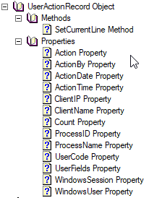
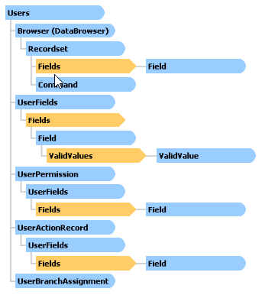
Other Business Objects: Users and Access Log
User object
Represents User record
Enables you to add, update, or find user records
Manage the authorization and branch assignment
UserActionRecord child object
User Access details
Notes:
Users is a business object that represents the users table of the SAP Business One application.
The users table includes the user list, login details, and authorizations.
This object enables you to:
Update a business partner record
Add users to the user list
Retrieve a user’s details by its key
Update a user’s details
Remove users from the user list
Save the object in XML format.
SAP Business One has the access details regarding the user activities. This feature is also exposed for the DI API in the UserActionRecord object.
The UserActionRecord object shows access details of users who have logged on and off with the SAP Business One client or DI API.
The UserActionRecord is a child object of the user object.
In the log, system administrators and system auditors can check user properties and access states at any time, so that they can verify that users in the system are managed correctly and that the system offers an adequate level of security.

Slide 14

Working with XML: Motivation
A Technique of saving and loading data
XML Advantages:
Enable exchanging large-scale data between SAP Business One company database and external systems
Standard
Cheap
Convenient
Simple
Notes:
The DI API provides the features to work with the Extensible Markup Language (XML) as well.
Using XML to exchange information has many advantages:
Information encoded in XML is easy to read and understand by both humans and machines
Almost all systems can work with XML data
Defined by the World Wide Web Consortium (W3C), the main international standards organization
Enables large-scale data exchange between the SAP Business One company database and external systems

Slide 15
Working with XML: Relevant Methods and Properties
Company object
oCompany.GetBusinessObjectFromXML (FilePath_OR_XMLString, Index)
oCompany.GetXMLelementCount (FilePath_OR_XMLString)
oCompany.GetXMLobjectType (FilePath_OR_XMLString, Index)
oCompany.GetBusinessObjectXmlSchema (ObjectType)
Business objects
oBusinessObject.SaveXML (FilePath_OR_XMLString)
oBusinessObject.Browser.ReadXML (FilePath_OR_XMLString)
Use ReadXML to update an existing object
XML export type – specifies the types for exporting data, e.g. to export read-only data
oCompany.XmlExportType = SAPbobsCOM.BoXMLExportTypes.xet_ExportImportMode
Working with XML as an XML string (not as an XML file)
oCompany.XMLAsString = True
Notes:
The method UpdateFromXML is provided for manipulating child objects. It is designed to simplify their update, removal, and creation processes.
If you want to change the child object content in a single step, then it is sufficient to save the current child object content as XML, make the required changes, and call the UpdateFromXML method.
You cannot use this method to insert a new row between existing rows, however, because this method updates the child object based on the order of the rows in the XML file instead of the LineNum property.
If you want to add a new row, simply add it as the last row.
This method is exposed for items, business partners, documents, and for product tree objects.

Slide 16

Working with XML: Delete Line/Sub-Object by XML
Method UpdateFromXML
Receives and processes the XML content.
You can remove sub-object lines from the object via the XML file.
Available for
Items object
BusinessPartners object
Documents object
ProductTrees object
Notes:
The DI API provides the features to work with the Extensible Markup Language (XML) as well.
Using XML to exchange information has many advantages:
Information encoded in XML is easy to read and understand by both humans and machines
Almost all systems can work with XML data
Defined by the World Wide Web Consortium (W3C), the main international standards organization
Enables large-scale data exchange between the SAP Business One company database and external systems

Slide 17
Working with XML: Example – SaveXML
'First connect to database…
Dim oBP As SAPbobsCOM.BusinessPartners = _
oCompany.GetBusinessObject(SAPbobsCOM.BoObjectTypes.oBusinessPartners)
oCompany.XmlExportType = SAPbobsCOM.BoXmlExportTypes.xet_ExportImportMode
…
If (oBP.GetByKey("C20000“) = False) Then MessageBox.Show("Failed to find the business partner") Else oBP.SaveXml ("c:\temp\BP_" + oBP.CardCode + ".xml") End If
Notes:
You can save business object data in XML format for use outside of SAP Business One.
To create an XML file, call the SaveXML method of the corresponding business object.
In the example, you can see the line where the XmlExportType property is changed to ExportImportMode.
This change ensures that only properties that have the property type read-write are exported from the existing business partner master data record.
This simplifies the import process for importing the XML file into another SAP Business One company database.

Slide 18
Working with XML: Example – Get Business Partner from XML
Dim sFileName As String = "c:\temp\BPs.xml“
Dim lEcount, ii As Long 'Get the number of Business object in the file ... lEcount = oCompany.GetXMLelementCount(sFileName)
'Loop through the objects; when finding the first BusinessPartner
'object: load it, add it to the DB.
For ii = 0 To lEcount–1 If oCompany.GetXMLobjectType(sFileName, ii) = _
SAPbobsCOM.BoObjectTypes.oBusinessPartners Then
‘”Read” the Business object data into the object…
‘Please note:
‘If the format is not OK you might run into an exception! oBP = oCompany.GetBusinessObjectFromXML(sFileName, ii)
iRetVal = oBP.Add() ‘…handle error…
End If Next ii
Notes:
In the next example, we will import the business partner master data record from the XML file.
We can use several methods of the company object to access the type and the number of items in the XML file:
GetXMLelementCount returns the number of items in the XML file.
GetXMLobjectType retrieves the item type of a specific item in the XML file.
GetBusinessObjectFromXML returns the attributes of a specific business object.

Slide 19

Transaction Handling: Overview
The Data Interface API supports two different types of transactions:
Single Transaction (default)
Each data operation performed on a business object starts a transaction
Depending on the result (success or failure), the system automatically issues a commit or a rollback
Global Transaction
Allows perform several data operations and then a full commit or rollback based on specific criteria
If any of the data operations fails, the global transaction will be rolled-back entirely
Start and end of a global transaction can be managed by using the Company object:
oCompany.StartTransaction() Boolean oCompany.InTransaction oCompany.EndTransaction([wf_RollBack / wf_Commit])
Notes:
We have two alternatives for using transactions in the SAP Business One DI API.
The default is the single transaction, which involves a single business object operation.
The global transaction is a collection of several single transactions.
When a data operation is performed on a business object, a transaction is started. The SAP Business One database uses transactions to keep the data consistent.
If the operation is successful, then a commit operation is issued and the data is saved.
If the operation fails, then a rollback operation is started and the data is discarded. If the data operation is performed on a single business object, all of this is done automatically.
If you want to perform database actions that must be divided into several steps, you can use the StartTransaction method to start a series of operations.
When a global transaction is started with StartTransaction, the business objects use this global transaction. If one of the business objects fails during any process, the transaction ends and an automatic rollback operation is started. If the transaction is successful, you must use the EndTransaction method to release the locked records and allow other users access to them.
Use the “InTransaction” property if you are not sure about the status of the transaction.

Slide 20
Transaction Handling: Flow Chart of Global Transactions
Start Transaction
Run a list of operations on the DB
Did ALL operations succeed?
NO!
At least one operation failed
Yes? …then you can still choose:
Automatic Rollback already happened, Transaction has been terminated
Rollback?
Commit?
Stop processing and handle error!
Please note: “InTransaction” property of Company object holds info whether or global transaction is still active.
End Transaction
Notes:
Let’s examine the flow chart of a global transaction.
Everything begins by calling the StartTransaction method. You can then perform the required task, such as creating the customer or invoice.
If all operations succeed, you can decide whether the global transaction should be committed or rolled back. You then need to close the transaction by calling the EndTransaction method.
If one operation fails, for example, the customer cannot be created, then the DI API executes the automatic rollback and the transaction is terminated.

Slide 21
How to Get Notified on Changes in Business Objects
Challenge
There are no DI API data-driven notifications (only FormData events in the UI API – see UI API presentation)
Adding SQL triggers at the database level is not permitted!
Solution
Enable the Transaction Notification in SAP Business One (Administration > System Initialization > General Setting > Service). This can be achieved by setting the EnableTransactionNotification property on the CompanyInfo object.
Insert the required object to the <companyDB>.CTNS table.
Consume the events from SBOCOMMON.SEVT
After handling the events, clean up the entry from SBOCOMMON.SEVT
Important remarks:
The Integration Framework for SAP Business One can use the SBOCOMMON.SEVT table as well. The table is cleaned automatically by the EventSender service.
SAP note 1320484
Notes:
In the following slide we will see how we can get notifications about data changes.
Unfortunately there is no data-driven notification built-in to the DI API and it creating database triggers is not allowed.
Let us see how we can solve this issue:
The EnableTransactionNotification property should be enabled at the company object level
The monitored objects should be manually inserted into the SAP Business One company database’s CTNS table. Currently there is no user interface in Business One to set the entries, so it should be set manually.
The events can be consumed from the SBOCOMMON.SEVT table.
The event then should be cleaned manually from the SBOCOMMON.SEVT table.
Any synchronization issues or issues with credentials will have to be considered carefully. Usually registering the incoming ”events” and processing them asynchronously should resolve that issue, just like it is handled in the integration framework for SAP Business One.
You can refer to the SBO_SP_TransactionNotification article:
https://blogs.sap.com/2013/10/15/implementing-sbosptransactionnotification-of-sap-business-one-version-for-sap-hana/

Slide 22

Business Objects: Exercise
You should now:
Work with Business Objects in general
Use the XML capabilities
Practice Transaction handling along the exercises at the end of this unit
Notes:
It is time to start the exercises. There are 3 exercises to complete for the current unit.
In the first exercise, we work with marketing documents to verify how the business object can be used.
The second exercise is about XML data manipulation.
In the final exercise, we will see how the global transaction can be used.
It is time to start the exercises. There are 3 exercises to complete for the current topic.
In the first exercise, we work with marketing documents to verify how the business object can be used.
The second exercise is about XML data manipulation.
In the final exercise, we will see how the global transaction can be used.

