Slide 1

TB 1300 - SAP Business One SDK Data Interface API – Metadata Objects
July, 2019
Notes:
Welcome to the Data Interface API Metadata Object course topic.

Slide 2

Metadata Objects: Topic Objectives
After completing this topic, you will be able to:
Create user-defined tables
Create user-defined fields
Add UserKeys in user-defined tables
Notes:
After completing this topic, you will be able to:
Create user-defined tables
Create user-defined fields
Add UserKeys to user-defined tables

Slide 3
Metadata Objects: Definition
User Defined:
Tables
Fields
Keys
Unique tables integrated within the SAP Business One database
Customized fields that can be integrated within SAP Business One tables or user defined tables
Additional index keys for User-defined Tables
Notes:
User-defined fields, tables, and keys are unique and created and customized by the customer.
The tables and fields are fully integrated in the SAP Business One application.
User-defined fields and tables can be a basis for additional customized functionality.
The data that is saved in the user-defined fields and tables can be used in reports, queries, and document layouts.
In addition, user-defined fields are searchable and can be used to search for records containing the data in the field, just like other searchable fields in SAP Business One.
User-defined keys are used to create additional database keys, which improve the performance of the user-defined tables.

Slide 4
Metadata Objects: User-Defined Tables – Scope
User-Defined Table
Database
Notes:
user-defined tables (UDTs) enable you to define your own tables within an SAP Business One company database. User-defined fields (UDFs) can then be added to a UDT.
Two few fields that are automatically added by default when you add a new UDT: Code and Name.
The Code field is used for the primary key. I have no idea what this sentence fragment is supposed to mean, so so I omitted it.

Slide 5
Metadata Objects: Add User-Defined Tables
Notes:
You can create UDTs in the User-Defined Tables – Setup window. You can access this window from the toolbar → Tools → Customization Tools.
You now enter a table name and a description. When the system generates the table, it adds an “at” sign (@) to the table name. If you enter XX_TST as the table name, for example, the name of the database table will be @XX_TST.
There are 6 object types you need to choose from. When working with user-defined objects it is essential to work with the master data or document-related object types. If you only want to store raw data in the table, which wil be not part of an object, then choose the “No Object” or the “No Object with Auto. Increment” object type.
Please note that you can delete a UDT using the context menu as long as:
The table is not used for a user-defined object.
The table is not used (linked) in a user-defined field.

Slide 6
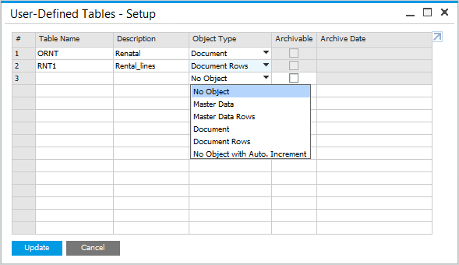
Metadata Objects: Add User-Defined Tables
Use the context menu to remove a User-Defined Table when possible
User tables have the prefix @
Add User-Defined Tables via Tools → Customization Tools → User-Defined Tables - Setup
Object Types:
No Object
No Object with Auto. Increment
Master Data
Master Data Rows
Document
Document Rows
Notes:
You can create UDTs in the User-Defined Tables – Setup window. You can access this window from the toolbar → Tools → Customization Tools.
You now enter a table name and a description. When the system generates the table, it adds an “at” sign (@) to the table name. If you enter XX_TST as the table name, for example, the name of the database table will be @XX_TST.
There are 6 object types you need to choose from. When working with user-defined objects it is essential to work with the master data or document-related object types. If you only want to store raw data in the table, which wil be not part of an object, then choose the “No Object” or the “No Object with Auto. Increment” object type.
Please note that you can delete a UDT using the context menu as long as:
The table is not used for a user-defined object.
The table is not used (linked) in a user-defined field.

Slide 7
Metadata Objects: UserTablesMD
Use the UserTablesMD object to create a user defined table via DI API
'Object variable
Dim oUTables As SAPbobsCOM.UserTablesMD
'Create Instance of UserTablesMD object
oUTables = oCompany.GetBusinessObject(oUserTables)
'Check whether table already exists
If oUTables.GetByKey(“TB1_Table”) Then
oUTables = Nothing
Exit Sub
Else
oUTables.TableName = “TB1_Table”
oUTables.TableDescription = “TB1300 test table”
lRet = oUTables.Add()
End If
' IMPORTANT: Only one (“handle to a”) user table or field object should be “alive”
' at the same time!!!
'In .NET call this first:
System.Runtime.InteropServices.Marshal.ReleaseComObject(oUTables)
‘In .NET set object variable to Nothing…
oUTables = Nothing
Notes:
The UserTablesMD object enables you to manage user-defined tables.
Use your SAP namespace as a prefix for the table name.
If you enter the name TB1_Table, the system automatically assigns the name @TB1_Table.
Please note:
You should call ReleaseComObject in .NET to make sure that the object you worked with is released synchronously.
GC.Collect() will release the object some time later and only ONE metadata object can be active at one time – check what happens if this is not the case…

Slide 8
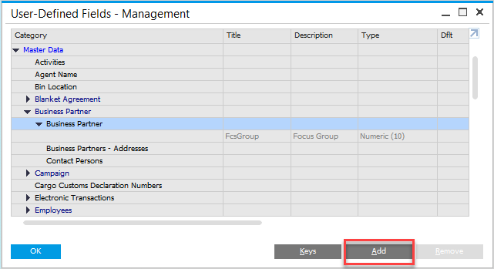
Metadata Objects: Add User-Defined Fields to Tables
Business Partner table: OCRD
An existing UDF
Choosing Add will open the Field Data window for a new UDF in table OCRD
Notes:
User-defined fields can be added to both existing SAP Business One tables and user-defined tables.
Select the table object entry in the User-Defined Fields – Management window and choose Add to create a new UDF.

Slide 9
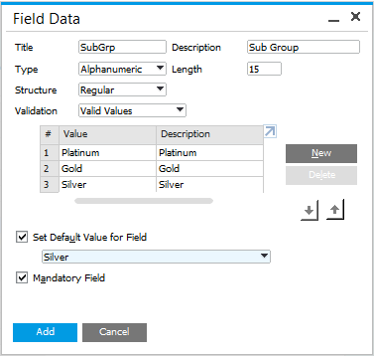
Metadata Objects: Defining a User-Defined Field
Alphanumeric:
Regular, Address, Telephone, Text
Numeric
Date/Time:
Date, Time
Units and Sums:
Price, Sum, Unit, Quantity
General:
Link, Picture
Valid values (optional)
Default value
Mandatory (requires Default value)
Notes:
When you choose Add, the Field Data window opens. Here you enter the field title, which will be used for the field name (maximum 18 characters) and a description (maximum 30 characters).
The Title should be entered in English, since all database table field names are in English.
The system creates a database field in this format: U_<title>. Since the description is displayed on screen, it should be defined in the local language.
You can select from multiple UDF types, such as Alphanumeric, Date, and Time.
The figure shows all the possible types and their structures that determine the format of the field. The Units and Sums types, for example can have a structure of price, sum, unit, or quantity. Fields representing date structures are displayed like all other date fields in the system and allow the same input. The content of General type fields, which allow placement of files and pictures, is stored in the Pictures or Attachments folders, respectively, which is specified in the General Settings window. After you add a field, you cannot change its type.

Slide 10
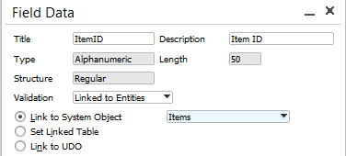
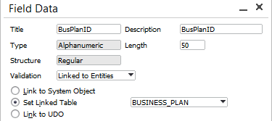
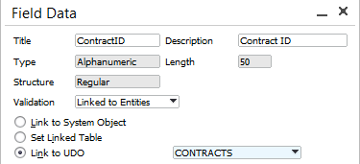
Metadata Objects: Linking User-Defined Fields
Linking to Entities:
System Objects
User-Defined Tables
User-Defined Objects
Please note:
The data in the field will be taken from the field Code in the linked entity.
The field type is automatically set to Alphanumeric and the length to 30 characters long
Not all system objects are available
Notes:
It is possible to link a user-defined field to an existing entity. System Object, User-Defined Table, and User-Defined Object records, for example, can be assigned to a user-defined field.
This helps to create customized bridges between objects across the SAP Business One database.
If a user-defined field that , uses the entity linking feature, it contains the primary key value from the linked object. Please note that foreign keys and other constraints cannot currently be used.
The field type is automatically set to Alphanumeric and the length is set to 30 characters.
The list of the available system objects is hard-coded. This list is maintained by the SAP Business One digital core. There is no option to set the link to a system entity that is not available in the digital core.

Slide 11
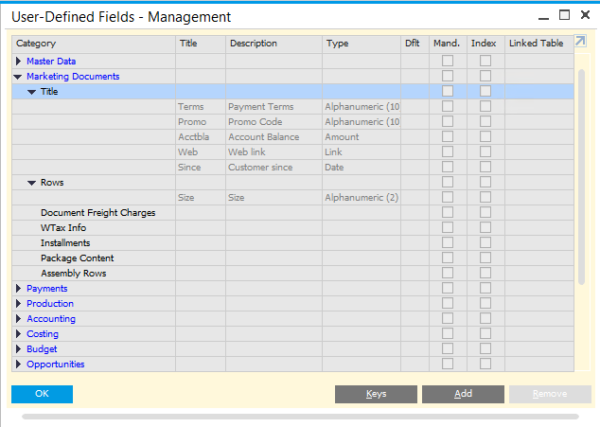
Metadata Objects: Marketing Document Row and Header Fields
Fields can be added to both header (title) and rows of marketing documents
A new field is added to all marketing document types
Header (Title)
Row
Notes:
You can add fields to both the header area and the rows of marketing documents.
When you add a user-defined field to a marketing document object, the new field is added to all marketing document types, including all sales and purchasing document types, as well as some inventory documents such as goods receipt and goods issue.

Slide 12
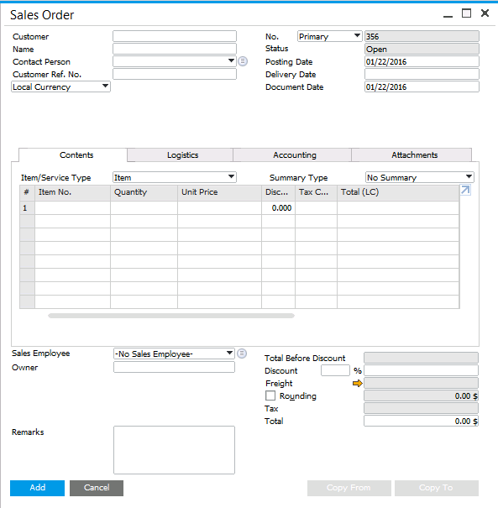
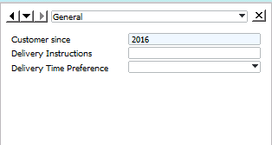
Metadata Objects: User-Defined Fields – Header Level
UDFs added at the header level initially appears in a separate window
To open this window, use the View menu and select User-Defined Fields, or press Ctrl+Shift+U
Object (e.g., Sales Order)
View
✓
User-Defined Fields
Ctrl+Shift+U
Notes:
When you add user-defined fields at the header level, the new fields appear in a separate window, which is positioned to the right of the existing document window by default.
This window is not visible immediately. To open this window, choose View > User-Defined Fields from the top menu bar or use the key combination Ctrl+Shift+U. You can reposition this window to the left or bottom of the existing window.
If the user-defined fields are not used in a marketing document, the new window can remain closed.

Slide 13
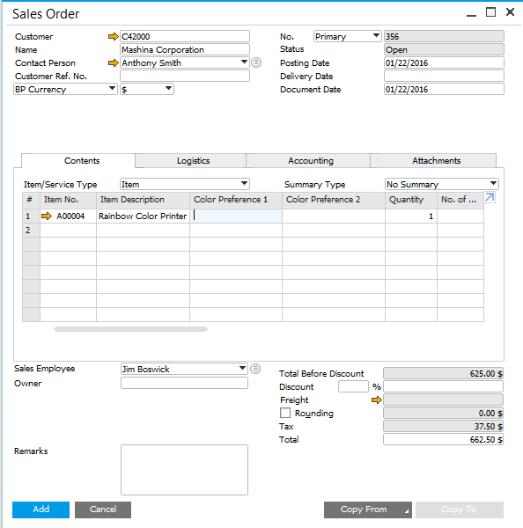
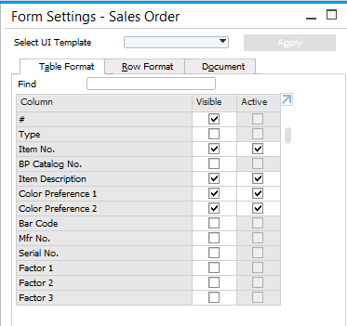
Metadata Objects: User-Defined Fields – Row Level
UDFs added at the row level are visible and active by default
Use standard form settings to position on row
Notes:
When you add a field at the row level, the system adds this field as an additional column in the row. The field is visible and active by default.
You can change these settings or move the field to a new position within the row using the standard form settings.

Slide 14
Metadata Objects: UserFieldsMD
Use the UserFieldsMD object to create user defined fields
'Object variable
Dim oUFields As SAPbobsCOM.UserFieldsMD
'Create Instance of UserTablesMD object
oUFields = oCompany.GetBusinessObject(oUserFields)
'Add field... "Manufacturer"
oUFields.TableName = “@TB1_Table”
oUFields.Name = "Make"
oUFields.Description = "Manufacturer"
oUFields.Type = db_Alpha
oUFields.EditSize = 20
lRet = oUFields.Add()
‘ IMPORTANT: Only one (“handle to a”) user table or field object should be “alive”
‘ at the same time!!!
In .NET call this first:
System.Runtime.InteropServices.Marshal.ReleaseComObject(oUFields)
‘In .NET and VB6 set object variable to Nothing…
oUFields = Nothing
Notes:
The following code example demonstrates how to add a user-defined field.
UserFieldsMD is a business object that enables you to manage user-defined fields in user--defined and system tables.
After creating a new user-defined field in .NET, you must release the object by executing a line of code where the object is a reference to the UserFieldsMD object.
The DI API only allows one UserFieldsMD object instance. This maintains data integrity by preventing any manipulation of a business object while its properties are being modified.

Slide 15
Metadata Objects: UserKeys Object
The UserKeys object allows you to manage additional Keys on User-Defined Tables.
They are meant to improve performance in searching (querying) and navigation.
How to add UserKeys:
Name the key.
Choose the User-Defined Fields that should be part of the key.
Choose Unique = True/False
Add the key.
Notes:
The UserKeysMD object enables you to manage user-defined keys of user-defined tables.
A user-defined table contains a default primary key that consists of the Code column. Use the UserKeysMD object if you want to add secondary keys to user tables.
In theory, a user-defined key can be create by applying the following process:
Define the key name for the KeyName property
Then set the table name to the TableName property
Set the user-defined field to the Elements child object
You can use the the Unique property to determine whether or not the key is unique
Finally, call the Add method

Slide 16
Metadata Objects: UserKeysMD
Use the UserKeysMD object to create user defined keys
'Object variable
Dim oUKeys As SAPbobsCOM.UserKeysMD
'Create Instance of UserTablesMD object
oUFields = oCompany.GetBusinessObject(oUserKeys)
oUKeys.TableName = "BE_MyTable"
oUKeys.KeyName = "BE_MyKey1"
'Set the first column's alias (No Add method for the first element) oUKeys.Elements.ColumnAlias = "FieldName1"
'Set the second column's alias oUKeys.Elements.Add() ' Add an item to the Elements collection
oUKeys.Elements.ColumnAlias = "FieldName2"
'Determine whether the key should be unique or not oUKeys.Unique = tYES
'Add the key lRet = oUKeys.Add()
'IMPORTANT: Only one handle to a user table or field or key object
'should be alive at the same time
Notes:
On the previous slide, we saw how to create a user-defined key in theory. You can now see how this theory has been implemented in this sample code.
After instantiating the UserKeysMD business object, the TableName and the KeyName properties are defined. By using the Element child objects, multiple user-defined fields are added to the key’s collection.
Note that we are only handling one key object at any given time. After we have made the required changes to the UserKeysMD object, the object is released immediately.

Slide 17

Metadata Objects: Exercise
You should now practice:
Creating a User Define Table with User Defined Fields
Inserting a record to the table
Notes:
In the exercise for this unit, you will practice the creation of user-defined tables with user-defined fields. There is also a practical exercise for creating records for user-defined tables.

