Slide 1

TB 1300 - SAP Business One SDK Data Interface API – Java Connector
July, 2019
Notes:
Welcome to the Data Interface API Java Connector course topic.

Slide 2

Java Connector: Topic Objectives
After completing this topic, you will be able to:
Describe how to use and troubleshoot the Java Connector (JCo)
Notes:
After completing this topic, you will be able to use and troubleshoot the Java Connector.

Slide 3
Java Connector: Architecture
Client
Server
JAVA application
…can deal with COM
(For DI API only!)
SBO-Common
SAP Business One Java Connector
Observer.dll
DI API Interface (SAPbobsCOM.dll)
Company
Implementation (OBServerDLL.dll)
Company
Company
Notes:
Let’s have a look at the architecture of the DI API.
The Java Connector communicates with the SAP Business One DI API by hiding the complex Java Native Interface (JNI) calls from the Java virtual machine to the COM objects of the DI API. With the Java Connector, you can get and set properties and invoke methods conveniently with JavaBean-like code.
Essentially, this means you can create an add-on solution in Java that uses the Java Connector exposed by the SAP Business One DI API.
The DI API is tightly connected to the OBServerDLL, which performs all the business logic operations.
The OBServerDLL component located on the client side is synchronized with the version deployed in the SBOCOMMON database or database schema.
The SAP Business One Java Connector can only interact with the DI API.

Slide 4
Java Connector: Details
Main Java classes
java.lang.Object
java.lang.Throwable
com.sap.smb.sbo.api.SBOCOMUtil
Package hierarchy
com.sap.smb.sbo.api
com.sap.smb.sbo.util
com.sap.smb.sbo.wrapper
Difference to DI API
Create new object - “new<Object name>”
com.sap.smb.sbo.util
to add new records are created using “new<Object name>” of the SBOCOMUtil class instead of using ICompany object’s “getBusinessObject”!
E.g. newBusinessPartners must be used when you want to add a business partner!
Notes:
On this slide, we can see the Java class hierarchy.
The java.lang.Object class is the root of the class hierarchy.
The java.lang.Throwable class is the superclass of all errors and exceptions in the Java language.
The com.sap.smb.sbo.api.SBOCOMUtil class is a help class to provide utilities that create or get business objects from OBS-COM.
The package com.sap.smb.sbo.api contains all the interfaces for handling SAP Business One business objects.
The package com.sap.smb.sbo.util represents a help class, which provides utilities to convert between different data types.
The package com.sap.smb.sbo.wrapper represents the SAP Business One wrapper.
All the interfaces are available in the package com.sap.smb.sbo.api.
There is also an extra JCo help file. Below this, the help file for the data interface API holds as well . What does the data interface API hold? What is meant by this?

Slide 5
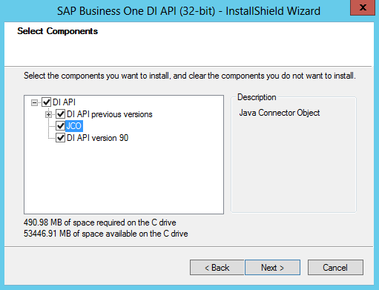
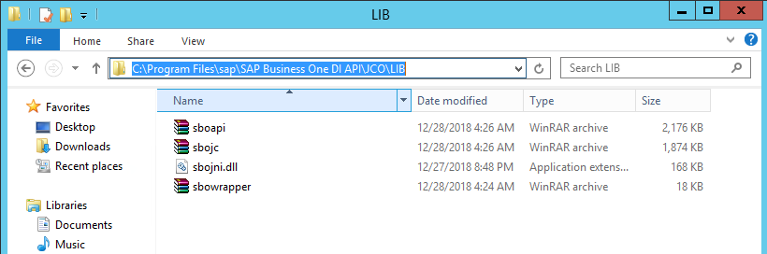
Java Connector: Installation
The JCo always connects to latest version of the DI API
Notes:
The SAP Business One Java Connector is part of the SAP Business One DI API deployment.
When the SAP Business One client is installed, the DI API is installed by default. In this case, the Java Connector is available after installation of the SAP Business One client.
If the Java Connector needs to be used in an environment where the SAP Business One client is not needed, then the SAP Business One DI API installation package can be executed to install the Java Connector for SAP Business One.
The Java Connector always uses the latest version of the DI API.

Slide 6
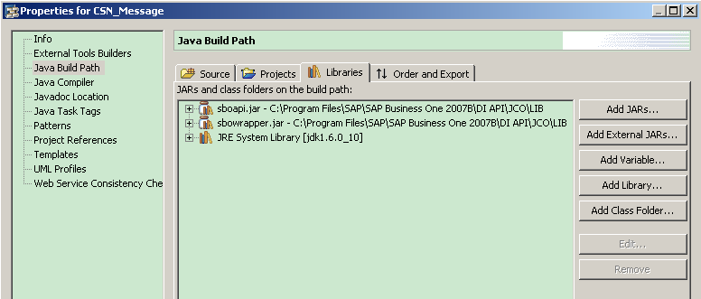
Java Connector: Usage
Add sboapi.jar and sbowrapper.jar in the JAVA application
Notes:
To use the Java Connector libraries in the integrated development environment (IDE), you have to add libraries to the IDE project.
The SAP Business One Java Connector Java archive files need to be added to the project.
Specifically, these files are sboapi.jar and sbowrapper.jar.

Slide 7
Java Connector: Example Connect to the Company
import com.sap.smb.sbo.api.*;
……
company = SBOCOMUtil.newCompany();
company.setServer("(local)");
company.setUseTrusted(new Boolean(true));
company.setCompanyDB("SBODemoSK");
company.setUserName("manager");
company.setPassword("manager");
……
rc = company.connect();
if (rc == 0) { System.out.println("Connected!");
} else { errMsg = company.getLastError();
System.out.println("Failed: "+ errMsg.getErrorMessage()+ " "+ errMsg.getErrorCode());
}
return rc;
Notes:
Please refer to the code example to establish the connection from the Java application to the SAP Business One environment.

Slide 8
Java Connector: Example Add a Business Partner
import com.sap.smb.sbo.api.*;
public static IBusinessPartners bp;
……
bp = SBOCOMUtil.newBusinessPartners(cmp);
bp.setCardCode("JCO1");
bp.setCardName("JCO Test1");
bp.setCardType(Integer.valueOf(0));
rc = bp.add();
Notes:
The current code snippet creates the business partner master data.
The code structure is very similar to.NET-based languages, with minor changes such as business object instantiation, where the new keyword needs to be added.

Slide 9
Java Connector: Example Update a Sales Order
import com.sap.smb.sbo.api.*;
public static IDocuments order;
……
order = SBOCOMUtil.getDocuments(cmp, Integer.valueOf(17), Integer.valueOf(138));
order.setComments("JCO test1");
rc = order.update();
Notes:
The next example demonstrates how the comments can be set for a sales order.
The first variable for the getDocument class is the cmp, which represents the Company interface.
The second variable defines the document object type: the number 17 is associated with sales orders.
The last variable, the number 138, is the document entry.

Slide 10
Java Connector: Example RecordSet
import com.sap.smb.sbo.api.*;
ICompany com = null;
IRecordset RecSet = null;
String FldName, String FldVal;
Object index;
String sQueryItemList1 = "Select * From OITM";
RecSet = SBOCOMUtil.runRecordsetQuery(conn.company,sQueryItemList1);
int Count = RecSet.getFields().getCount().intValue();
while (RecSet.isEoF().equals(new Boolean(false))) {
for (i = 0; i < Count; i++) {
index = new Integer(i);
FldName = RecSet.getFields().item(index).getName();
FldVal = String.valueOf(RecSet.getFields().item(index).getValue());
RecSet.moveNext();
}
}
Notes:
The last example in the current topic shows how the Recordset interface can be used.

Slide 11
Java Connector: Troubleshooting
Test the issue in DI API first to identify, whether the issue is caused by the DI API
If the issue cannot be reproduced in DI API, then the issue is caused by the Java Connector
If the issue CAN be reproduced in DI API, then it’s a common issue for JCO and DI API
SAP Notes
1313297 : How to use SAP Business One Java Connector (JCO)
2550515 : How to Use getDataInterface Through JCO
Notes:
All software-related programs errors are handled by sending a support incident to SAP.
Before you report an incident, please search the SAP Notes, because you might have encountered a known issue and the correction may lie in the delivery process.
The following method will help you to find the affected component of the issue.
The issue needs to be tested on the SAP Business One DI API as well, using.NET-based languages, because it communicates directly with the DI API.
If the issue cannot be reproduced there, then the issue is related to the Java Connector, which means you should create a support incident for component SBO-SDK-JCO.
Otherwise, the issue might be DI API-related. In this case, the corresponding component is SBO-SDK-DI.
Please refer to the listed SAP Note, where you will also find more about Java Connector usage.

