Slide 1

TB 1300 - SAP Business One SDK Data Interface API – DI Server
July, 2019
Notes:
Welcome to the Data Interface API DI Server course topic.

Slide 2

DI Server: Topic Objectives
After completing this topic, you will be able to:
Use DI Server in principle
Notes:
In this unit we will cover the usage principle of the DI service.

Slide 3
DI Server: Introduction
These DI services are based on the concept of Service-Oriented Architecture (SOA).
Acts as a “Server” (as a service)
Supports all business objects
Enables you to develop SOAP-based solutions
Give suitable solution for heavy duty operations (e.g. batch)
Can support larger number of clients working at the same time
Wide range of possible client technologies (APS, JSP, …)
Single transaction handling
Better scalability
Enhanced performance
Notes:
The DI server is designed to run on a server machine and provide a lightweight service-oriented architecture access layer for heavy duty integration purposes.
The DI services provide interfaces to additional logic within SAP Business One that is not necessarily encapsulated in a business object.
Based on the DI API technology, but acts as a “server” (that is, a service)
Supports all business objects that are exposed by the DI API
Enables the development of SOAP-based solutions
Provides a suitable solution for heavy duty operations
Can support a larger number of clients working at the same time
Does not limit the client to a COM interface, but allows a wide range of possible client technologies, such as building traditional web applications using ASP or JSP
The DI server processes all commands within a SOAP request as a single transaction
The connection pooling mechanism improves scalability and provides better performance

Slide 4
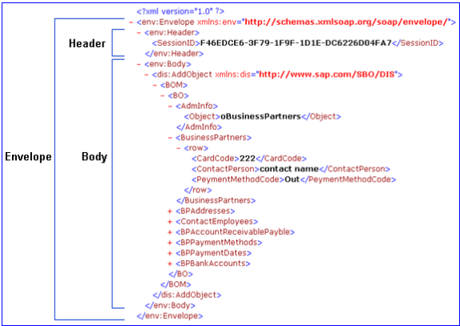
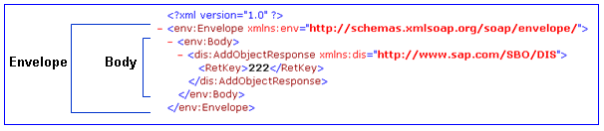
DI Server: SOAP Message Structure
SOAP Request Message Example
SOAP Response Message Example
Notes:
A SOAP message is an ordinary XML document that contains three elements: Envelope, Header, and Body elements.
On this slide, you can see example SOAP messages for request and response.
The main elements of the SOAP message are:
Envelope element, which identifies the XML document as a SOAP message. The envelope element represents a single transaction.
You must use the namespace xmlns:env="http://schemas.xmlsoap.org/soap/envelope/“
Header element, which is only included in the SOAP request message and contains the session ID, which the DI server provides after login.
Body element, which contains commands in the request message in XML format, to connect to the DI Server or manipulate SAP Business One database.
Each command must include the namespace: xmlns:dis="http://www.sap.com/SBO/DIS/".

Slide 5
DI Server: Main Methods
Interact - the syntax of the method is Function Interact(ByVal SOAPCommand As String) As String
SOAPCommand - A string that contains the SOAP request message.
String - A returned value that contains the SOAP response message.
BatchInteract - perform multiple transactions in the database using a single SOAP request message
The BatchInteract structure consists of an Envelopes element that contains a separate Envelope element for each transaction as shown below:
xmlns:env="http://schemas.xmlsoap.org/soap/envelope/"
<Envelopes>
<Envelope>
.
</Envelope>
<Envelope>
.
</Envelope>
</Envelopes>
Notes:
The DI server object interface consists of two methods, called Interact and BatchInteract.
The Interact method is the main interface of the DI server.
The input parameter of the Interact method is a SOAP request message (string), which has to apply the business object schema. The return value of the Interact method is a SOAP response message.
Please refer to the syntax of the Interact method highlighted in green.
The second method is BatchInteract.
The BatchInteract method enables you to perform multiple transactions in the database with a single SOAP request message.
For example, you can add 1000 items to the database with a single SOAP request message.
The main advantage of using this method instead of the Interact method is that if a single transaction fails, all the remaining transactions remain unaffected.
The BatchInteract structure consists of an Envelopes element, which contains a separate Envelope element for each transaction, as shown below.
The structure of each envelope is the same as described in DI Server SOAP Message Structure

Slide 6
DI API Introduction – DI Server Software Architecture
Client(s)
Server
Expose DI Server functionality e.g. in a WebService…
Use method Interact for calls to DI Server
DI Server
SBOCOMMON
Database
3rd Party Application
e.g. a Browser
COM Interface
SOAP Parser
OBServerDLL.dll
Company Database
Common Database
DI Core
Web Service
Notes:
The DI service is basically the web dservice for DI API.
The business logic is provided through the OBServerDLL, which runs on the server instead of being loaded by DI API in the background.
The web-based clients access the DI server directly and render data back to the user side. There is no need to have the DI API installed on the client side, which is mandatory for classic add-on solutions.
The DI service can be consumed by a web based solution, as well as by a desktop or mobile application.

Slide 7
DI Server: SOAP Command types
There are four types of commands:
System Commands – Login, logout (and “debug”).
Data Manipulation – Add, Update, Cancel, Close and other basic operations on objects.
Data Retrieve – GetByKey, ExecuteSQL and Functions which are encapsulated in the SBObob object in DI API.
DI Services – similar to DI API services. The same services as the DI API (MessagesService, AlertsManagementService,…)
Notes:
Only one type of command is allowed in a single SOAP request.
Let’s have a look at the command types:
System commands are responsible for the connection and session management, for example, Login and Logout.
Data manipulation commands let you perform any data changes, for example Add, Update, and Delete.
Data retrieval commands provide the access to the SAP Business One data, for example GetByKey, ExecuteSQL, and SBObob functions.
The service-based command makes it possible to consume DI API-based services such as MessagesService and AlertsManagementService.

Slide 8
DI Server: How to use it
Wrap an XML into a SOAP envelope
Call the COM object through the Interact(request) command
The COM object will send the XML and will return an XML as the result.
Notes:
Let’s have a look at usage theory.
Create a SOAP message structure. This message must be encoded using XML and must use the SOAP Envelope namespace.
Then execute the call by sending the SOAP request to the SAP Business One DI server.
Finally, consume the response provided by the DI server. The response is returned in XML format.

Slide 9
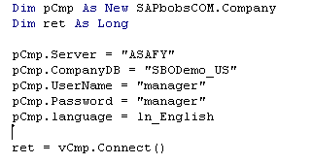
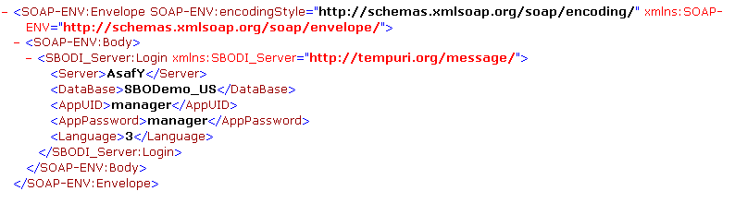
DI Server: Example – Login
DI API
DI Server
Notes:
The upper box shows the login process for the DI API. The bottom box contains an example login for the DI server.
To establish the connection for DI server it is necessary to use the Login element name with the namespace SBODI_Server. In the child element, you can define the properties required for connection.
After executing this SOAP request, you receive SOAP response with detailed information about the handling on the DI server side.
As you can see, usage of the DI server is slightly different than we learned for the DI API.

Slide 10
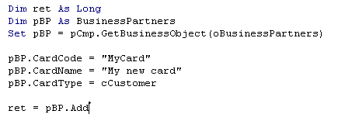
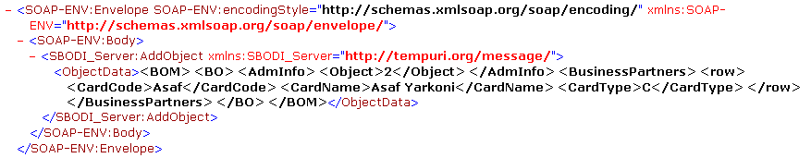
DI Server: Example – Add Object
DI API
DI Server
Notes:
Continuing, we now see how the we can add a business partner master data entry using the DI server.
To add the object, the AddObject element must be entered, whereas the ObjectData describes the whole BOM – BO XML model. We have already seen this BOM – BO model in the DI API, where we interacted with objects. The DI server uses the same XML structure as the DI API.

Slide 11
Overview of differences between DI API and DI Server
DI Server | DI API | Characteristic
Uses a single SOAP request that contains all parameters. | Uses many RPC calls in order to invoke a single method. But please note: Using XML reduces the numbers of calls to a very few! | “Function call efficiency”
Can (theoretically) handle “unlimited” number of connections (configurable) per database. Session pooling mechanism. | Can handle one connection per database/per DI API instance | Connection handling & scalability
Single and Global transactions defined by using Interact or BatchInteract. NO GetNewObjectCode equivalence inside a transaction | Single and Global transactions by Start/EndTransaction commands. Allows GetNewObjectCode method inside a transaction… | Transaction management
Not Possible | Possible | Handling „Meta Data“ (UDTs, etc)
Not Possible | Possible | „Single-Sign On“ in conjunction with UI API
Deployed on a single server; may be used by many client machines | Must be installed on client machines (COM DLL). | Deployment
Direct SOAP calls | Java wrapper (JCo) or ext. SOAP layer. | Integration with External tools (Internet sales, XI system)
Notes:
Let’s see the key differences between the DI server and the DI API.
The main difference is that the DI API is Component Object Model (COM)-oriented and the DI server has a SOAP-oriented architecture.
From the function call side, the DI API uses many remote procedure calls, while the DI server only uses a single SOAP request.
The DI API can only handle one connection per database, while the DI server can handle multiple connections to the same database.
In the DI API, commands can hand over the information to another command in the global transaction. The DI server does not support this feature.
The DI server cannot handle metadata.
The DI server does not support single sign-on login with the UI API.
The DI API has client-side deployment, while the DI server has server-side deployment.

