Slide 1

TB 1300 - SAP Business One SDK
User Interface API – Introduction
July, 2019
Notes:
Welcome to the User Interface API Introduction course topic.

Slide 2

Agenda
  Explain what the User Interface API is
  Explain how to establish a connection to a running SAP Business One application
  Explain how the API interacts with the SAP Business One client
Notes:
In this unit we would cover the main topics:
User Interface API Introduction
The UI API interaction with SAP Business One client
Connection details

Slide 3
SAP Business One SDK – Components Overview
Client
Server
3rd Party
Application
SAP Business One
Database
SAP
Business One
User Interface API
Data
Interface
API
DI Server
Java Co
Server
License
Service
UDO
Notes:
On the current slide you can see the basic architectural diagram for SAP Business One components related to the SDK.
In the DI API introduction chapter we have seen, how each component is connected and what is their role in the environment.
Now we would focus to the UI API, which is located between the SAP Business One Client and the Add-On solution.

Slide 4

The User Interface API: Business Example
  Perform additional checks in SAP Business One
  Enhance SAP Business One by seamlessly integrating additional functionality
Notes:
A typical business example for using the UI API is to perform additional checks in SAP Business One.
By using this technology the seamless look can be achieved for newly created functionality.

Slide 5

UI API Introduction
Notes:
Let’s start with the UI API Introduction topic.

Slide 6

UI API Introduction: Topic Objectives
  After completing this topic, you will be able to
  Explain how User Interface API works
Notes:
After completing this topic, you will be able to explain, how the User Interface API works.

Slide 7
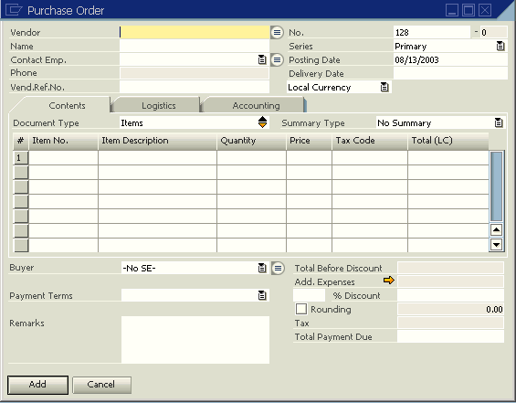
UI API Introduction: Scope
Change existing screen layout:
  Add/Remove Controls
  Change Control Properties
Add new screens (i.e. “Forms”)
Inquiry
Vendor
Inquiry No.
Name
Inquiry Date
Contact Employee
Phone
Vendor Ref. No.
Inquiry Ref. No.
Add/Modify/Remove menus
Document Type
#
Item Number
Item Description
Quantity
Price
Tax
Control flow of applications
Total Sum
Add
Cancel
Summary: UI API provides the capability for seamless integration maintaining the uniform “look and feel” of SAP Business One
Notes:
The UI API exposes user interface elements of the SAP Business One front-end.
It responds to internal events in the SAP Business One client application.
By using the UI API it’s possible to modify the menus, create new forms and perform the data binding.
By using the event mechanism the add-on application can react to user interactions with the SAP Business One application.

Slide 8
UI API Introduction: Characteristics
DCOM executable running on the client machine – 1 instance per Windows session
Connected to all instances of the SAP Business One application
Gives access to user interface elements within the SAP Business One application via a COM interface
Sends events (usually originating) from SAP Business One GUI elements (items) to your event sink / event handler
Enables add-on executables to customize or extend the SAP Business One client application
Relatively low-level – most large-scale/complex changes require significant programming effort
Notes:
Only one instance of the Distributed Component Object Model (DCOM) for UI API is running per Windows session, which is used by all instances of the SAP Business One client running on the same user session.
The UI API provides the access to the user elements exposed in the SAP Business One client application.
It has the event sink layer, which can capture all events provided by SAP Business One graphical user interface.
All these features enables to create add-on solution, which can customize and extend the SAP Business One client application.
On the other hand we are talking about a relatively row-level technology, which requires significant programming effort.

Slide 9
UI API Introduction: Solution Architecture
Client
Server
3rd Party
Application A
SAP
Business One
SAP Business One
Database
User Interface API
3rd Party
Application B
3rd Party
Application C
…
Server
License
Service
Notes:
A typical architecture on the customer side is as they are running several add-on solution.
It’s not to rare as the add-on are from several vendors.
The add-ons solutions deployed on the client side are connected to the same UI API COM instance.
The add-ons can modify the graphical user interface.
They are reacting to the events coming from the SAP Business One client in order to react to the user interaction.

Slide 10
UI API Introduction – Upgrade Compatibility
Add-ons generally only need recompilation to run on newer versions of the UI API
3rd Party
Application developed on
UI API
UI API
version 2007
UI API
version 8.8
UI API
Version 9.0
Upgrade
Upgrade
SAP
Business One
version 2007
SAP
Business One
version 8.8
SAP
Business One
version 9.0
Notes:
In order to perform the upgrade to a newer SAP Business One release, it’s enough just to recompile the add-on solution. After the recompilation the newer UI API will be assigned.
The add-on always needs to be tested before it gets deployed in a productive environment.
Due to bug fixes in the SDK, incorrect code might “work” on an older version, but it might encounter exceptions after an upgrade.

Slide 11
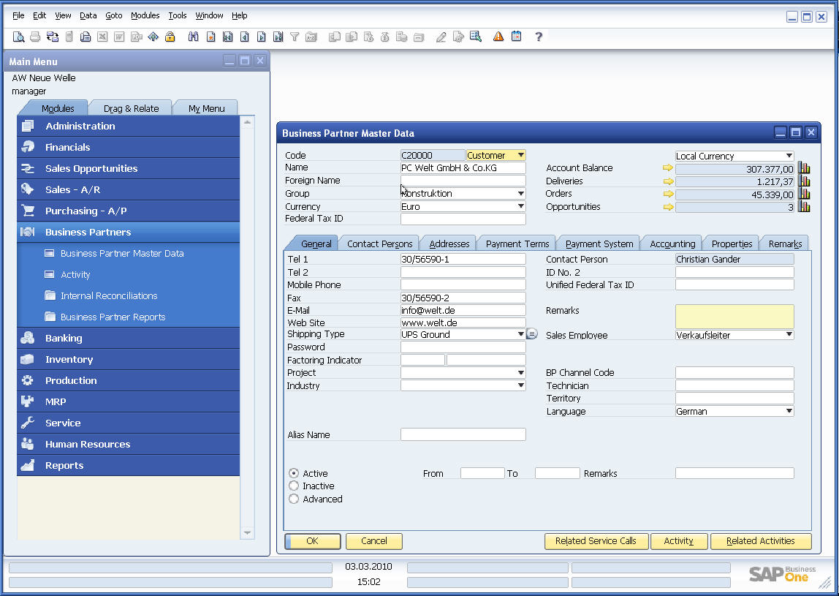
UI API Introduction – Object Overview
Connection Objects
  SboGuiAPI
  Application
Desktop
Menu
Form
  Items
    ComboBox
    EditText
    Matrix
    Grid
    Folder
    ActiveX
    …
  DataSources
    DBDataSource
    DataTable
    UserDataSource
Menus
Forms
Controls (“Items”) on Forms
Notes:
The User Interface API (UI API) is a collection of COM objects that provide access to additional child objects.
The connection object are SboGuiAPI and Application objects.
The Desktop represents the SAP Business One desktop (main window).
Menus Collection represents a menu, that is, a collection of MenuItem objects.
Forms collection is a collection of Form objects. This object holds all the open forms in the application.
The controls on the forms are called Items and are encapsulating multiple child object like, ComboBox, EditTex and so on.
The DataSources are creating the link between the Items and database layer.
The “Main Menu” and the status bar are forms as well.

Slide 12
UI API Introduction – Objects and Collections
Application
Legend
<Object>
Menus
1..n
MenuItem
<Collection>
SubMenus
…
Forms
1..n
Form
Items
1..n
Item
1..1
Specific
…
Company
DataSources
Further Props.
DBDataSources
1..n
DBDataSource
UserDataSources
1..n
UserDataSource
StatusBar
DataTables
1..n
DataTable
ResourceData
ChooseFromLists
1..n
ChooseFromList
Desktop
Menu
1..n
MenuItem
Further Properties
SubMenus
DataBrowser
…
Settings
„Events“
> 20 further Properties !
Notes:
The Application object (reflecting the IApplication interface on the UI API DCOM server side) provides access to forms, controls within forms, menus and the main window (desktop).
“Forms” and “Menus” are collections accessible via the Application object.
„Menus“ holds a snapshot of the menu items currently available – both visible and not visible
„Forms“ holds the collection of the currently available forms – both visible and not visible.
It is not possible to explicitly display a new instance of a specific type of system form, e.g. Sales Quotation. New system forms can be instantiated indirectly, for example by activating the corresponding menu item
„Form“ object is a representation of a form, both system and user-defined
„Item“ object rrepresents a window control - contents, position, size, visibility and other attributes can be modified
„DataSources“ collection - objects which hold data for form items, designed to provide efficient data handling separately from UI presentation
Desktop object/property - use it to change e.g. the background image

Slide 13
Add-On Basics
Notes:
Our next topic is the Add-On Basics.

Slide 14
Add-On Basics: Topic Objectives
  After completing this topic, you will be able to
  Know how to connect to the SAP Business One application through UI API
  Explain how to use single sign-on to connect to both the User Interface API and the Data Interface API
  Explain how to use the option to get the Data Interface API connection parameters through UI API
Notes:
After completing this topic, you will be able to:
Create user-defined tables
Create user-defined fields
Add UserKeys in user-defined tables
Know how to connect to the SAP Business One application through UI API
Explain how to use single sign-on to connect to both the User Interface API and the Data Interface API
Explain how to use the option to get the Data Interface API connection parameters through UI API

Slide 15
Add-On Basics: Load and establish connections
User Interface API
SAP
Business One
(A + B registered)
1
2
<<create>>
IAppLink
IApplication
<<create>>
3rd Party
Application A
<<event sink>>
<<event sink>>
3
3rd Party
Application B
IApplication
<<create>>
<<event sink>>
Notes:
When SAP Business One is launched, it starts the UI API and connects with it before any add-ons are started
If Add-ons are registered to start within a user session:
1. SAP Business One links to the UI API and establishes an event-sink for them
2. SAP Business One starts add-on A and passes a command line parameter to it
2.a add-on application A creates an Application object that has a counterpart in the UI API
2.b add-on application A provides an event sink for events to be fired from the Application object on the UI API side
2.c The UI API application object registers itself in the IAppLink object for bidirectional communication
3. The same set of steps is repeated for add-on application B

Slide 16
Add-On Basics: Startup process for add-ons
User logs in to a company in SAP Business One
SAP Business One
checks for registered
add-ons
SAP Business One starts registered add-ons
Add-on must use command line input as “connection string”
SAP Business One and add-on(s) run in parallel
When SAP Business One shuts down:
Add-ons responsible for their own shutting down
Notes:
Let’s have a look to the whole UI based add-on execution process.
The user login to the SAP Business One client. Afterwards the registered add-on solution is started. The timeout limit is approximately 10 seconds.
The add-on execution requires the Connection String property filled as a command line argument.
The SAP Business One client and the add-on solution is running in parallel.
If the user performs the SAP Business One client shutdown, the add-on must be able to handle the event in order to terminate the add-on solution as well.

Slide 17
Add-On Basics: Connecting to the Application
Add-on
SAP Business One Client (as seen from the Add-On)
Add On
Application
SAP Business One
UI API
SAP Business One
Application in UI API
Connect
Connected to GUI Object
GetApplication
returns Application Object
Notes:
Your application connects to the SAP Business One client through the SboGuiApi object using the Connect method
If a connection has been established, the GetApplication method of the SboGuiApi object grants access to an application instance, which must be used to access the application’s containers (for example, menus or forms) for event manipulation and for property settings
The user interface can be accessed using the objects that exist within User Interface API objects.
Using the connection string supplied by the SAP Business One application as a command line parameter for Connect method ensures that the add-on gets connected to the correct instance of the SAP Business One application.

Slide 18
UI API Introduction: Example – Connecting to UI API
Object(s):
SboGuiApi
Private WithEvents SBO_Application As SAPbouiCOM.Application
Private Sub Logon()
'Declare a new instance of the SboGuiApi object which represents the UI API app...
'…which only runs once on each client system…
Dim oSboGuiApi As New SAPbouiCOM.SboGuiApi
Dim sConnStr As String
'Get the connection string – as a commandline parameter…
‘Use the “Debug” connection string to launch the Add-On from development env.…
sConnStr = Environment.GetCommandLineArgs.GetValue(1)
‘Set the AddOn identifier (optional) – some long string with numbers
‘oSboGuiApi.AddOnIdentifier = <just a placeholder>
'Connect to UI API
oSboGuiApi.Connect (sConnStr)
'Get the Application object / interface – the only object you need from here:
‘… there’s an opt. parameter that identifies the SAP B1 instance; only for “Debug”
SBO_Application = oSboGuiApi.GetApplication()
‘After we got the Application object we don’t need this anymore.
oSboGuiApi = Nothing
End Sub
Methods:
+Connect(…)
+GetApplication(…)
Properties:
AddOnIdentifier…
Notes:
In Visual Basic, the SBO_Application object has to be declared with the WithEvents modifier for it to support event handling
The connection to the UI API requires the Connection String supplied by the SAP Business One application as a command line parameter.
An Add-On Identifier String allows the SAP Business One License Service to recognize your Add-On. To create the identifier, use the Add-On Identifier Generator available from the SAP Business One application using the License Administration module.
Licensing and AddOnIdentifiers are discussed later in the course.

Slide 19
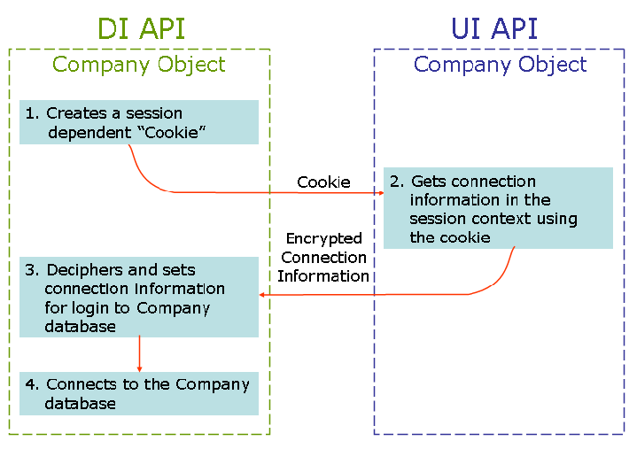
Add-On Basics: Single Sign-On
Notes:
The SAP Business One SDK has his own Single-Sign On mechanism as well.
Add-on solutions that consist both UI API and DI API can connect to the SAP Business One database, in the same session, with a single sign-on. After log on through the UI API, the connection information can be transferred from the UI API to the DI API.
The single sign-on process is the following:
The DI API Company object creates a "cookie" that consists of the current DI API session. This cookie is available for the UI API.
The UI API Company object uses this cookie as an encryption key to encrypt the connection information. The encrypted connection information is session dependent, and therefore cannot be used in other sessions.
The DI API Company object deciphers the encrypted connection information – based on the cookie created in step 1 – and then sets the connection information for login.
The DI API Company object connects to the company database using the Connect method.
Single sign on is a recommended option to connect to both UI API and DI API, because the performance is better than multiple add-on. unless you have memory issue, you can choose multiple add-on.

Slide 20
Add-On Basics: Example – Single Sign-On
'After connecting to UI
'Initialize DI API Company object
oDICompany = new SAPbobsCOM.Company();
'Acquire the connection context cookie from the DI API
Dim sCookie As String
sCookie = oDICompany.GetContextCookie
'Retrieve the connection context string from the
'UI API using the acquired cookie.
Dim conStr As String
conStr = SBO_Application.Company.GetConnectionContext(sCookie )
'Set the connection context information to the DI API.
ret = oDICompany.SetSboLoginContext(conStr)
If Not ret = 0 then
Exit Sub 'the operation has failed.
End If
'Establish the connection to the company database.
ret = oDICompany.Connect()
Notes:
It‘s time to have a look into the Single-Sign On feature from the code perspective.
This code sample requires the UI connection, like we have seen it in the previous code sample.
Afterwards we can continue with the initialization of the DI API’s Company object.
Then we could define the context cookie from the DI API and retrieve the connection string from UI API.
It follows with the definition of the connection context information for the DI API, where the connection string is passed as a parameter.
All ends with calling the Connect method on the DI API level.

Slide 21
Add-On Basics: Multiple Add-Ons using DI API
Call Application.Company.GetDICompany() in UI API to get a reference to the DI API Company object
SAP Business One Application
(Loading OBServerDLL at 1st add-on connection)
DI API
UI API
UI API + DI API
connection;
memory consumption > ~1.5MB
UI API + DI API connection;
mem > ~1.5MB
UI API + DI API connection;
mem. > ~1.5MB
Add-on 1
(first add-on to connect)
Add-on 2
Add-on N
Notes:
Moreover the SAP Business One SDK offers an alternative method for creating DI API connection from an add-on solution, what is already using the UI API.
If you have very limited physical memory or critical memory consumption requirement, you may try the multiple add-on DI connection method.
This connection requires a running application. This connection only supports the latest DI API version. Side by side connection is not supported.
You must handle shut down events properly, otherwise add-on process remains in memory. It is highly recommended to use XML format of the DI API.

Slide 22
The User Interface API: Use Case
There are a couple of scenarios where User Interface API is engaged:
Achieve a „seamless“ integration of additional functionality with SAP Business One (usually requested by customers), including
    …linking into SAP Business One standard processes
    …adding custom GUI elements into SAP Business One standard forms
    …adding custom forms with user-defined data links
Manipulate SAP Business One standard functionality (when standard options do not apply to the customer‘s or industry processes, including
    …hiding SAP Business One GUI elements
    …blocking SAP Business One events
  => Changes to standard functionality must be documented!
Notes:
As a short recap, please refer to the use cases of the UI API, because there are a couple of scenarios where User Interface API is engaged.
The newly created functions and desktop objects would have the seamless look, like it’s in the Digital Core.
You can perform a full customization for the existing forms, and create also new one, which might be linked to the standard processes.
On the other hand it’s possible to redesign the standard functions and processes, if it’s required by the customer’s business processes.
Beside of hiding the GUI element you can alter the standard events as well.
Please note, all the changes, which will change the existing behavior of the standard functionality needs to be documented, because it can cause some issues if the customer is running an additional add-on solution from different vendor. The third-party add-on solution might relay on the standard functionality, which might be disabled or changed by your add-on solution!

Slide 23

Add-On Basics: Exercise
You should now:
  Connect to the SAP Business One with Single-Sign On
  Multiple DI-API connection, shared among all Add-Ons running in the same SAP Business One client.
Notes:
In the exercise for this unit you will practice the several type of connection based on the user interface, like pure UI API connection, Single-Sign On or Shared Memory connection for DI API.

