Slide 1

TB 1300 - SAP Business One SDK User Interface API – Creating Forms
July, 2019
Notes:
Welcome to the User Interface API Creating Forms course topic.

Slide 2

Creating Forms: Topic Objectives
After completing this topic, you will be able to
Explain how to create new forms and items
Save and load forms using XML
Notes:
In this unit we will cover the main topics:
Creation of forms and items
Manipulation with the XML based forms

Slide 3
Creating Forms: User Forms
User form is a form that you add to Business One using the UI API
There are several ways to create a user form
Code it step-by-step
Use the Screen Painter add-on
Use the SAP Business One Studio
You must assign a type, which must be prefixed with your company’s namespace, e.g. SAP_AsstMD stands for the form type of Fixed Asset Master Data in SAP Fixed Asset Add-On.
Notes:
The form object is a collation of items, data sources, forms settings, menus, and additional child objects.
User forms are new forms that are created in the SAP Business One application by using the UI API technology.
There are several ways for users to create forms. They can be programmed with direct coding or by using form designer tools such as Screen Painter and SAP Business One Studio.
Screen Painter is an older version of an add-on solution that was replaced by SAP Business One Studio.
We recommend using SAP Business One Studio, because it can also interact with Microsoft Visual Studio.
A form is identified by its unique ID, but only for the lifecycle of the form. The form type should contain the SAP development namespace, to differentiate these forms between multiple add-on solutions and the multiple vendors who provide them.

Slide 4
Creating Forms: Example – Create a Form
Dim oForm As SAPbouiCOM.Form
Dim creationPackage As SAPbouiCOM.FormCreationParams
‘Create the FormCreationParams object
creationPackage = SBO_Application.CreateObject(
SAPbouiCOM.BoCreatableObjectType.cot_FormCreationParams)
‘Specify the parameters in the object
creationPackage.UniqueID = “MP_MyFormID" ‘Auto UniqueID assigned
creationPackage.FormType = “MP_MyFormType"
creationPackage.BorderStyle = SAPbouiCOM.BoFormBorderStyle.fbs_Fixed
‘ Add the form to the SBO application
oForm = SBO_Application.Forms.AddEx(creationPackage)
‘Set the form title and visibility
‘Please note! Even if the form is not visible – it may be „there“ in the Forms collection…
‘…and UI API will throw an Exception if you try to add a form with the same UniqueID!
oForm.Title = “Hello World”
oForm.Visible = True
Notes:
The preferred method is to use the FormCreationParams object.
In addition, you can use the ObjectType property to set a reference to a user-defined object.
After instantiation of the FormCreationParams object, the properties can be assigned. The AddEx method needs to be called for the Form object to add the form to the SAP Business One client.
This operation generates a new form at runtime. It is then possible to define the form properties or add child items, such as buttons.
Please keep in mind that the form is not visible. To make it visible in the user interface, you have to change the Visible property.

Slide 5
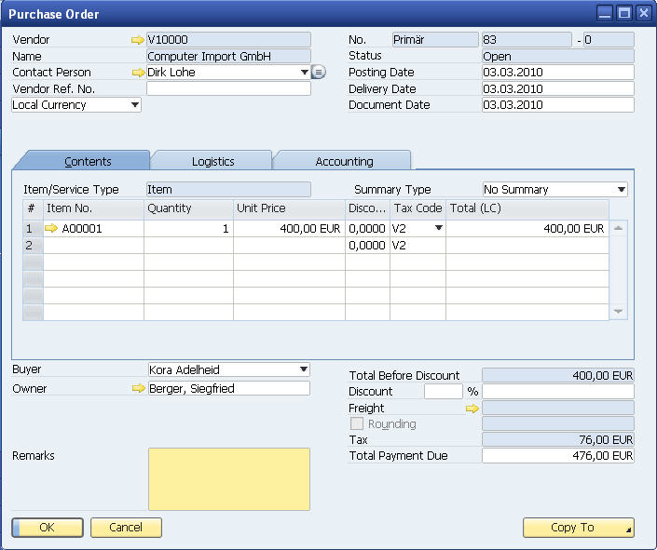
Creating Forms: Items Item Types
EditText
StaticText
Folder
Combobox
Matrix
Checkbox
LinkedButton
ButtonCombo
Button
Notes:
Items are collections of Item objects.
Form item types are the same as controls in Visual Basic forms from a user perspective - aside from the LinkedButton, which is specific to SAP Business One.
Technically, the SAP objects are unrelated to VB form controls.
Let’s see what kind of items we might find in the UI API:
Button
CheckBox
ComboBox
EditText
LinkedButton
Grid
Matrix (most tables in system forms)
OptionBtn (Radio Button)
PictureBox
StaticText

Slide 6
Creating Forms: Items Item Properties
Properties which are common to all items are directly available in the Item object
Examples:
Top, Left, Width, Height properties
Update method
Other members depend on item type (ComboBox, Matrix, etc).
These are available through the Item's "Specific" property
Examples:
String property (EditText item)
Selected property (ComboBox item)
ValidValues property (ComboBox item)
Columns property (Matrix item)
Layout property (Matrix item)
Notes:
The item object contains the properties that are common for all item types.
The location properties are here a good example. The Top, Left, Width, and Height are common for each item type.
The item-specific properties are available in the lists, under the specific property for each item object.
For example, the EditText object has the String as a specific property. The ComboBox object uniquely contains the Selected and the ValidValues properties.

Slide 7
Creating Forms: Items Create Items on the Form - Sample
Dim oItem As SAPbouiCOM.Item
Dim oButton As SAPbouiCOM.Button
'Add button, buttons with UID 1 and 2 should be OK and Cancel
oItem = oForm.Items.Add("1", it_BUTTON)
oButton = oItem.Specific
oButton.Caption = "&OK"
'Set Size and Location:
oItem.Top = 200
oItem.Left = 20
oItem.Width = 70
oItem.Height = 19
oItem = oForm.Items.Add("2", it_BUTTON)
oButton = oItem.Specific
oButton.Caption = "&Cancel"
'Set Size and Location:
oItem.Top = 200
oItem.Left = 95
oItem.Width = 70
oItem.Height = 19
Notes:
The following code snippet demonstrates how to add the buttons to a form.
If the buttons have unique ID 1 and 2 on the form, this means they inherit the system behavior for data changes from the digital code.
This means if the form is in find mode, then the button with unique ID 1 would have the caption “Find”.
If the form is in add mode, then the button with the unique ID would have the caption “Add”.

Slide 8
Creating Forms: Items Accessing Item Members - Sample
Dim oItem As SAPbouiCOM.Item
Dim oEdit As SAPbouiCOM.EditText
oItem = oForm.Items.Item(“54”)
'now you can access generic Item properties
oItem.Width = 120
‘…to access the String property and other properties specific to
‘the EditText type of item use the specific “sub” object EditText
‘VB implicitly casts the item‘s Specific value
‘ to the left-hand side object type.
‘In C#, C++ you need to cast explicitly.
oEdit = oItem.Specific
oEdit.String = “Hello World”
Notes:
In this example, we see how an existing form can be modified.
The code will instantiate the item with unique ID 54 on the form, which is an EditText object.
The string text is an EditText-specific property, then the Specific property must be used at the item level.
The value can then be assigned.
Setting the String property of the EditText item will (technically) cause a COM event to be sent to the UI API. If you change many properties from add-on code, this will result in many calls through the UI API and may cause performance issues. We therefore recommended using DataSource to set values. Refer to DataBinding with DataSources for details.

Slide 9
Creating Forms: Items PaneLevel Property
The Form.PaneLevel Property is used with the Item.FromPane and Item.ToPane to create multiple panes or “layers” on a form, in which different items are visible on different panes.
Typically used with Folder items to display different items on different “Tabs”.
For each Item, set FromPane and ToPane properties.
If both properties are set to 0, the item will be visible on all panes
Example: If item oEdit1.FromPane = 1 and oEdit1.ToPane = 3, the item will be visible when oForm.Panelevel = 1, 2, or 3.
In Folder item set Pane property to the associated PaneLevel that will be visible when the folder is selected.
Notes:
The Form.PaneLevel property is used with the Item.FromPane and Item.ToPane values to create multiple panes or “layers” within a form, in which different items are visible on different panes.
It is typically used with Folder tabs, to display different items on different tabs. Set FromPane and ToPane properties for each item.
If both properties are set to 0, the item will be visible on all panes.
For example, if item oEdit1.FromPane is 1 and oEdit1.ToPane is 3, then the item will be visible when oForm.PaneLevel is 1, 2, or 3.

Slide 10
Creating Forms: Items TabOrder Property
Tab order is the ability to control the order of moving focus from item to item when pressing on the TAB key.
Only items that can get focus can „have“ TabOrder.
Only available for specific item objects like EditText, ComboBox
Limitations:
Specific item objects
Tab order is not applied on cells nor columns. Trying to set tab order on those type will raise an exception
The Tab order index can be any Integer value >= 0.
Two items can have same tab order value, but then the order between them will be inconsistent.
Notes:
The tab order is the order in which form items become the focus when the user presses the TAB key.
Only items that can become the focus can receive a tab order value. This means you cannot set a tab order for cells or columns, for example.
The item’s tab order can be any long integer equal to or greater than 0.
Two items can have the same tab order, but the order is not guaranteed in this case.
This feature is available only for specific object types, such as EditText or ComboBox.

Slide 11
Creating Forms: Form Focus / ActiveItem
Use Case:
Set the focus to a particular item on the form
Need to check, if item a particular item has focus
Query the form which item has focus
Limitations:
Only EditText and ComboBox, PaneComboBox items can have focus.
Only Active form has focus items.
For Matrix: ItemUID of item in focus will be MatrixUID not cell/column UID.
Properties & Methods:
Form.ActiveItem - Read-only property
Form.ActiveItem(string csItemID ) – Sets focus to specific item
EditText, ComboBox and PaneComboBox Active - Read-write property.
EditText, ComboBox and PaneComboBox Active(Boolean fInFocus) - Sets focus
Notes:
The ActiveItem property is responsible for setting the focus on the Item object.
If no item has the focus, this property is set to an empty string.
You can also use it for querying which item in the form has the focus.
The current limitations:
Only EditText and ComboBox, PaneComboBox items can have a focus
The cell and the column ID might not have the focus for Matric item
Only the active form has focus items

Slide 12
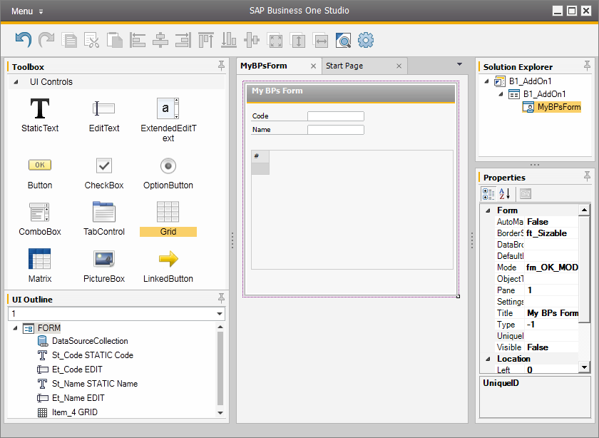
Creating forms - SAP Business One Studio
Notes:
The SAP Business One studio is an integrated development environment based on the Microsoft .NET Framework, which supports you in developing extensions on top of SAP Business One.
The SAP Business One studio suite is a state-of-the-art development platform for SAP Business One extensions that dramatically improves partner development efficiency.
It provides an effective integrated development environment (IDE) for partners to develop extensions on top of SAP Business One.
The SAP Business One studio suite consists of two editions: SAP Business One studio and SAP Business One studio for Microsoft Visual Studio.

Slide 13
Creating Forms: Working with XML
Why to use XML?
A series of operations is replaced by a single batch operation. This means less code and better performance!
Saving a form layout to an XML file
sXML = oForm.GetAsXML() 'get XML String
oXML.loadXML(sXML) 'load XML into DOM document obj.
oXML.save (App.Path & "\Form.xml") 'save file
Updating ANY Form (or loading a user form) from an XML file
SBO_Application.LoadBatchActions (oXMLDoc.xml) 'load string through one call
Preferred user form loading mechanism
oFormCreationParams.XmlData = oXMLDoc.xml
Use with creation params; preferred over LoadBatchActions due to greater flexibility/control
Notes:
The best way to get the form to the add-on solution is to load it from the XML file.
The load process is executed in a single batch operation, which improves performance significantly.
The SAP Business One studio and Screen Painter generate forms in XML format, which can be loaded directly to the UI API.
By using the GetAsXML method with the Form object, you can retrieve any form structure as an XML string.
Multiple forms can be loaded and changed with a single operation by using the LoadBatchActions method in the Application object.

Slide 14
Creating Forms: Example – Save, Load or Update using XML
Dim oXMLDoc As New Xml.XmlDocument ‘…when using .NET’s System.Xml Dim oForm As SAPbouiCOM.Form Dim xmlData As String Dim m_sPathToFormXML As String = “c:\xml\xml_UpdateSample.xml“
‘1) Save: get XML resource from Quotation form oForm = SBO_Application.Forms.GetForm(“149”, 1) If oForm Is Nothing Then Exit Sub xmlData = oForm.GetAsXML() ‘2) Load or Update: load the xml file into the XML document object oXMLDoc.Load (m_sPathToFormXML) ‘upload the xml… (preferrably to update a form…) SBO_Application.LoadBatchActions (oXMLDoc.InnerXml)
‘eventually check for errors and warnings SBO_Application.GetLastBatchResults()
oXMLDoc = Nothing
Notes:
To create new forms, we recommend using the GetAsXML method with the Form object.
To modify an existing, you should use LoadBatchAction with the update action.
In the following example, we can see how the sales quotation form can be saved as an XML string. We can add some changes directly in the XML and save the XML in a resource file, for example.
The second step of this example involves the XML document load, which uses the System.Xml library in Microsoft .NET.
The LoadBatchAction method takes an XML string. In addition, you can also simply load the XML as a text file or from the DB as a string.
Using XML libraries facilitates handling and makes it possible to modify the XML before loading.

Slide 15
Creating Forms: Example – Loading Forms using XML
Dim oForm As SAPbouiCOM.Form
Dim creationPackage As SAPbouiCOM.FormCreationParams
Dim oXMLDoc As New Xml.XmlDocument ‘…when using .NET’s System.Xml
‘Create the FormCreationParams object
creationPackage = SBO_Application.CreateObject( _
SAPbouiCOM.BoCreatableObjectType.cot_FormCreationParams)
‘Please note: These parameters override corresponding data in the XML
creationPackage.UniqueID = “MP_MyFormID"
creationPackage.FormType = “MP_MyFormType"
creationPackage.BorderStyle = SAPbouiCOM.BoFormBorderStyle.fbs_Fixed
‘Just a sample for an XML string describing a form… same as used for LoadBatchActions
oXMLDoc.Load(“C:\XML\Sample.srf”)
creationPackage.XmlData = oXMLDoc.InnerXml
‘Add the form to the SBO application
oForm = SBO_Application.Forms.AddEx(creationPackage)
‘Set the form visible (can be set in XML too)!
oForm.Visible = True
Notes:
The following example demonstrates the creation of a new form by loading it from an XML file.
The mandatory properties are loaded from the XML file as well, which means it is not necessary to provide any additional property in the code itself.
The Microsoft .NET System.Xml library is used to retrieve the file from the file system.
You call the FormCreationParams object with the XML content. You can then create the form by calling the AddEx method.

Slide 16
Creating Forms: General Remarks
Adding items to user forms
Unique id “1” and “2” will inherit Business One’s behavior for “OK” and “Cancel” buttons
LinkTo property
Default tab order is based on the order in which items are added to a form, but can be changed with TabOrder property.
DataSources improve performance.
XML layout improves form load speed.
Form.UDFFormUID
Property that links to each system form to its corresponding UDF form.
Notes:
Let’s summarize the general information about form creation.
When items are created in user forms, the IDs 1 and 2 inherit the SAP Business One behavior.
The LinkTo property can be used to link to another object in the system.
The TabOrder property is responsible for the tab order, which is based on the item creation order by default; this property will help to define the required tab order for the items on the form.
The DataSources property specification improves the overall performance of the form during data binding.
The XML layout improves the form loading speed.
The UDFFormUID property ion the Form object specifies the unique ID of the user-defined field form.

Slide 17

Creating Forms: Exercise
You should now practice:
Create a Form from the code
Save the Form as XML
Load the form in the Add-on from XML
Notes:
In the exercise for this unit, you will practice the creating forms from code and manipulating forms in XML format.

