Slide 1

TB 1300 - SAP Business One SDK User Interface API – Handling Events and Menus
July, 2019
Notes:
Welcome to the User Interface API Handling Events and Menus course topic.

Slide 2

Agenda
Events
Menus and Handling Menu Event
Additional Events
Notes:
In this unit, we will cover the main topics:
Events
Menus and handling menu event
Additional events

Slide 3

Events
Notes:
Let’s start with the events topic.

Slide 4

Events: Topic Objectives
After completing this topic, you will be able to
Explain the use of events to ensure that your add-on is synchronized with SAP Business One, handlers for the (mandatory) AppEvents
Handle AppEvents
Handle ItemEvents
Use Event Filtering
Manipulate SAP Business One forms
Notes:
After completing this topic, you will be able to
Explain the use of events to ensure that your add-on is synchronized with SAP Business One, handlers for the (mandatory) AppEvents
Handle AppEvents
Handle ItemEvents
Use event filtering
Manipulate SAP Business One forms

Slide 5
Events for Add-Ons
UI API Server
SAP Business One
IAppLink
User Interface API
3rd Party Application A
Notify on Button pressed
Notify on Button pressed
IApplication
Sends Button pressed event via event sink
Notify on Button pressed
IApplication
Sends Button pressed event via event sink
3rd Party Application B
Notify on Button pressed
IApplication
Sends Button pressed event via event sink
3rd Party Application C
Notes:
SAP Business One starts add-on applications registered for automatic startup in the order determined by the system administrator.
The add-ons establish connections to the UI API and register event sinks.
When an event occurs in SAP Business One UI, it is passed to add-ons, which create event sinks for such events, one at a time.

Slide 6
Events for SAP Business One…
User Interface API
SAP
Business One
Sends “property changed” event via event sink
IAppLink
3rd Party Application B
Notify on property changed
IApplication
Sets property of GUI element
Notes:
Every add-on action is reflected in the SAP Business One application via the UI API.
The same mechanism is also used in the other direction, from the SAP Business One application to add-ons.
The SAP Business One application notifies the UI API Application object when events occur.
By connecting to the UI API and registering with the Application object, add-ons receive all the events notified on this object via the UI API event sink.

Slide 7
Events reflected in UI API
Mandatory:
AppEvent: Application shutdown, Company Database changed, Interface language changed, Font changed.
Important / Frequently used:
ItemEvent: Specific events that occur on forms or items (Click on button, form loading…)
FormDataEvent : Fired when a form with a linked business object loads/saves/removes data
MenuEvent: A click on a sub-menu item in the application
Supplementary :
RightClickEvent: Fired before + after context / right-click menu comes up
PrintEvent : Occurs during any kind of “print” (i.e. print, preview + adding attachment)
ReportDataEvent: Follows PrintEvent and allows capture of print data
StatusBarEvent: Occurs when a message is displayed in the application’s status bar
ProgressBarEvent : Occurs when a progress bar is created, stopped or released
Except for AppEvent and StatusBarEvent, UI API usually notifies event handlers twice:
BeforeAction = True Before
SAP Business One (and other add-ons) handle the event.. Gives you the option to block a particular event
BeforeAction = False After
SAP Business One (and other add-ons) have handled the event
Notes:
Most UI API code is event-driven. Events are usually triggered in response to user actions within the SAP Business One application.
In the SAP Business One user interface, the following categories of events are defined:
Mandatory event: the AppEvent
Frequently used events such as ItemEvent and MenuEvent
Supplementary events, such as PrintEvent and StatusBarEvent
AppEvent, ProgressBarEvent, and StatusBarEvent will always be forwarded to add-ons, which means they cannot be filtered out.
AppEvent events must be processed by your application.
Other types of events can be filtered (ItemEvent) or must be added to the (ItemEvent) event filter (click on menu).
It is the developer’s responsibility to make sure that their code will handle each application event successfully.
The events usually notify the event handler twice: before and after the action. The AppEvent and StatusBarEvent are exceptions to this.

Slide 8
Events: Application Events (mandatory!)
Public Event AppEvent(ByVal EventType As BoAppEventTypes)
Handles SBO_Application.AppEvent
Language Change
Occurs when the user changes the display language in the company settings (Administration > System Initialization > General Settings)
=> The Modules menu is rebuilt and any additional add-on menus removed. You must handle the Language Change events in your add-on and reapply your menu changes using the new language selected by the user
Shutdown of SAP Business One / Company Change
Shutdown occurs when the user closes the SAP Business One application or an Add-On is requested to stop through Add-On Manager (Administration -> Add-ons -> Add-on Manager)
Company change occurs when the user selects another company within the same user interface session
=> You must do clean-up work (remove menus (in case of shutdown), close windows, …) and stop your add-on in all cases (e.g. call End in VB.NET).
Notes:
The application events are mandatory and add-on solutions must handle them.
Application events take place when one of the following changes takes place in the SAP Business One application:
Application shutdown
Change of company database
Change of interface language
UI server shutdown
It’s important to react to the language change event type, because the Modules menu is rebuilt and any additional add-on menus are removed. You must handle the language change events in your add-on and reapply your menu changes using the new language selected by the user.
After the application or UI server shutdown or the company change event occurs, the work needs to be finalized within the add-on solution. This means the menus must be removed and all the add-on solutions need to be stopped. Otherwise the add-on will continue to run in the background even if the SAP Business One client is no longer running.

Slide 9
Events: Item Events
Occurs when a UI event takes place on a form OR any of its items (controls)
LostFocus,
GotFocus,
FormActivate,
FormLoad,
Click,
ItemPressed,
…
Private Sub SBO_Application_ItemEvent ( ByVal FormUID As String, ByRef pVal As ItemEvent,
ByRef BubbleEvent As Boolean ) Handles SBO_Application.ItemEvent
pVal: contains a large number of data providing details regarding the calling situation.
BubbleEvent: specifies whether the event will continue to be processed by SAP Business One.
Notes:
Item events occur when a UI event such as Click, Form Load, Got Focus, Lost Focus, and so on takes place in a form or its aggregates (controls) in the SAP Business One application.
You must handle items events for your add-on because the application does not handle them automatically.
Let’s take a detailed look at the item event content.
The FormUID is a string that specifies the unique ID of the item that received this event.
The pVal specifies an ItemEvent object that contains the event type and other properties.
The BubbleEvent specifies whether the event will continue to be processed by SAP Business One.
The default value is True. By setting BubbleEvent to False, you cancel the event. The BubbleEvent is only valid if BeforeAction has the value True.

Slide 10

Events: ItemEvent Flow Of Control
SAP Business One Client
Add-on
Form in SAP Business One application
SAP Business One event handler
My event handler
ItemEvent
BeforeAction = True
return Control
BeforeAction = False
ActionSuccess = False / True
return Control
Notes:
This diagram visualizes the Item Event control flow.
The user performs an action within the SAP Business One form. This event is then routed directly to the add-on event handler, where we can already start to perform some operations, based on the user action.
At this stage, the value of the BeforeAction property is True. The BeforeAction property is part of the ItemEvent object.
Once the event is handled or ignored in the add-on event handler, the event is then handed back to the SAP Business One event handler, where the standard functionality is executed.
Once this is, the event is then moved back to the add-on event handler.
The BeforeAction property value is now False and the ActionSuccess property contains the information about the successful standard functionality, which is a Boolean value.
The flow then moves back to SAP Business One event handler and then back to the SAP Business One form.

Slide 11
Events: ItemEvent Flow Of Control: BubbleEvent = False
SAP Business One Client
Add-on
Form in SAP Business One
SAP Business One event handler
My event handler
ItemEvent
BeforeAction = True
return Control
BubbleEvent = False
Notes:
The BubbleEvent is a parameter for the ItemEvent and MenuEvent actions.
It indicates how the application handles the event. It is only relevant if the BeforeAction property value is True.
Let’s look at the flow: what will happen is, we set the BubbleEvent to False in the add-on event handler.
The add-on event handler returns the control back to the SAP Business One form and the SAP Business One event handler is passed.
In this case, only the code available in the add-on event handler is executed and the standard SAP Business One functionality is ignored.

Slide 12
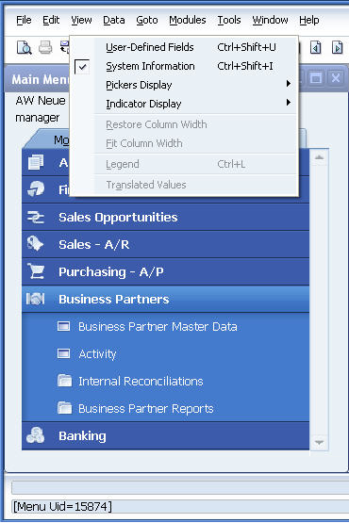
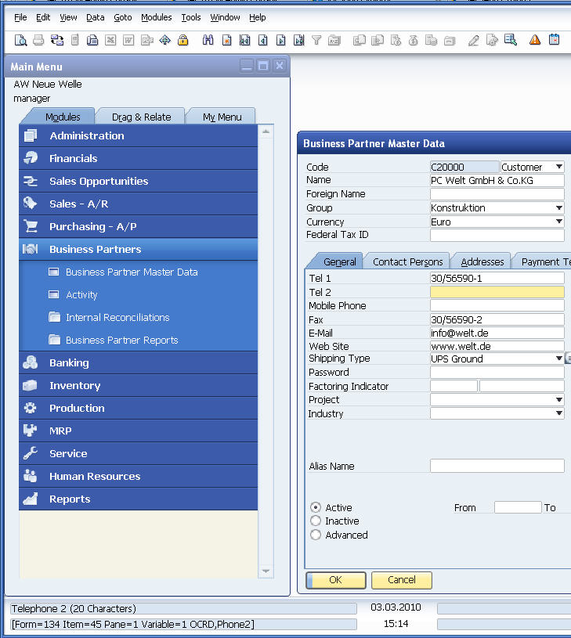
Events: Gathering Information
Notes:
You can view technical information related to forms, items (controls), and the corresponding database tables or fields by selecting View > System Information and performing a mouse-over of the items in question.
The information is shown in the lower left corner of the screen:
Form type (string, but appears as a number for system forms)
Item UID (string, but appears as a number for system items)
Pane - current layer linking items with folders (tabs) – see later in this unit
Database table name
Database field name
Menu item unique ID
Please note that the database details are not available for items that display information that is:
Calculated within the user interface
Sourced from more than one database field – for example, amounts combine the float value with the currency code, such as “EUR 7.59”. The information in the status bar will contain a “variable” ID.
Related to the position of the mouse pointer, not necessarily the item that currently has the input focus

Slide 13
Events: ItemEvent Sample of Adding and Disabling an Item
Sub SBO_Application_ItemEvent(ByVal FormUID As String, _ ByRef pVal As SAPbouiCOM.ItemEvent, _
ByRef BubbleEvent As Boolean) Handles SBO_Application.ItemEvent
‘Check FormTypeEx to handle all instances of the Business Partners Form the same way!
If pVal.FormTypeEx = “134” AND pVal.BeforeAction = False Then If pVal.EventType = et_FORM_LOAD Then 'adding a button to the BP Master Data form when it just has been loaded
Dim oItems As SAPbouiCOM.Items = SBO_Application.Forms.Item(FormUID).Items
Dim oItem As SAPbouiCOM.Item Dim oButton As SAPbouiCOM.Button
oItem = oItems.Add("item1", it_BUTTON) oItem.Top = oItems.Item(“2").Top oItem.Left = oItems.Item(“2"). Left + oItems.Item(“2").Width + 10
oButton = oItem.Specific
oButton.Caption = "second"
oItems.Item(“40").Enabled = False ‘disable the drop-down ComboBox for BP types…
End If ’END et_FORM_LOAD
If pVal.EventType = et_ITEM_PRESSED Then If pVal.ItemUID = "item1" Then 'do something when the new button is pressed End If End If ’END et_ITEM_PRESSED
End If ’END If pVal.FormTypeEx = “134”
End Sub
Notes:
This example adds a button to a business partner master data form when it loads and also disables the ComboBox item for business partner types.
The pVal object is used for filtering in the business partner master data form.
A new button is then placed in the form.
The item ID 40 is then deactivated on the same form. This item represents the ComboBox for business partner types.
Changes to SAP system forms occur only at runtime and are not persisted in any way.
The method shown uses explicit low-level code. The alternative is to use XML batch actions.

Slide 14
Events: FormDataEvent Sample of Adding and Disabling an Item
The FormDataEvent occurs when the application performs the following actions on forms connected to business objects:
Add, Update, Delete, Load (via browse, link button or find) form data.
Private Sub SBO_Application_FormDataEvent( _
ByRef BOInfo As SAPbouiCOM.BusinessObjectInfo, _
ByRef BubbleEvent As Boolean) _
Handles SBO_Application.FormDataEvent
If (BusinessObjectInfo.BeforeAction = True) Then ‘Before Event 'Do something Else 'After event Dim oForm As SAPbouiCOM.Form = SBO_Application.Forms.Item(BOInfo.FormUID) Dim oBusinessObj As SAPbouiCOM.BusinessObject = oForm.BusinessObject Dim uid As String = oBusinessObj.Key If (BOInfo.Type = "2") Then Dim BP1 As SAPbobsCOM.BusinessPartners
BP1 = oCompany.GetBusinessObject(BoObjectTypes.oBusinessPartners) BP1.Browser.GetByKeys(BOInfo.ObjectKey) Dim cardCode As String = BP1.CardCode End If End If End Sub
Notes:
The FormDataEvent occurs when the application performs the following actions on forms connected to business objects: add, update, delete, or load form data via browse, link button, or find.
The event supplies the unique ID of the modified business object. Use it as an input object for the DI API DataBrowser.GetByKeys method to get a DI object.
You can also use this feature in the new UDO default forms with the header-line style.

Slide 15
Events: Event Filtering Motivation
A lot of form events are forwarded to add-ons, including
et_ITEM_PRESSED a button released/pressed
et_FORM_LOAD SAP Business One application opened a form
et_KEY_DOWN a key was pressed
et_GOT_FOCUS/ et_LOST_FOCUS an item got/lost focus
et_CLICK “Mouse Up” on editable item
All menu click events are forwarded to add-ons…
et_MENU_CLICK “Mouse Up” occurred on menu item (not a sub-menu!) in SAP Business One application
This event must be included in a filter if an add-on
is to handle MenuEvents
by default, all add-ons receive all events in the event handlers they implement -> this takes time even for events to which the add-on does not respond
filtering (capturing) only the events that need to be handled improves performance
Notes:
The EventFilter Collection represents an event filter, which contains a collection of form types to which this event filter applies.
Each event filter applies to a single event type, as specified in the EventFilters.Add method.
By using the EventFilter Collection it is possible to handle only those events that are required by the business logic developed in the add-on solution.
Other events that are not included in the event filter collection are simply ignored.
The most frequently used even types are listed in this slide.
The et_ITEM_PRESSED and et_FORM_LOAD event types are often used to add additional validation checks before saving a document or to manipulate a form before it is displayed.
You can make some fields invisible depending on the business logic, for example.
The et_KEY_DOWN might be useful for a special kind of “help”, for example, displaying some details when the “X” is pressed.
The et_GOT_FOCUS and et_LOST_FOCUS event times receive the releasing of the focus on a specific item.
When the main mouse button is clicked for an item, this is represented as et_CLICK.
When the main mouse button is released for a menu item without submenus, this is represented as et_MENU_CLICK.
Other form events are normally used less frequently. You can find more details about the event types in the document SAP Business One UI API Object Reference.

Slide 16
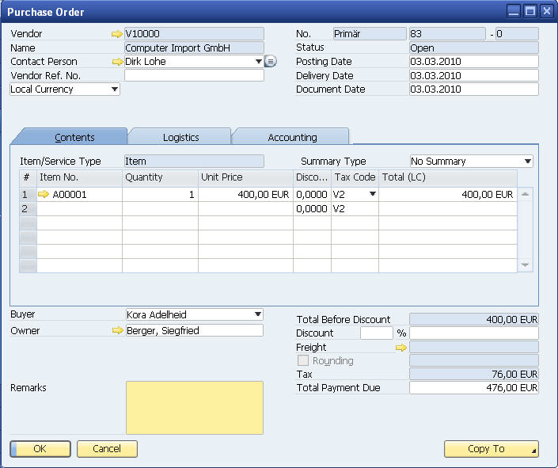
Events: Event Filtering Before and After
Add-on
ItemEvents
x
Event Handler
without vs.
With ( x )
Event Filters
x
x
x
X = NOT included in Event Filter
=> will not get fired to event handler when filter is applied
Notes:
By default, the UI API receives all events triggered by the SAP Business One application.
Without event filtering, all events are sent to your add-on application. Your event handler is called each time an event is raised. This can result in poor performance overall.
If you use event filtering, only the selected events are sent to your add-on application. This results in significantly fewer COM calls and improves performance.
AppEvents are not affected.
Let’s see an example.
After you define an EventFilter, add it to the EventFilters object, and assign it to the Application object, your add-on will start to receive only the events specified in the filters.
If you want to continue to receive MenuEvents, it’s essential to include et_MENU_CLICK in the filter as well.

Slide 17
Events: Event Filtering Sample
oFilters
oFilter et_ALL_EVENTS
form2 142 (Purchase Order)
oFilter et_KEY_DOWN
form1 139 (Sales Order)
oFilter et_ITEM_PRESSED
oFilter et_MENU_CLICK
The add-on will receive only the following events:
et_ITEM_PRESSED for all forms
- Other forms:
Purchase Order - all events (et_ALL_EVENTS)
Sales Order - et_KEY_DOWN and et_ITEM_PRESSED
NOTE: To make sure that MenuEvents are sent to the add-on et_MENU_CLICK needs to be added to the event filter too!
Notes:
Events are filtered by event type and form type.
The add-on indicates the list of required events through the SetFilter() method of the Application object
The event list contains event types for form events, listing all form types for which they will be raised.
The event list cannot contain AppEvents, ProgressBarEvents, or StatusBarEvents.
Most UI API events are notified twice – before they take place in the user interface (BubbleEvent = True) and after they have taken place.
In the current example, the add-on will receive events for all events performed for the purchase order form and only for the key down and item pressed event types for the sales order form.
All other forms will also receive the item pressed event type.
The menu event can be handled by the add-on solution as well, because the menu click event type is registered to the EventFilter.

Slide 18
Events: Filtering Events Code Example
‘1) create a new EventFilters object
oFilters = New SAPbouiCOM.EventFilters
‘2) add an event type to the container
‘ (this method returns an EventFilter (<> EventFilters) object)
oFilter = oFilters.Add(et_CLICK)
‘3) assign the form types on which the event should be processed
oFilter.AddEx(“139”) ‘Sales Order Form
oFilter.AddEx(“142”) 'Purchase Order Form
‘… add a second event type to the container
oFilter = oFilters.Add(et_KEY_DOWN)
‘… assign the form type on which this event should be processed
oFilter.AddEx(“139”) ‘Sales Order Form
‘4) set the event filters object to the application
SBO_Application.SetFilter(oFilters)
Notes:
Here is a code example of how the event filter can be created.
After you create an event filter object, it is important to assign the event type.
You can use the AddEx method to specify the form types related to that specific event type.
The second event container handles the key down event for the sales order form.
Finally, the SetFilter needs to be called for the application object.
You can remove a particular form type from the filter by using RemoveEx.
You can also remove all filters with a Reset() of the Filters collection.

Slide 19
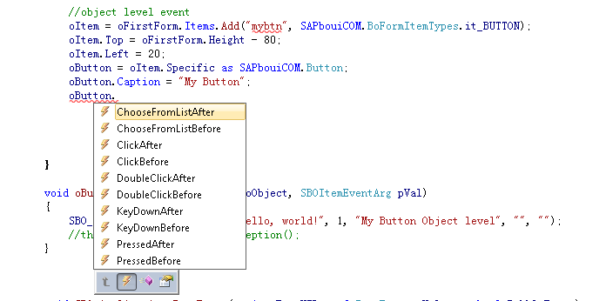
Events: Object Level Events
It’s possible to define a different method handling the ItemEvent per Item object level.
Notes:
Item objects such as Button, ComboBox, EditText and others have events in addition to their properties.
This makes it possible to create events based on the specific item object, making it unnecessary to specifically capture and handle the events for a form and item.
The object level event can simplify the add-on solution complexity, because the other methods of event handling are very low-level. I’m not sure what the author is trying to say here – this is merely one possible interpretation.

Slide 20
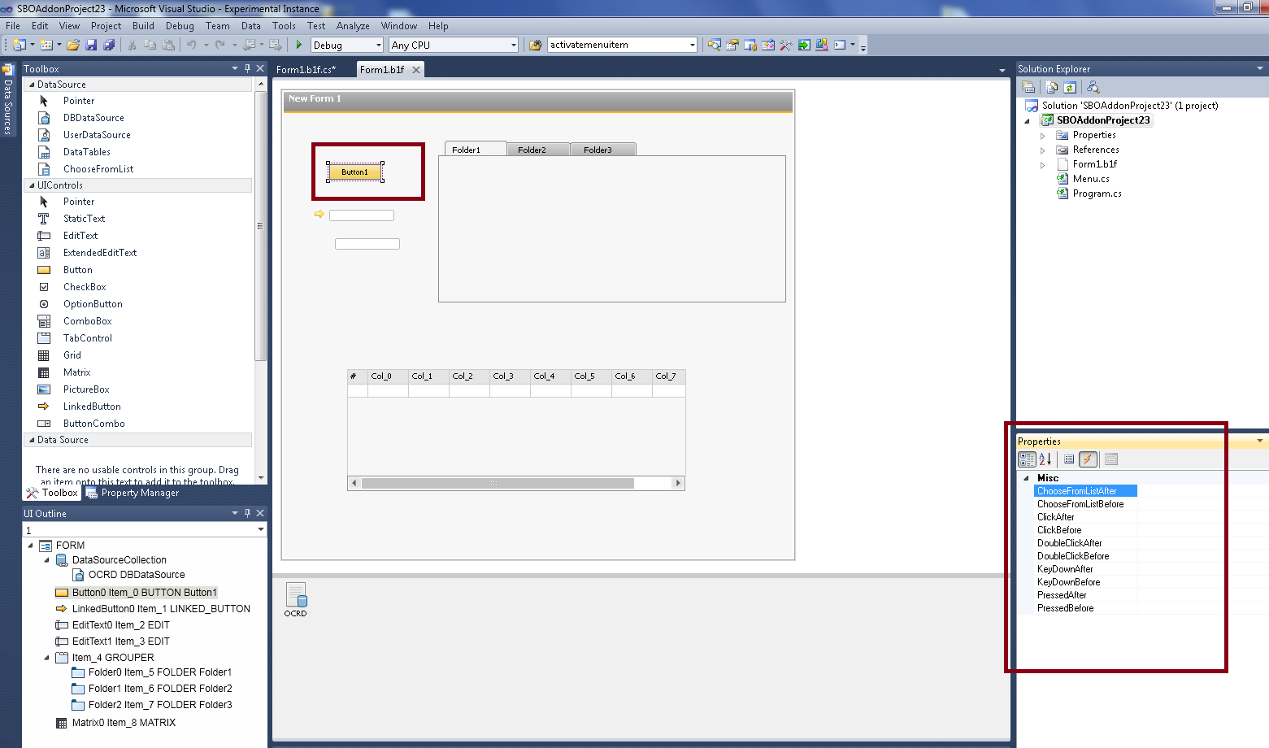
Events: Object Level Events Visual Studio B1 add-in
Notes:
The object level filters are very useful if the forms are designed in the SAP Business One studio, because the event can be assigned immediately at design time.
On the current slide, you can see how the event can be assigned for the button item, using the SAP Business One studio for Microsoft Visual Studio.

Slide 21
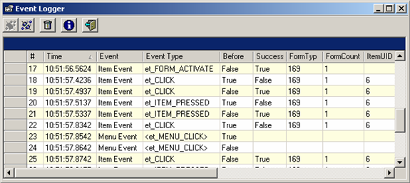
Events: Want to find the “right” event? Use the Event Logger!
EventLogger is part of the SAP Business One Development Environment (B1DE) toolset
Easily identify the events fired by the UI API depending on user actions
Check the information given by SAP Business One for each event – including available event types (ItemEvent, MenuEvent, AppEvent etc).
Notes:
The SAP Business One Development Environment package was published in the SAP Community network.
This package includes a tool called Event Logger, which can collect all SAP Business One UI-based events that are triggered in the graphical user interface.
It captures all user actions and, displays the event details as a result, such as information on the event type, form type, item UID, and so on.
Using this information makes it much easier to create the event filter for the functions you would like customize.
We will also see other SAP Community tools later in this course.

Slide 22

Events : Exercise
You should now practice:
Create handler for FormLoad Event
Create handler for Item Event
Notes:
In the exercise for this section, you will create the application event handler. You will practice handling the FormLoad event and the Item event.

Slide 23
Menus and Handling Menu Event
Notes:
The next topic covers menus and menu event handling.

Slide 24
Menus and Menu Event: Topic Objectives
After completing this topic, you will be able to :
Add and remove menu items
Describe menu event handling
Notes:
After completing this topic, you will be able to
Add and remove menu items
Describe menu event handling

Slide 25
Menus: Relevant Objects and Events
The Menus object is a collection of MenuItem objects
It holds all currently visible menu items
You can add your own menus
You can enable/disable/remove menus
Application
Menus
MenuItem
1..n
SubMenus
…
Forms
Form
1..n
…
Menu
MenuItem
1..n
SubMenus
…
MenuEvent provides notification of menu click events
You can use it to open user forms or to perform other operations
…or to capture (and eventually block) the opening of system forms at a very early stage
Please note that clicks on toolbar buttons are represented as menu events as well
Notes:
The Menus object is a collection of MenuItem objects.
The menu may be the top-level menu or a submenu.
The Menus object holds all currently visible menu items. You can use it to enable, disable, or remove existing menus and add your own menus.
MenuEvent represents a menu event in the SAP Business One application.
You use this object to intervene in SAP Business One processes for this event.
You can use it to open user forms or to perform other operations.
Clicks of toolbar buttons are also represented as menu events.

Slide 26
Menus: Example – Adding a Popup Menu Item
Dim oMenus As SAPbouiCOM.Menus Dim oMenuItem As SAPbouiCOM.MenuItem Dim oCreationPackage As SAPbouiCOM.MenuCreationParams
' Point to the Module SubMenus collection oMenuItem = SBO_Application.Menus.Item("43520") oMenus = oMenuItem.SubMenus
oCreationPackage = SBO_Application.CreateObject( SAPbouiCOM.BoCreatableObjectType.cot_MenuCreationParams)
‘ Set SubMenu values into the MenuCreateionPackage object oCreationPackage.Type = SAPbouiCOM.BoMenuType.mt_POPUP oCreationPackage.UniqueID = "SM_VID“ oCreationPackage.String = "Video Store“ oCreationPackage.Image = sPath & "VID.bmp“ oCreationPackage.Position = -1 ' Some valid position; -1 for the last position.
Try ' If the menu already exists this code will fail
oMenuItem = oMenus.AddEx(oCreationPackage) ' Add the SubMenu item
Catch err As Exception ' Error Handling
SBO_Application.MessageBox(err.Message)
End Try
Notes:
The following example shows how you can create a popup menu item in a top-level menu item.
You want to create a new menu in Modules, which is the main application menu.
This means the MenuItem needs to be set to ID 43520, which represents the Module menu, and the newly created menu will be the submenu for the Module menu object.
You can use the MenuCreationParams object to define the menu properties, such as the type, which is pop up in the current case, or the unique ID and many other properties.
To create the menu, call the AddEx method at the Menus object level. Again, this is only one possible interpretation of the sentence.

Slide 27
Menus: Example – Adding a String Menu Item
' Get the menu collection of the newly added pop-up item Try oMenus = oMenuItem.SubMenus
' Add Menu Item oCreationPackage.Type = SAPbouiCOM.BoMenuType.mt_STRING oCreationPackage.UniqueID = "SM_VID_F1“ oCreationPackage.String = "Movies On Shelf“ oCreationPackage.Image = sPath & "v1.bmp“ oCreationPackage.Position = 1
oMenus.AddEx(oCreationPackage)
Catch err As Exception ' Error Handling
SBO_Application.MessageBox(err.Message)
End Try
Notes:
This next slide describes the creation of the string menu item.
Think of the previously created pop up menu like a folder and the string menu as the content of this folder.
The procedure is the same as in the previous example.
You have to invoke the Menus, MenuItem, and MenuCreationParams objects to create the required menu item.
If you reuse one MenuCreationParams object for several menu items, set all the properties, including Position, every time, because the AddEx() method does not change or increase any property implicitly.

Slide 28
Menus: Additional Information
You cannot add top-level menu items (i.e. at the same level as “File”, “Edit”, “Modules”, “Help”, …)
If you add a menu item with sub-menus to menu “Modules”, it will automatically appear in the “Main Menu” form
If you link menus to a form, they will appear under the “GoTo” top level menu
oForm.Menu.AddEx(oMenuCreationParams)
Every menu item has its unique id
You can export menu items to XML to find out the particular IDs.
You can use „System information“ to find it – just let the mouse pointer hover over the menu item
Context or „right-click“ menus can be modified when handling the RightClickEvent
Notes:
We will now discuss some general rules about using the menus.
It is not possible to create top-level menu items that are located at the same level as the File, Edit, or Modules section.
When you add a menu item to the Modules menu, it is also available in the Main Menu form.
If the menu item is linked to the form, then it is available under the GoTo top-level menu.
Every menu item has its own unique identifier.
It is also possible to export all menu items as XML.
The System Information feature in the SAP Business One client can display the menu item’s UniqueID property.
The right-click menu items can be modified by using the RightClickEvent

Slide 29
Menus: Example – MenuEvent
Private Sub SBO_Application_MenuEvent _
(ByRef pVal As SAPbouiCOM.MenuEvent, _
ByRef BubbleEvent As Boolean) _
Handles SBO_Application.MenuEvent
If pVal.BeforeAction Then SBO_Application.MessageBox _
("Menu item: " + pVal.MenuUID + " sent BEFORE SAP Business One processes it.", _
bmt_Long, _
True)
'// to stop SAP Business One from processing this event '// unmark the following statement '// BubbleEvent = False Else SBO_Application.MessageBox _
("Menu item: " + pVal.MenuUID + " sent AFTER SAP Business One processed it.", _
bmt_Long, _
True) End If
End Sub
Notes:
Let’s take a look at the example for the menu event.
In the current code, we create a SAP Business One message box in which the menu’s UniqueID is displayed, before the SAP Business One event handler performs the business logic. In the else statement, we can see that the same message box will be displayed after SAP Business One handles the event.
Generally this generates 2 message boxes, one each before and after the form is opened.

Slide 30
Menus and Menu Event: Exercise
You should now practice:
Create Menu Item
Handle Menu Event
Notes:
In the exercise for this section, you will create a menu item and handle the corresponding event for it.

Slide 31
Additional Events
Notes:
The next topic covers additional events.

Slide 32
Additional Events: Topic Objectives
After completing this topic, you will be able to :
Know more about the ProgressBarEvent
Know more about the StatusBarEvent
Know more about the RightClickEvent
Know more about the ReportDataEvent
Know more about the PrintEvent
Notes:
After completing this topic, you will know more about the Progress Bar, Status Bar, Right-Click, Report Data, and Print events.

Slide 33
Additional Events: ProgressBarEvent and StatusBarEvent
ProgressBarEvent
Occurs when a progress bar (in the status bar) is created, stopped or released
ProgressBarEvent - holds all the relevant information about the event – essentially the type:
pbet_ProgressBarCreated
pbet_ProgressBarStopped
pbet_ProgressBarReleased
Public Event ProgressBarEvent (ByVal pVal As ProgressBarEvent, ByRef BubbleEvent As Boolean)
StatusBarEvent
Occurs when a message is displayed in SAP Business One’s status bar
Public Event StatusBarEvent (ByVal Text As String, ByVal MessageType As BoStatusBarMessageType)
Notes:
The ProgressBarEvent occurs when a progress bar is created, stopped, or released in the status bar of the application.
In SAP Business One, you can display progress information of heavy operations in the application status bar.
ProgressBarEvent contains all the relevant information about the event: the main event types are ProgressBarCreated, ProgressBarStopped, and ProgressBarReleased.
A StatusBarEvent occurs when a message is displayed in SAP Business One’s status bar.

Slide 34
Additional Events: RightClickEvent Overview
By default all menu entries from Edit, Data and GoTo menus in the SAP Business One application are displayed in the context or right-click menu
RightClickEvent is raised when the user right-clicks an item
To add/remove menus to/from the context menu of an item:
…catch RightClickEvent ‘Before’ and
…add menus to Edit, Data, GoTo menus in the SAP Business One application
In the ‘After’ event user should retrieve changes and/or remove menu changes that should only be temporary
Notes:
The RightClickEvent occurs when a user clicks the right mouse button in a form.
Use this event to create a right-click menu for your add-on forms or to modify the right-click menu for system forms.
By default, the right-click menu displays all the menu items from the Edit, Data, and Goto menus.
If you want to modify the right-click menu for a specific item, catch the event before notification and modify the Edit, Data, and Goto menus as required.
Then, catch the event after notification and remove your changes to restore the menus.

Slide 35
Additional Events: RightClickEvent Code sample for Before Action: Add menu items
Private Sub SBO_Application_RightClickEvent
(ByRef contextMenuInfo As SAPbouiCOM.contextMenuInfo, ByRef BubbleEvent As Boolean) Handles SBO_Application.RightClickEvent
'Adding new menu to Data menu in B1
If (contextMenuInfo.BeforeAction = True) Then
Dim oCreationPackage As SAPbouiCOM.MenuCreationParams = SBO_Application.CreateObject (BoCreatableObjectType.cot_MenuCreationParams) oCreationPackage.Type = SAPbouiCOM.BoMenuType.mt_STRING oCreationPackage.UniqueID = "MyMenu1" oCreationPackage.String = "MyMenu1" oCreationPackage.Enabled = True
' Adding new menu to Data menu in B1
Dim oMenuItem As SAPbouiCOM.MenuItem = SBO_Application.Menus.Item("1280") '1280=ID Data menu
Dim oMenus As SAPbouiCOM.Menus = oMenuItem.SubMenus
oMenus.AddEx(oCreationPackage)
End If
End Sub
Notes:
In the current code example, you can see how the new menu item can be created for the context menu, specifically in the Data menu item.
The new menu item is created using the MenuCreationParams object.
To assign the newly created menu item, you set the application’s menu item to the value 1280, which is the unique ID of the Data menu item.

Slide 36
Additional Events: RightClickEvent Code sample for Before Action: Remove menu items
Private Sub SBO_Application_RightClickEvent( ByRef contextMenuInfo As SAPbouiCOM.contextMenuInfo, ByRef BubbleEvent As Boolean) | Handles SBO_Application.RightClickEvent
If (contextMenuInfo.BeforeAction = True) Then
'Remove menu from context menu only contextMenuInfo.RemoveFromContent("4870") 'Data->Filter & Grid
'Remove menu from context menu by disabling menu 'Edit->Paste
Dim menuItem1 As SAPbouiCOM.MenuItem = SBO_Application.Menus.Item("773") menuItem1.Enabled = False
End If
End Sub
Notes:
In the current code example, you see how the specific menu item can be removed from the context menu.
The RemoveFromContent method needs to be used with the parameter of the submenu item’s unique identifier.
The value 4870 stands for the Filter & Grid submenu item.
The next part of the code only disables the Edit & Past submenu item, which is represented by value 773.

Slide 37
Additional Events: RightClickEvent Code sample for After Action: Cleanup
Private Sub SBO_Application_RightClickEvent
(ByRef contextMenuInfo As SAPbouiCOM.contextMenuInfo,
ByRef BubbleEvent As Boolean)
Handles SBO_Application.RightClickEvent
If (contextMenuInfo.BeforeAction = False) Then
'Enable menu that was disabled in before action (Edit->Paste) Dim menuItem1 As SAPbouiCOM.MenuItem = SBO_Application.Menus.Item("773") menuItem1.Enabled = True
'Remove user menu that was added to Data menu in ‘Before’ Right Click event menuItem1 = SBO_Application.Menus.Item ("MyMenu1") oMenus.Remove(menuItem1)
'No need to add menu removed from MenuContext
End If
End Sub
Notes:
In the last code example for this unit, you can see how the work cleanup can be performed, to reactivate the previously removed or deactivated menu items.
In the previous two examples, the event was handled only when the BeforeAction property was True at the contextMenuInfo object level.
We will now perform an action when the BeforeAction value is False.
The first part involves enabling the Edit & Paste menu item, while the second part removes the newly created menu item called MyMenu1.

Slide 38


Additional Events: ReportDataEvent and PrintEvent
Occurs when an end-user performs one of the following actions:
Click Print or Print Preview icons
Send documents to print using “Document Printing” option
A document is sent to print by the “Document Generation Wizard”
ReportDataEvent
This event lets you get report data in XML format.
In “BeforeAction = True” for this event the add-on has to
signal that it wants to get report data in XML format. It does so by calling RegisterForReport():
eventInfo.RegisterForReport (True)
PrintEvent
Notes:
The ReportDataEvent occurs when a report is sent to the printer. This event lets you retrieve report data in XML format.
If the BeforeAction property has the value True, the add-on has to signal that it needs to receive the report data in XML format.
It does so by calling the RegisterForReport method.
The PrintEvent occurs when one of the following takes place:
The user clicks the Print or Print Preview icons.
The user sends documents to print using the Document Printing option.
A document is sent to print by the Document Generation Wizard.

