Slide 1

TB 1300 - SAP Business One SDK User Interface API – Other Objects
July, 2019
Notes:
Welcome to the User Interface API Other Objects course topic.

Slide 2

Additional Objects: Topic Objectives
After completing this topic, you will learn more about
Grid/Matrix
ChooseFromList
FormSettings
Tab page/Folder
Toolbar
Notes:
After completing this topic, you will know more about the following objects:
Grid/Matrix
ChooseFromList
FormSettings
Tab page/Folder
Toolbar

Slide 3
Grid – Overview
The Grid is planned to replace the longer-established Matrix as a tabular control
Grid is a view of a DataTable
The Grid is responsible for the visual settings
The DataTable is responsible for the data behind the user interface
Grid & DataTable synchronize automatically
Data changes flow from Grid to DataTable and vice versa
Meta-Data / Structural changes are synchronized from the DataTable to its managed Grids
The Grid enables expand/collapse
Notes:
Let’s have a look at the Grid object.
The Grid is a tabular control item that has been created to replace the Matrix item.
The Grid is basically a view of the DataTable data source, in which the Grid is responsible for visualization and the DataTable is responsible for data binding.
The synchronization between the Grid and the DataTable is performed automatically. All the changes made in one of the objects will be automatically executed on the second one.
You can use the expand and collapse features in the Grid object. They are not available in the Matrix object.

Slide 4
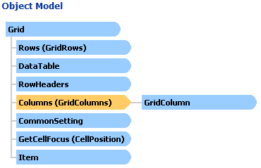
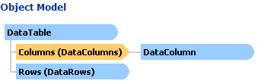
Grid & DataTable – Object Models
DataTable is a type of DataSource
Notes:
The object model for the Grid is displayed on the slide. It contains the child objects such as GridRows, DataTable, RowHeaders, CommonSetting, CellPositions, and Item.
The GridColumns use a collection of GridColumn objects.
The DataTable is kind of collection of the DataSource object.
The DataTable contains the Rows child object and the Columns object collection, which collects the DataColumn child object.

Slide 5
DataTable versus Grid
DataTable
Structural actions
Execute query (+data)
Load from XML (+data)
Add columns
Data Actions
Add rows
Set cell value by data type
Grid
Structural actions
Control of column display types & properties
Expose collapsible view mechanism of existing data
Row selection methods
Data Actions
Set cell value by display type
Notes:
The following differences exist between the DataTable and Grid objects:
The DataTable is responsible for data querying and data load, which might be performed directly on the database with an SQL statement or from an XML file.
It is also responsible for preparing the columns based on the data.
The DataTable adds the rows and sets cell values based on the data type collected from the SQL statement or XML file.
In contrast, a Grid controls the columns display type properties. The expose, collapse, and row selection functions are also handled by this object.
The Grid changes the cell value based on the data type defined for the grid item.

Slide 6
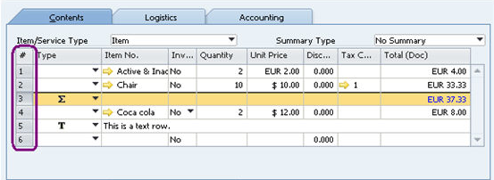
First column in Grid
You can put values into the first column of the grid objects in UI API.
RowHeaders object (property of Grid object):
GetText method
SetText method
TitleObject property
Width property
Note: Manual filling of the first column.
Notes:
It is possible to customize the first column in the Grid object by using the RowHeaders child object.
It represents the row header column of a grid, which is the first column in a grid.
The RowHeaders child object has two public methods – GetText and SetText – along with two properties – TitleObject and Width.
The purple section on the screen highlights the row header in the grid.
Please note that the RowHeaders object needs to be filled manually, otherwise it will remain empty.

Slide 7
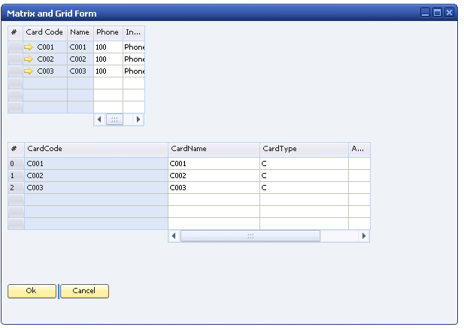
Pinning Column in Grid/Matrix
Pin columns in Matrix/Grid to keep them displayed on the screen when you drag the scrollbar.
Columns with pinning status are in blue color
For both Grid and Matrix, added property in CommonSetting.
Not supported in System matrix, not supported in row pinning.
When the matrix is wide enough to be able to contain all columns, the scrollbar disappear.
When a grid is collapsed, there are no pinning columns existing in grid.
Delete/Hide columns: doesn’t affect the existing behavior
Notes:
Column pinning is a feature that is available for Grid and Matrix objects.
The blue columns are pinned on the screen, which means they remain visible when the scrollbar is used.
The CommonSetting child object has to be used with the property FixedColumnsCount.
The pinning feature is not supported for system Matrix objects or the row level.
The scrollbars are automatically managed by the graphical user interface. This means if the form and the item are wide enough, then the scrollbar will disappear.
When the grid is collapsed, pinning is deactivated.
The pinning feature is not affected by deleting or hiding columns.

Slide 8
Pinning Column: Usage
oGrid.CommonSetting.FixedColumnsCount = 4;
Set FixedColumnsCount value from 1 to oGrid.ColumnCount.
Setting FixedColumnsCount lower than 1 sets count to 1 due to the system grid behavior.
Setting FixedColumnsCount above the actual column count will throw an exception – Invalid column number.
Setting FixedColumnsCount in System matrix will throw an exception.
FixedColumnsCount is based on physical count. Invisible and deleted columns are taken into account.
First column is fixed by default and setting FixedColumnCount to 0 does not affect the first column.
Notes:
Let’s take a look at how pinning can be used. If the FixedColumnsCount is set to 4, then the columns numbered 1 to 4 will be fixed or pinned.
It is possible to pin all columns by using the ColumnCount property at the Grid object level.
If the FixedColumnsCount property value is less then 1, then the system sets it to value 1 automatically.
If the FixedColumnsCount value is more than the existing column count, an exception is raised.
An exception will also be raised if the pinning would be performed on the system matrix item.
FixedColumnsCount is based on the physical count. Invisible and deleted columns are taken into account.
The first column is fixed by default and this behavior cannot be changed.

Slide 9
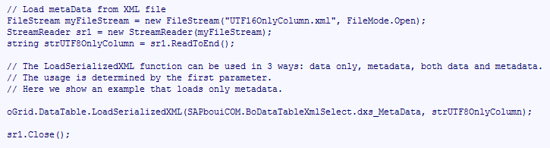
Matrix & Grid: Features (1)
Matrix: GetCellSpecific method
Returns an instance of a specific (unique) item type, such as EditText or CheckBox, for a specific cell.
Grid
You can export the contents of a grid to XML, as well as make changes to the XML and re-import to the grid. Support for loading only data to the Grid – while keeping the layout
DataTable:
LoadSerializedXML method
SerializeAsXML method
GetSchema method
Notes:
We now see some additional features for the Matrix, Grid, and DataTable objects that have been not mentioned yet.
GetCellSpecific is a method for the Matrix object, which returns an instance of a specific item type that can be added to the cell – for example, EditText or CheckBox items.
It is possible to export the Grid object content to an XML file, perform some changes in the XML, and load it back to the grid. Only the data would be changed in the current case, but not the layout.
The DataTable object exposes several methods that help you work with the XML-based data.
For example, the LoadSerializedXML method loads data from an XML string.
The SerializeAsXML method returns information about the data table in XML format.
The GetSchema method returns the XML schema.

Slide 10
Matrix & Grid: Features (2)
Special Lines: The matrix and grid objects now support special lines to mimic the Type column of the marketing documents.
Cells Configuration: In matrix and grid objects, you can now:
Set colors and fonts for rows, columns, and cells
Disable or enable cells
Set and get the focus of a specific cell (GetCellFocus methods of the Grid and Matrix objects)
Cells for Column Total: In matrix and grid objects, you can now use cells that show the total sum of columns.
Notes:
It is possible to define special lines for the Grid and Matrix objects, to mimic the Type column of the marketing documents.
It is possible to change the background color and font for a specific column, row, or cell. Features to disable and enable cells are also available, together with get and set focus.
You can create additional columns, which should contain some summarization information as well.

Slide 11
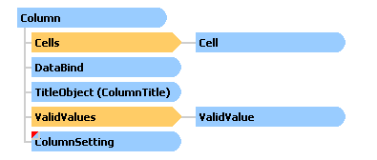


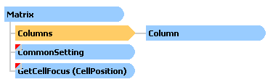

Matrix & Grid: Special Lines
In order to mimic the Type column of the marketing documents you can use the following new features:
Display a ComboBox containing pictures in the Type column of your matrix using the DisplayType property of the ColumnSetting object.
Merge several column cells in a row in order to simulate a Text line by using the MergeCell property of the CommonSetting object.
Draw a black line between two rows in order to simulate a subtotal line by using the SeparateLine property of the CommonSetting object.
Notes:
We have already mentioned the special lines. Let’s see what this feature entails.
The Column object has a child object called ColumnSetting, where the DisplayType property is defined. Using this property makes it possible to set it to edit text or the picture types.
It is also possible to merge several column cells in a row, to simulate a Text line, by using the MergeCell property of the CommonSetting object.
If you need to draw a black line between two rows to simulate a subtotal line, for example, use the SeparateLine property of the CommonSetting object.

Slide 12

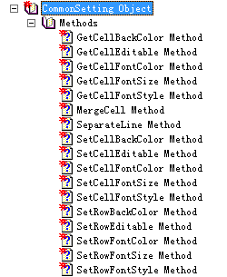
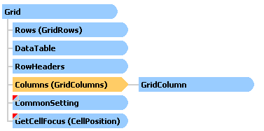
Matrix & Grid: Cells Configuration
SetCellFocus and GetCellFocus properties in Matrix and Grid objects.
CommonSetting property in the Matrix and Grid objects.
Notes:
We will now see how the cell configuration can be done for Matrix and Grid objects.
Each object has the public methods SetCellFocus and GetCellFocus.
The SetCellFocus method is responsible for setting the focus for a certain cell. This method requires the row number and column number as numeric parameters.
The GetCellFocus method returns the position of the selected cell – that is, the cell that currently has the focus.
The child object CommonSetting is available for the Matrix and Grid objects. A number of methods is exposed there. Please refer to the list shown on the slide for more details.

Slide 13
Matrix & Grid: Column Total
In matrix and grid objects, you can now use cells that show the total sum of columns by using the SumType property in the ColumnSetting object, accessible from the Column, ComboBoxColumn, EditTextColumn, CheckBoxColumn, PictureColumn objects.
Notes:
In Matrix and Grid objects, you can now use cells that show the total sum of columns by using the SumType property in the ColumnSetting object. It is accessible from the Column, ComboBoxColumn, EditTextColumn, CheckBoxColumn, and PictureColumn objects.

Slide 14
ChooseFromList: Overview
ChooseFromList (CFL) is the ability to use the built-in lookup functionality form from a trigger item
The CFL form displays a list of objects (of the same type) as a result of a simple query
New functionality will enable developers to apply filters to CFL objects which were defined for system forms
No need to develop lookup forms from scratch
No need to listen to the ChooseFromListEvent, chosen information automatically copied to the corresponding item.
Notes:
A very frequently used object is ChooseFromList. The ChooseFromList object makes it possible to set the display of the choose-rom list for a specified object.
This behavior is widely used in the system form. By using this object you can apply the same behavior without having to code it from scratch.
The choose-from list displays a list of objects as a result of simple query.
There is no need to listen to the ChooseFromListEvent, because the chosen information is automatically copied to the corresponding item.

Slide 15
ChooseFromList: Details
Use CreationParams mechanism to create a ChooseFromList (CFL) object
Set a condition (same object as for DBDataSources)
Connect a CFL-capable item to a CFL (EditText , EditTextColumn, Button):
EditText , EditTextColumn
Property ChooseFromListUID as String (read-write)
Sets the item to be the trigger item for the CFL UID (using a wrong ID will cause an exception)
Property ChooseFromListAlias as String
Alias – Field in database that will be compared in query (using a wrong alias will cause an exception)
Remark: Set the alias after setting CFL UID.
Button
Property ChooseFromListUID as String (read-write)
Sets the item to be the trigger item for the CFL UID (using a wrong ID will cause an exception)
Notes:
The following rules apply to using the ChooseFromList object:
The object needs to be created by using the ChooseFromListCreationParams object.
The condition must then be set. This step is very similar to the condition definition for the DBDataSources object.
Finally, the ChooseFromList object needs to be connected to a choose-from list-capable item, such as EditText, EditTextColumn, or Button.
For the EditText object, the ChooseFromListUID property has to be set.
In an EditTextColumn object, the ChooseFromListAlias property should be assigned.
For the Button object, the ChooseFromListUID property is used.

Slide 16
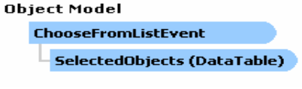
How to handle the Event et_CHOOSE_FROM_LIST
New Event : Choose from List Event “inherits” from ItemEvent
It comes as an ItemEvent, but the structure passed to the event handler is different!
BeforeAction = True
Sent before the ChooseFromList form is opened
If BubbleEvent = FALSE the CFL form will not open – as you would expect.
BeforeAction = False
Sent after the user made his choice (select) or pressed on cancel in the CFL form.
Properties:
ChooseFromListUID as String (read-only)
Please note: For a CFL that was opened from “Find” – the UID of the CFL will be -1
SelectedObjects as DataTable (read-only)
The result is valid/available during the after event only.
Every manipulation on the data should be performed during the event.
Notes:
The choose-from list event is represented as an ItemEvent, but its structure is different.
If the BeforeAction event property is true, then it is possible to create some code before the choose-from list form is opened.
If the Bubble event is set to false, then the choose-from list is not opened.
In this case, the BeforeAction has the false value after the selection is performed on the choose-from list and the form is closed.
The property ChooseFromListUID is read-only and cannot be changed at runtime. The choose-from list form that was opened from Find mode has a UID of -1.
The property SelectedObjects is read-only as well. The results are available only when the BeforeAction property value is false and all data changes should be performed in this stage.

Slide 17
ChooseFromList: Code sample (1)
‘1. Add new ChooseFromList by creation params
Dim oCFLCrParams As SAPbouiCOM.ChooseFromListCreationParams
Set oCFLCreationParams = SBO_Application.CreateObject(cot_ChooseFromListCreationParams)
oCFLCreationParams.IsMultiSelection = False
oCFLCreationParams.uniqueID = "MyCFL"
oCFLCreationParams.ObjectType = "2“
Dim oChooseFromlists As SAPbouiCOM.ChooseFromListCollection
oForm.ChooseFromLists.Add(oCFLCreationParams)
‘2. Connects Item to a ChooseFromList
Dim oItem As SAPbouiCOM.Item
oItem = oForm.Items.Add("MyEdit", SAPbouiCOM.BoFormItemTypes.it_EDIT)
Dim oEdit As SAPbouiCOM.EditText
oEdit = oItem.Specific
oEdit.ChooseFromListUID = " MyCFL"
Notes:
In the current slide, we see how the choose-from list can be created and used in Microsoft .NET.
First of all, the ChooseFromList is created by using the ChooseFromListCreationParams object.
The choose-from list is assigned to the ObjectType 2, which is the Business Partner Master Data. Only one record can be selected because the property IsMultiSelection is false.
The unique identifier of the choose-from list is MyCFL.
Once the choose-from list is created by calling the Add() method, it is possible to connect it to an EditText item.
The EditText object is instantiated by using the Specific interface with the form object.
It is then possible to define the ChooseFromListUID property for the edit text.

Slide 18
ChooseFromList: Code sample (2)
‘3. Get the copy of the current conditions
Dim oCFL As SAPbouiCOM.ChooseFromList
oCFL = oForm.ChooseFromLists.Item("MyCFL")
Dim oConds As SAPbouiCOM.Conditions
oConds = oCFL.GetConditions
‘4. Set the new conditions
Dim oCond As SAPbouiCOM.Condition
If oConds.Count > 0 Then `if there are already user conditions.
oConds.Item(oConds.Count - 1).Relationship = SAPbouiCOM.BoConditionRelationship.cr_AND
End If
oCond = oConds.Add()
oCond.Alias = "CurrTotal"
oCond.Operation = SAPbouiCOM.BoConditionOperation.co_GRATER_THAN
oCond.CondVal = 0
oCFL.SetConditions(oConds)
Notes:
It is possible to retrieve the current conditions from an existing choose-from list object.
This is shown in the upper code snippet. The GetConditions method is used for this operation.
In the lower code part, you can see how the new condition can be created for the choose-from list object.
The if statement verifies whether some additional conditions exist and if so, it adds the AND keyword to join the conditions together. Otherwise this step is not required.
You can then create the new condition by calling the Add() method, defining the column (that is, the operation) and the condition value.
Calling the SetConditions() method creates the condition.

Slide 19
ChooseFromList: Code sample (3)
‘5. Catching the Event
Private Sub SBO_Application_ItemEvent(ByVal FormUID As String,
ByRef pVal As SAPbouiCOM.ItemEvent,
ByRef BubbleEvent As Boolean) Handles SBO_Application.ItemEvent
If pVal.EventType = SAPbouiCOM.BoEventTypes.et_CHOOSE_FROM_LIST Then
Dim oCFLEvent As SAPbouiCOM.IChooseFromListEvent
oCFLEvent = pVal
Dim oCFL_Id as String
oCFL_Id = oCFLEvent .ChooseFromListUID
‘6. The Event after - catching the event and the value in my data source
Dim oDataTable As SAPbouiCOM.DataTable
oDataTable = oCFLEvent.result
Dim resVal as string
resVal = oDataTable. GetValue(1, 0)
oForm.DataSources.UserDataSources.Item(“MyDS”).ValueEx = resVal
Notes:
In the upper section, you see how the event can be caught. It is necessary to create a separated function for this and perform the filtering based on the ChooseFromListUID value.
Once the event is caught, the results from the choose-from list selection can be bound back to the main form using the UserDataSources object.

Slide 20
ChooseFromList: XML Support
<Form>
<ChooseFromLists>
<ChooseFromList UniqueID="1" ObjectType="2" MultiSelection="0" IsSytem="1">
<conditions>
<condition alias="CardType" bracket_close_num="0" bracket_open_num="0" compare_fields="0" compared_field_alias="" cond_end_val="" cond_value="C" operation="1" relationship="0" use_result="0"/>
</conditions>
</ChooseFromList>
</ChooseFromLists>
<Items>
<Item uid="5" type="EditText">
<Specific ChooseFromListUID="" ChooseFromListAlias="CardCode"/>
</Item>
<Column ChooseFromListUID="MyCFL" ChooseFromListAlias="kk" >(EditText/linkbutton)</Column>
<Items>
</Form>
Notes:
The choose-from list can also be created from XML. This is how the SAP Business One studio creates the output.
The form is saved as an XML file and the details about the choose-from list object are available under the ChooseFromLists element.
The choose-from list item type details are available under the Items element.

Slide 21
ChooseFromList: Limitations & Restrictions
Possible trigger item types are Button, EditText and EditTextColumn (use of other types will throw an exception)
The user CFL is opened the same way as a system CFL:
EditText/Edit Column /Link Column – by {TAB}
Button – By press
The table of the CFL object is the header table. Therefore the condition is applied to the header table.
No need to listen to the ChooseFromListEvent, chosen information automatically copied to the corresponding item.
A user-CFL form will always open, even if there is only one match or no match at all
Find mode – Executing find also opens a CFL form but there is no trigger item
CFL form – cancel on ‘new’ button will not raise an “after event”
There’s a 1:1 relationship between the trigger item and the CFL
System CFL limitations
We can’t see the system conditions on CFL. We can only see the Add-On Conditions.
System CFL is not editable - the only change that is allowed is adding conditions
You cannot change the trigger item of system CFL
Changing the trigger item of a user CFL
When new item is bound to a CFL the old one is overridden
When replacing CFL – the old connection of both is overridden
Notes:
You will now learn about the current restrictions and limitations for the choose-from list object.
It is only possible to use it together with Button, EditText, and EditTextColumn objects.
It is opened by clicking the item or by using the TAB key.
The choose-from list is connected to the target object’s header table. The condition can only be set in this table.
The choose-from list event is optional, because the selected value is copied automatically.
The user choose-from list is always shown, even if there is no related record.
In find mode, the choose-from list is also available without the trigger item.
If the cancel or new button is pressed on the form, the after event is not raised.
There is a one-to-one relation between the trigger item and the choose-from list.
The conditions for the system choose-from list cannot be viewed or changed and the trigger item cannot be replaced.
Once the trigger item is changed on the user choose-from list, the connection is overridden.

Slide 22
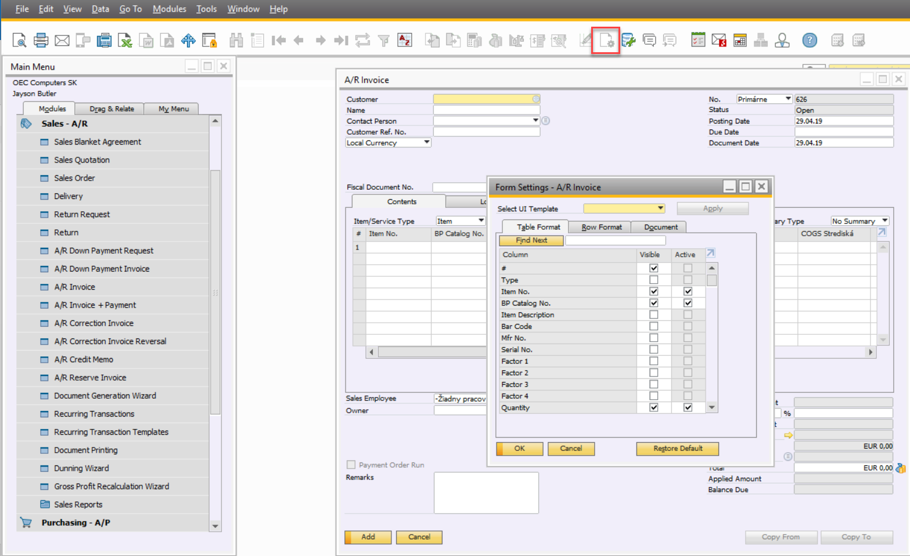
User Form Settings: Overview (1)
The setting button enables users to configure the way a matrix in a form will be displayed
Every column can be toggled as visible and/or active
Notes:
The Form Settings window lets you display or hide frequently used fields, rows, and other options for an active window.
You can also arrange the table or row format in each window, add more details, and restore default settings.
To access the window, choose in the toolbar .

Slide 23
User Form Settings: Overview (2)
Form Settings / Form Preferences (see DI API)
Saving preferences
Form settings are updated when a form is closed
The preferences are held in memory (application cache) until the application is closed or another database selected
When the application is closed the updated preferences are saved to the database (table CPRF)
Loading preferences
Application caches form preferences as it logs in to the company database
When a form is loaded, it loads and applies the settings from cache
User Forms – Preferences are applied automatically only when layout is loaded from XML
Form
Property Settings as FormSettings (read-only)
Only on user forms, exception is raised on system forms
Notes:
The FormPreferencesService in DI API manages the display preferences of a specified form for a specified user.
The Settings child object is part of the Form object in UI API.
The form settings are saved when the form is closed.
The preferences are held in memory until the SAP Business One client application is completely closed or the change company event occurs.
The user form settings are loaded into memory after the user logs in to the company database. As soon as the form is loaded, the settings are applied based on the cache memory settings.
The preferences for the user form are only applied automatically if they is loaded from XML.
Beware of “unexpected” behavior when multiple forms of the same type are opened simultaneously or when the user is logged in in multiple sessions.

Slide 24
Form Settings: Default Behavior
The default behavior expects a form with a “grid”:
The grid is set as the default grid for the settings
The Settings menu will be enabled for the form
The row format and expand line will be enabled for the grid
Disabling this functionality:
The Settings functionality is on by default
To disable it from an add-on, disable the form settings menu item (ID 5890)
To disable the row format and expand line, set EnableRowFormat = False
Notes:
The default behavior of the user-defined form is that it expects a form with a grid item.
The grid is set as the default grid for the settings and the Form Settings menu is available for the form.
The row format and the expand line are enabled for the grid.
It is possible to deactivate the form settings function as well; it is enabled by default.
To do so, it is enough to disable the menu item with identifier 5890.
To disable the row format and expand line, you have to set the EnableRowFormat property value to false for the FormSettings object.

Slide 25
XML Support
<Form>
<Settings MatrixUID="Matrix1" EnableRowFormat="1" />
<Menus> // this enable the setting button (ASK)
<action type="enable">
<Menu uid="5890" />
</action>
</Menus>
</Forms>
Notes:
It is possible to enable the form settings button for the user form using the XML technology.
The settings element specifies the form settings details for a specific item.
The menus element performs the action in connection with the form.

Slide 26
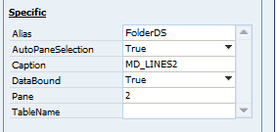
Tab page/Folder: Auto selection
Auto-select the form pane level via the UI API and the B1 Studio.
Two new attributes added in UI API Folder object and Screen Painter:
Pane attribute -> bind the folder with a pane level.
AutoPaneSelection flag -> turn on/off the auto-selection of form pane level.
Notes:
The User Interface API has a Folder object, which makes it possible to create tab pages in the form. This item is also available in SAP Business One studio, to enable rapid form design.
The AutoPaneSelection is a property of the Folder object, which indicates whether the folder allows automatic pane selection. If the folder allows automatic pane selection, then when you click a folder, the UI API automatically sets the form pane level to the pane level bound to the folder.
The Pane property is the associated pane level of the folder. This property only works for folders of user forms.

Slide 27
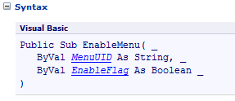
Toolbar: Enablement
Enables activating and disabling toolbar items when your add-on form is in focus.
Form object:
EnableMenu method
Note: You cannot enable or disable toolbar items for SAP Business One application forms.
To enable the application navigation icons for your form use it_BROWSE_BUTTON item type in the Items.Add method.
Notes:
EnableMenu is a method of the Form object.
It lets you activate and disable toolbar items when your add-on form is in focus. In the SAP Business One application, forms control the status of toolbar items. During the form life cycle, toolbars check their items and enable or disable items depending on the form currently in focus.
You cannot enable or disable toolbar items for SAP Business One application forms.
If you want to enable the application navigation icons for your form, use the new it_BROWSE_BUTTON item type in the Items.Add method.

Slide 28
Toolbar: Activation
Simulate a toolbar user button press from UI API.
Application object:
ActivateToolBar method
SBO_Application.ActivateToolbar("4865");
Notes:
ActivateToolBar is a method of the Application object.
This method can be used to simulate a user click on a specific menu item.
The method is called with the unique ID of the item to activate.

