Slide 1

TB 1300 - SAP Business One SDK Development Tools – SAP Business One Studio Suite
July, 2019
Notes:
Welcome to the Development Tools SAP Business One Studio Suite course topic.

Slide 2

SAP Business One Studio Suite: Topic Objectives
After completing this topic, you will learn more about
Tool
Value positioning
Components overview
Notes:
After completing this topic, you will know more about:
Tools
Value positioning
Components overview

Slide 3
SAP Business One Studio Suite
Set of tools to extend SAP Business One, from customization to extension development. SAP Business One Studio (abbr. Studio)
Out-of-the-box solution included in SAP Business One, where you can design the layout of your add-on.
It is an upgraded version of Screen Painter and an open platform for other designers, such as Workflow Designer.
SAP Business One Studio for Microsoft Visual Studio
Development environment highly integrated with Visual Studio 2010, 2013 and 2015 to achieve high satisfaction for partner developers, speed up B1 Add-On development efficiency & learning curve
Partners can develop add-ons with full capability such as UI design, code generate, debug, build, and deployment.
Notes:
SAP Business One studio suite is a state-of-the-art development platform for SAP Business One extensions that dramatically improves partner development efficiency.
SAP Business One studio is an open platform based on the .NET framework for a variety of designers. Currently, this platform supports two types of designer: Add-On Designer and Workflow Designer.
SAP Business One studio for Microsoft Visual Studio is a deeply customized programming environment for SAP Business One. It is highly integrated with Visual Studio 2010, 2013, and 2015.
In addition to the functionalities of SAP Business One studio, SAP Business One studio for Microsoft Visual Studio leverages the powerful capabilities of Microsoft Visual Studio in development functionalities such as code generation, project and item template wizard, code intelligence, friendly GUI, and so on.

Slide 4




SAP Business One Studio Suite: Target Users
Developer
Consultant
Customer IT
UX Designer
SAP Business One Studio for Microsoft Visual Studio
SAP Business One Studio
Suite
Notes:
SAP Business One studio suite can be used by different user groups.
SAP Business One studio for Microsoft Visual Studio should be used by developers, because they have full capability to create the add-on solution.
SAP Business One studio has a more user-friendly user interface and greater ease of use, which is why it is a better fit for non-developer users who are responsible for the forms’ content and appearance.
Examples of such users include SAP Business One consultants, and customer IT staff, or UX designers.

Slide 5
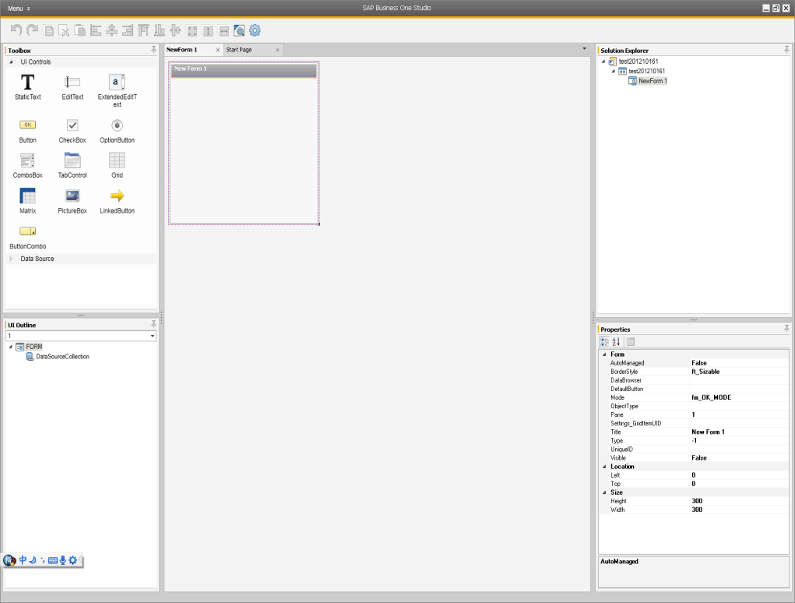
SAP Business One Studio: Highlights
Reduce development effort
Offer better user experience by drag & drop
Cover user/UDO/system forms (compatible screen painter file format)
Open platform for functions like SAP Business One Workflow
Notes:
Key functions and benefits of SAP Business One studio:
Reduced development effort
Better user experience through use of the drag-and-drop feature
Creating and editing the user, system, and UDO forms
Standardized platform with SAP Business One Workflow Designer

Slide 6
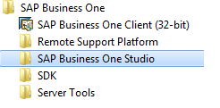
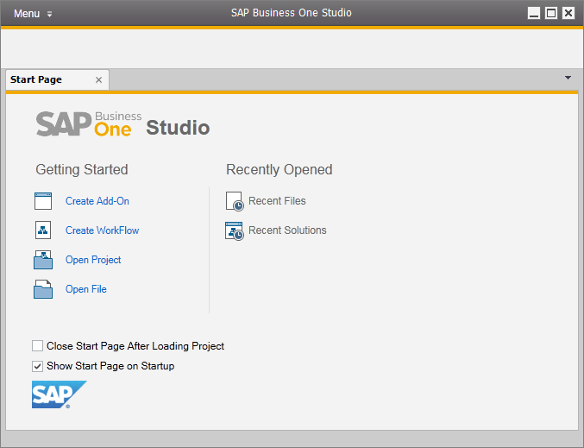
SAP Business One Studio: Start up
All Programs menu -> SAP Business One -> SAP Business One Studio.
Notes:
SAP Business One studio has a separate installer, which is available on the SAP Business One product CD.
After the installation, a new entry is available in the All Programs menu.
You can see the start page of SAP Business One studio on the slide.
You can start your work by choosing one of these options:
Create a new Add-on project
Open an existing Add-on project
Create a new Workflow project
Open an existing Workflow project

Slide 7
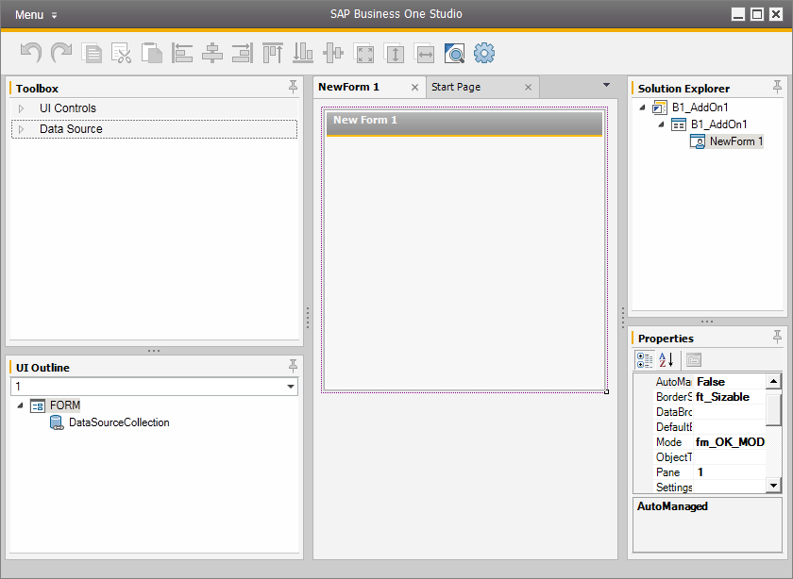
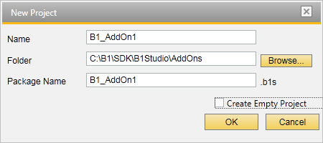
SAP Business One Studio: New Project
Notes:
Let’s take a look at the add-on project creation process. After clicking the Create Add-on option, you are able to specify the add-on name, the project file name, and location. The project file name must be entered to the Package Name field and it has the extension b1s. The add-on package is stored in an XML file, but the extension has different name.
The first user-defined form is created by default. When designing the form, you can use all the UI controls: all form items available in the UI API and the data sources to perform the data binding between the UI item and the database.

Slide 8
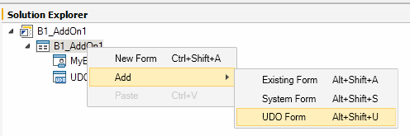
SAP Business One Studio: UI Forms
Create a New Form
Modify an existing form
Existing Form open in B1
System Form (needs to be open in B1)
UDO Form
Notes:
You can create or modify an existing form by using SAP Business One studio.
The classical UI designer is called Screen Painter. The forms created with this tool have their output in the srf file.
You can also add an old srf file to your SAP Business One studio project by choosing Add -> Existing Form.
It is possible to modify the system forms, the SAP Business One client must be running for this operation, because this tries trying to make the UI connection within the existing user session.
The existing User-Defined Object form can be modified as well. To do so, you must have a DI connection set for the SAP Business One database.

Slide 9
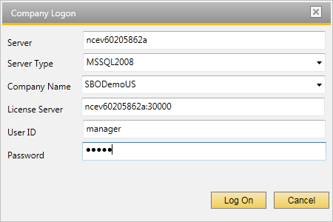
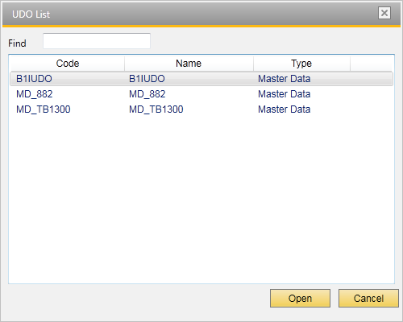
SAP Business One Studio: Add New UDO Form
The corresponding UDO Form will be open for editing once you select a specific UDO from the list.
Notes:
The form for the User-Defined Object is stored in the SAP Business One database table. It is possible to connect to the database by using the DI API connection.
The available User-Defined Objects in the SPA Business One company database are then displayed.
When you select the UDO entry, the UDO form is opened for editing. The changes on the UDO form can be then saved back to the SAP Business One company database.

Slide 10
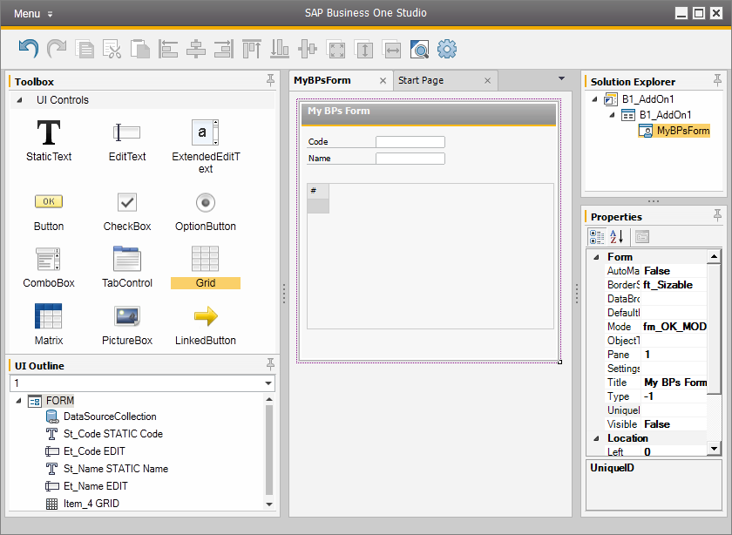
SAP Business One Studio: Create new UI Form
Notes:
The new items can be moved to the form very easily, by using the drag–and-drop feature.
In the Toolbox, which is on the left side, you can find all the UI items that have been exposed in the UI API.
The item specification can be modified or added on the right side, in the Properties section.
This windows displays all properties that are exposed for the specific item.

Slide 11
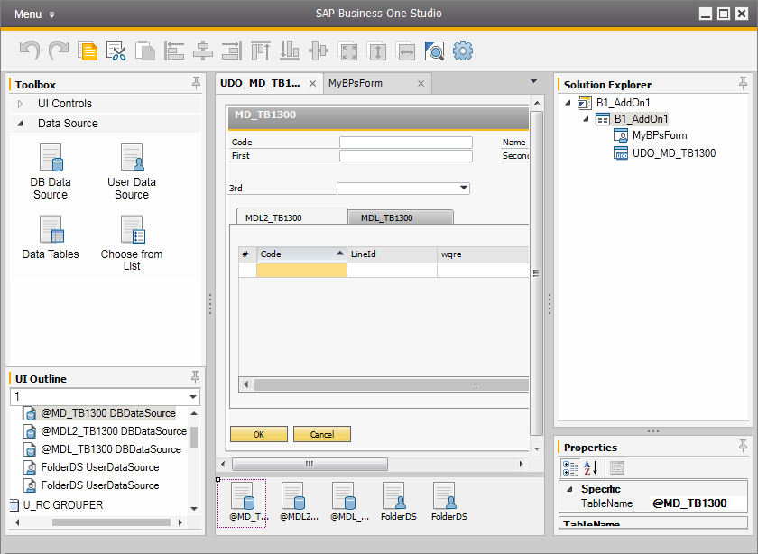
SAP Business One Studio: Data Sources
Notes:
The items on the form without data binding are not very useful. That’s why it is essential to map the UI item to the database table fields.
This is also the reason why the data sources are exposed in SAP Business One studio.
In the data sources, you will find all known data sources from the UI API – DB Data Source, User Data Source, and Data Tables. The choose-from list has its own data source entry, to consume it easier at design time.
The data sources also need to be moved to the form and will appear at the bottom of the screen. It is then possible to define the properties and other specification of the data sources.

Slide 12
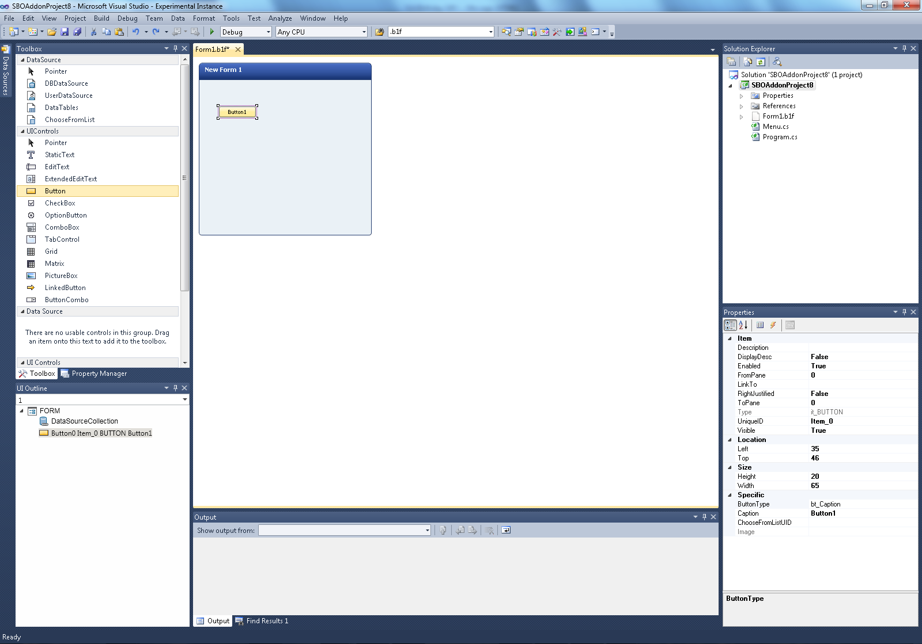
SAP Business One Studio for Microsoft Visual Studio: Highlights
Leverage Visual Studio (SAP Business One supports C# and VB.NET)
Design and develop user/UDO/system forms and event handling by drag & drop
Add-On code generation based on SDK UI Object Level Event
Shared input and output between Studio and Studio for VS
Notes:
We now see the key benefits and features of SAP Business One studio for Microsoft Visual Studio.
Leverage Microsoft Visual Studio with SAP Business One SDK by using the .NET programming languages
Creating and editing the user, system, and UDO forms
The Add-on code generated for UI API object level events

Slide 13
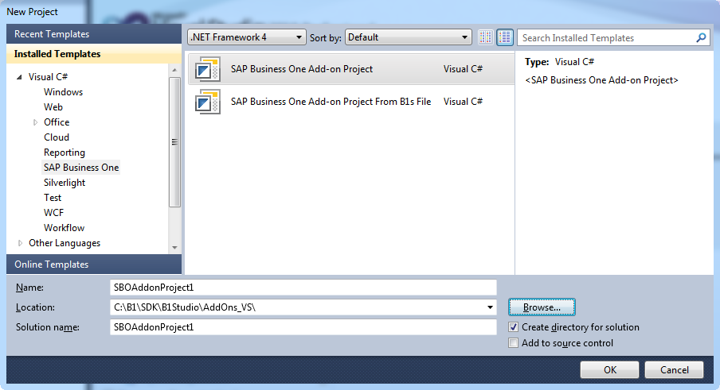
SAP Business One Studio for Microsoft Visual Studio
Started from Microsoft Visual Studio -> New Project
Notes:
A new template has been installed into Microsoft Visual Studio for C# and Visual Basic languages.
It is possible to use a template directly in Microsoft Visual Studio to create a new add-on project.
Alternatively, it is possible to use a b1s file that was created previously in SAP Business One studio and create an add-on based on that file.

Slide 14
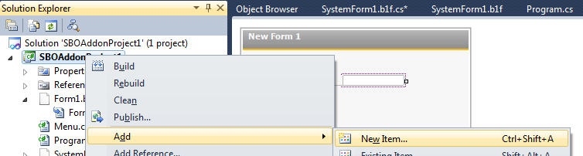
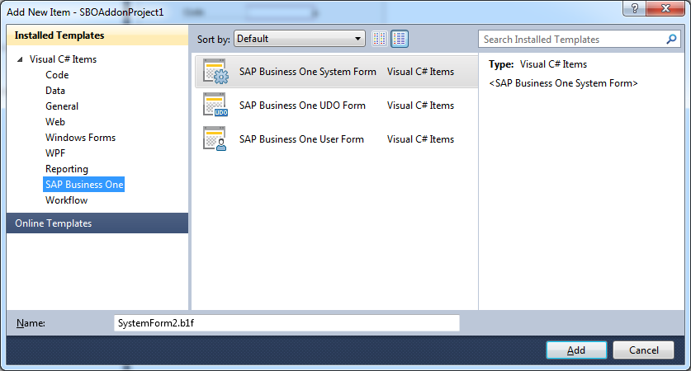
SAP Business One Studio: Add New Item
Select your project -> Add New Item.
Notes:
Microsoft Visual Studio has new item types where the form can be added. Similar to SAP Business One studio, some of them require a UI or DI connection.
The user form can be created without a connection at the time of design and coding.

Slide 15
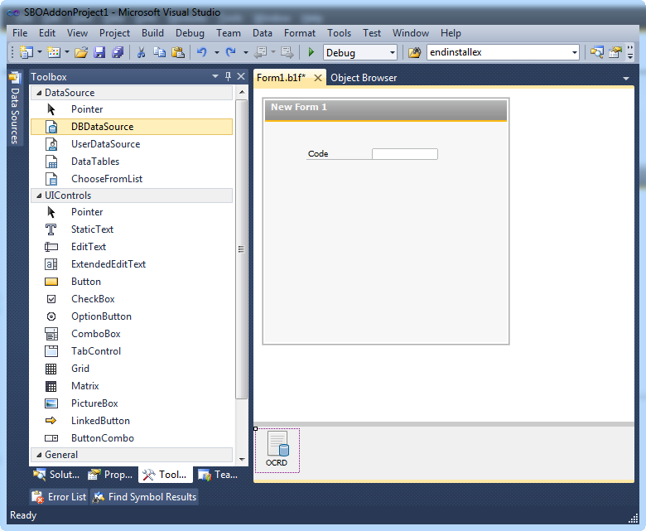
SAP Business One Studio: UI Forms designer
Notes:
The design of the user form in SAP Business One studio for Microsoft Visual Studio is very similar to the process that is available in SAP Business One Studio.
You can drag and drop the items from the toolbox to the form. In the current form, you can see that the StaticText and the EditText items have been created together with the DBDataSource object.

Slide 16
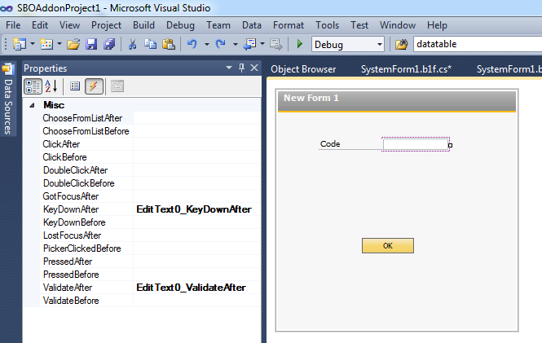
SAP Business One Studio: Events
Select the Item -> Properties -> Select Event Icon
Double click on the selected Event type to have a new method created
or
Select one of the available methods if a ComboBox is proposed.
Notes:
It’s very convenient to use object-level events in SAP Business One studio for Microsoft Visual Studio.
After you select the specific item, like a button, the property window contains the Event icon.
You can double click the event type list to create a new function, which you can then customize.
Alternatively, you can use the combobox to select the available functions.

Slide 17
SAP Business One Studio: Typical Use Cases
case 1: consultant designs a Add-On form in Studio, a developer programs this form in Studio for VS.
case 2: customer IT designs and implement a UDO in Studio for VS.
case 3: developer implements a Add-On from scratch in Studio for VS.
case 4: consultant/UI designer draw a form in Studio; a developer loads it by raw API.
case 5: continue developing old SRF generated from ScreenPainter in Studio for VS.
Notes:
Let’s have look at a few typical use cases for SAP Business One studio suite.
CASE 1: An SAP Business One consultant is uses SAP Business One studio to design the user form, based on the customer’s requirements.
The output file is shared with the developer, who will import the form to the add-on solution and who will continue to develop the additional features for the form using SAP Business One studio for Microsoft Visual Studio.
CASE 2: The customer’s IT can design and implement the user-defined object form by using the SAP Business One studio for Microsoft Visual Studio.
CASE 3: The developer creates an add-on solution from scratch by using SAP Business One studio for Microsoft Visual Studio.
CASE 4: The UI designer draws a form in the SAP Business One studio and the developer loads it via raw API.
CASE 5: You can continue to develop the old SRF form generated in Screen Painter using SAP Business One studio for Microsoft Visual Studio.

Slide 18

User Defined Objects: Exercise
You should now practice:
Project creation
Menu item creation
Form creation
Notes:
In the exercise for this part, you will practice creating a project, menu item, and form creation using SAP Business One studio.

