Slide 1

TB 1300 - SAP Business One SDK Development Tools – SAP Business One Workflow
July, 2019
Notes:
Welcome to the Development Tool SAP Business One Workflow course topic.

Slide 2

SAP Business One Workflow: Topic Objectives
After completing this topic, you will learn more about
Workflow
Value positioning
Components overview
Notes:
After completing this topic, you will know more about:
Workflow
Value positioning
Components overview

Slide 3

Introduction
The SAP Business One Workflow enables user collaboration and business process management from process definition, process execution and process tracking in an easy and effective way.
It brings instant value to customer, including increase process transparency, user productivity and communication efficiency. Meanwhile it also provides partners more extensibility capability to create best practice processes for certain industries.
Notes:
SAP Business One Workflow enables user collaboration and business process management for process definition, process execution, and process tracking in an easy and effective way.
It brings instant value to customers, including increased process transparency, user productivity, and communication efficiency. It also gives partners more extensibility capability to create best practice processes for certain industries.
A workflow is a business process that consists of a series of connected tasks or events in sequence.
In SAP Business One, workflows provide a consolidated entry for users to process all the tasks they are involved in.
They also give the management overall control of the business process and help to enhance the operational efficiency of the company.

Slide 4
Value Proposition
Customer
Partner
SAP
Process transparency and standardization.
Increase user productivity and communication efficiency.
Effective process controlling.
More extensibility to create differentiation.
Make best practice process and implement to customer.
Notes:
SAP Business One Workflow is a new platform that enables users to define workflows and the corresponding business processes in Business One. It aims to provide greater process transparency and standardization across Business One, increase user productivity, and promote greater collaboration and efficient communications. This platform is an effective way to control processes.

Slide 5
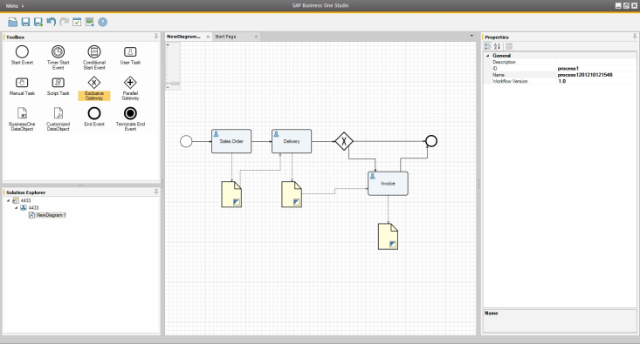
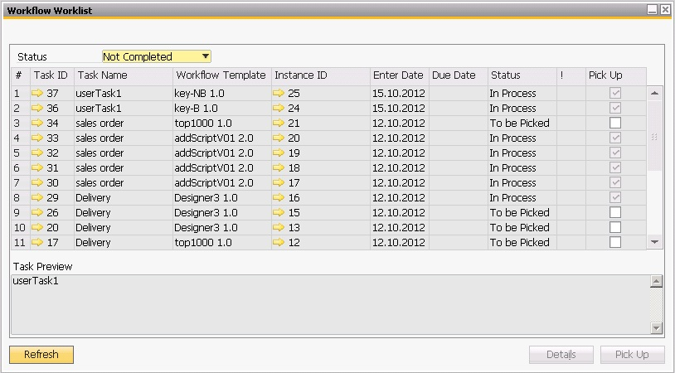
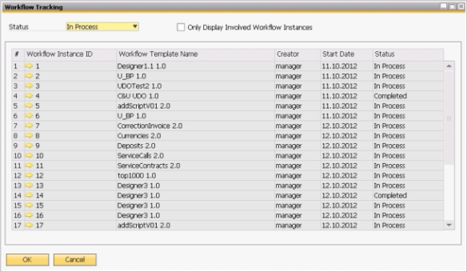
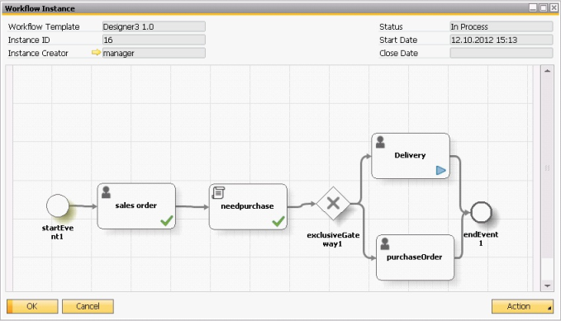
SAP Business One Workflow
Workflow Manager
Workflow Worklist
4 components:
Workflow Manager – manages the workflow process template and imports XML generated in the workflow designer. Inside SAP Business Studio.
Workflow Instance – starts the process based on the workflow template and visualizes the process to inform end users of the process status.
Workflow Worklist – user finds and picks up a task
Workflow Monitor – checks the status of all process instances
More info → http://sappartneredge.com/B1/howtoguides
Workflow Monitor
Workflow Instance
Notes:
There are two main components to Business One Workflow.
The first step is to design your workflow in the SAP Business One studio and visualize your process.
The next step is the user Task list: the workflow is imported into SAP Business One as a task list in a workflow inbox for execution and monitoring.
Process visualization provides transparency.
The Workflow Engine is a service that runs on the SAP Business One server and is part of the SAP Business One Server Tools package.
Workflow in SAP Business One enables end users to operate workflows with the following features:
The Workflow Manager manages the workflow process template and imports XML generated in the workflow designer
The Workflow Instance starts the process based on the workflow template and visualizes the process to inform end users of the process status
The Workflow Worklist finds and picks up the tasks
The Task Detail executes and process the tasks
The Workflow Monitor checks the status of all process instances

Slide 6

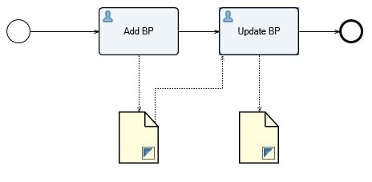
SAP Business One Workflow: Business Example
OEC Computers has dedicated users responsible for financial relevant data at Business Partner Master Data.
Therefore, once new Business Partner Master Data is created the responsible user should get a task to check and complete the financial data at this new Business Partner Master Data.
OEC Computers
Bryce the accountant, wants to get full control of new business partners created in the system.
You tell him about the Workflow solution in SAP Business One.
Notes:
Let’s see a business example of how SAP Business One Workflow can be used for business process management.
OEC Computers has dedicated users responsible for financial relevant data in Business Partner Master Data.
Therefore, when new Business Partner Master Data is created, the responsible user should be sent a task to check and complete the financial data in this new Business Partner Master Data.
Bryce the accountant wants to get full control of new business partners created in the system.
You tell him about the Workflow solution in SAP Business One.

