Slide 1

TB 1300 – SAP Business One SDK Cross DI API / UI API – User-Defined Objects
July, 2019
Notes:
Welcome to the Cross DI API and UI API User-Defined Objects course topic.

Slide 2

User-Defined Objects: Topic Objectives
After completing this topic, you will be able to:
Describe the SAP Business One objects
Explain why UDOs may make sense
Implement UDOs step-by-step
Use DI API’s GeneralService to maintain UDO data
Use UDOs within an add-on
Notes:
After completing this topic, you will be able to:
Describe the SAP Business One objects
Explain why UDOs may make sense
Implement UDOs step-by-step
Use DI API’s GeneralService to maintain UDO data
Use UDOs within an add-on

Slide 3

Cross DI API / UI API Features: Business Example
Create and use some additional objects that are not covered yet by the current SAP Business One system definition with the help of user-defined objects (UDOs).
Notes:
A typical use case for this topic might involve creating and using some additional objects that are not covered yet by the current SAP Business One system definition with the help of user-defined objects.

Slide 4
User-Defined Objects: Benefits
User-defined business objects will be added to the SAP Business One application objects collection.
User-defined business objects come with a set of basic functionalities (named “services”) that are common for any business object in SAP Business One.
Object Collection
UDO
New partner object
Predefined Services
Register the object for services
Notes:
A typical use case for user-defined objects involves adding new business logic to the SAP Business One application.
It simplifies the add-on development process, as the bulk of the implementation is provided automatically.
This is a fast way to develop any add-on that works with data from user-defined tables in a database format used for UI.

Slide 5
User-Defined Objects: Object Types
The SBO application supports two main types of objects:
Master data objects – business partners, for example
Documents (such as sales orders)
The document object supports methods that are not implemented in master data objects, such as:
Document numbering (serial numbers)
Close
Notes:
A user-defined object may have two types of objects:
A master data object (business partners, for example)
A documents object (such as the sales order in question)
A user-defined object of the document object type supports some additional methods on top of those supported for master data.
The closing and numbering of documents are typical examples of this difference.

Slide 6
User-Defined Objects: Predefined Services
Service | Description
Add | Adds a new record of the object to the DB.
Update | Updates the fields of the object in the DB.
Find | Supports “Choose From List” for the object.
Close | Only relevant for user-defined objects of the document data type.
Cancel | Only changes the record‘s status to "Cancel = Y”.
Delete | Master data – deleting record, Doc – no effect.
Manage Series | Relevant to document objects. Adds the object to the Document Numbering form and manages the series for that object..
Log | Creates a log table for the object and saves its history.
Default Form | Creates a default form for the object that manages all the services.
Year Transfer | Copies the tables and the records in the Year Transfer operation (only released for the Netherlands and Israel).
Notes:
This slide presents the most frequently used services (or “methods”) for user-defined objects.
Add – Adds a new record of the object to the database.
Update – Updates the fields of the object in the database.
Find – Supports “Choose From List” for the object.
Close – Only relevant for user-defined objects of the document data type
Delete – This function works only for removing an entry from objects of the master data type.
Manage Series – Relevant to document objects. Adds the object to the Document Numbering form and manages the series for that object.
Log – Creates a log table for the object and saves its history.
Default Form – Creates a default form for the object that manages all the services.

Slide 7
Information Flow Between Add-ons and SAP Business One Using DI API and UI API
UI API
Partner add-on
GUI layer
System
form
Each add-on implements a basic functionality itself:
Numbering
Log
Add
Find
Update
And more
User-defined form
Business layer
DI API
System
objects
Interface to table, no logic
DB layer
System
table
User-defined table
Notes:
In the following diagram, you can see how custom functionality can be achieved in the add-on solution.
All basic functionalities are implemented in the add-on solution, and all methods or actions need to be coded from scratch.
User-defined objects were introduced to solve the current issue and simplify development needs.

Slide 8
Flow Between Add-ons and SAP Business One Using UI API and UDOs, Including Implementation DLL
UI API
UI add-on
GUI layer
Predefined service register for the object
System
form
Add, Update…
History log
Series
User signature
Year Transfer
User-defined form
Create user form and connect it to the defined object
Business layer
System
objects
User-defined object
UDO implementation
DB layer
System
table
User-defined table
Notes:
After running the UDO wizard, your object will be registered to SAP Business One services. It’s possible to create the UDO directly from the add-on solution.
User-defined objects help you create custom objects and carry out basic operations like modifying UDO entries or searching among records.
It’s not necessary to develop the standard feature in the add-on solution because the UDO offers this already.

Slide 9
User-Defined Objects: Implementation Steps
Define base table:
Create user table(s) with user fields that will hold the data for your new business object.
Register the required services for your new business object.
Create a UI form (optional)
Create the user-defined object
By means of the client wizard or DI API code
Object implementation (optional):
Implement base class methods that may need to be extended by the object.
Notes:
Let’s see how a user-defined object can be implemented.
A user-defined object first needs to be created with the master data or document type.
The services then need to be selected during the creation of the user-defined object.
It is possible to create a default form, create a menu entry, or implement some additional classes for the user-defined object in order to overwrite the standard functionality.
All these steps can be done in the source code or from the user interface.

Slide 10
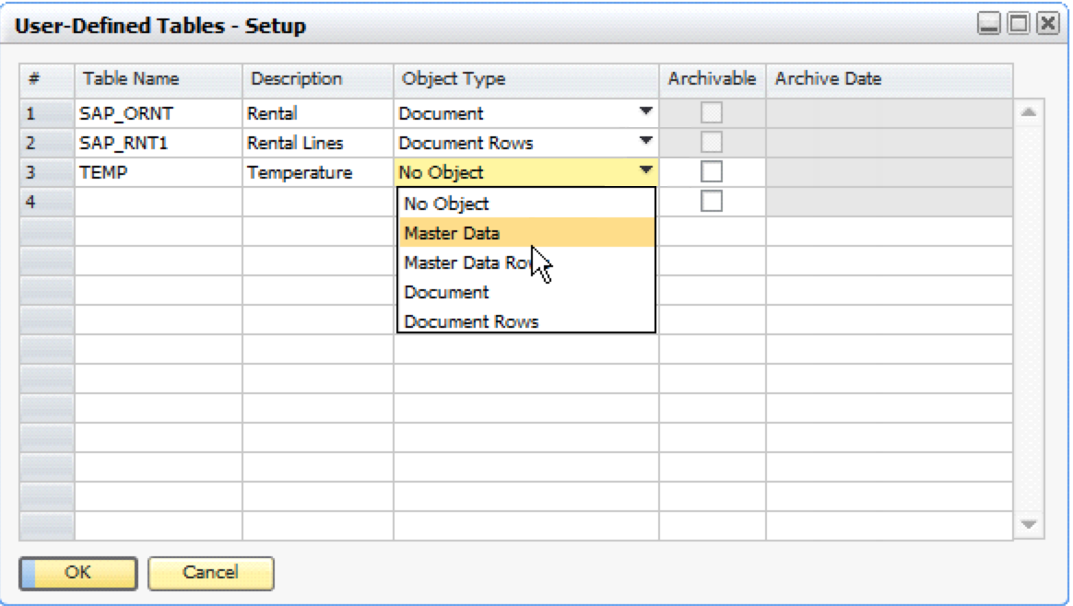
User-Defined Objects: Define Base Tables
Create user table(s) with user fields that will hold the data for your new business object.
Use the SAP Business One application
(Tools → User-Defined Fields → Manage User Fields → User Tables)
Use the DI API Metadata object
(UserTablesMD and UserFieldsMD)
Do not forget to choose the suitable object type.
Notes:
Now we can have a look at table creation using the user interface.
The object type should be master data or documents. The master data rows and document rows are only the child table for the user-defined object.
In the case of DI API, the UserTablesMD and UserFieldsMD objects are used, but we will cover that process later.

Slide 11
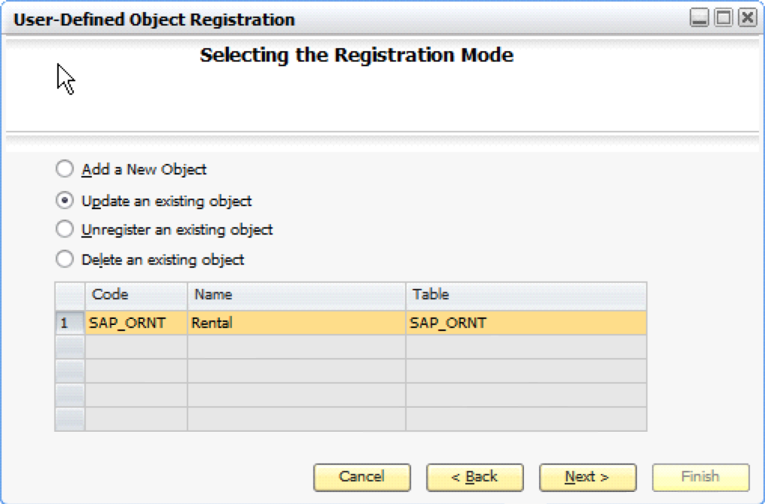
User-Defined Objects: Registration Step 1 - Using the Wizard
The registration wizard helps you register your user-defined objects.
Registration takes place for each company.
From the SAP Business One menu, choose Tools → User-Defined Objects → Registration Wizard
Notes:
After executing the User-Defined Object Registration Wizard, it’s possible to select an action, such as create, update, or delete.
The user-defined object is defined for a specific company database.

Slide 12
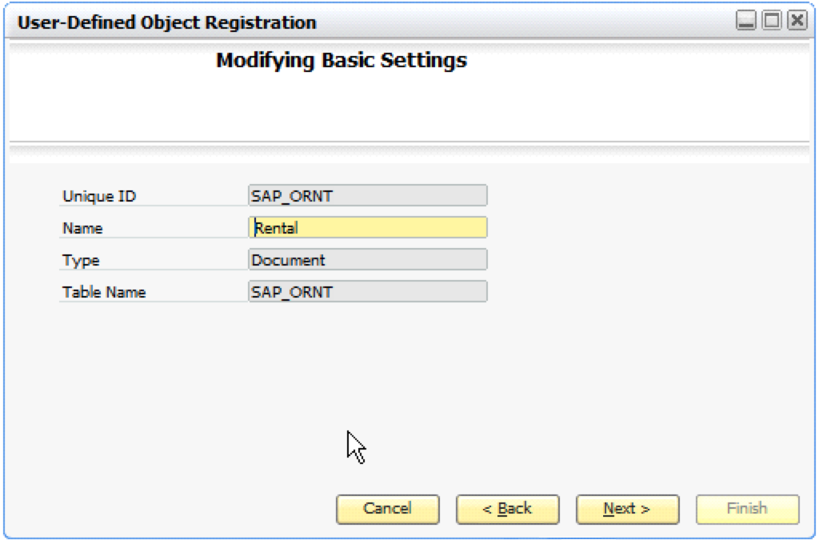
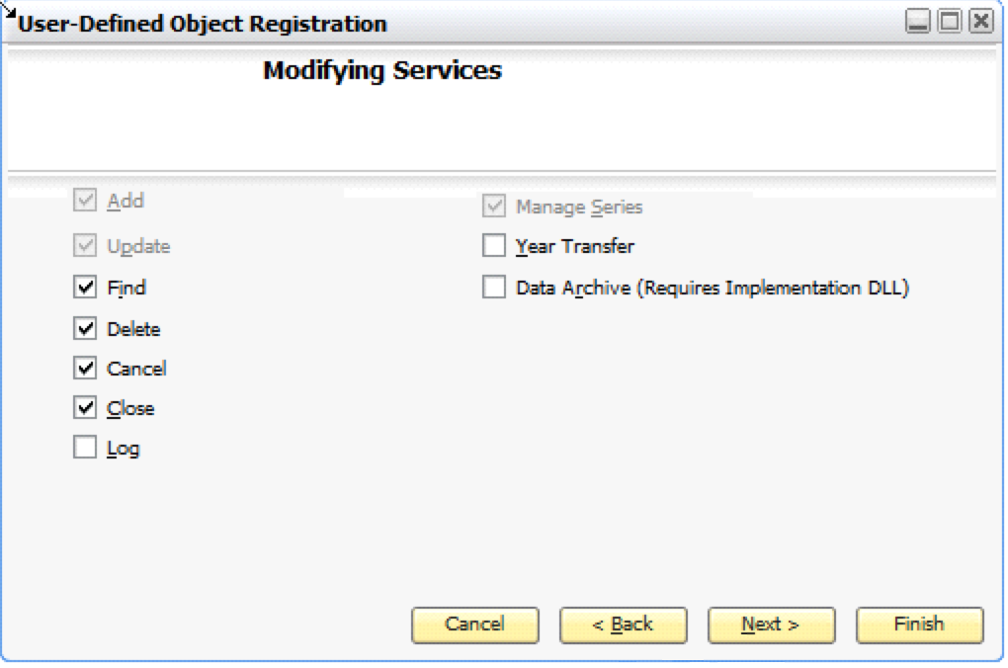
User-Defined Objects: Registration Step 2 – Basic Settings and Step 3 – Services
Set a unique ID for your object (use namespace)
Set the object type
Set the header/parent table
Register for services.
Add and Update are the basic services and cannot be deselected.
Notes:
During the user-defined object creation process, the Unique ID, Name, Type and Table Name fields need to be filled. The table name property is bound to the selection list, where you can pick an existing table based on the exact type.
In the next phase of the wizard, you can select the required services, such as Find, Delete, or Cancel.

Slide 13
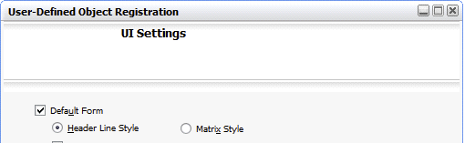
User-Defined Objects: Default Form Step 4 – Default Form (optional)
You can choose between two UDO form styles:
A form with a matrix only (old style)
A form with a header area and a lines area (new style)
Notes:
A user-defined object has a default form creation feature. This feature is also accessible to the user interface, so there is no need to have it provided by an add-on solution.
You can select from two styles. The matrix style is the historical one.
The header line style comes with the separation of the form from the header and line parts. Here, it is similar to the master data and document system forms.

Slide 14
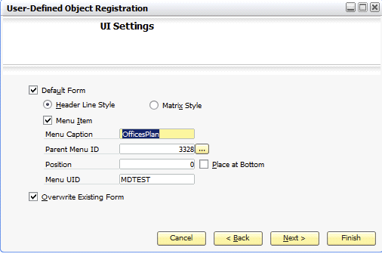
User-Defined Objects: Registration Step 4 – Menu location (optional)
Specify the menu location of the UDO in the SAP Business One main menu.
Notes:
Since user-defined objects are usually frequently used because a customer’s business processes require them, it is possible to place the form of a user-defined object directly in the main menu.
In the generation wizard, you can also specify this feature with the properties required to create the menu item.

Slide 15
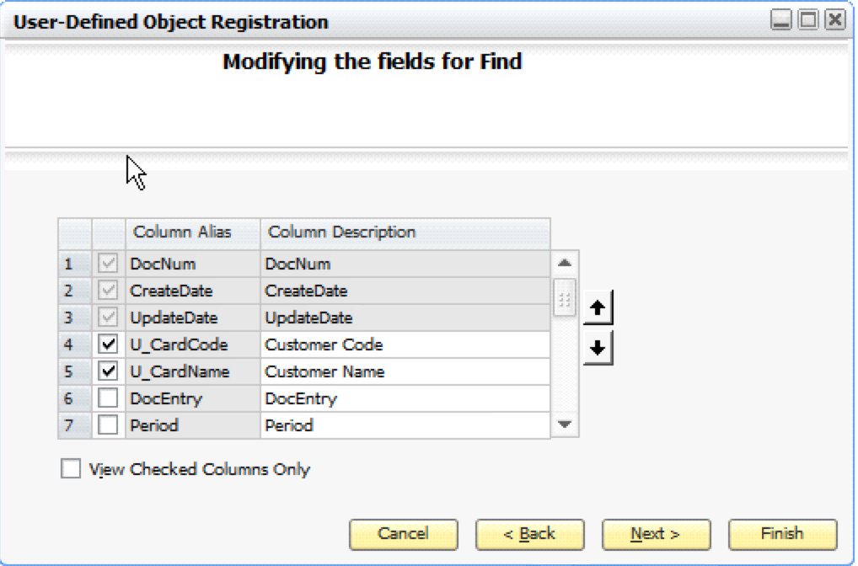
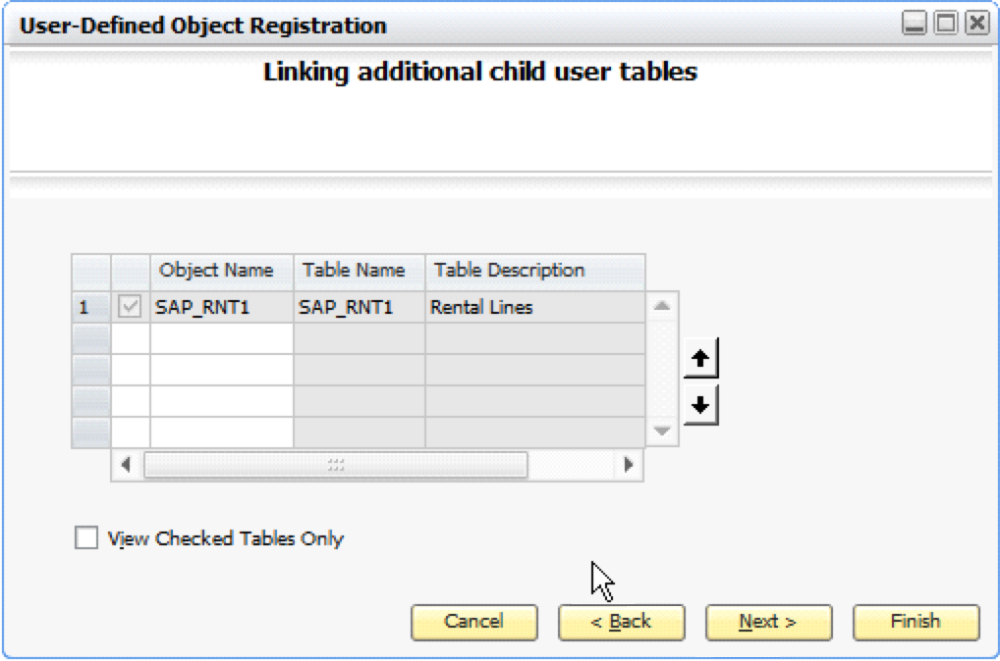
User-Defined Objects: Registration Step 5 – Fields for “Find” and Step 6 – Select child tables
If the Find service was selected:
Select the fields from the parent table to be displayed in the find form.
Select the Child tables of the object.
Only suitable tables are displayed in the list.
Notes:
In the next step, it‘s possible to define the fields in which the find function can be used.
The additional step of the wizard is about the definition of child user tables.
You can select the row tables here, which should be part of the user-defined object.

Slide 16
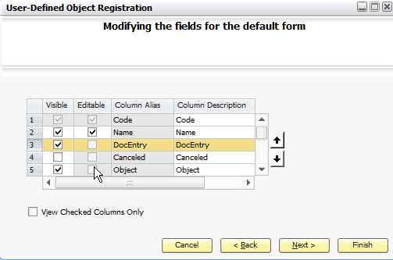
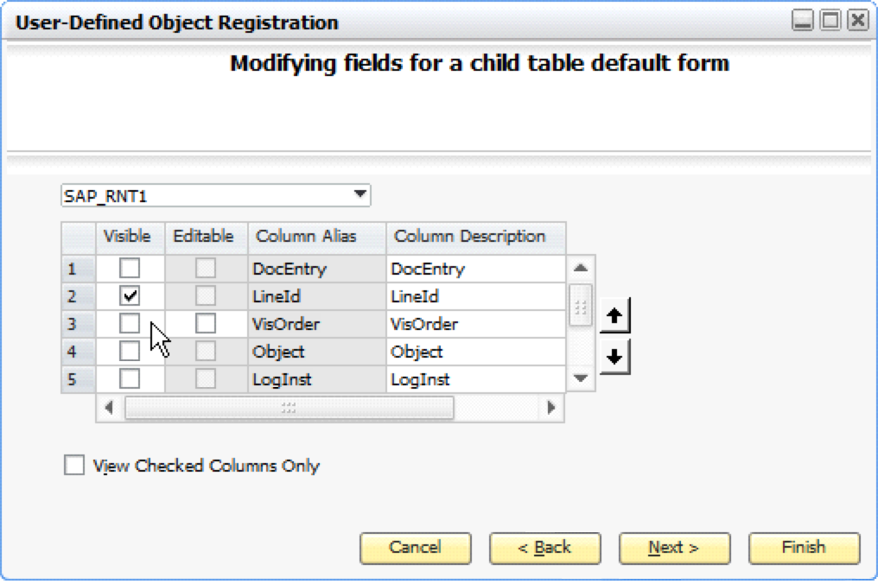
User-Defined Objects: Registration Step 6 – Define “Default Form” (optional)
If the Default Form service was checked:
Select fields from parent table to be displayed in the default form.
Select fields from one child table.
Notes:
If the Default Form service was selected, a wizard step (as pictured on the left) enables you to define the visible fields on the default form.
These fields come from the header table.
The next step is to define the visible fields for the child table(s). This is depicted on the right side of the slide.

Slide 17
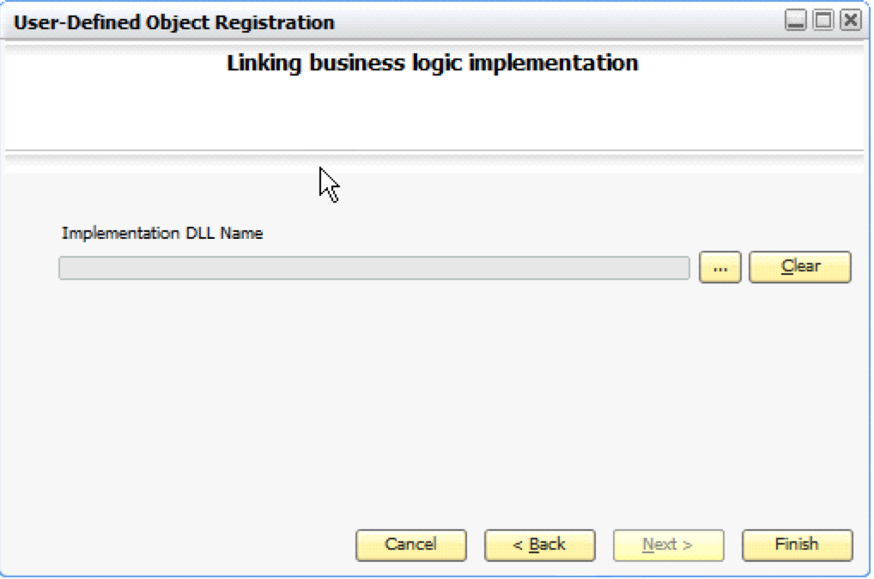
User-Defined Objects: Registration Step 7 – Implementation DLL (optional)
Set the Extension DLL file (optional).
Notes:
In the final phase of the wizard, it’s possible to attach a class written in C++ language.
This feature will allow you to overwrite the standard services line, add the object, or just add some additional services for the user-defined object.

Slide 18
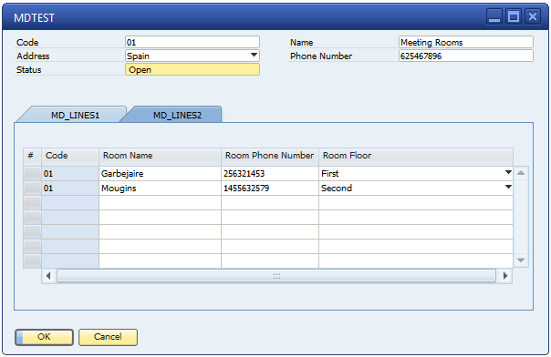
User-Defined Objects: Default Form Example
Notes:
This is an example of the default form using the header line style. It‘s very similar to the system form user for master data and document objects.

Slide 19
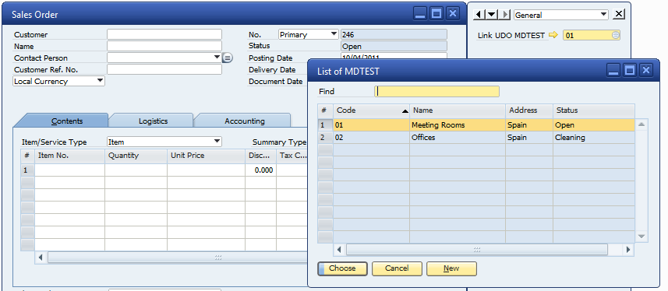
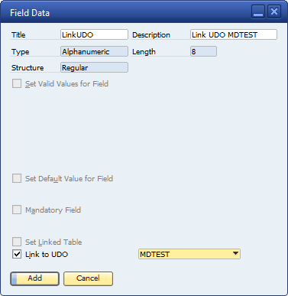
User-Defined Objects Link between user-defined fields and user-defined objects
New checkbox “Link to UDO” added to the user-defined fields (UDFs) management form.
Supported by the LinkedUDO property of the UserFieldsMD object in the DI API.
Notes:
It‘s possible to create a link between user-defined fields and user-defined objects.
This operation needs to be performed at the user-defined field level.
A user-defined field has a checkbox called “Link to UDO” in the user interface, where you can select from the existing user-defined objects using the ComboBox item.
It’s also possible to configure this feature using the DI API’s UserFieldsMD object, where the LinkedUDO property needs to be set.
As a result, you will see a selection list with the records of the user-defined object. If the record list is empty, then it’s possible to create a new object entry using the New button.

Slide 20
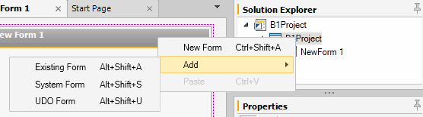
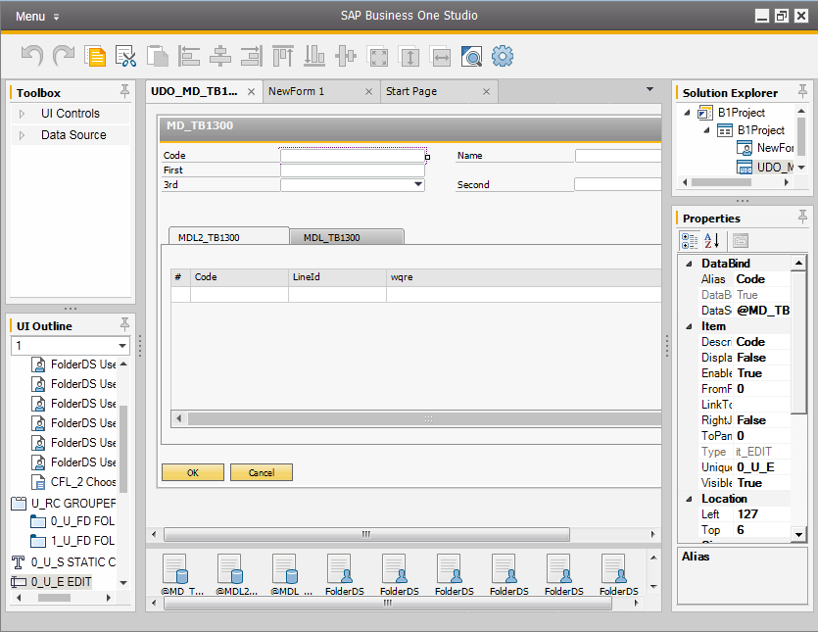
User-Defined Objects: Default Form Editing – B1Studio
Enter DB connection details.
Select UDO from list.
The UDO form opens in edit mode.
Saving the form will save the changes to the database.
The updated content will take effect the next time you open the UDO form in B1.
Notes:
The default form can be edited in SAP Business One Studio, as well.
After connecting to the company database, it’s possible to list all the user-defined objects available.
The default form will then be opened in edit mode, which enables you to change the design.
It’s possible to save the changes back to the database.
The changes will be applied immediately as soon as the default form is opened for the user-defined object.

Slide 21
User-Defined Objects: Definition Through DI API (1/2)
Dim oUserObjectMD As UserObjectsMD
oUserObjectMD = oCompany.GetBusinessObject(SAPbobsCOM.BoObjectTypes.oUserObjectsMD)
oUserObjectMD.Code = "TT_MD“
oUserObjectMD.Name = "TEST_MD“
oUserObjectMD.ObjectType = SAPbobsCOM.BoUDOObjType.boud_MasterData
oUserObjectMD.TableName = "T_MD“ ‘ Main user table (same type as the UDO)
oUserObjectMD.ChildTables.TableName = "T_MD1“ ‘ First child user table
‘ Add second line; first line already exists by default
oUserObjectMD.ChildTables.Add()
oUserObjectMD.ChildTables.TableName = "T_MD2“ ‘ Second child user table
Notes:
We will now start to create the user-defined object from the code using the DI API.
The UserObjectsMD needs to be instantiated. It‘s then possible to define the properties:
Code – Represents the code of the UDO
Name – The name of the UDO
ObjectType – May only be the document or master data type
TableName – Represents the user-defined table
In the current wxample we would add two child tables as well.

Slide 22
User-Defined Objects: Definition Through DI API (2/2)
Dim c_Yes As SAPbobsCOM.BoYesNoEnum = BoYesNoEnum.tYES
‘Configure Services
oUserObjectMD.CanCancel = c_Yes
oUserObjectMD.CanClose = c_Yes
oUserObjectMD.CanCreateDefaultForm = c_Yes ‘ Need to specify columns
oUserObjectMD.CanDelete = c_Yes
oUserObjectMD.CanFind = c_Yes ‘ Need to specify columns
oUserObjectMD.CanLog = SAPbobsCOM.BoYesNoEnum.tNO
oUserObjectMD.CanYearTransfer = SAPbobsCOM.BoYesNoEnum.tNO
oUserObjectMD.ManageSeries = c_Yes
'Columns added in the ChooseFromList form, repeat these three lines for each column
oUserObjectMD.FindColumns.ColumnAlias = "Code"
oUserObjectMD.FindColumns.ColumnDescription = "Code"
oUserObjectMD.FindColumns.Add() oUserObjectMD.FindColumns.ColumnAlias = "U_MyName"
oUserObjectMD.FindColumns.ColumnDescription = "My Name"
‘… add columns for default form in the same way …
‘Add the UDO
lRetCode = oUserObjectMD.Add()
Notes:
The code example then continues with the service definition for the UDO.
For example, the CanFind property value is set to Yes, so it is be possible to use the standard search funtionality on the user-defined object.
The find function needs to have the fields defined for the searching area. In this case, it‘s declared using the child object oUserObjectMD.FindColumns with the properties ColumnAlias and ColumnDescription.
The UDO is created by calling the method Add.

Slide 23
User-Defined Objects DI API Object - UserObjectsMD default form and menu
The UserObjectsMD object supports the same UDO features as the wizard:
Properties for managing the UDO-enhanced default form:
EnableEnhancedForm property
EnhancedFormColumns: UserObjectMD_EnhancedFormColumns collection
FormSRF property
RebuildEnhancedForm property
Properties for attaching a menu:
MenuItem property
MenuCaption property
FatherMenuID property
Position property
MenuUID property
Notes:
In general, all the UDO features available in the user interface can be defined and also performed in the DI API code using the object UserObjectsMD.
The following properties and child objects can be used to manage the default form on the user-defined objects:
With EnableEnhancedForm, a header-line style form can be created and the EnhancedFormColumns child object will specify the database columns visible on the form.
The property RebuildEnhancedForm is responsible for the form rebuild.
The FormSRF property stores the name of the srf form file.
There are some additional properties responsible for menu-related operations, as well. With MenuItem, it’s possible to declare whether the menu needs to be created.
The menu item can be specified using the MenuCaption, FatherMenuID, Position, and MenuID properties, which also make it possible to ensure the right naming, position, and location in the main menu.

Slide 24
User-Defined Objects: Implementation DLL (1/2)
You can overwrite the implementation for your object in the following cases:
You want to add actions to the default behavior.
You want to replace the default behavior.
Important:
You must implement this in C++
You can only register one DLL for each UDO
Pay attention to the namespaces to avoid conflicts
When a user activates a UDO, the SAP Business One application loads the DLL into memory
Notes:
You can use the implementation DLL feature for a user-defined object in case you want to add actions or replace the default behavior.
The class needs to be created in C++ language. Only one class can be registered for each UDO. The naming convention is essential to avoid conflicts.
When a user activates a UDO, the SAP Business One application loads the DLL into memory.
The implementation DLL can then be loaded using the UDO wizard on the ExtensionName property in the DI API.

Slide 25
User-Defined Objects: Implementation DLL (2/2)
Write a C++ class that inherits from CSboBusinessObject and redefine the purely virtual methods Clone and Destroy.
class MyUDO : public CSboBusinessObject
{
public:
MyUDO (unsigned long systemHandle);
~MyUDO ();
‘ Mandatory
virtual CSboBusinessObject *Clone (unsigned long systemHandle)
{return new MyUDO (systemHandle);}
virtual void Destroy ()
{delete this;}
‘ Optional (just a sample!)
virtual SBOErr OnAdd ();
virtual SBOErr OnUpdate ();
};
Notes:
Steps to writing your own object’s business logic unit:
Write a class that inherits from CSBOBusinessObject.
Export the CreateObject function (DLL entry point).
Implement Destroy and Close functions (purely virtual).
Overwrite any desired virtual functions.
Call the base class functions to get the default behavior.
Use the interface functions to do your work.
Register the DLL in the registration wizard or in the DI API.

Slide 26
User-Defined Objects: DI API General Service Methods
The new interface includes the GeneralService and a set of four supporting objects
One interface is valid for all UDOs (master data and document types)
The new interface provides access to UDO data:
Add records
Find records
Delete records
Cancel / close document
Invoke partner method (to invoke a custom method written in an implementation DLL for your UDO)
GetDataInterfaceFromXMLFile / GetDataInterfaceFromXMLString (creates object from XML file or string)
Get/Set property – for getting and setting table field values (for most fields that are auto-generated, only getting is implemented)
Notes:
With the GeneralService object, you can add, update, look up, and remove rows from user-defined tables.
You can also invoke custom methods on the UDO's custom business implementation DLL.
You can use the InvokeMethod method as a dispatcher to other methods in your DLL.
For creating a user-defined object, you might use the GetDataInterface, GetDataInterfaceFromXMLFile, and GetDataInterfaceFromXMLString methods to create an empty object or an object from an XML string or file.
For retrieving the records from the UDO, the GetByParams method is used.

Slide 27
User-Defined Objects: DI API General Service Objects
General Data
Represents a single row in a database table of a UDO, or in a child table of the UDO
GeneralDataParams
Holds the keys to rows in database tables linked to UDO data. This object is used to pass keys to and from GeneralService methods
GeneralCollectionParams
A collection of GeneralDataParams objects
GeneralDataCollection
A collection of GeneralData objects, each of which represents a row in a child user table for a specific row of the main table of a UDO
InvokeParams
Holds a single string value. This object is used to pass a parameter to or receive a return value from the Invoke method of the GeneralService service
Notes:
Let‘s have a look at the content of the GeneralService object.
General Data represents a single row in a database table of a UDO, or in a child table of the UDO.
GeneralDataParams holds the keys to rows in database tables linked to UDO data. This object is used to pass keys to and from GeneralService methods.
GeneralCollectionParams is a collection of GeneralDataParams objects.
GeneralDataCollection is a collection of GeneralData objects, each of which represents a row in a child user table for a specific row of the main table of a UDO.
InvokeParams holds a single string value. This object is used to pass a parameter to or receive a return value from the Invoke method of the GeneralService service.

Slide 28
User-Defined Objects: DI API General Service Objects – Implementation Chart
GeneralCollectionParams
(Header Table Key Collection)
1
n
GeneralDataParams
(Header Table Key)
1
GeneralDataCollection
(Son Key Collection)
1
n
GeneralData
(Header Table
Record)
1
1
n
GeneralData
(Son Table
Record)
Notes:
Please refer to the implementation chart to see how data is organized within objects and collections.
GeneralCollectionParams holds the header table key collections, which are connected to the GeneralDataParams object in which the header table keys are located.
It has a one-to-one relationship with the header table record, which may be connected to the GeneralDataCollection object responsible for the son or child key collections.
The son table records are also stored in the GeneralData object.

Slide 29
User-Defined Objects: DI API General Service Add Document – Sample Code
SAPbobsCOM.GeneralService oDocGeneralService;
SAPbobsCOM.GeneralData oDocGeneralData;
SAPbobsCOM.GeneralDataCollection oDocLinesCollection;
SAPbobsCOM.GeneralData oDocLineGeneralData;
// Retrieve the relevant service
oDocGeneralService = (SAPbobsCOM.GeneralService)oCompService.GetGeneralService("MyDocUDO");
// Point to the header of the Doc UDO
oDocGeneralData = (SAPbobsCOM.GeneralData)oDocGeneralService.GetDataInterface
(SAPbobsCOM.GeneralServiceDataInterfaces.gsGeneralData);
// Insert values into the header properties
oDocGeneralData.SetProperty("U_CustCode", "2");
oDocGeneralData.SetProperty("U_CustName", "Customer2");
// Insert values into the Lines properties
oDocLinesCollection = (SAPbobsCOM.GeneralDataCollection)oDocGeneralData.Child("SAP_DOCL");
// Line
oDocLineGeneralData = oDocLinesCollection.Add();
oDocLineGeneralData.SetProperty("U_ItemCode", "Item1");
oDocLineGeneralData.SetProperty("U_Quantity", "1");
// Add - Doc UDO header and line data to DB
oDocGeneralService.Add(oDocGeneralData);
Notes:
In the following example, you will see how the new user-defined object entry can be added with the document object type.
The GetGeneralService method is used in the GeneralService object to get the UDO.
The data is then created in the UDO’s header table.
The example continues with the child table data creation.
Finally, the user-defined object entry is added using the Add method on the GeneralService object with the GeneralData parameters.

Slide 30
User-Defined Objects: DI API General Service Update Document – Sample Code
SAPbobsCOM.GeneralService oDocGeneralService;
SAPbobsCOM.GeneralData oDocGeneralData;
SAPbobsCOM.GeneralDataCollection oDocLinesCollection;
SAPbobsCOM.GeneralData oDocLineGeneralData;
SAPbobsCOM.GeneralDataParams oGenralParameter;
// Retrieve the relevant service
oDocGeneralService = (SAPbobsCOM.GeneralService)oCompService.GetGeneralService("MyDocUDO");
// Get by key - header record
oGenralParameter = (SAPbobsCOM.GeneralDataParams)oDocGeneralService.GetDataInterface (SAPbobsCOM.GeneralServiceDataInterfaces.gsGeneralDataParams);
oGenralParameter.SetProperty("DocEntry", "1");
oDocGeneralData = oDocGeneralService.GetByParams(oGenralParameter);
// Update - Add lines to the child tables, insert values into the lines properties
oDocLinesCollection = (SAPbobsCOM.GeneralDataCollection)oDocGeneralData.Child("SAP_DOCL");
// Add line
oDocLineGeneralData = oDocLinesCollection.Add();
oDocLineGeneralData.SetProperty("U_ItemCode", "Item2");
oDocLineGeneralData.SetProperty("U_Quantity", "2");
// Update DocTotal in the header
oDocGeneralData.SetProperty("U_DocTotal", "50");
// Update the MD UDO
oDocGeneralService.Update(oDocGeneralData);
Notes:
The current example updates the user-defined object entry.
The code structure is similar to the previous example. After retrieving the relevant UDO service, the record is selected based on the primary key DocEntry.
The changes are performed at the child object level – more specifically, a new line is added.
The SetProperty method is used for changing the data at the header table level in order to update the value of the document total stored in the user-defined field.
Finally, the Update method is executed at the GeneralService object level.

Slide 31
User-Defined Objects: DI API General Service Delete Document – Sample Code
SAPbobsCOM.GeneralService oDocGeneralService;
SAPbobsCOM.GeneralData oDocGeneralData;
SAPbobsCOM.GeneralDataParams oGenralParameter;
// Retrieve the relevant service
oDocGeneralService = (SAPbobsCOM.GeneralService)oCompService. GetGeneralService("MyDocUDO");
// Get by key – header record
oGenralParameter = (SAPbobsCOM.GeneralDataParams)oDocGeneralService.GetDataInterface(SAPbobsCOM.GeneralServiceDataInterfaces.gsGeneralDataParams);
oGenralParameter.SetProperty("DocEntry", "3");
// Delete whole record (header and lines)
oDocGeneralService.Delete(oGenralParameter);
Notes:
To delete a record from a user-defined object, it’s essential to instantiate the GeneralService and assign the DocEntry primary key value to the GeneralDataParams object.
The Delete method can then be executed at the GeneralService object level.
To close or cancel the document, the same approach needs to be used by selecting the corresponding method.
The close and cancel methods are relevant only for document object types.

Slide 32
User-Defined Objects: DI API General Service GetList – Sample Code
SAPbobsCOM.GeneralService oDocGeneralService;
SAPbobsCOM.GeneralCollectionParams oDocsCollectionParams; //List
// Retrieve the relevant service
oDocGeneralService = (SAPbobsCOM.GeneralService)oCompService.GetGeneralService("MyDocUDO");
// Get the list
oDocsCollectionParams = oDocGeneralService.GetList();
oDocsCollectionParams.ToXMLFile(System.AppDomain.CurrentDomain.BaseDirectory + "\\DocList.xml");
MessageBox.Show("There are " + oDocsCollectionParams.Count + " documents");
Notes:
The GetList method returns the keys for all the rows in the main table for a specific user-defined object.
For example, if the UDO MyDocUDO was linked to the user-defined table @TABLE1 table and the service was instantiated for the MyDocUDO UDO, then this method would return the keys for all the rows in @TABLE1.
The code example will retrieve the keys from the MyDocUDO user-defined object and will save them to an XML file.
The Count property for the GeneralCollectionParams collection contains the entry count located in the UDO.

Slide 33
User-Defined Objects: DI API General Service Code Samples
Simple Sample Blog (Accessing a UDO in DI API):
https://https://blogs.sap.com/2009/02/01/simple-sample-blog/
How to use UDO services in DI Server:
https://blogs.sap.com/2010/02/02/how-to-use-udo-services-in-di-server/
Notes:
Please refer to the hyperlinks on the slide in order to learn more about General Service usage in DI API and DI Server.

Slide 34
User-Defined Objects: UI API How to use your new UDO within an add-on
Connect a form to a UDO:
creationPackage = SBO_Application.CreateObject
(SAPbouiCOM.BoCreatableObjectType.cot_FormCreationParams)
creationPackage.FormUID = "MathExamsID"
creationPackage.Type = "SM_MathExam“
‘ Need to set the parameter with the object unique ID
creationPackage.ObjectType = "SM_MATHGRADES“
oForm = SBO_Application.Forms.AddEx(creationPackage)
Notes:
In this example, we are using the UI API in order to create a new form for the user-defined object.
The code is very similar to the form creation process covered in the UI API chapter.
The key property is the ObjectType on the FormCreationParams object.
You are entering the unique ID of the user-defined object for the ObjectType property, which will ensure that the newly created form will be assigned to the specific UDO.

Slide 35
User-Defined Objects: UI API Default Buttons on UDO Form
Service | UI form support
Ok / Add / Update / Find (Automatic event handling for the OK buttons( | oItem = oForm.Items.Add("1", SAPbouiCOM.BoFormItemTypes.it_BUTTON) oButton = oItem.Specific Do not set the caption for this button
Cancel | oItem = oForm.Items.Add("2", SAPbouiCOM.BoFormItemTypes.it_BUTTON) oButton = oItem.Specific Do not set the caption for this button
Notes:
Two buttons are automatically generated on the default form of the user-defined object.
The UniqueID of the OK button is “1” and the UniqueID of the Cancel button is “2”.
The SAP Business One digital core changes the caption of the OK button dynamically to OK, Add, Update, or Find strings depending on the data mode status.
In this case, do not set the Caption property for the Button object.

Slide 36
User-Defined Objects: UI API Form Data Binding Number Series
Service | UI form support
Manage Series | ‘ create a combo box for the series relevant for this document type oItem=oForm.Items.Add("SeriesName", BoFormItemTypes.it_COMBO_BOX) oComboBox = oItem.Specific ‘ fill the combo with relevant series oComboBox.ValidValues.FillWithSeries(True, False, 0) oComboBox.DataBind.SetBound(True, "@MATH", "Series") ‘ edit text that holds the document number (related to the selected series) oItem = oForm.Items.Add(“DocNum", SAPbouiCOM.BoFormItemTypes.it_EDIT) oEditText = oItem.Specific oEditText.DataBind.SetBound(True, "@MATH", "DocNum") ‘***** later in the event handler (for example) ************************************* ‘ get the “next serial number” from the selected series in add mode strSeries = oComboBox.Selected.Value lNum = oForm.BusinessObject.GetNextSerialNumber(CLng(strSeries)) ‘ set the “next serial number” into the document number field oEditText.String = CStr(lNum)
Notes:
A user-defined object of the document object type can have the Numbering Series feature enabled.
The corresponding service name in the UDO is called ManageSeries, which is represented as a property in DI API‘s UserObjectsMD object.
The code example on the slide creates a new ComboBox item on the form, which is bound to the Series field of the @MATH database table.
In addition, a new EditText item is placed on the form, which is bound to the DocNum field of the @MATH table.
The assignment to the serial numbering is handled in the event handler.
In some cases – especially if the form is in adding mode – the next serial number will be assigned to the user-defined object’s record using the GetNextSerialNumber method.

Slide 37
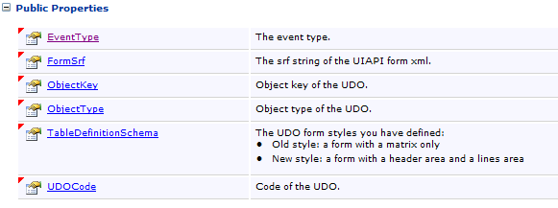
User-Defined Objects: UI API Specific UDO Events
UDO Event:
et_UDO_FORM_BUILD - A UDO form was built
et_UDO_FORM_OPEN - A UDO form was opened
Notes:
The EventFilter collection contains event types that are related only to user-defined objects.
et_UDO_FORM_BUILD is triggered when the user-defined object’s form has been built.
et_UDO_FORM_OPEN is triggered when the user-defined object’s form has been opened.

Slide 38

User-Defined Objects: UI API FormDataEvent key information provided
Provides a UDO key when a new object is added/updated/deleted/loaded by a B1 form.
Note: Only supported by the new UDO form style.
BusinessObjectInfo - The object that holds the event information
BubbleEvent - Indicates how the application handles the event. Relevant only when BusinessObjectInfo.BeforeAction is true.
Notes:
The FormDataEvent occurs when the application performs the following actions on forms connected to business objects:
Add
Update
Delete
Load form data via browse, link button, or find
The event provides the UniqueID of the modified business object. Use this as an input object for the DI API DataBrowser.GetByKeys method to get a DI object.
The event contains two variables:
BusinessObjectInfo - The object that holds the event information
BubbleEvent - Indicates how the application handles the event. Relevant only when BusinessObjectInfo. BeforeAction is true.

Slide 39

User-Defined Objects: DI API - Change Log
The change log function is supported for UDOs.
You can access the change log for UDO objects using the ChangeLogsService object in the DI API (see DI API section)
Access the UDO change log tables if you selected the Log checkbox during UDO creation in the UDO wizard
Notes:
You can use the change log to gain an overview of changes in most windows of SAP Business One.
Each time you update a user-defined object, you can use ChangeLogsService to look up the change logs and show the differences between two change logs.

Slide 40

User-Defined Objects: Exercise
You should now:
Bind data to fields of a form within the SAP Business One window
Notes:
In the exercise for this part, you will practice binding data to the fields located on the SAP Business One form.

