Slide 1

TB 1300 - SAP Business One SDK Cross DI API / UI API – Crystal Reports
July, 2019
Notes:
Welcome to the Cross DI API and UI API Crystal Reports course topic.

Slide 2

Crystal Reports: Topic Objectives
After completing this topic, you will be able to:
Create and manage new Crystal Reports from an add-on
Know which DI API services are available for Crystal Reports development
Know how to handle LayoutKeyEvent
Notes:
After completing this topic, you will be able to:
Create and manage new Crystal Reports from an add-on
Know which DI API services are available for Crystal Reports development
Know how to handle LayoutKeyEvent

Slide 3
Crystal Reports: SDK features
Crystal Reports Integration for Add-ons: You can now use the SAP Crystal Reports integration functionality with add-ons (both SAP Business One add-ons and add-ons provided by partners).
DI API
ReportLayouts – import and export the report layout
ReportLayoutsService
ReportTypesService
UI API
LayoutKeyEvent of the Application object
et_PRINT_LAYOUT_KEY of the BoEventTypes enumeration
LayoutKeyInfo object
ReportType property of the Form object
ExportRptAsXML property of the Application object
Motivation: Allow to create and manage new Crystal Reports from the add-ons
Notes:
The SAP Crystal Repost integration functionality enables you to work with the reports and layouts directly from the code by using the UI and DI API interfaces.
The main DI API-based objects are the ReportLayouts, ReportLayoutsService, and ReportTypesService objects.
The LayoutKeyEvent is the event type that is relevant for printing, which is part of the Application object. It has an additional property called ExportRptAsXML.
The ReportType property is exposed at the Form object level.
The main motivation for using this object is to provide automation for managing Crystal Reports directly from the add-on solution.

Slide 4
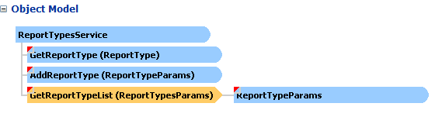
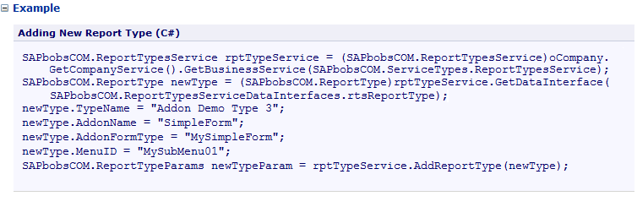
Crystal Reports: DI API ReportTypesService
Add, look up, and delete report types in SAP Business One
Notes:
The ReportTypesService service enables you to add, look up, and delete report types in SAP Business One.
The ReportType child object represent the report type to which a layout is assigned.
The ReportTypeParams child object holds the key to an existing report type. This object is used to pass keys to and retrieve them from a ReportTypesService object’s methods.

Slide 5
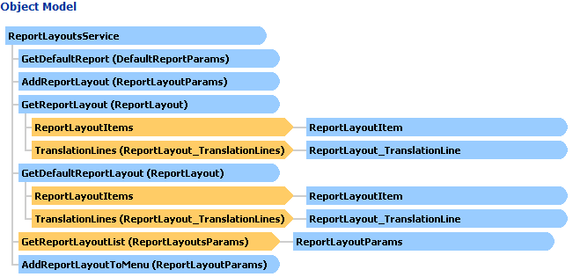
Crystal Reports: DI API ReportLayoutsService
Copy a PLD report layout from one company to another.
Add a Crystal Reports layout or standalone report.
Notes:
The ReportLayoutsService object is exposed in the DI API.
It enables you to do the following:
Copy a Print Layout Designer report layout between the company databases. When transferring a system layout, change the following properties before adding the layout to the destination company: Author, Editable, and Name.
Add a Crystal Reports layout or standalone report. When this object is used to import a layout/report for Crystal Reports, the fields Name, TypeCode, Author, and Category must be set. Set the Category to Crystal Reports and the TypeCode to either RCRI (for standalone reports) or a document type (for layouts).

Slide 6
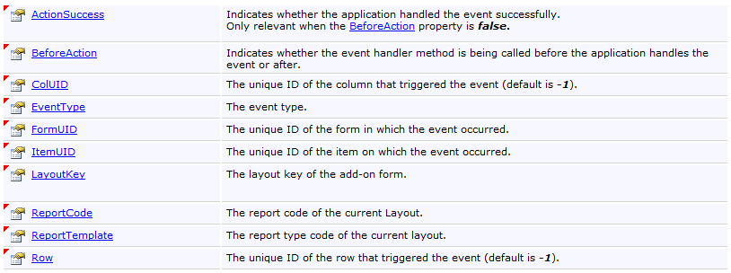
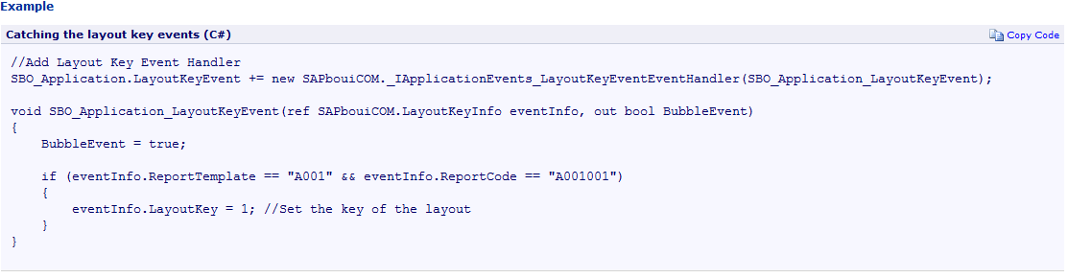
Crystal Reports: UI API LayoutKeyEvent
Occurs when you print or print preview a layout of an add-on form.
When the layout needs the key of the add-on form, the add-on catches and sets LayoutKeyInfo.LayoutKey to the key value.
Notes:
The LayoutKeyEvent is an event assigned to printing. It occurs when you print or execute the print preview action for a layout of an add-on form.
In the upper figure, you can see the LayoutKeyInfo object members, which contain the information about the current LayoutKeyEvent.
If the layout needs the key of the add-on form, the add-on catches and sets LayoutKeyInfo.LayoutKey to the key.
In the lower figure, you can see how the event handler can be defined for the layout key event.

Slide 7
Crystal Reports: Sample Add a new Crystal Report (1/3)
Create a new Report Type and a new Report Layout (DI API)
//Add new Report Type
SAPbobsCOM.ReportTypesService rptTypeService = (SAPbobsCOM.ReportTypesService)oCompany.GetCompanyService().GetBusinessService(SAPbobsCOM.ServiceTypes.ReportTypesService);
SAPbobsCOM.ReportType newType = (SAPbobsCOM.ReportType)rptTypeService.GetDataInterface(SAPbobsCOM.ReportTypesServiceDataInterfaces.rtsReportType);
newType.TypeName = "Addon Demo Type 3";
newType.AddonName = "SimpleForm";
newType.AddonFormType = "MySimpleForm";
newType.MenuID = "MySubMenu01";
SAPbobsCOM.ReportTypeParams newTypeParam = rptTypeService.AddReportType(newType); //The Report Type will be added to the table RTYP
//Add new Report Layout
SAPbobsCOM.ReportLayoutsService rptService = (SAPbobsCOM.ReportLayoutsService)oCompany.GetCompanyService().GetBusinessService(SAPbobsCOM.ServiceTypes.ReportLayoutsService);
SAPbobsCOM.ReportLayout newReport = (SAPbobsCOM.ReportLayout)rptService.GetDataInterface(SAPbobsCOM.ReportLayoutsServiceDataInterfaces.rlsdiReportLayout);
newReport.Author = oCompany.UserName;
newReport.Category = SAPbobsCOM.ReportLayoutCategoryEnum.rlcCrystal;
newReport.Name = "Demo AddOn Report 1";
newReport.TypeCode = newTypeParam.TypeCode;
SAPbobsCOM.ReportLayoutParams newReportParam = rptService.AddReportLayout(newReport); //The Report Layout will be added to the table RDOC4
//Update the ReportType default layout value
newType = rptTypeService.GetReportType(newTypeParam);
newType.DefaultReportLayout = newReportParam.LayoutCode;
rptTypeService.UpdateReportType(newType);
Notes:
The next few slides will show how the Crystal Report can be added to the SAP Business One company database.
The ReportType entry can be added through the DI API, which will add the report type to the RTYP database table. The report type can also have a menu entry.
The ReportLayout is also used from the DI API and populates the RDOC4 table.
You can then update the report type default value by using the UpdateReportType method exposed for the ReportTypesService object.

Slide 8
Crystal Reports: Sample Add a new Crystal Report (2/3)
Link the new Report LayoutCode to the Crystal Report file (DI API)
SAPbobsCOM.BlobParams oBlobParams = (SAPbobsCOM.BlobParams)oCompany.GetCompanyService().GetDataInterface(SAPbobsCOM.CompanyServiceDataInterfaces.csdiBlobParams);
oBlobParams.Table = "RDOC";
oBlobParams.Field = "Template";
SAPbobsCOM.BlobTableKeySegment oKeySegment = oBlobParams.BlobTableKeySegments.Add();
oKeySegment.Name = "DocCode";
oKeySegment.Value = newReportParam.LayoutCode;
FileStream oFile = new FileStream("C:\\temp\\demo.rpt", FileMode.Open);
int fileSize = (int)oFile.Length; byte[] buf = new byte[fileSize]; oFile.Read(buf, 0, fileSize); oFile.Dispose();
SAPbobsCOM.Blob oBlob = (SAPbobsCOM.Blob)oCompany.GetCompanyService().GetDataInterface(SAPbobsCOM.CompanyServiceDataInterfaces.csdiBlob);
oBlob.Content = Convert.ToBase64String(buf, 0, fileSize);
oCompany.GetCompanyService().SetBlob(oBlobParams, oBlob);
Link the new Report Type to our form (UI API)
// Set Form Report Type
oAddOnForm.ReportType = reportType.TypeCode;
Notes:
We still use the DI API to create a link between the layout and the report file.
The SetBlob method at the CompanyService object level is used to load the binary large object file, the Crystal Report file, into the SAP Business One company database.
The SetBlob method’s input parameter are the BlobParams, where we have defined the table and field and the blob content represented in the oBlob variable.
We have now finished the work in the DI API and now switch to the UI API.
The Form object has the ReportType property, where the DI API’s ReportType code needs to be assigned. This step links the new report type with the user form.

Slide 9
Crystal Reports: Sample Add a new Crystal Report (3/3)
Set the eventInfo.LayoutKey to the value of the edit text in our form containing the key needed by the report:
void SBO_Application_LayoutKeyEvent(ref SAPbouiCOM.LayoutKeyInfo eventInfo, out bool BubbleEvent)
{
BubbleEvent = true;
eventInfo.LayoutKey = oEditTextKey.Value;
}
Notes:
In the final step, you can create an event handler to handle the LayoutKeyEvent.

