Slide 1

TB 1300 - SAP Business One SDK Cross DI API / UI API – Cockpits
July, 2019
Notes:
Welcome to the Cross DI API and UI API Cockpits course topic.

Slide 2

Cockpits: Topic Objectives
After completing this topic, you will be able to:
How to activate SAP Business One Cockpits and out of the box content
DI API CockpitsService
UI API Cockpit and Widget objects
Cockpit and widget related events
Notes:
After completing this topic, you will know more about :
How to activate SAP Business One cockpits and out-of-the-box content
The DI API CockpitsService
The UI API Cockpit and Widget objects
Cockpit and widget-related events

Slide 3
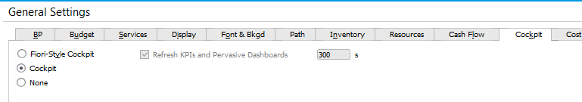
Cockpits: Activation on the Company level
Open Administrator -> System Initialization -> GeneralSettings -> Cockpit Folder
Check the Enable Cockpit at Company LevelCheckbox
Do not check the „Enable Dashboard Widget“ at this time. To use the Dashboard Widget the Integration Component needs to be installed first.
NOTE: You need to logon again to this company for the settings to take effect.
Notes:
The cockpit is a personalized work center where you can view, search, organize, and perform your regular work and related activities in SAP Business One.
This topic describes how to work with the cockpit from the perspectives of both system administrators and regular company users.
The cockpit enables you to:
Group your most frequently used functionalities in one place
Focus on your responsibilities with the necessary information and data presented to you
To enable the cockpit at company level go to the SAP Business One main menu, choose Administration -> System Initialization -> General Settings, and choose the Cockpit tab.
On the Cockpit tab, select the Cockpit radio button.

Slide 4
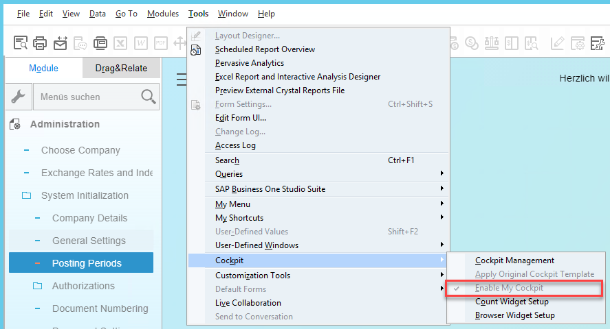
Cockpits: Activation on the User level
Open Tools -> Cockpit -> Enable My Cockpit
NOTE: You need to logon again to this company for the settings to take effect.
Notes:
After the system administrator has successfully enable the cockpit for the whole company, you need to enable the cockpit individually to access it in SAP Business One. If you prefer to use the traditional SAP Business One user interface, you can choose to not enable the cockpit.
To enable your own cockpit, choose Tools -> Cockpit from the SAP Business One menu bar. Then choose Enable My Cockpit.
For your settings to take effect, log off and then log on again to the same company database.

Slide 5
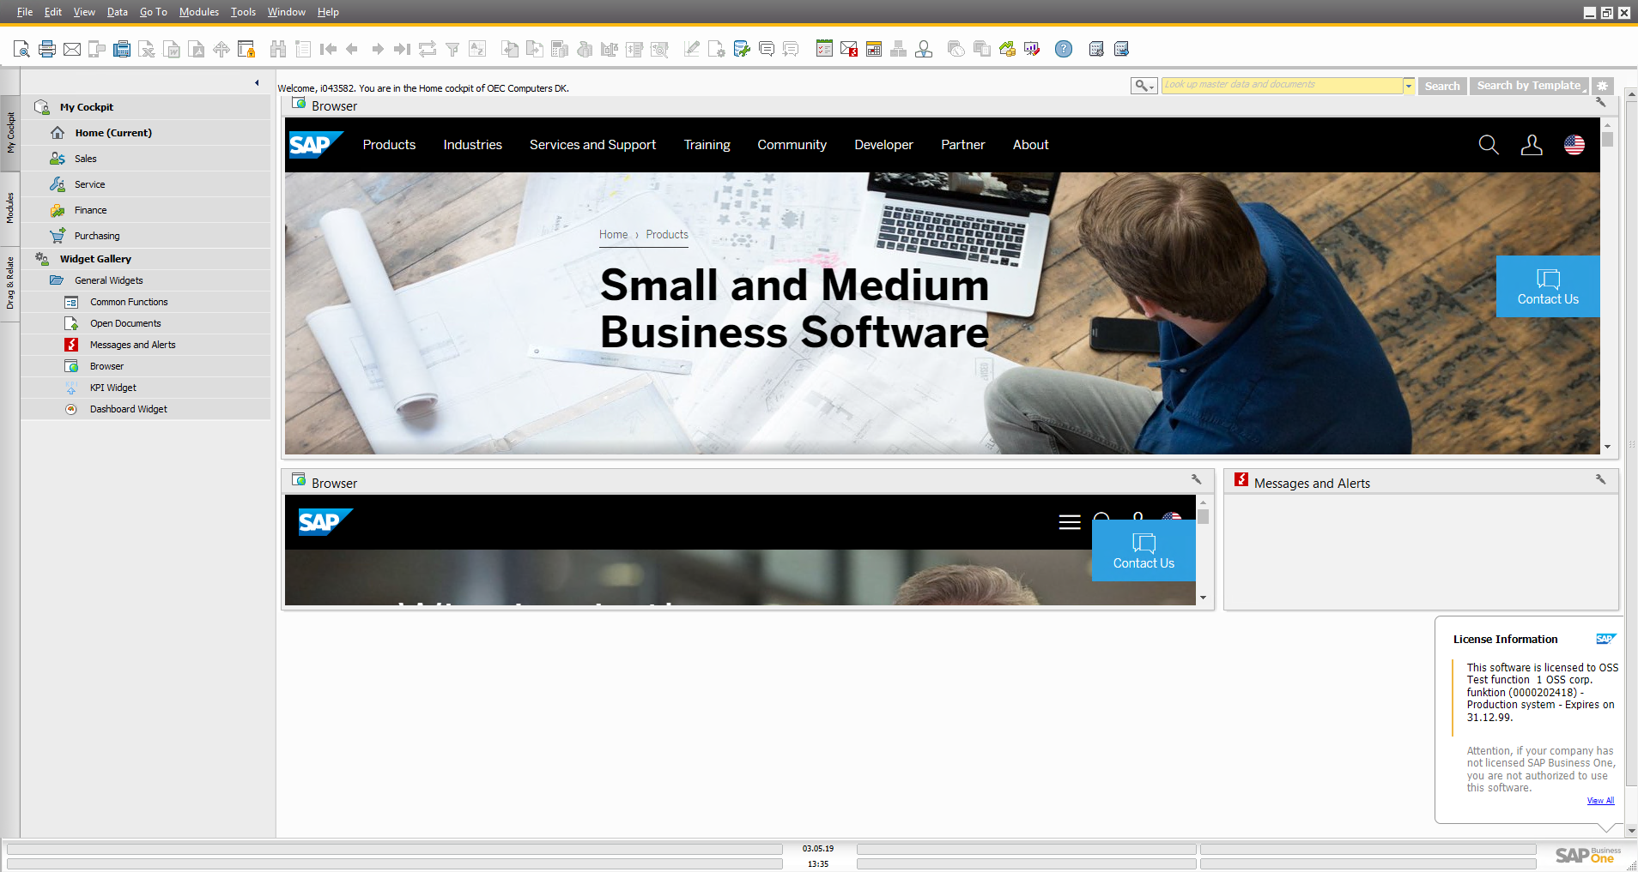
Cockpits: SAP Business One Desktop
Search Area
Menu
Widget Area
Notes:
On the current slide, you can see how the SAP Business One client is changed after you enable the cockpit. We also refer to the client’s user interface as the “SAP Business One desktop”.
The Main Menu form is located on the left side, but this depends on the exact localization. In the in Israeli localization, for example, the Main Menu appears on the right side.
The Search Area is available at the top of the SAP Business One desktop. SAP Business One lets you search menus using the search bar below the toolbar.
The lookup function enables you to locate all the windows listed in the SAP Business One main menu by searching for the window name.
The widget area holds all the widgets. The widgets can be dragged from Main Menu’s general widget section onto the canvas area and dropped in the position you want them to appear.
You cannot place a widget in a location that already contains another widget.
To automatically arrange the widgets in your cockpit canvas area, choose Window -> Auto Arrange All Widgets. Each time you choose this menu option, the widgets in the current canvas area are arranged automatically.

Slide 6
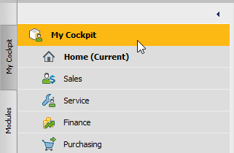
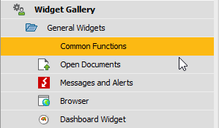
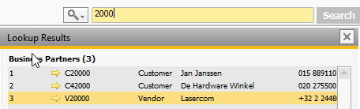
Cockpits: Predefined cockpits and widgets
Predefined Cockpits
Home
Sales
Service
Finance
Purchasing
Predefined Widgets
Common Functions
Open Documents
Messages and Alerts
Browser
Dashboards
Lookup function
quick access to operations, master data and marketing documents
Notes:
After you enable the cockpit, the Home cockpit is the default cockpit you see whenever you log on to SAP Business One. You can then choose from among the other predefined cockpits according to your work area and job responsibilities and modify the cockpit settings and layouts according to your needs.
The predefined widgets are:
Common Functions – organize and access your most frequently used B1 functionalities
Open Documents – quick access to open documents
Messages and Alerts – display messages in a clearer and easier-to-read way
Browser – embed web documents by setting up URLs or HTML/DHTML snippets
Dashboards – Xcelsius dashboards container
The Lookup Function enables you to perform a search within data and menus.

Slide 7
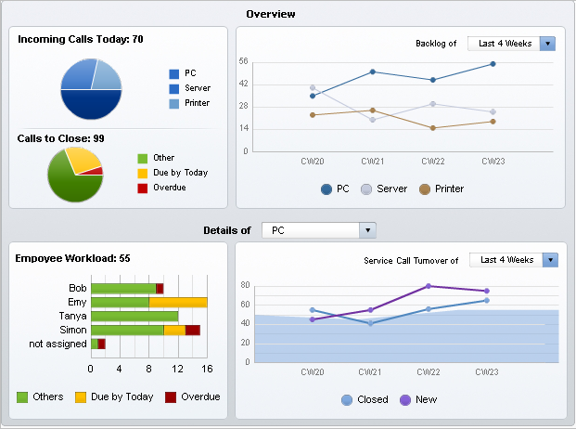
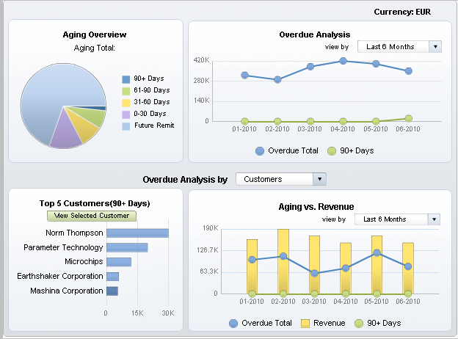
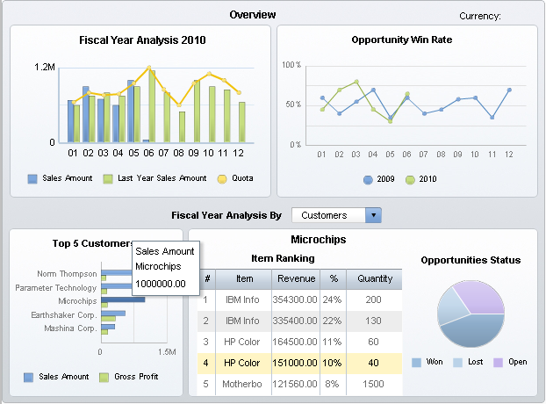
Cockpits: Dashboards
Motivation: Improves usability and clarity of on screen data.
Notes:
Dashboards are an element of the cockpit, which present easy-to-understand visualizations, such as bar or pie charts of transactional data from the SAP Business One database. Depending on the dashboard, data can be presented either as time-specific static snapshots or as refreshable visualizations.
SAP Business One delivers predefined crystal dashboards for financials, sales, and service modules. In addition, SAP Business One partners and customers can create their own dashboards.

Slide 8
Cockpits: DI API Service
CockpitsService
AddCockpit
UpdateCockpit
GetCockpit
DeleteCockpit
list of all cockpits (all users included)
list of the current user cockpits
list of the template cockpits
publish a user cockpit as a template cockpit
GetCockpitList
GetUserCockpitList
GetTemplateCockpitList
PublishCockpit
Notes:
The CockpitsService service available in the DI API enables you to add, look up, update, and remove cockpits.
Here we see a list of the most frequently used methods of the CockpitsService object.
Some of the method names automatically indicate the function behind them, such as AddCockpit, UpdateCockpit, GetCockpit, and DeleteCockpit.
The GetCockpitList method generates a list of all cockpits for all users. The current user cockpits can be retrieved by using the GetUserCockpitList method.
The GetTemplateCockpitList method lets you retrieve the template cockpits, while the user cockpits can be published using the PublishCockpit method.

Slide 9
Cockpits: UI API Objects
WidgetUID
Widget
Widgets
WidgetType
CockpitTypeID
CockpitTypeID
Form
Cockpit
uiApp
Cockpits
CreateWidgetInstance()
Close()
CurrentCockpit
MoveWidget()
Restore()
GetWidget()
Save()
Miminimize()
SwitchCockpit()
SetValue()
RegisterWidget()
GetValue()
Refresh()
Notes:
Let’s have a look at the cockpit assets available for the user interface.
The SAP Business One user interface has a Cockpits object, which represents a collection of Cockpit objects. This object holds all the cockpits in the application.
The Cockpits collection has his own properties and methods, such as GetCurrentCockpit() and SwitchCockpit().
In the Cockpit object, you can use methods like MoveWidget() and CreateWidgetInstance().
The Widgets object is a child object of the Cockpit object and represents a collection of the Widget object. Only one public method is available for a Widgets collection and the main property there is CockpitItemType.
The Widget object is an instance of the cockpit. A widget can help users to perform a certain kind of task.

Slide 10
Cockpits: UI API Events
WidgetEvent – occurs when a widget instance is created
Public Event WidgetEvent(ByVal pWidgetData As WidgetData, ByRef BubbleEvent As Boolean)
wet_created : A new widget is created.
wet_content_save : The widget data is saved when you close the SAP Business One application or reconnect to another company.
ItemEvent
et_Drag : thrown when dragging items.
only editText items on system & user-defined forms are supported.
combo-box items on user-defined forms are supported.
et_ITEM_PRESSED : for widgets menus:
PWC_SYS_SETTINGS_ITM
PWC_SYS_REFRESH_ITM
PWC_SYS_ABOUT_ITM
Note: WidgetEvent is only sent on the before action, BubbleEvent has no influence.
Notes:
The WidgetEvent is triggered when a new widget instance is created.
There are two event types, which specifies the action performed on the widget:
wet_created – occurs on the new widget creation action
wet_content_save - occurs when the widget data is saved when you close the SAP Business One application or reconnect to another company database
The main item events that might occur for the Cockpit object are:
et_Drag - The item was dragged and dropped at the position you want it to appear. Only editText items on system & user-defined forms are supported. The ComboBox items on User-Defined forms are supported.
et_ITEM_PRESSED - The main mouse button was clicked.
WidgetEvent is only sent on the before action, BubbleEvent has no effect.

