Slide 1

TB 1300 – SAP Business One SDK Service Layer – Create Add-On
July, 2019
Notes:
Welcome to the Service Layer Create Add-On course topic.

Slide 2

Agenda
Create a WCF-based extension
Connect using Single Sign-On
Notes:
In this unit, we will cover the following main topics:
Create a WCF-based extension
Connect using Single Sign-On

Slide 3

Create a WCF-Based Extension
Notes:
Let’s start with creating a WCF-based extension.

Slide 4
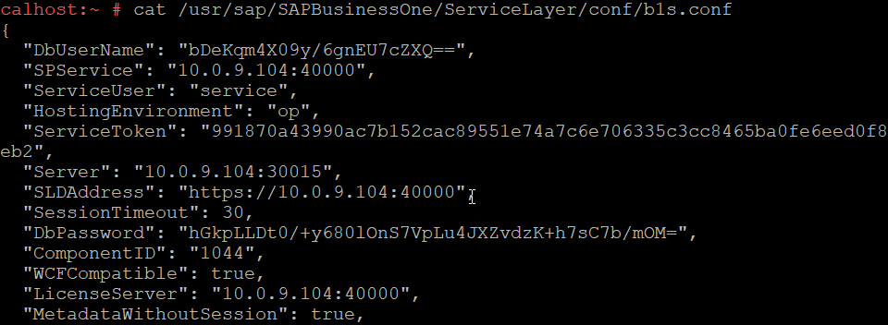
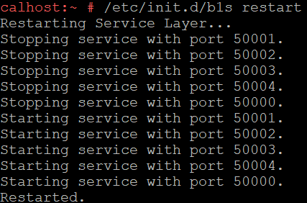
Create a WCF-Based Extension: Preparation
Windows Communication Foundation (WCF) is a framework for building service-oriented applications.
Edit the file b1s.conf on the Linux server on which the Service Layer is running (default location: /usr/sap/SAPBusinessOne/ServiceLayer/conf/b1s.conf)
Set the value of the MetadataWithoutSession property to true
Set the value of the WCFCompatible property to true
Restart the Service Layer service
Use the command /etc/init.d/b1s restart
Install WCF Data Services 5.6.0 RTM Tools for Visual Studio
You can download it from Microsoft’s site
Notes:
The Windows Communication Foundation (WCF) is a framework for building service-oriented applications.
Perform the following changes in order to enable the Service Layer to be used by the Windows Communication Foundation framework.
Set the value true for the property MetadataWithoutSession in b1s.conf
Set the value true for the property WCFCompatible in b1s.conf
Restart the Service Layer service
Install Microsoft Visual Studio
Install the WCF Data Services 5.6.0 RTM Tools package, which is an extension package for Microsoft Visual Studio

Slide 5
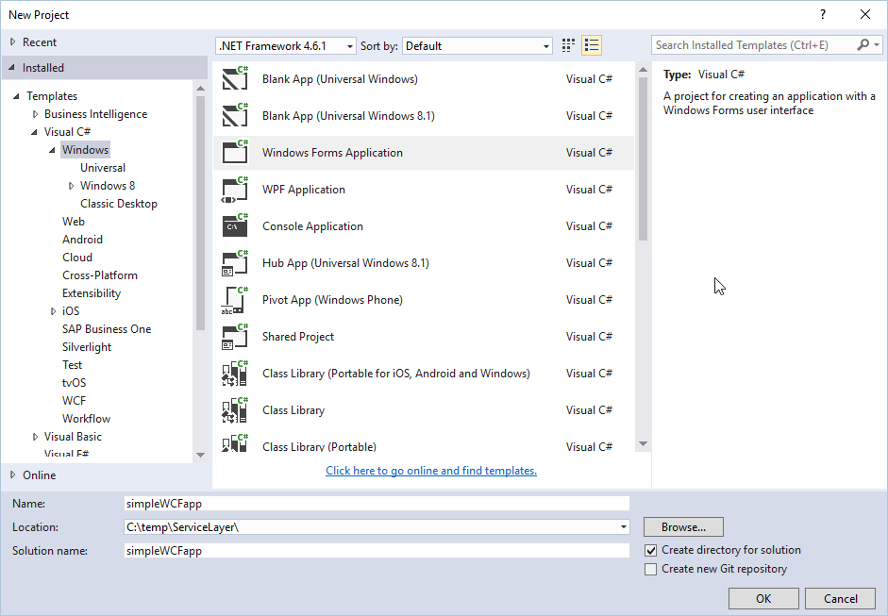
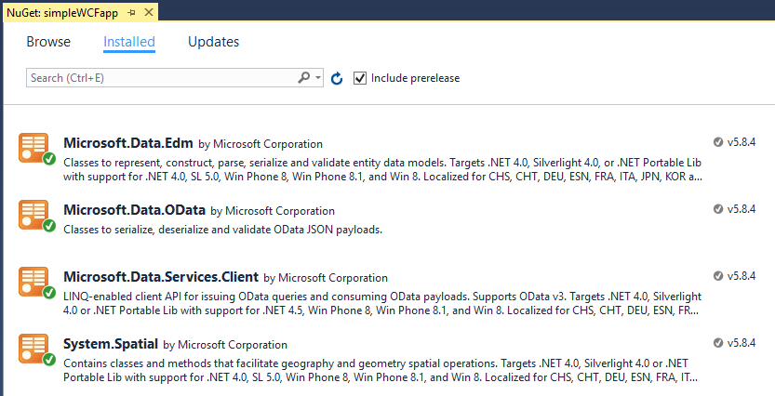
Create a WCF-Based Extension: Project Preparation 1/2 Visual Studio 2015 and lower versions
Install / update NuGet packages
Microsoft.Data.Edm
Microsoft.Data.Odata
Microsoft.Data.Services.Client
System.Spatial
Create project in Visual Studio
Notes:
Now it’s time to create a new project in Microsoft Visual Studio 2015.
In this example, the Windows Forms application is used for the Visual C# programming language.
Please make sure that the Microsoft.Data.Edm, Microsoft.Data.Odata, Microsoft.Data.Services.Client, and System.Spatial NuGet packages are installed for the newly created solution.

Slide 6
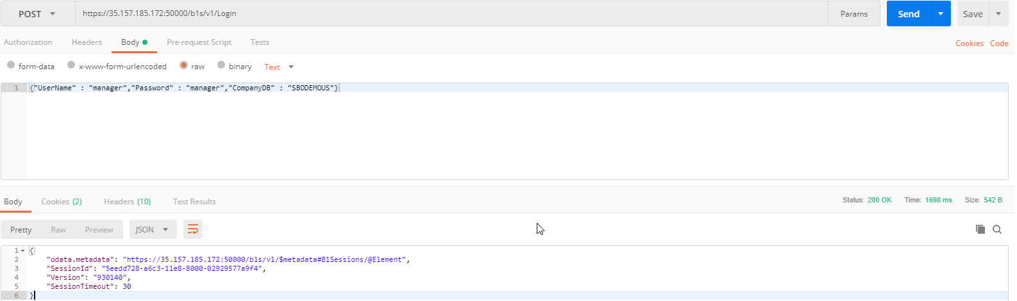
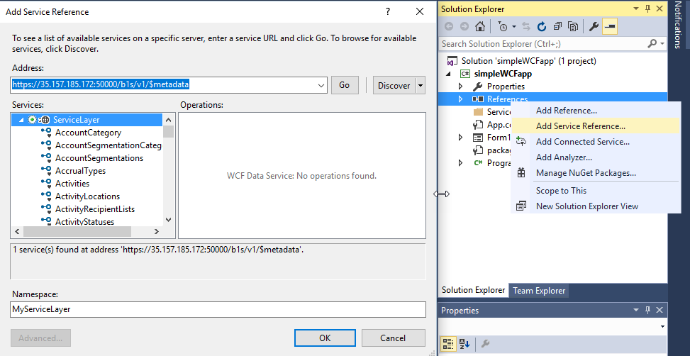
Create a WCF-Based Extension: Project Preparation 2/2 Visual Studio 2015 and lower versions
Add the metadata as a service or file directly by selecting “Add Service Reference” for your Microsoft Visual Studio project. The metadata will be validated automatically.
Open a connection using a third-party tool like Postman by posting the Login method for the Service Layer.
Notes:
Open Postman or another third-party REST API tool and perform the login action for the Service Layer.
Choose Add Service Reference in Visual Studio and enter the address of the Service Layer metadata there.
Enter the namespace; the service reference can then be added.

Slide 7
Create a WCF-Based Extension: Project Preparation 1/2 Visual Studio 2017
Install / update NuGet packages
Microsoft.Data.Edm
Microsoft.Data.Odata
Microsoft.Data.Services.Client
System.Spatial
Create project in Visual Studio
Notes:
If you would like to use Microsoft Visual Studio 2017, the process is as follows:
For instance, the same Windows Forms application project will be created and the same NuGet packages need to be installed as in the case of Visual Studio 2015.

Slide 8
Create a WCF-Based Extension: Project Preparation 2/2 Visual Studio 2017
Add the metadata as a service or file directly by selecting “Add Service Reference” for your Microsoft Visual Studio project. The metadata will be validated automatically.
Open a connection using a third-party tool like Postman by posting the Login method for the Service Layer.
Notes:
The connection needs to be performed similarly.

Slide 9
Create a WCF-Based Extension: Write the Code Login
Notes:
Now it’s time to write the code to establish the connection from the add-on solution to the Service Layer.
The Service Layer service reference is instantiated, and it’s essential to define the URL of the service.
In this example, we will use the JSON formatting.
For sending requests, the SLSendingRequest function is subscribed for attaching or revising the request sent process.
A similar subscriber function was assigned for receiving the response, which would later handle the response coming from the Service Layer.
An additional subscribe function was created for the server certificate validation.
Finally, it’s enough to define the endpoint method, add the message body part, and establish the connection.

Slide 10
Create a WCF-Based Extension: Write the Code Subscribe to handle the Sending Request event
Notes:
The current function is subscribed to handle the sending request event.
This part is always executed if the request is sent.
The System.Net.HttpWebRequest provides an HTTP-specific implementation class.
In case of a non-login method, the cookies information will be added to the message header in order to attribute the action to a specific login.
The second condition is verifying whether the Item entity is used in the URL; if so, the paging size will be set to display all values available in the item master data.

Slide 11
Create a WCF-Based Extension: Write the Code Subscribe to handle the Receiving Response event
Notes:
The next subscriber function is handling the receiving response event.
This is executed every time, once the web service is sending the response back to the add-on solution.
In the current example the response message header is store to a string variable and formatted.

Slide 12
Create a WCF Based Extension: Write the Code Logout
Notes:
This function handles the logout operation.
The System.Uri class is used to specify the exact action for logging out.
The POST method is then used to perform the web service call to disconnect the add-on solution from the Service Layer.

Slide 13
Connect Using Single Sign-On
Notes:
The next topic is connecting using Single Sign-On.

Slide 14
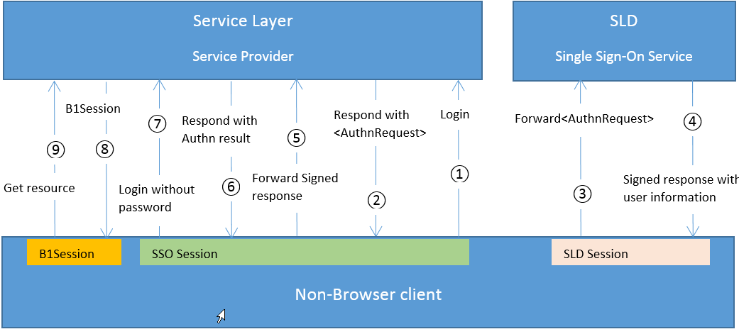
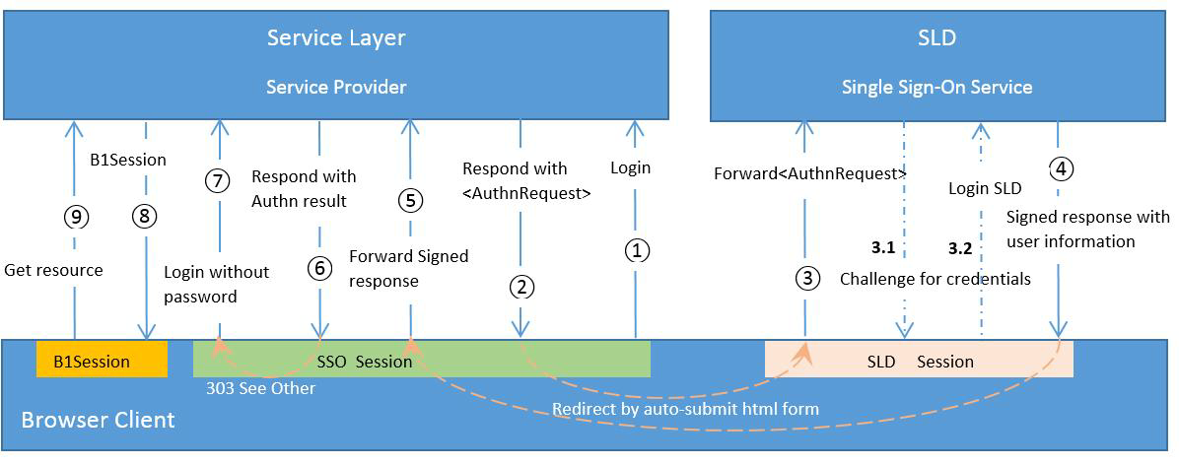
Connect Using Single Sign-On: Overview
SSO via PAOS
SSO via HTTP-POST
Notes:
As a service provider (SP), Service Layer implements the SSO process via the SAML2 protocol on top of SLD, which functions as an identity service provider (IDP).
Service Layer supports two SSO methods:
HTTP-POST: used in the browser environment
PAOS (Reverse HTTP Binding for SOAP Specification): used for the non-browser client
We recommend deploying the Service Layer on the same Linux machine as SLD.
If you deploy it on two separate machines, the time must be synced between the two machines before the SSO process is implemented.

Slide 15
Connect Using Single Sign-On: Write the Code Login
Notes:
The following example opens a connection from a UI API-based add-on solution to the Service Layer.
The GetServiceLayerConnectionContext method is used in the Company object to establish the connection.
The rest of the actions required are the same as in the case of creating the UI API connection.
The Service Layer will be used with the user account that had executed the add-on solution within the SAP Business One client.
Single Sign-On takes care of the user permissions and authorizations in the Service Layer service, as well.

Slide 16

Connect Using Single Sign-On: Exercise
You should now practice:
Creating a WCF-based project
Opening a connection from an add-on to the Service Layer
Notes:
In the exercise for this part, you will practice creating a WCF-based project in which you will open a connection from the add-on solution to the Service Layer.

