Slide 1

TB 1300 – SAP Business One SDK Add-On Licensing
July, 2019
Notes:
Welcome to the Add-On Licensing course topic.

Slide 2

Add-On Licensing: Topic Objectives
After completing this topic, you will be able to:
Describe the System Landscape Directory (SLD) and security features
Explain the license concept for the SAP Business One SDK and add-ons
Notes:
After completing this topic, you will be able to:
Describe the System Landscape Directory (SLD) and security features
Explain the license concept for the SAP Business One SDK and add-ons

Slide 3

Add-On Licensing: Business Example
Your company has built a solution (add-on) for SAP Business One. Now you want to add license checks for named users to your solution. To do so, you use the license concept of the SAP Business One Software Development Kit.
Notes:
Let’s look at a business example of why the add-on licensing process might be required.
Your company has built an add-on solution for SAP Business One.
Now you want to add license checks for named users to your solution.
To do so, you use the license concept of the SAP Business One Software Development Kit.

Slide 4
Add-On Licensing: License Server & System Landscape Directory Role and deployment
Browser/ SLD Client
config
config
Server list
SSO
DB credential
Site user
Dynamic key
Encryption algorithm
Read-only DB user
License
Server machine
License server
SLD
login
login
B1 client
Add-on
Notes:
The license server and the System Landscape Directory are separate components of the SAP Business One Server.
The license server is responsible for license request management. Each user who would like to connect to SAP Business One must have a license allocated by the license server.
Accordingly, every user or add-on connects to the license server in order to check whether a license exists for that specific user.
The System Landscape Directory (SLD) control center is a central workplace where you perform various administrative tasks.
You can access the SLD control center in a web browser for the following:
Enabling the Single Sign-on function
Managing site users
Enabling dynamic encryption keys
Exporting and importing configuration files
Adding services in the System Landscape Directory
Mapping external addresses to internal addresses

Slide 5
Add-On Licensing: System Landscape Directory Details
System Landscape Directory (SLD)
Installed from server tools; must be on the same machine as license manager
Offers a web interface for configuration
Uses https; selection required during installation
PXCS12 certificate store and password
or
Self-signed certificate (default)
Creates new DB for SLD info (SLDModel.SLDData)
Choice of authentication:
Windows authentication => asks for domain user; service will be run under this user (must have administration rights)
Database authentication => service will be run with local system user
Notes:
The System Landscape Directory is part of the SAP Business One server tools. During the default deployment, a self-signed certificate is created to manage the https-based communication.
It’s also possible to implement a certificate released by a certificate authority to provide for more security and convenience.
The SLD component creates a new database or database schema called SDLDATA, where all the configurations pertaining to SAP Business One connectivity are stored.
For SAP HANA deployment, only database authentication is available.
For Microsoft SQL Server deployment, you can select the Windows authentication in advance, as well.

Slide 6
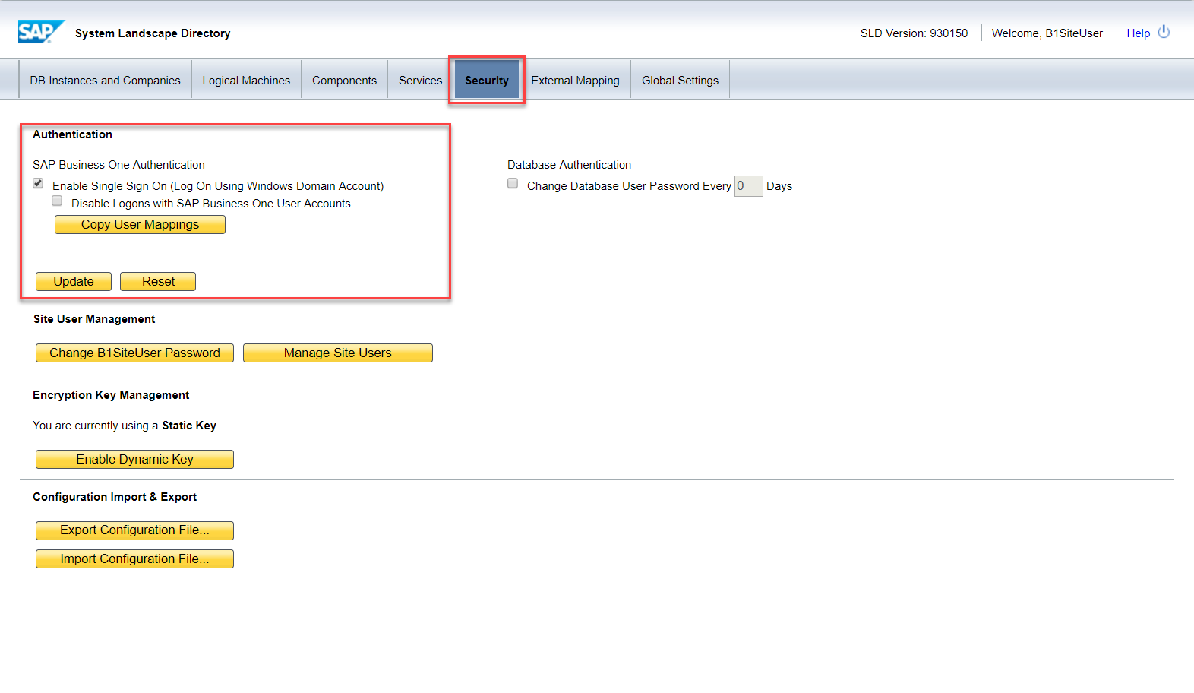
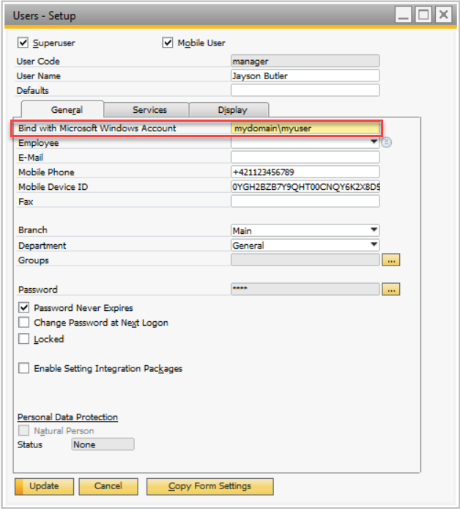
Add-On Licensing: Security Single Sign-On (SSO) – Enablement
Administrators can enable global SSO functionality in the System Landscape Directory.
Bind an SAP Business One user account to a Microsoft Windows domain account.
Notes:
SAP Business One, version for SAP HANA supports Single Sign-On (SSO) functionality.
You can bind an SAP Business One user account to a Microsoft Windows domain account. After registering a Service Principal Name (SPN) and binding SAP Business One users to Microsoft Windows accounts, you can enable the Single Sign-On function in the SLD.
The user binding needs to be defined at the SAP Business One user level, as well. Please refer to the picture on the right, where “Bing with Microsoft Windows Account” is highlighted.

Slide 7
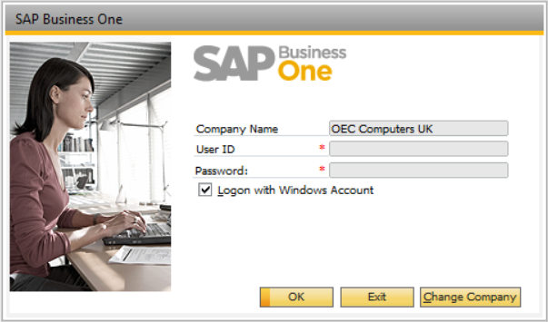
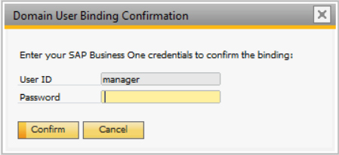
Add-On Licensing: Security Single Sign-On (SSO) – Usage
Users bypass the “Choose Company” window and start using the application without being prompted to enter their SAP Business One login credentials.
When logging in the first time, users need to confirm their B1 user password.
After the first time, users no longer need to enter credentials.
Notes:
Users bypass the “Choose Company” window and start using the application without being prompted to enter their SAP Business One login credentials.
If the user session is being started for the first time, the SAP Business One user password needs to be confirmed.
Once a password is entered, SAP Business One will no longer ask for user credentials.

Slide 8
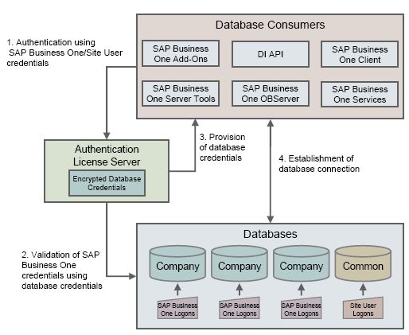
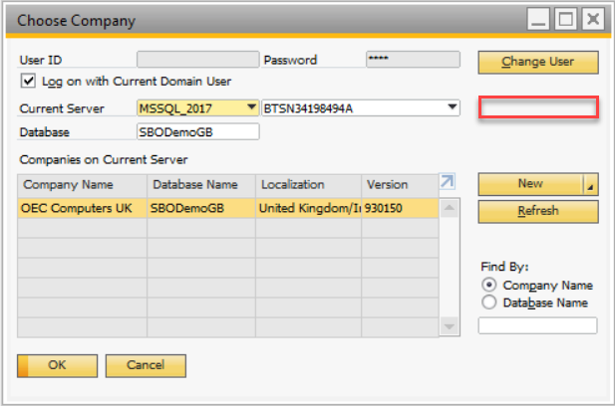
Add-On Licensing: Security DB credentials
DB credentials handled via license service. Not kept on client PC anymore!
Motivation: Better protection and tighter security of customer data.
Notes:
SAP Business One has a mechanism to protect the database from easy changes through direct access.
The advantages of restricting access to the SAP Business One database are:
End users are not exposed to database credentials and thus cannot change the databases directly, which protects the databases from being changed or attacked.
Database credentials are stored on the license server and end users can access the database only after the application performs a successful site user authentication through the System Landscape Directory.
This is meant to ensure better protection and tighter security of customer data.

Slide 9
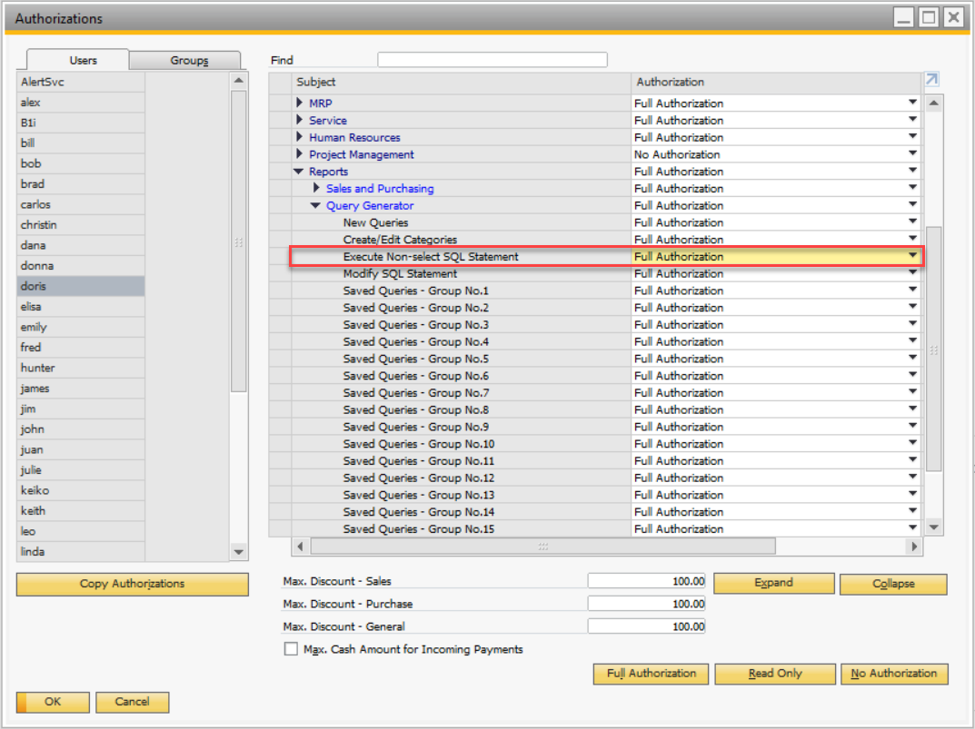
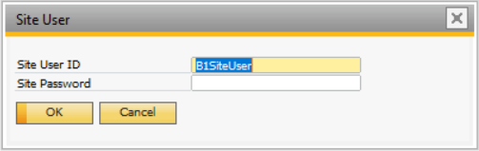
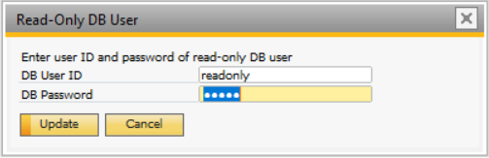
Add-On Licensing: Security Read-only DB user
A read-only DB user can be defined to execute SELECT-only queries
End users with limited authorization will use the read-only DB user profile to access the DB
Motivation:
Notes:
To grant read-only authorization to non-super users for queries (system and user-defined) in SAP Business One, you must manually create a read-only database user and assign it to the company database.
To enable an SAP Business One user to view the results of both system and user-defined queries, you can directly grant the user full authorization to the Execute Non-select SQL Statement permission item in the General Authorizations window in the SAP Business One client application.
A read-only DB user can be defined to execute SELECT-only queries.
The motivation here is to restrict end users from running critical SQL operations.

Slide 10
Add-On Licensing: Security Different DB user for each company DB
The company list can be filtered by domain user.
Goals
Prevent B1 users from seeing all companies, even if they have no access to it.
Prevent B1 users from creating SQL queries from B1 to access other DBs.
With this feature, each B1 user can only see and access the companies that he or she can access from his or her Windows account.
Example:
Domain user assigned only to one B1 company DB user => If SSO and “Different DB user for each company DB” are defined, the user will only see the respective company.
Notes:
You can use the SLD service to create different database user accounts for each company database.
After creating accounts, SAP Business One does not access company databases using the database administrator account.
Instead, SAP Business One uses a different read-only account supplied by the SLD service to access each company database.
For example, the domain user is assigned only to one SAP Business One company database if the Use Specified Database User for Each Business One User option is selected and Single Sign-On is activated.

Slide 11
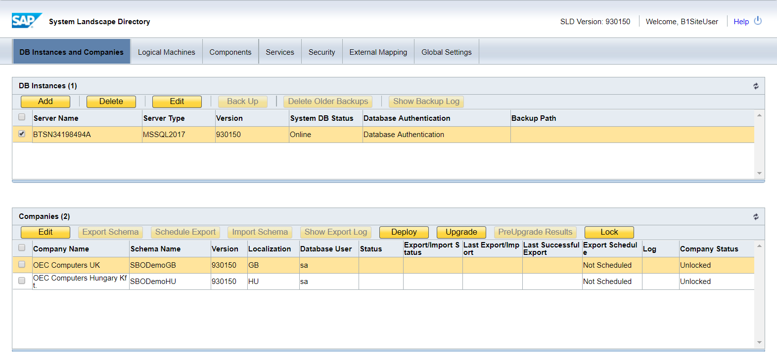
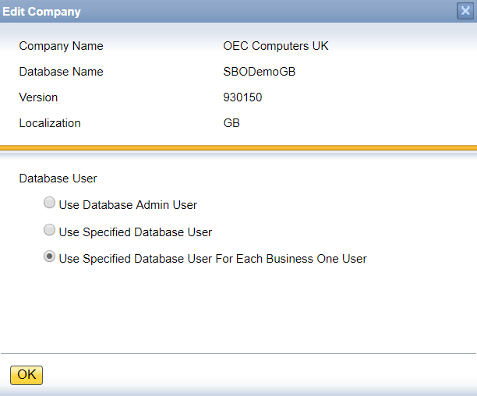
Add-On Licensing: Security Different DB user for each company DB – activation
This feature can be activated for each company from the System Landscape Directory.
Notes:
This feature can be activated for each company from the System Landscape Directory.
The most secure and recommended way is to select the Use Specified Database User for Each Business One User option.

Slide 12
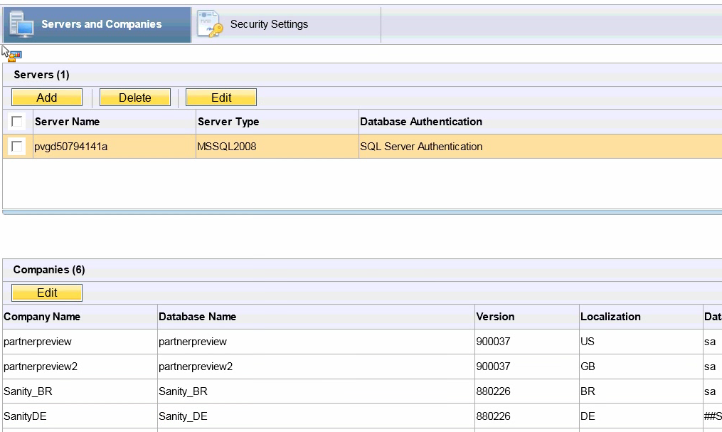
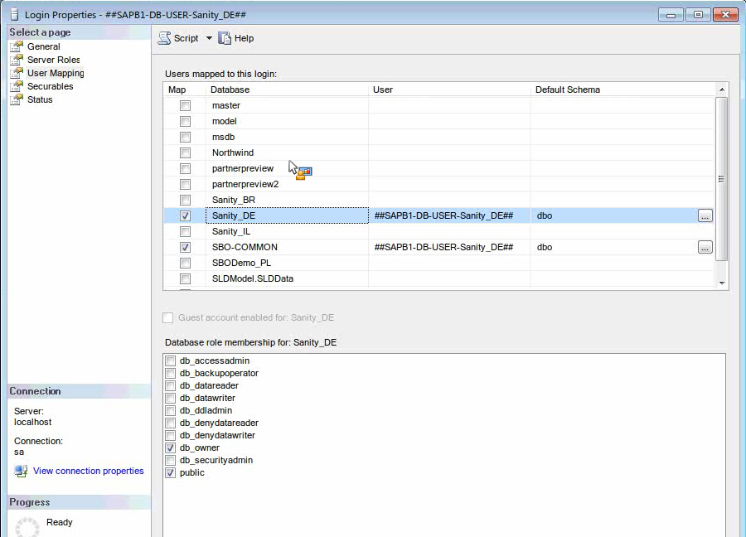
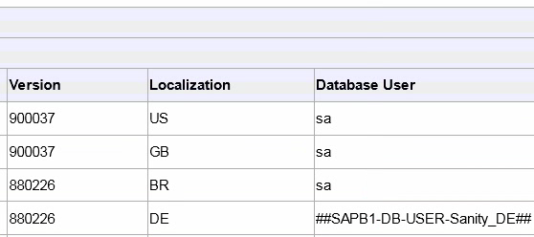
Add-On Licensing: Security Different DB user for each company DB – SQL user
A new DB user is automatically created in SQL Server and assigned to the DB (instead of the default DB administrator user).
Notes:
The system automatically generates a pair of database users without administrator privileges for each SAP Business One user.
SAP Business One accesses the database using one of the database users depending on the SAP Business One user currently logged in and the specific database transaction at hand.
Whenever a new SAP Business One user is added, a pair of corresponding database users is added.

Slide 13

Add-On Licensing: Licensing Infrastructure Architecture and landscape sample
The license service facilitates all license checks
The connection information (server + port) for an SAP Business One database server is stored in the SLIC table in SBO-Common
License assignments to user codes are stored in the file B1upf.xml
Partner Tool
License
File
B1upf.xml
SAP Business One
client
Check
License Service (CORBA)
Licensing API
Check
Partner solution
SDK
UI API
SAP Business One
client
Check
SBOCOMMON.SLIC
Partner solution
SDK
DI API
Check
SAP Business One
database server
(…“points” to license service)
Partner solution
DI Server or Service Layer
Notes:
Let‘s have a look at the licensing infrastructure, where multiple database consumers are engaged. These include the SAP Business One client, a UI API-based add-on, a DI API-based add-on, and a web solution making use of the DI Server or Service Layer.
The license server contains the license file and b1upf.xml, which is the user-based license allocation file.
The connection information (server + port) for an SAP Business One database server is stored in the SLIC table in the SBOCOMMON schema or database.

Slide 14
Add-On Licensing: Licensing Infrastructure Technical components 1/2
License service
Part of the SAP Business One server tools
Can be installed on any computer
Calculates a hardware key
Provides logging capabilities to detect license-related issues
Makes it possible to set the port number it listens to
The port that is specified is actually the port number of the naming service that handles the initial connection to the license service…
License service itself listens to that port number + 1
Checks whether a session is still alive – to release concurrent user type licenses if necessary
Responds to license checks triggered from any SAP Business One component
Please note: “Named user” license checks are performed for each user code + database name (disregarding DB server + client PC)
Only one login to SAP Business One is allowed for each user code / DB name!
Notes:
It’s a component of the SAP Business One server tools, which can be installed on any computer.
It calculates the hardware key and collects the license-related logs, as well.
The TCP/IP ports are configurable, and the license service is also responsible for the user’s session verification.
It provides the response to every SAP Business One component that requests license information.
“Named user” license checks are performed for each user code and database name.
Only one login to SAP Business One is allowed for each user code and database name.

Slide 15
Add-On Licensing: Licensing Infrastructure Technical components 2/2
License
File
License file
Specific to a particular license service
Generated on request through Support Launchpad for SAP Business One
Includes licenses for:
All purchased SAP Business One components
Includes SAP components that are available for free
…and add-on solutions
Can be uploaded through the license service – or through the SAP Business One client application
Issued for each “localization”; customers who upgrade from previous versions will receive a “global” license that still allows use of any localization.
B1Upf.xml
Stores information regarding licenses assigned to specific user codes
Stores this information independently from the company database and even the SAP Business One “server”
B1upf.xml
Notes:
The license server has two main files that are required for successful execution of SAP Business One user sessions.
The license file is specific to a particular license service based on the exact SAP Business One release in use.
It might be generated directly on the Support Launchpad for SAP Business One.
The license file can be deployed through the SAP Business One client or the System Landscape Directory.
The file might be localization-specific or global, which makes it possible to use a customer database with any localization.
The B1upf.xml file stores information regarding licenses assigned to specific user codes.
The license assignment is independent from the company database and even the SAP Business One server.
Basically, a user who has been assigned a named user license can connect to multiple databases without needing to assign a license in each database.

Slide 16
Add-On Licensing: Add-On-Related Licenses Overview
The following table lists relevant licenses and the use each of them enables.
Named = Named user license
Conc. = Concurrent user license
CPU = CPU-based license
Please note (again):
To use UI API or DI API, the user must also have an SAP license assigned (Indirect Access, Limited or Professional User) – no matter which SDK license type should be used!
Licenses vs. Components | License Type | UI API | DI API | DI Server | Namespace and Add-On Registration
SDK Development | Conc. | X | X | - | Yes
Solution License | Named | X | X | - | -
DI Server | CPU | - | - | X | -
Indirect Access | Named | - | X | - | -
SDK Implementation (free) | Conc. | X | - | - | -
Notes:
To use UI API or DI API, the user must also have an SAP license assigned (Indirect Access, Limited or Professional User) – no matter which SDK license type should be used!
The Named User license makes it possible to log in through the SAP Business One client. This license also enables add-ons that do not use the SAP license mechanism (or their own).
The named user license types include the following: Professional User, Limited Financial, Limited Logistics, Limited CRM, CRM Sales, and CRM Service.
The SDK Development license is for developers of add-ons that use the DI API or both the DI and UI APIs.
The (ISV) Solution license is for a specific add-on (PayrollLink, for example). These licenses are displayed in the External Licenses area of the Allocation tab of the License Administration form.
The DI Server License allows connections to the DI Server. It’s a concurrent license bound to an individual CPU.
The Indirect Access License makes it possible to connect to SAP Business One via an add-on solution based on DI API or the Service Layer.
The SDK Implementation license is for developers of add-ons that use only the UI API. SAP Business One comes with an unlimited number of SDK Implementation licenses for each Professional User license.

Slide 17
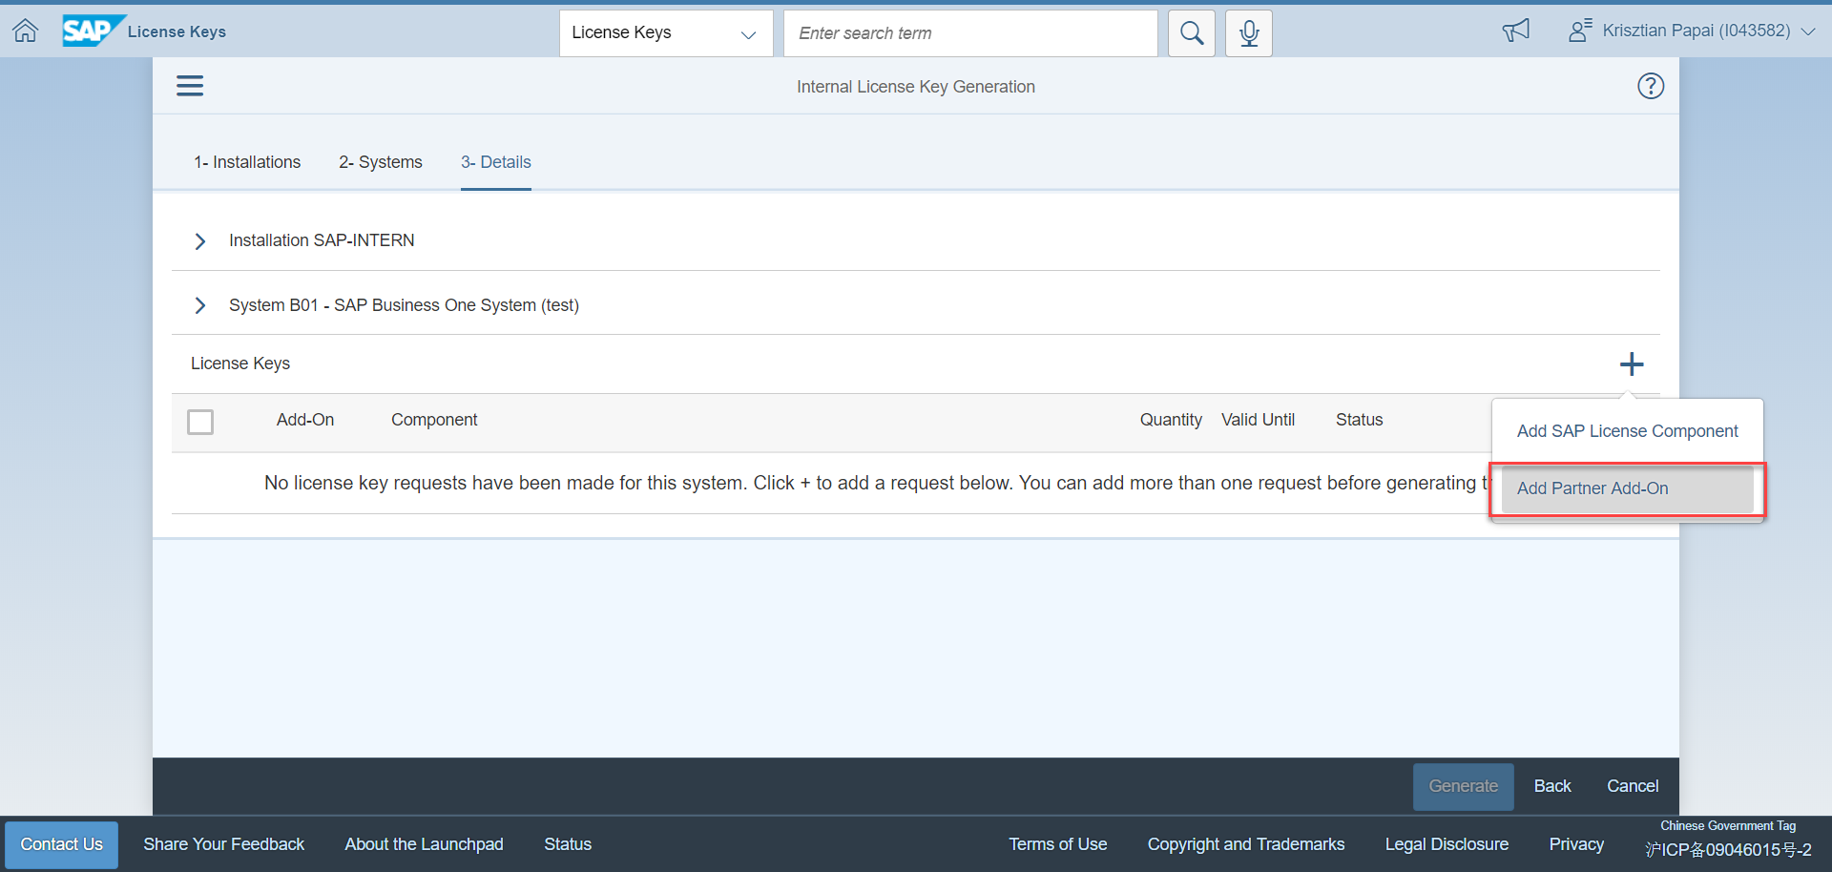
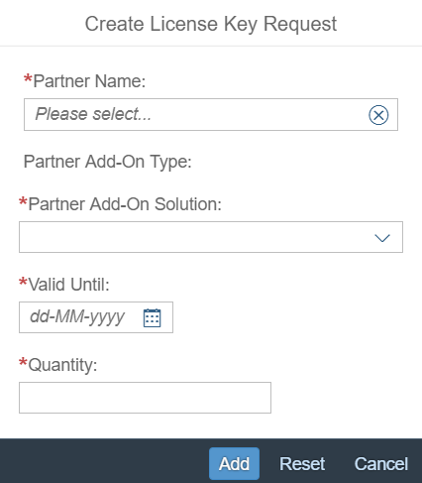
Add-On Licensing: License Concept Motivation
Ensure return on investment (ROI)
Restrict usage of an add-on solution
Re-use license mechanism of SAP Business One
No need to program your own license check
No need to set up a license infrastructure
Note: Licenses for registered add-ons will be provided without further approval. A partner can check the customer and number of licenses requested.
In the license overview at the SAP Channel Partner Portal (https://launchpad.support.sap.com/#/licensekey), a license report lists requested licenses for your registered add-on solutions.
Notes:
The SAP Business One license mechanism also supports use by the add-on solution you develop.
This will help ensure a solid return on investment and restrict the usage of the add-on solution.
It is therefore not necessary to develop your own license logic.
Keep in mind that the licenses for registered add-ons will be provided without further approval. A partner can check the customer and number of licenses requested.
During the license key generation process, you have the option to assign the licenses for your partner add-on.

Slide 18
Add-On Licensing: Step-by-Step
Solution Partner (ISV)
Register add-on solution
Currently uses messages to SAP Support for component SBO-SDK-AA
Receive license key name
Generate add-on identifier
Use an add-on identifier in source code to trigger checking of specific add-on solution licenses
VAR / Sales & Service Partner / Customer
Order SAP licenses on the Support Launchpad for SAP Business One
“Request” license keys from SAP (includes add-on licenses)
Install add-on solution
Assign licenses to users
Notes:
Let‘s see what steps need to be performed by a solution partner in order to use the SAP licensing mechanism for a third-party add-on solution.
The add-on needs to be registered by a support incident using the component SBO-SDK-AA.
The partner received the license key name that needs to be used in the Generate Add-On Identifier tool.
The tool will return the add-on identifier string that must be implemented in the add-on source code.
Meanwhile, customers and VAR, Sales, and Service partners perform the following steps in order to use add-on specific licenses.
During a license key request, they might ask for an add-on solution license, as well. Once the key has been applied for the SAP Business One license server, the add-on can be installed and the licenses can be assigned to the users.

Slide 19
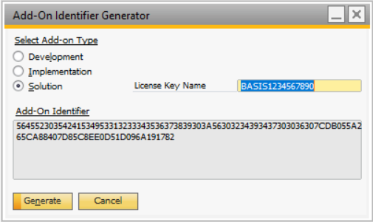
Add-On Licensing: Terms
License Key Name
Technical string returned by SAP upon registration of the add-on solution
Starts with “BASIS“ followed by a 10-digit number
Identical to SWPRODUCTNAME in the license file + extension (extension related to chosen DB type); for example: SWPRODUCTNAME=BASIS1234567890_MSS
Add-On Identifier
Identifier that is used in add-on code
Add-On Identifier Generator in SAP Business One generates “Solution”, “Implementation” or “Development” add-on identifiers
A “Solution” add-on identifier is generated from the license key name and facilitates use of DI API and UI API (add-on license to be assigned to the user)
An “Implementation” add-on identifier makes it possible to use UI API only (concurrent user license)
A “Development” add-on identifier makes it possible to use both DI API and UI API, but requires an “SDK Development” license (concurrent user license)
Use only the license key name (e.g. BASIS1234567890) to generate a “Solution” add-on identifier
Notes:
Here, we can see how the Add-On Identifier Generator is used.
The license key name is a unique string provided by SAP when an incident is created with the component SBO-SDK-AA. Starts with “BASIS“ followed by a 10-digit number.
The Solution option then needs to be selected in the tool and the license key name needs to be entered. Pressing the Generate button will create the add-on identifier.
The add-on identifier needs to be used in the add-on code. You will see an example of use on the next slide.

Slide 20
Add-On Licensing: Activate License Check
In general, an add-on identifier string must be passed on to the AddOnIdentifier property before calling the Connect() method of an API.
Sample code, UI API
Dim b1GuiApi as New SAPbouiCOM.SboGuiApi b1GuiApi.AddonIdentifier = „4CC5B8A4E0213A68489E38CB4052855EE8678 _ CD237F64D1C11C52706A541BD245D5E6E4050AE9B919FBE0FAB44F9” b1GuiApi.Connect(sConnectionString)
Sample code, DI API (for usage without UI API)
m_cmp = New SAPbobsCOM.Company m_cmp.AddonIdentifier = „4CC5B8A4E0213A68489E38CB4052855EE8678 _ CD237F64D1C11C52706A541BD245D5E6E4050AE9B919FBE0FAB44F9” lret = m_cmp.Connect()
Notes:
The add-on identifier string needs to be assigned to the add-on identifier property before calling the connect method in the APIs.
Connections should be re-used to avoid wasting licenses for the same user.
Add-on solutions that use the UI and DI APIs should set the add-on identifier only. They should connect to the UI API first, and then to the DI API.
Another connection through the DI API would use up another license.
If the add-on is assigned to the “Mandatory” start group, a user that has not been assigned a license for this add-on cannot log into the company in question.

Slide 21
Add-On Licensing: Technical Details
Please note:
Add-on solutions that use both UI API and DI API in conjunction with Single Sign-On have to leave the AddOnIdentifier property of DI‘s company object empty!
When using the “Multi Add-on” feature to open the DI connection through UI API, the Connect() method won’t be called anyway.
DI Server performs a license check when it starts.
DI Server has a CPU-based license model!
Please note further:
UI API has a functionality that checks the license status of a particular form for the user currently logged in:
Application.Company.GetFormLicenseStatus(…)
Notes:
Add-on solutions that use both UI API and DI API in conjunction with the Single Sign-On feature have to leave the AddOnIdentifier property of DI‘s company object empty.
When using the “Multi Add-on” feature to open the DI connection through UI API, the Connect() method won’t be called anyway.
DI Server performs a license check when it starts because it has a CPU-based license model.
UI API has a functionality that checks the license status of a particular form for the user currently logged in at the company object level using the method GetFormLicenseStatus.

Slide 22
Add-On Licensing: License Administration
SAP Business One and add-on licenses can be maintained and controlled through the license administration form ( -> Administration -> License -> License Administration).
Configurations can be maintained only for the company database the administration is currently logged into.
Indirect Access user is a valid SAP Business One license type, but is not authorized for any functionality inside the SAP Business One GUI application.
No limitation on the number of add-ons assigned to one user
Add-on licenses can only be assigned to users with a valid SAP Business One license type
Registered add-ons are displayed under External Licenses
Please note:
To use the integration framework for SAP Business One, two (free) licenses have to be assigned to the (technical) user “B1i” in SAP Business One:
License type “B1i”
License type “B1iINDIRECT_MSS”
Notes:
SAP Business One and add-on licenses can be maintained and controlled through the license administration form (-> Administration -> License -> License Administration).
Configurations can be maintained only for the company database the administration is currently logged into.
Indirect Access user is a valid SAP Business One license type, but is not authorized for any functionality inside the SAP Business One GUI application.
There is no limitation on the number of add-ons assigned to one user.
Add-on licenses can only be assigned to users with a valid SAP Business One license type.
Registered add-ons are displayed under External Licenses.
In addition, the integration framework for SAP Business One has two additional license types, which are delivered for free by default during the license file generation process.

Slide 23
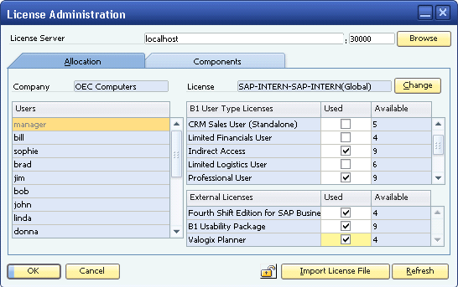
Add-On Licensing: License Administration Form
Registered add-ons are displayed under External Licenses
Indirect Access user is a valid SAP Business One user type, but is not authorized for any application functionality. Users must be assigned a named user license (such as Professional User) or the new Indirect Access license.
No limitation on the number of add-ons assigned to one user type
The license administration form enables:
Administrators to maintain licenses and grant users access to SAP Business One modules and add-on solutions
Viewing of content of license files
Importing of a new license file into the license service
Locking of any users from the SAP Business One system
Notes:
The license administration form enables:
Administrators to maintain licenses and grant users access to SAP Business One modules and add-on solutions
Viewing of content of license files
Importing of a new license file into the license service
Locking of any users from the SAP Business One system
Registered add-ons are displayed under External Licenses.
Indirect Access user is a valid SAP Business One user type, but is not authorized for any application functionality. Users must be assigned a named user license (such as Professional User) or the new Indirect Access license.
There are no limitations on the number of add-ons assigned to one user type.

