Slide 1

TB1300 - SAP Business One SDK Add-On Packaging
July, 2019
Notes:
Welcome to the Add-On Packaging course topic.

Slide 2

Add-On Packaging: Topic Objectives
After completing this topic, you will be able to:
Explain how to package your solution
Describe what to include in the add-on package
Explain how to get the registration data file
Describe how your solution will be registered in SAP Business One
Notes:
After completing this topic, you will be able to:
Explain how to package your solution
Describe what to include in the add-on package
Explain how to get the registration data file
Describe how your solution will be registered in SAP Business One

Slide 3

Add-On Packaging: Business Example
You have developed an industry-specific solution for SAP Business One. Now you want to deliver this solution to your customers.
Notes:
Here we have a business example of why the add-on packaging process could be required.
You have developed an industry-specific solution for SAP Business One. Now you want to deliver this solution to your customers.

Slide 4
Add-On Packaging: Package Contents
Add-on components (including registration data file, setup, etc.)
Add-on installer must be one executable file
Provide documentation for the add-on solution
Describe user-defined fields and tables
Describe the user-defined objects you define in your add-on (if applicable)
List where you modify SAP Business One’s standard functionality (if appropriate):
List which modules – or forms / items – you hide, for example
List where you interfere with the control flow of SAP Business One’s standard functionality (if appropriate)
List any event you capture that originates from SAP Business One’s standard functionality, for example:
Recommended for all add-ons
Mandatory for add-ons to be certified by SAP
Especially if you might set BubbleEvent to false (mandatory for all add-ons)
This is important because various add-ons from various vendors may be in use on the customer side!
Notes:
The add-on package contains the add-on components, including a data file, setup, and other files.
The add-on installer must be a single executable file.
The documentation should also be part of the add-on package, along with UDO, UDT, and UDF descriptions.
It’s essential that you list all the instances in which the standard SAP Business One functionality has been modified.

Slide 5
Add-On Packaging: Add-On Deployment, Step-by-Step Overview
Creation – Develop / Create Package
Compile the add-on program
Create installation program
Create registration data file
Deployment – Register / Install / Administrate
Register (and install) the add-on
Set company preferences
Set user preferences
Assign add-on licenses to users (if appropriate)
Runtime
Run or stop the add-on
Notes:
On the current slide, you can see an overview of the add-on lifecycle. It has three main categories: Creation, Deployment, and Runtime.
In the creation phase, the add-on is developed and compiled. Then the installation program is created, and finally the registration data file is generated.
In the deployment phase, the add-on is registered and installed. Afterward, it’s possible to configure the company and user preferences. Finally, the license can be assigned for the add-on solution if the license mechanism is used.
During the runtime phase, it’s possible to stop and start the add-on solution.

Slide 6
Add-On Packaging: Add-On Installer AddOnInstallAPI.dll
The installation is always initiated by the SAP Business One client.
The installer must be able to accept a command line parameter for installation and uninstallation from SAP Business One.
You must use AddOnInstallAPI.dll in your installer!
Mandatory:
EndInstallEx(String, Boolean)
Call this function at the end of the installation process.
The boolean parameter makes it possible to indicate success (= true) or failure (= false).
The function returns an integer value; 0 signals success.
EndUnInstall(String, Boolean)
Call this function at the end of the uninstallation process.
The boolean parameter makes it possible to indicate success (= true) or failure (= false).
The function returns an integer value; 0 signals success.
Optional:
SetAddOnFolder(path)
If you modified the default installation path as provided by SAP Business One
RestartNeeded()
Call this function if the setup program restarts the PC (see SDK documentation for more details!)
Notes:
The installation is always initiated by the SAP Business One client. You must use AddOnInstallAPI.dll in your installer.
The installer must be able to accept a command line parameter for installation and uninstallation from SAP Business One.
The installer must call the EndInstallEx function from AddOnInstallAPI.dll when the installation is complete.
The AddOnInstallAPI.dll contains functions that support the installation process, such as RestartNeeded, B1Info, or SetAddOnFolder.
The mandatory functions for each add-on are EndInstallEx and EndUnInstall.

Slide 7
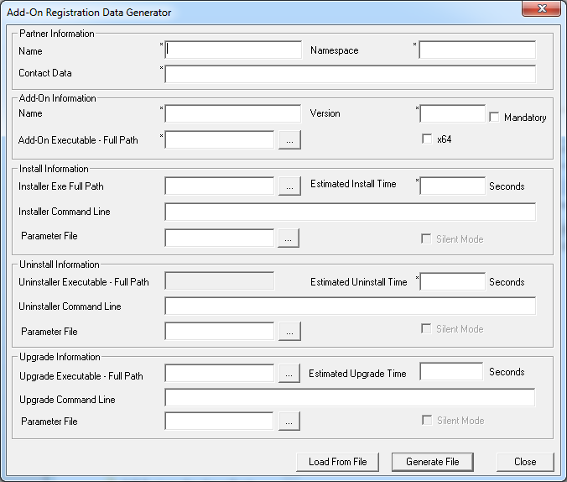
Add-On Packaging: Run Add-On Registration Data Generator
The registration data file allows the application to identify your add-on and run it automatically when the application is launched.
To generate the license data file, run the AddOnRegDataGen.exe file, which is typically located at: C:\Program Files (x86)\SAP\SAP Business One SDK\Tools\AddOnRegDataGen
Notes:
The registration data file enables you to register your add-on with the SAP Business One application.
This allows the application to identify your add-on and run it when the application is launched.
In addition, after registration, you will be able to set add-on preferences for a company and specific users.
To generate the license data file, run the AddOnRegDataGen.exe file, which is part of the SAP Business One SDK package.

Slide 8
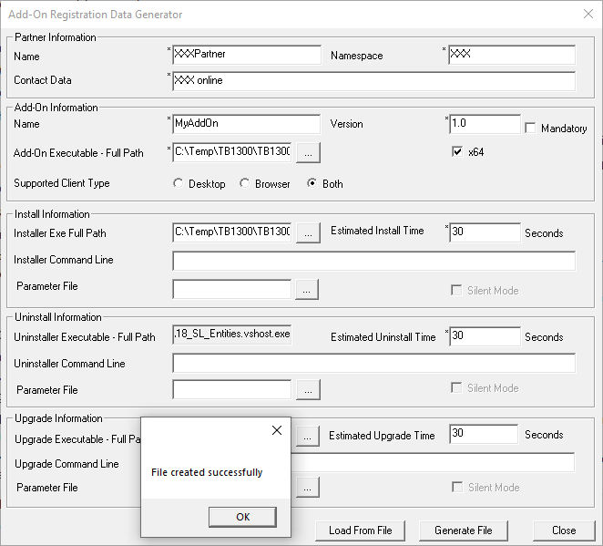
Add-On Packaging: Create Registration Data File User interface
Enter your partner information.
Enter the add-on information.
Enter the data of the add-on installer, uninstaller, and upgrader.
Choose “Generate File” to create the registration data file.
Don’t forget to check the x64 option for 64-bit add-ons.
Notes:
To successfully generate the add-on data registration file, it’s essential to fill in the following group of properties:
Partner information, like partner name, namespace, and contact data
Add-on information, like add-on name, version, executable path, and bitrate
Installation information, like installer path and install time
Uninstallation information, like installer path and install time
Upgrade information, like installer path and install time
It’s possible to generate the file by pressing the Generate File button. Alternatively you can load an already existing file as well.

Slide 9
Add-On Packaging: Create Registration Data File Command line mode
AddOnRegDataGen.exe is batch-capable.
Calling convention (command line parameters):
AddOnRegDataGen.exe <xml info> <InstallerVersion> <Installer> <Uninstaller> <Add-On-Exe>
Sample:
AddOnRegDataGen.exe MyAddOn.xml 1.0 setup.exe setup.exe MyAddOn.exe
The „<xml info>“:
<AddOnInfo partnernmsp=“ABC" contdata=“support contact data" addonname=“MyAddOn" addongroup="M" esttime="300" instparams="" uncmdarg="" unesttime="180" partnername=“ABC" silentinst=“N" silentugd="N" silentuninst=“N" ugdcmdargs="" ugdesttime="180" platform="X" />
Note: platform="N" represents x86 platform platform="X" represents x64 platform
Notes:
The AddOnRegDataGen tool is batch-capable. Please refer to an example of how this can be used as a command line utility.
The output of this file is an XML file that has a specific ARD name. If necessary, the XML file can be edited and fine-tuned, as well.
In the AddOnInfo element, a platform parameter can be found, where the value AddOnInfo represents the 64-bit platform.

