Slide 1

TB 1300 – SAP Business One SDK Add-On Administration
July, 2019
Notes:
Welcome to the Add-On Administration course topic.

Slide 2

Add-On Administration: Topic Objectives
After completing this topic, you will be able to:
Describe how your solution will be registered in SAP Business One
Notes:
After completing this topic, you will be able to describe how your solution will be registered in SAP Business One.

Slide 3
Add-On Administration: Introduction
The Add-On Administration tool is designed to help administrators deploy and manage add-on applications on end users’ workstations.
With Add-On Administrator, you can:
Register add-ons
Set company preferences
Set user preferences
Remove add-ons
Monitor add-ons
Notes:
The Add-On Administration tool is designed to help administrators deploy and manage add-on applications on end users’ workstations.
To run add-ons with the SAP Business One application, you must register them with the application.
Registering add-ons enables SAP Business One to identify the add-ons and lets you set both company-wide and user-specific preferences.
With Add-On Administrator, you can:
Register add-ons
Set company preferences
Set user preferences
Remove add-ons
Monitor add-ons

Slide 4
Add-On Administration: Overview
The add-on registration process registers add-on applications in the SBO-Common DB on the SAP Business One server
Will be done before the first installation of an add-on on a client machine
The system administrator registers the add-on using Add-On Administration; this triggers the import of the installation package and the ARD file into the SBO-Common DB (SARI table).
Add-On installation can be started in one step with registration; otherwise it will be started at the next logon.
Add-on upgrades can be carried out by repeating the add-on registration process.
Please note that the new add-on version must be greater than the installed version (“1.1” instead of “1.0”, for example).
In the first step, the upgrade process will start the uninstallation!
Add-on upgrades can be started in one step with registration; otherwise they will be started at the next logon.
Add-On Administration is only available for users with super user privileges for the company at hand.
Notes:
Add-On Administration is only available for users with super user privileges for the company at hand.
You will need to register an add-on only once from any SAP Business One workstation.
The registration process uploads the add-on installation package files to the SAP Business One server.
The registered add-ons are available for all the companies in SAP Business One.
Add-on upgrades can be carried out by repeating the add-on registration process.
The add-on version needs to be changed, and the upgrade process will start the uninstallation of the add-on solution.

Slide 5
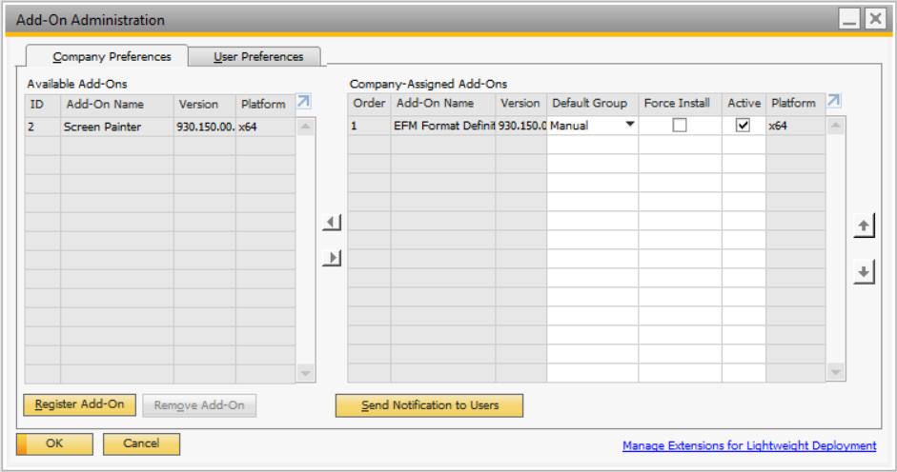
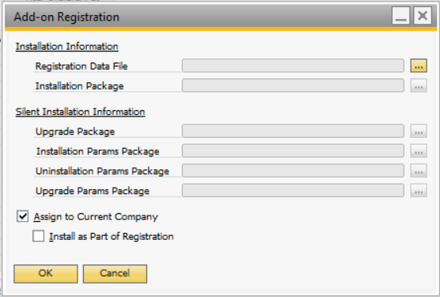
Add-On Administration: Register Installation Package
In SAP Business One, go to: Administration -> Add-On -> Add-On Administration
Choose Register Add-On
Registration Data File: Choose the data file of the add-on.
Installation Package: Choose the installation file of the add-on.
Check Assign to Current Company if you wish to assign the add-on to the current company.
Check Activate for Company if you wish to start the installation on the PC you are currently using.
Choose OK to close the window and register the add-on.
Once the add-on is registered, it will appear in the Available Add-On list in the Add-On Administration window.
Package has been copied into SBO-Common database (SARI table)…
Add-ons assigned to current company
Add-ons on the server NOT assigned to current company
Notes:
The add-on registration process is as follows:
From the SAP Business One main menu, choose Administration -> Add-Ons -> Add-On Administration.
The left side of the screen displays the list of add-ons that are deployed on the SAP Business One server; on the right side, the add-ons related to the company database are listed.
After pressing the Register Add-On button, the Add-On Registration window appears. Here, it’s possible to install a new add-on solution for the SAP Business One server, which will be added to SBOCOMMON’s SARI table.
The add-on solution can be assigned to the current company database; this will move it from the left side to the right in the Add-On Administration window.

Slide 6
Add-On Administration: Company Preferences
Assigning a start-up group controls the start-up behavior and deployment of add-ons for all users who connect to a particular company.
Mandatory - Add-on is needed to fulfill requirements of the customer specification; it will be started automatically
Automatic - Add-on is started automatically by the SAP Business One application
Manual - Add-on is not started automatically by the SAP Business One application
This setting can be changed for each user (except for mandatory add-ons)
Force install - Forces the SAP Business One application to retry a failed add-on installation each time the end user logs into the company.
Active – An add-on can be temporarily deactivated through this setting.
Notes:
Let’s go over the most frequently used company preferences used for add-on administration.
The default group is also called the start-up group. It defines the way an add-on is opened when SAP Business One is started.
Mandatory: SAP Business One starts the add-on automatically. The add-on is necessary for the successful operation of the SAP Business One application.
Automatic: SAP Business One starts the add-on automatically. Users can stop automatically started add-ons with no impact on SAP Business One.
Manual: SAP Business One does not start the add-on automatically. Users can start the add-on at any time.
These settings can be changed at the user level as well, except when add-ons have been set as mandatory.
Force Install forces the SAP Business One application to install the add-on each time the user on this client logs into the assigned company.
The Active option temporarily activates or disables the selected add-on.

Slide 7
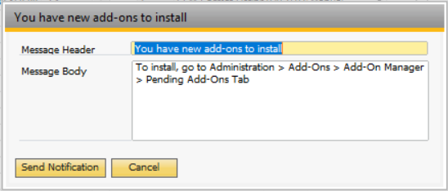
Add-On Administration: Send Notification to Users
Administrator registers new add-ons and sends notifications to users by clicking on the button on the Add-On Administration form.
Notes:
Once the add-on administrator has uploaded a new add-on, it‘s possible to notify the users.
You can create a notification for new add-ons and send it to all the users at the company.
Then the users can install the add-on immediately without needing to log back into the SAP Business One client.

Slide 8
Add-On Administration: Add-On Admin Remarks
Active flag overrides all other settings for the add-on at a company:
If the add-on is marked as not active (the check box is not checked), the add-on can be updated without being installed and executed immediately.
Extended log for add-on installation:
Add Windows environment variable AAdminLog
Values 0 (no log) … 3 (every message will be logged)
Log file can be found in the <Temp> folder of the current Windows user (for example, C:\Documents and Settings\<user>\Local Settings\Temp)
Notes:
The Active flag overrides all other settings for the add-on at a company.
If the add-on is marked as not active (the check box is not checked), the add-on can be updated without being installed and executed immediately.
It’s also possible to have extended logs for add-on installation. The procedure is as follows:
Add the Windows environment variable AAdminLog (value 0 means no log, value 3 displays every message)
Log file can be found in the <Temp> folder of the current Windows user

Slide 9
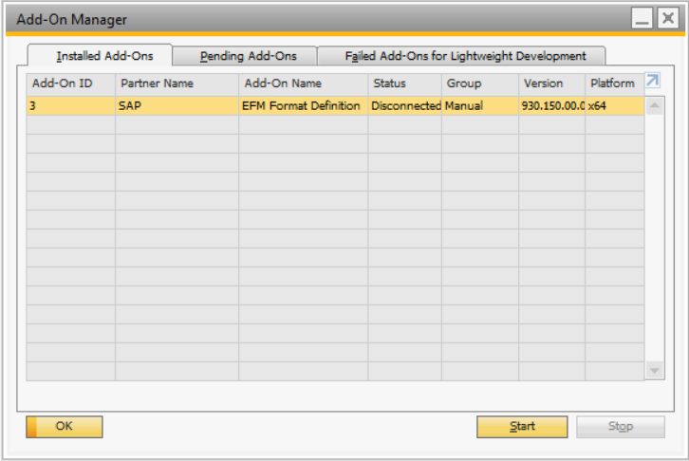
Add-On Administration: Add-On Manager
In SAP Business One, go to: Administration → Add-On → Add-On Manager
Monitor add-ons in the SAP Business One client (current user)
Displays a list of add-ons the user is allowed to run
Displays current add-on status: Connected, Disconnected, Failed
Provides pop-up notification if an add-on fails
Ability to start an add-on manually within the SAP Business One application
Displays only the relevant information for the current user
Add-on status
Stop add-on
Start add-on
Notes:
Here, you can monitor running add-ons and manually start or stop an add-on. This window displays add-ons that were specifically assigned to you or to the company you have logged into.
It’s possible to access the following options here:
Display a list of add-ons the user is allowed to run
Display current add-on status (for example, Connected, Disconnected or Failed)
Provide a pop-up notification if an add-on fails
Ability to start an add-on manually within the SAP Business One application
Display only the relevant information for the current user

Slide 10
Add-On Administration: What’s Next?
The preferred way to create the deployment and administrate the add-on / extensibility solution is the Lightweight Deployment model.
WHY?
Only this model is supported for SAP Business One Cloud
Deploys add-on and SAP HANA Delivery Unit
Automated installation is performed by the SAP Business One client
Notes:
The preferred way to create the deployment and administrate the add-on / extensibility solution is the Lightweight Deployment model.
The main advantages of using the Lightweight Deployment model are:
Only this model is supported for SAP Business One Cloud
Deploys add-on and SAP HANA Delivery Unit
Automated installation is performed by the SAP Business One client

