Slide 1

TB1300 - SAP Business One SDK Lightweight Deployment
July, 2019
Notes:
Welcome to the Lightweight Deployment course topic.

Slide 2

Agenda
Packaging Process
Deployment Process
Notes:
In this unit we will cover the following main topics:
Packaging process
Deployment process

Slide 3
Extensions and add-ons
The applications created by the SAP Business One SDK (UI and DI API) and the XS Engine based application we are collectively calling as Extensibility:
Third-party add-on solutions based on SAP Business One SDK
SAPUI5 Web Application hosted in the XS Engine of SAP HANA
Fiori App hosted in the XS Engine of SAP HANA
ASP.NET or PHP Application hosted in the XS Engine of SAP HANA
Notes:
In the following slide, we will clarify the extension terminology.
The applications created by the SAP Business One SDK (UI API and DI API) and the XS Engine-based web applications are collectively called “extensions”.
In this case, the SAP Business One add-ons are extensions. We use the term “extension” for all content that is built on top of the SAP HANA XS.
Here we can also talk about SAP UI5, Fiori, ASP.NET, PHP application, or events. More content can be delivered for HANA XS Engine, which might be shipped as a SAP HANA delivery unit.

Slide 4
Lightweight Deployment advantages
The classical add-ons and the SAP HANA delivery units can be deployed in one action.
Lifecycle management of the extensions for lightweight deployment is managed end to end by SAP Business One
Installation is performed by the SAP Business One client automatically
No need to use InstallShield (or equivalent) third party tools
Automated life cycle management of extensions without user interaction
Zero operational down time required for extension deployment
No administrator privileges required for end users to install the extension
Fully supported by the SAP Business One Cloud
Parameters can be used between the Extension Manager and extensions
Notes:
Let’s take a look at the benefits of using this tool.
The classical add-ons and SAP HANA delivery units can be deployed in one action.
The lifecycle management of the extensions for lightweight deployment is managed end to end by SAP Business One.
Installation is performed by the SAP Business One client automatically.
There is no need to use InstallShield or equivalent third-party tools.
Automated lifecycle management of extensions without user interaction.
Zero operational downtime required for extension deployment.
No administrator privileges required for end users to install the extension.
Fully supported by the SAP Business One Cloud.
Parameters can be shared between the Extension Manager and extensions.

Slide 5

Prerequisites
Mandatory
Install the SAP Business One SDK package from Product / Upgrade CD and select Tools → ExtensionPackage
Optional
Install the SAP Business One Studio package from Product / Upgrade CD
Notes:
To use the lightweight deployment, you will need to install the SAP Business One SDK package, which is available in every product and upgrade package. The SAP Business One SDK contains a tool called Extension Package, which we will use later in this session.
Alternatively, you can also install SAP Business One studio, which can then help you use an extension package directly from the development environment.

Slide 6

Packaging Process
Notes:
Let’s start with the packaging process topic.

Slide 7

Packaging Process: Topic Objectives
After completing this topic, you will be able to :
Pack the Add-Ons with the lightweight method
Pack the SAP HANA Delivery Unit
Notes:
After completing this topic, you will be able to
Pack the add-ons with the lightweight method
Pack the SAP HANA delivery unit

Slide 8
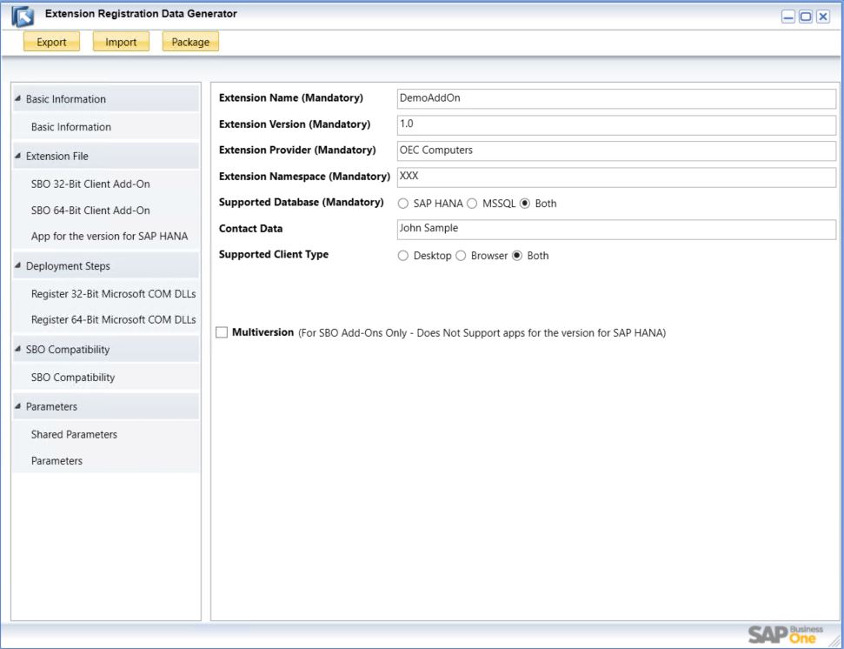
Packaging Process: Basic Information
Start ExtensionPackage Tool
In …\SAP\SAP Business One SDK\Tools\ExtensionPackage, run the ExtensionPackage.exe file
Fill Basic Information
In the Extension Registration Data Generator window, expand Basic Information, and specify the fields
Notes:
To use the tool, we need to run the extension package executable file. First of all, we will need to define the mandatory properties, which are available in the Basic Information screen. The extension name property is the name of our solution. The extension version is our own version number. Please avoid using non-numeric characters here. Set the extension provider property to the extension-produced company name. The extension namespace should be our unique company prefix. We then select the Supported Database property, where we can declare whether our extension should run on SAP HANA, Microsoft SQL Server, or in both of these database environments. Alternatively, we can also define the contact person property as well. The Supported Client type property will enable use of the extension using browser access technology, in the SAP Business One client itself, or using it in both client types. The Multiversion property is explained in more detail in the next slide, so let’s go there now.

Slide 9
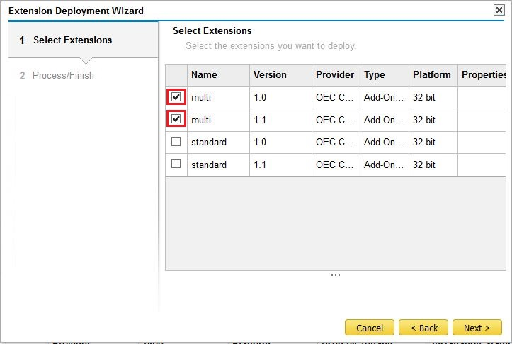
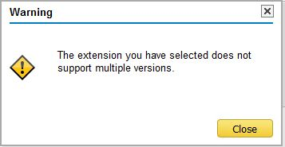
Packaging Process: Multiversion property
Cloud only!
The Multiversion property is relevant for SAP Business One Cloud only.
This property allows to deploy multiple version of the same extension
The Multiversion property is not selected, then the deployment will end with the following warning:
Notes:
The Multiversion property can be used only for extensions that will be use in the cloud. This feature is not supported for on premise deployment. It is used if multiple versions of the extension have to be deployed on the same tenant.

Slide 10
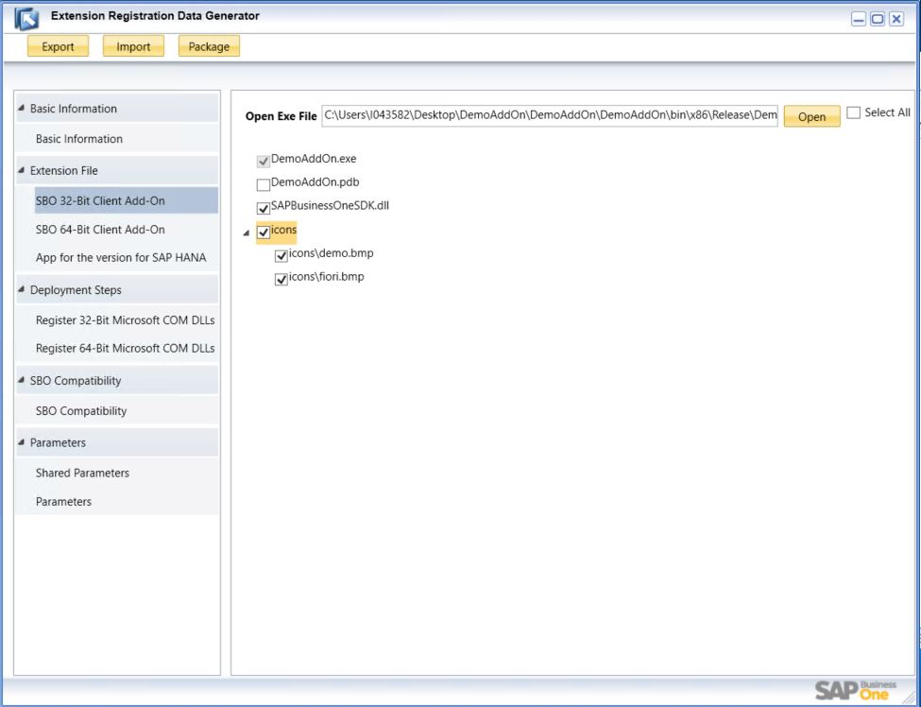
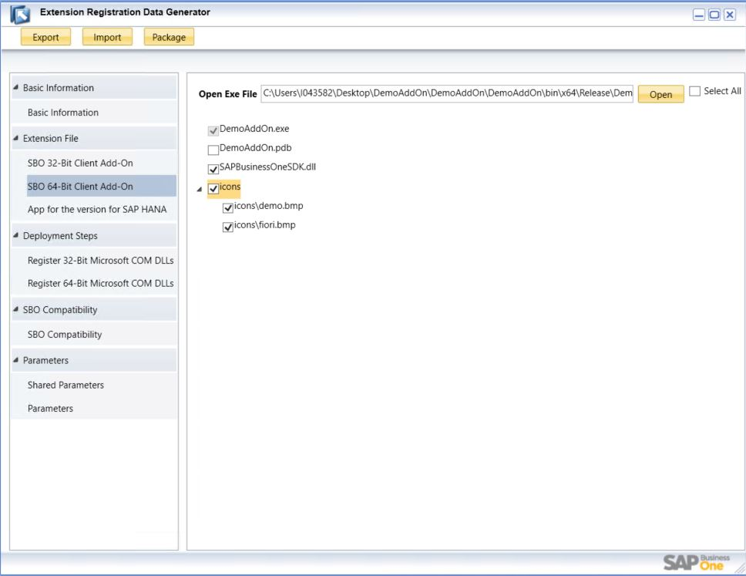
Packaging Process: Extension File SBO Client Add-On
Select the Add-On executable file for specific bitness and all other files, which are part of the solution
The select all button is available to choose all the content in the project
Notes:
Now it is to add the add-on related files to the packaging process. Based on the bitness of your solution, you might select both the 32-bit and 64-bit versions. If you had compiled both bitnesses, then you might add them both to the same extension package.
First let’s see how we might pack the 32-bit add-on. We select the option Extension file and 32-bit Client Add-on selection from the left side of the screen. We then have to press the Open button, which opens a file explorer, where we can choose the 32-bit add-on executable file compiled in our IDE. The Extension packager will load all the files and subdirectories and we have the option to select the required files and folders for our add-on solution. In the top left corner, you can see the Select All option, which can help with the selection of multiple files.
The 64-bit add-on packaging process is the same, with the exception that we have to choose the Extension file and 64-bit Client Add-on option from the left side of the screen.

Slide 11
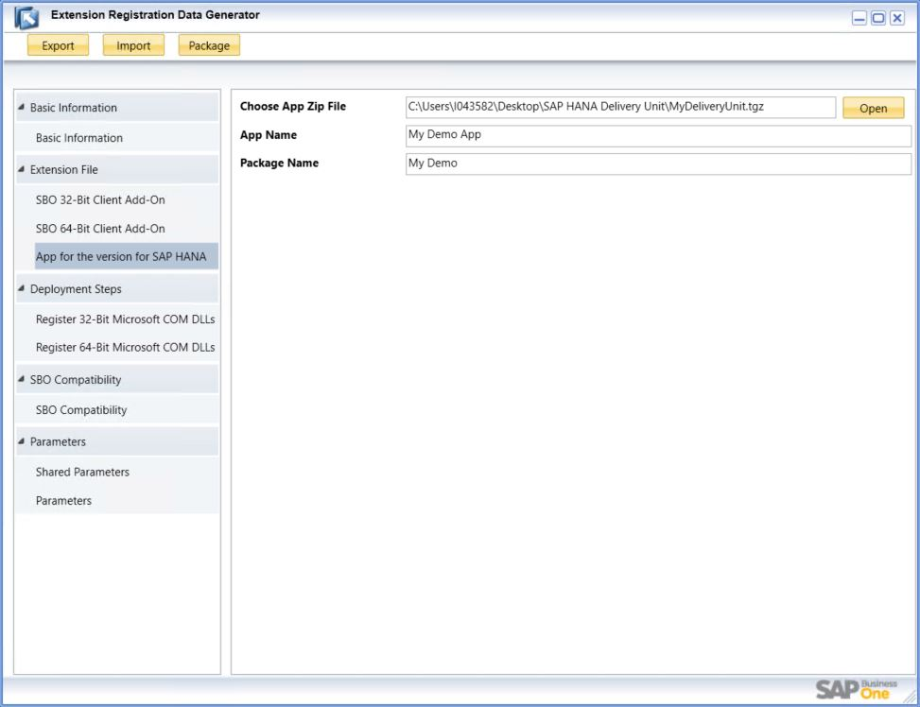
Packaging Process: Extension File App for the version for SAP HANA
Select the Delivery Unit archive.
For more details about the SAP HANA XSC app, please refer to the B1 Extensibility training published on SAP Learning Hub
Notes:
If we want like to pack HANA-specific content, then we should select the Extension file and App for the version for the SAP HANA option from the left side of the screen, where we then have an option to assign the SAP HANA delivery unit to the package. If you would like to know more about the SAP HANA XS Classic application creation and Life Cycle Management, please refer to the B1 Extensibility training published on SAP Learning Hub.

Slide 12
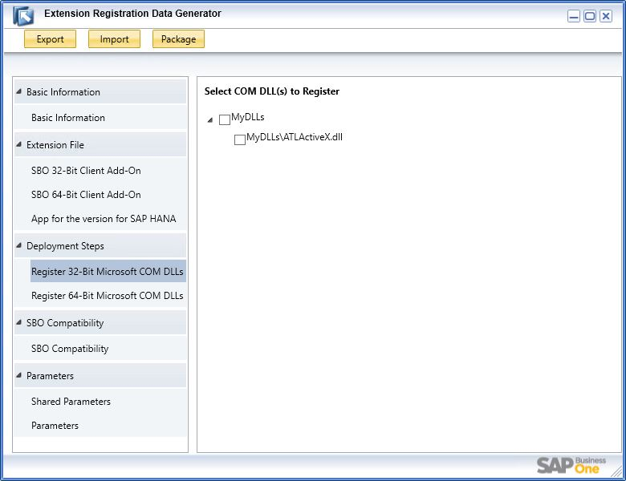
Packaging Process: Deployment Steps Register COM DLLs
Prerequisite:
The DLL file needs to be selected on the Extension File section as well.
Register own or third-party Microsoft COM (Component Object Model) object.
The DLL files needs to be placed to the same or subdirectory, where the Add-On executable file is located.
Notes:
If your add-on solution requires the use of your own or a third-party Microsoft COM object, then you can specify it under the Deployment Steps, by selecting the exact bitness based on the deployed add-on executable file.
Please note that the add-on executable file needs be defined first. You then link the solution with a COM object and the Deployment Steps list will be filled accordingly.
To compile the add-on solution, the required COM DLL file should be placed in the same directory or a subdirectory, where the Add-On executable file is located.

Slide 13
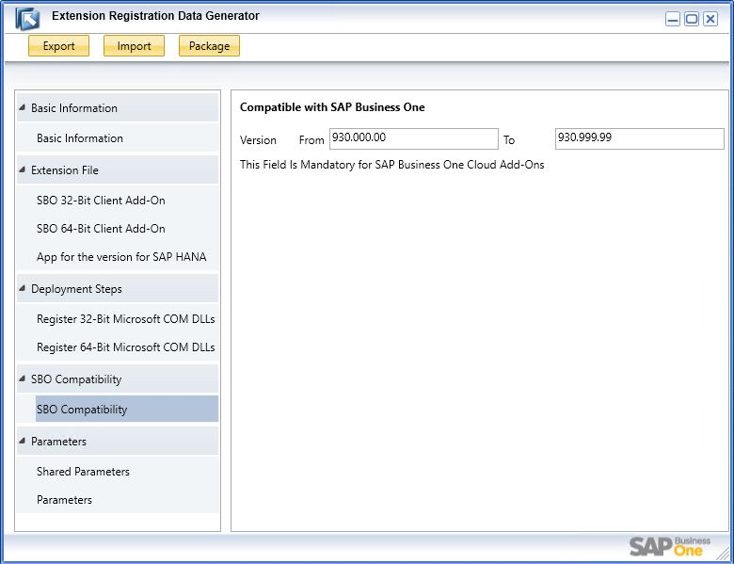
Packaging Process: SBO Compatibility
Enter compatible versions of SAP Business One with the format <xxx.yyy.xx>, for example,
930.000.00
Notes:
SBO Compatibility option will help us to specify the versions of SAP Business One with which the add-on is compatible. We can also enter the From and To property values here.
Please use the versioning format provided on the slide.
This property is mandatory for the SAP Business One cloud Add-Ons.

Slide 14
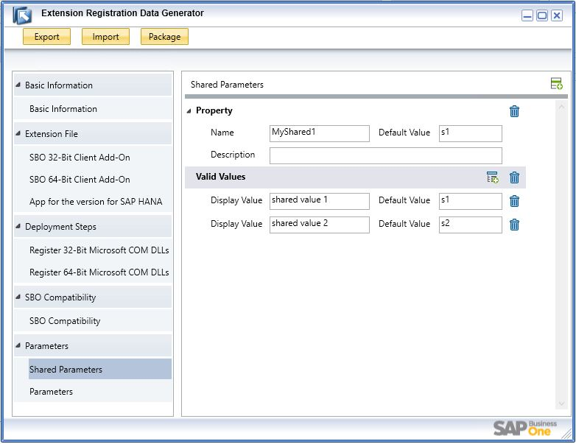
Packaging Process: Parameters Shared Parameters
To use the shared parameters inside of your Add-On solution, you will need to use the method GetExtensionProperty with the enumeration of lcm_deployment
for example:
string deploy_parameter;
deploy_parameter = uiApp.Company. GetExtensionProperty (sConnectionString,SAPbouiCOM. BoExtensionLCMStageType.lcm_deployment,"MyShared1“);
Notes:
The files that you generate using the Extension Package tool can also contain parameter information. The first parameter type is called “shared parameters”. Shared parameters are shared in all extension instances that run on different companies.
To consume the shared parameters in the add-on solution, it is necessary to call the GetExtensionProperty method with the enumeration of lcm_deployment.

Slide 15
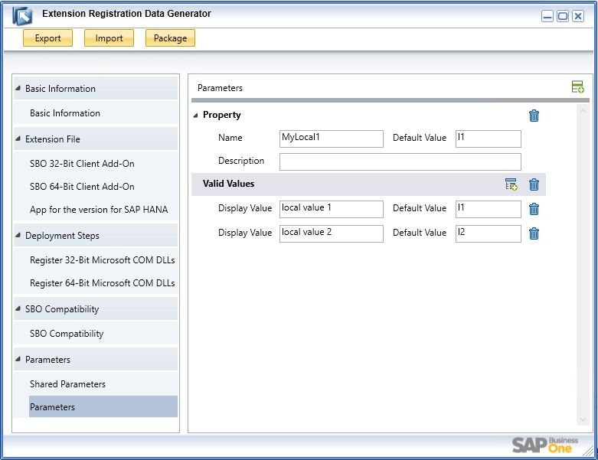
Packaging Process: Parameters
To use the shared parameters inside of your Add-On solution, you will need to use the method GetExtensionProperty with the enumeration of lcm_deployment
for example:
string assign_parameter;
assign_parameter = uiApp.Company.GetExtensionProperty (sConnectionString,SAPbouiCOM. BoExtensionLCMStageType.lcm_assignment, "MyLocal1");
Notes:
The second parameter type is called Parameters. The parameters act as local parameters and are specific for each company.
To consume the parameters in the add-on solution, it is necessary to call the GetExtensionProperty method with the enumeration of lcm_assignment.

Slide 16
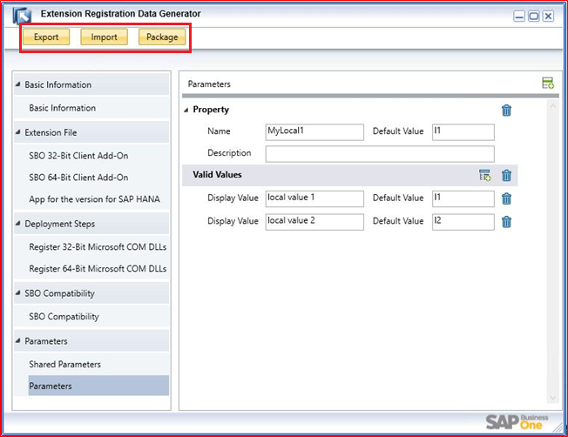
Packaging Process: Pack the Extension
Package button – pack the add-on and the SAP HANA Delivery Unit together with all properties to a single archive file
Export button – save the filled properties to an ARD file
Import button – load the saved properties from ARD file
Notes:
To finalize package preparation, it is necessary to press the Package button. This step generates the archive, which can be deployed later to the SAP Business One Extension Manager.
Other useful options: using the Export button to save the filled parameters to the ARD file and using the Import Button to load the previously saved ARD file. These actions can help to reduce the time required to fill the necessary properties for the final extension.

Slide 17
Deployment Process
Notes:
The next topic is the deployment process.

Slide 18
Deployment Process: Topic Objectives
After completing this topic, you will be able to :
Deploy the Lightweight package in OnPremise environment
Deploy the Lightweight package in OnDemand environment
Notes:
After completing this topic, you will be able to
Deploy the Lightweight package in an on premise environment
Deploy the Lightweight package in an on-demand environment

Slide 19
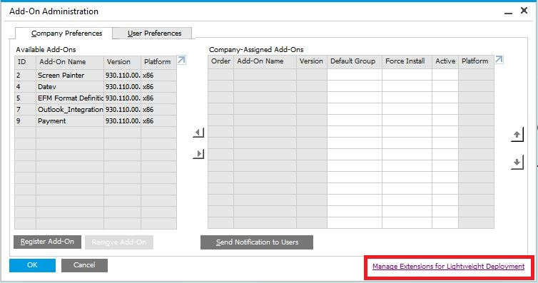
Deployment Process: Accessing SAP Business One Extension Manager
Option 1 – from SAP Business One client
In the SAP Business One client, from the Main Menu, choose Administration → Add-Ons → Add-On Administration.
In the Add-On Administration window, click the Manage Extensions for Lightweight Deployment hyperlink.
A Web browser opens and displays the logon page of System Landscape Directory (SLD).
To log on, enter the site user name and password and choose the Log On button.
Option 2 – directly from a Web browser
https://<hostname>:<port>/ExtensionManager
(e.g. https://myServerAddress:40000/ExtensionManager)
Notes:
The deployment process can be performed in SAP Business One Extension Manager. The Extension Manager link is available in the SAP Business One client’s Add-On Administration form. Alternatively, you can also open the direct link by typing the SLD’s web address, supplemented with the Extension Manager subaddress.

Slide 20
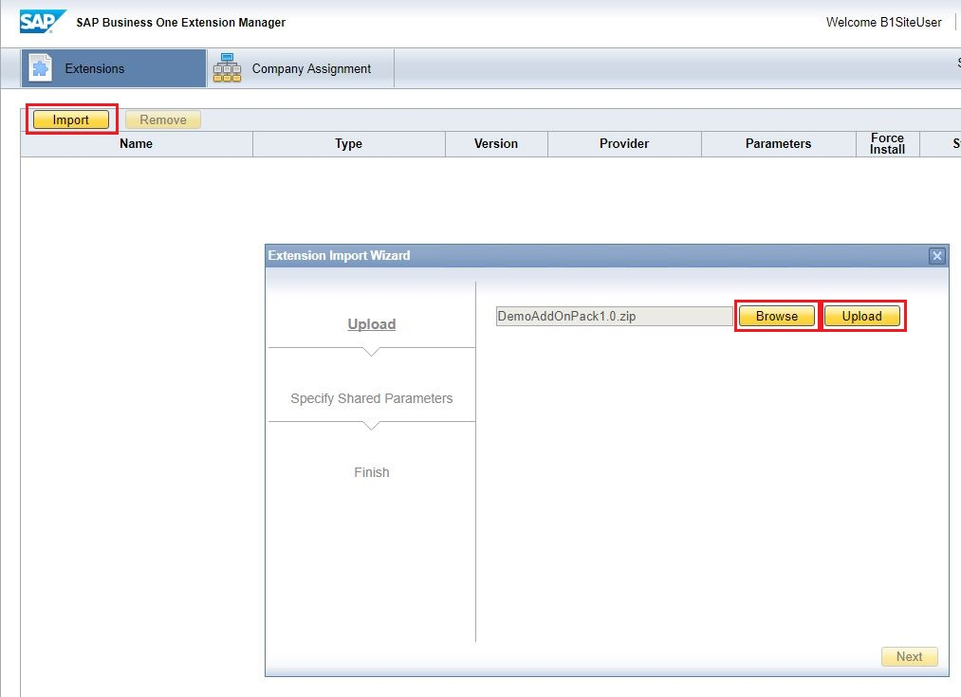
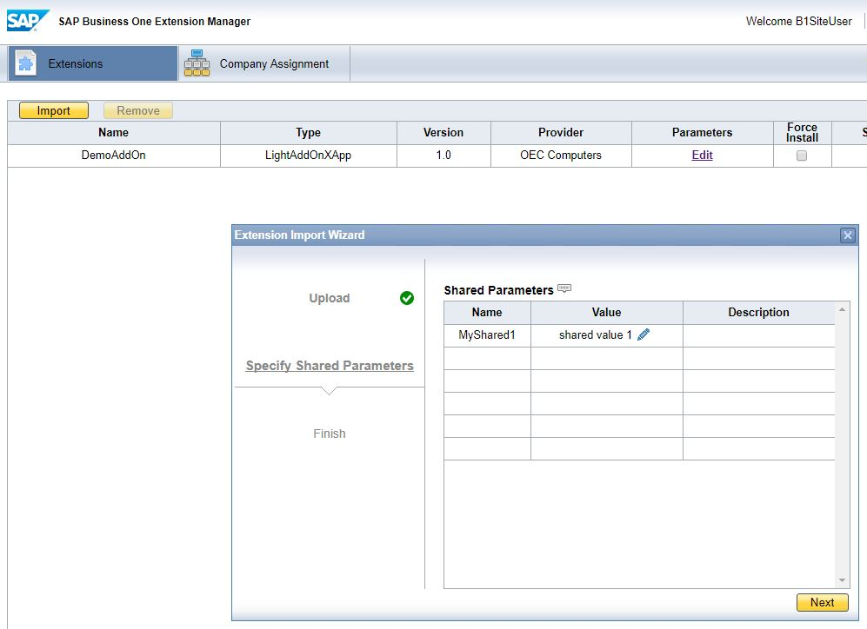
Deployment Process: Importing an Extension
Choose the Import button. The Extension Import Wizard window appears.
Choose the Browse button to locate the zip file of your extension, and choose Upload.
Choose Next to optionally specify the value of the shared parameters.
The Shared Parameters table displays all shared parameters that are defined in the Extension Package tool when you package your extension.
Choose Next.
On the Finish tab, we recommend that you continue to assign this extension to a company.
Notes:
Let’s import the extension package by pressing the Import button. This displays the Extension Import Wizard. We should press the Browse button to select the extension archive file, followed by the Upload button to upload the extension to the Extension Manager.
After pressing the Next button, we go to management of the assigned shared parameters. Finally, we navigate to the last page of the wizard, where we can finish the import process.

Slide 21
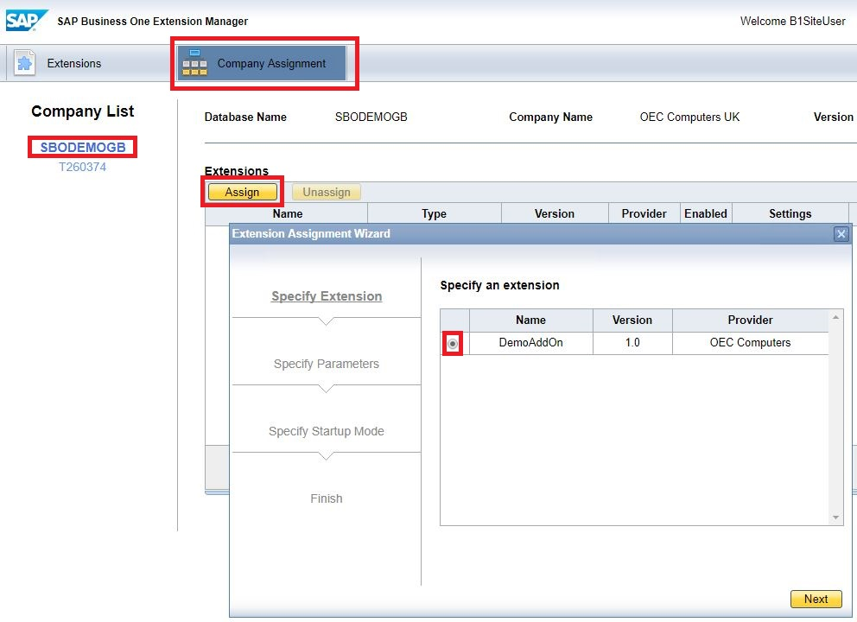
Deployment Process: Assigning an Extension to a Company
Choose the Company Assignment tab
Select the database name from the Company List to which you want to assign this extension
Choose the Assign button.
Select the ”radio” button on the extension to assign it to the company
Choose Next.
Optionally, from the Specify Parameters tab, specify the value of the parameters and choose Next
From the Specify Setup Mode tab, select the default startup mode of this extension, specify the user preferences, and choose Next
Choose Finish
Notes:
The next operation is to assign the extension to a company database. After selecting the Company Assignment tab, we select the database from the Company list. We can then start the assignment process by clicking the Assign button.
This opens the Extension Assignment Wizard, where we can select the required extension in the first form.
The next part of the wizard involves configuring the parameters. After pressing the Next button, we have the option to set the startup mode and the user preferences.
Continuing, we can finalize the extension company database assignment by pressing the Finish button.

Slide 22
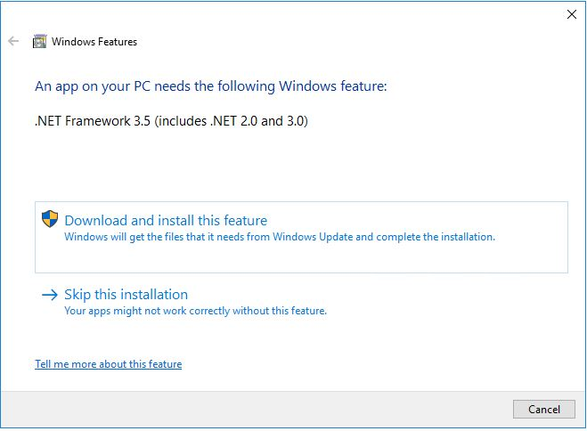
Deployment Process: Extension based prerequisites
Please install manually to the SAP Business One client computer the other dependencies, what the Add-on solution might have and if those cannot be delivered just by copying the required files. For example:
Microsoft .NET framework
Microsoft Visual C++ Redistributable
Other third-party installation packages
Notes:
Before the extension is used on the client side, if would be great to install any optional software packages that are required by your extension. In general, the Extension Manager can deliver any files that are part of the extension package.
If your solution relies on a specific version of the Microsoft .NET, Microsoft Visual C++ Redistributable packages, or any addition third-party installation packages that must be installed on the client side, then it would be necessary to install them manually.

Slide 23
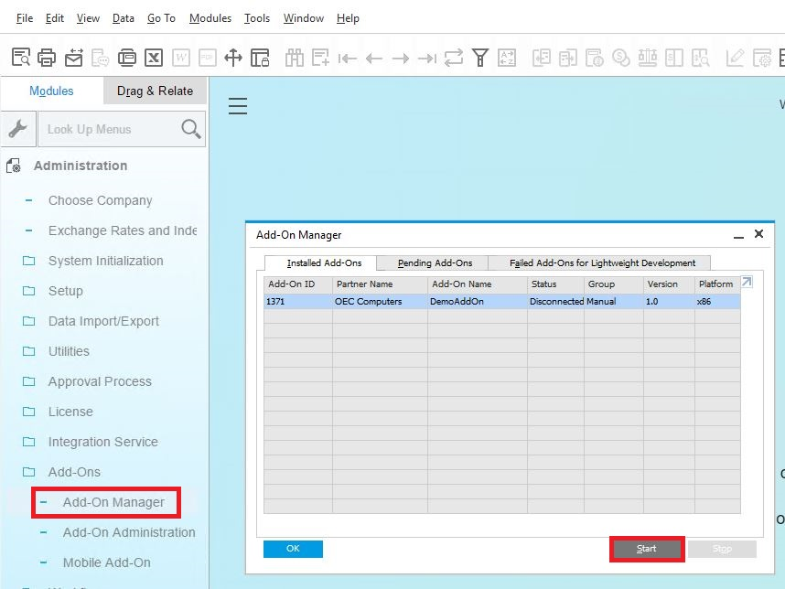
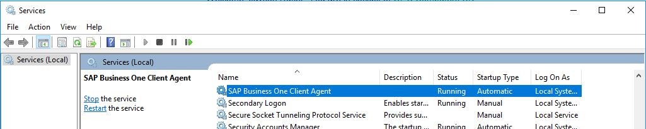
Deployment Process: Running the Extension in SAP Business One
SAP Business One starts the extension automatically if you set the preference to Automatic.
To manually start the extension, perform the following steps:
From the SAP Business One Main Menu, choose Administration → Add-Ons → Add-On Manager
On the Installed Add-Ons tab, select the relevant extension and choose the Start button.
SAP Business One starts the add-on and sets the status to Connected
The SAP Business One Client Agent service must be running as administrator. Otherwise the extension will fail to load.
Notes:
Finally we can run and consume the extension from the SAP Business One client.
The extension can be started and installed automatically, based on the set of preferences for the extension and user.
The SAP Business One Client Agent service must be running as administrator. Otherwise the extension will fail to load.

Slide 24
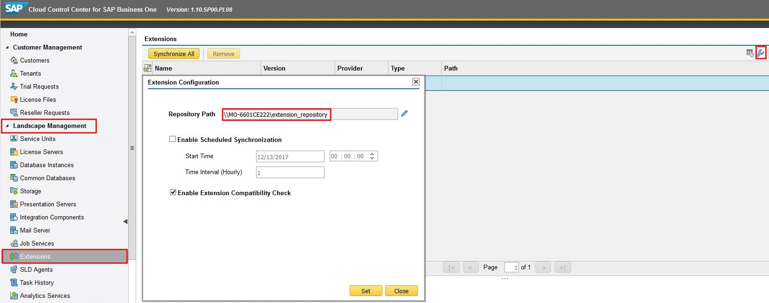
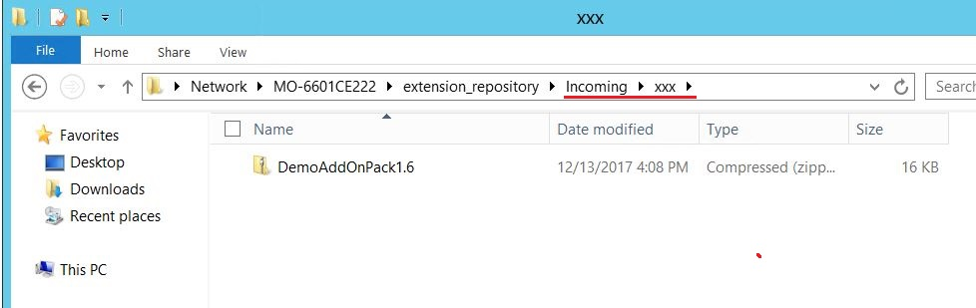
Deployment Process: Cloud Control Center Deploy to Could Environment
Create a shared folder for extension repository
CCC → Landscape Management → Extensions → Extensions Configuration → assign the network directory
Press the Synchronize All button in CCC → Landscape Management → Extensions to create the default directory structure
Create a subdirectory with your name space under the folder ..\Incoming\<name_space>
Copy the extension archive to the newly created folder
Press the Synchronize All button in CCC → Landscape Management → Extensions to create deploy the extension to the Cloud Control Center
Notes:
The first step is to create the shared folder for the extensions in the landscape. This shared folder should be added to the Extension configuration.
The Synchronize all button generates the default subdirectory structure.
We can now create a new subfolder under the incoming directory.
We can then place the extension archive in the newly created folder. When we press the Synchronize all button, the extension is deployed to the Cloud Control Center.

Slide 25
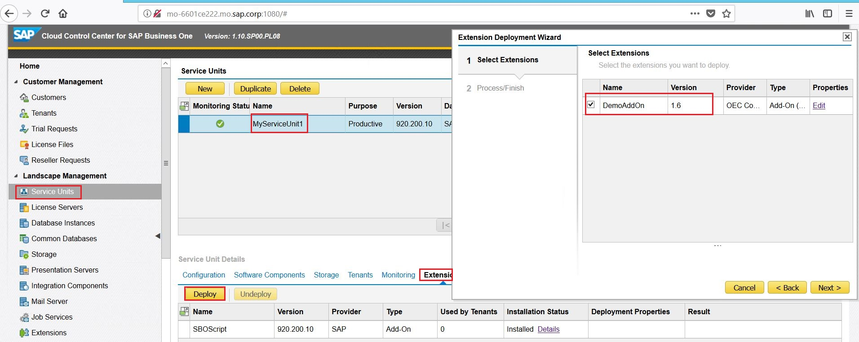
Deployment Process: Cloud Control Center Assign to Service Unit
CCC → Landscape Management → Service Units → select the SU → Service Unit Details → Extensions → Deploy button
Finish the wizard and select the extension, what you would like to assign for the Service Unit
Notes:
Because the extension is available in our environment, we can assign it to the service unit. This operation can be performed by selecting the service unit’s extension tab, where the deploy button is located. This operation opens a wizard, where we can select the required extension. You can click the Edit button to specify the shared parameters.

Slide 26
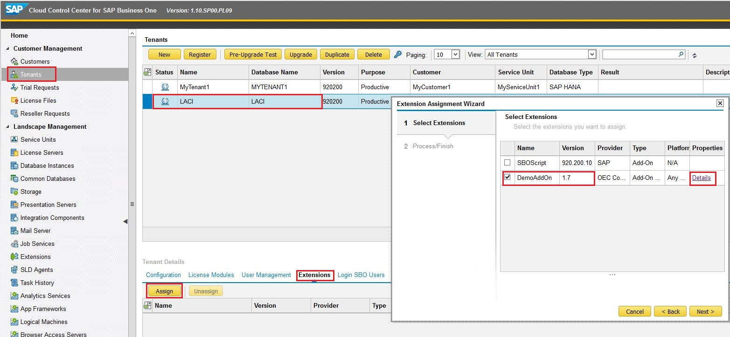
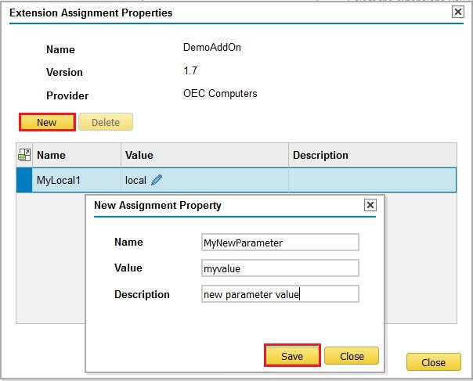
Deployment Process: Cloud Control Center Assign to Tenant
CCC → Customer Management → Tenants → select the Tenant → Tenant Details → Extensions → Assign button
Select the extension, what you would like to assign for the Tenant
Press the Details option to defined the parameters.
Notes:
The final deployment step is to assign the extension to the tenant. The assignment process initiates a wizard with the list of all extensions. After clicking the details button, you can configure and create the parameters related to a specific tenant’s extension.

