Slide 1

TB 1300 - SAP Business One SDK Lightweight Deployment – Upgrade, Additional Features and Troubleshooting
July, 2019
Notes:
Welcome to the Lightweight Deployment Upgrade, Additional Features, and Troubleshooting course topic.

Slide 2

Agenda
Upgrade Process
Additional Features
Troubleshooting
Notes:
In this unit, we will cover the following main topics:
Upgrade process
Additional features
Troubleshooting

Slide 3

Upgrade Process
Notes:
Let’s start with the upgrade process topic.

Slide 4

Upgrade Process: Topic Objectives
After completing this topic, you will be able to :
Perform the upgrade process
Notes:
After completing this topic, you will be able to perform the upgrade process.

Slide 5
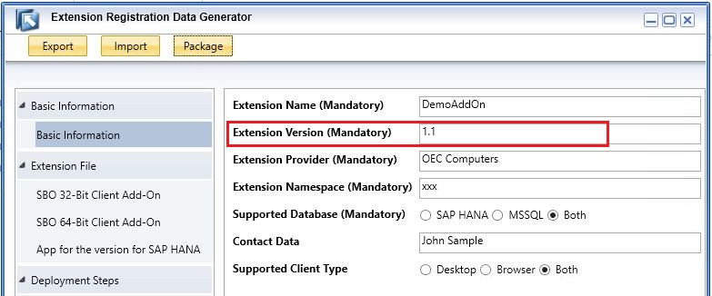
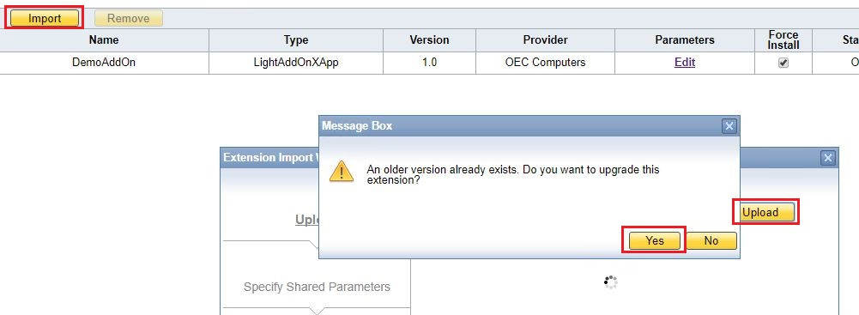
Upgrade Process: Standalone SAP Business One client
To upgrade your extension for lightweight deployment, perform the following steps:
Package the higher version extension files in the Extension Package tool (specify the same Extension Name and the same Extension Provider, and a higher Extension Version)
Import the higher version extension zip file into SAP Business One Extension Manager.
Assign the extension to a company in SAP Business One Extension Manager (optional)
Run the extension in SAP Business One client.
Notes:
The first scenario is to prepare a new version of the extension and deploy it to a standalone SAP Business One client.
The main steps here are:
In Extension Packager tool, you need to change the Extension Version property to a higher number.
Import the higher version extension’s archive file into SAP Business One Extension Manager.
Assign the extension to a company in SAP Business One Extension Manager.
Run the extension in the SAP Business One client.

Slide 6
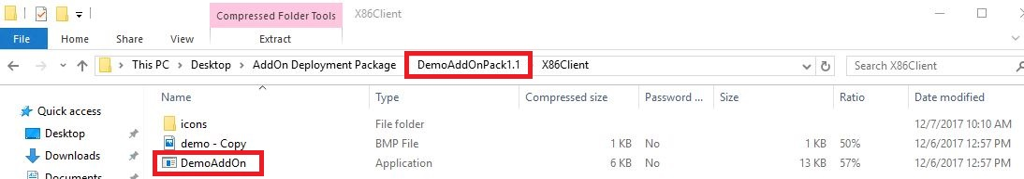
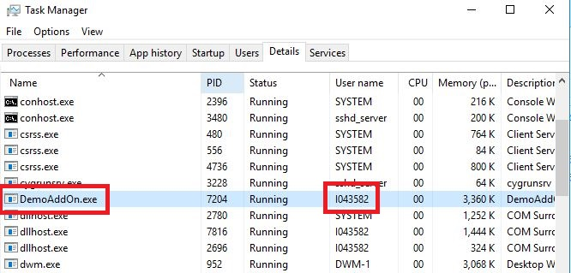
Upgrade Process: Terminal Server & Cloud specific prerequisites
Identify the Add-On name
To upgrade your extension for lightweight deployment, on a terminal computer, where multiple users are connected:
Make sure as nobody is using the Add-On solution
Identify the process according the Add-On executable file, you can get it from the package
Identify the user according the running process
Notify the user to stop working with the Add-On
Run the same upgrade process as for standalone SAP Business One client usage
Identify the user using the Add-On
Notes:
The second scenario involves preparing a new version of the extension and deploying it to a terminal service environment where the SAP Business One client is used by multiple users or to SAP Business One Cloud.
It is necessary to ensure that the specific extensions are not being used by any user . Once the new version of the extension package is generated by the Extension Packager tool, you should check the add-on executable name by opening the archive and exploring the executable file name.
You should then verify that this executable file is not being used by any user, by checking the terminal server’s or presentation server’s Task Manager.
Once we are sure that the extension is not being used, we can simply import the package, which performs the upgrade process automatically.
This is one possible interpretation of the sentence; others are also possible.

Slide 7
Additional Features
Notes:
The next topic covers the additional features.

Slide 8
Additional Features: Topic Objectives
After completing this topic, you will be able to :
Know the command line option
Check the capabilities on Browser Access service
Use the Visual Studio to prepare the package
Notes:
After completing this topic, you will be able to
Know the command line option
Check the capabilities on Browser Access service
Use the Visual Studio to prepare the package

Slide 9
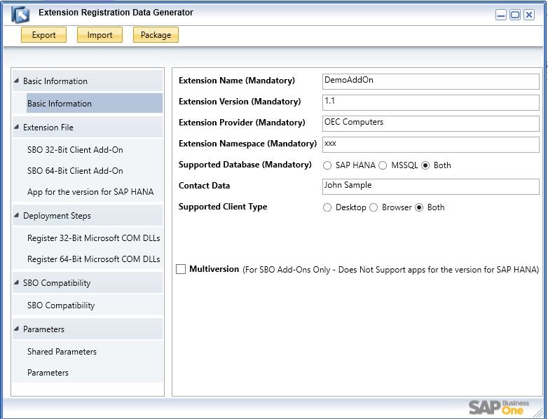
Additional Features: Command Line General Usage
Available from SAP Business One and SAP Business One version for SAP HANA versions 9.3 PL2 or higher releases.
The xApp packaging is currently not available for command line packaging.
Display the help: ExtensionPackage.exe /help
1. Open Extension Packager and fill the basic Information screen
2. Export the ARD file
3. Start using the command line options
Notes:
The command line feature for the Extension Package tool is available from version 9.3 patch level 2. The main prerequisite here is to have an ARD file with the basic information properties. This we might achieve by opening the Extension Package tool and filling the Basic Information screen. Then we use the Export button to generate the ARD file.
Afterwards we can use this ARD file with the Extension Package tool from command line in order to automatize the new extension version from our development process.

Slide 10
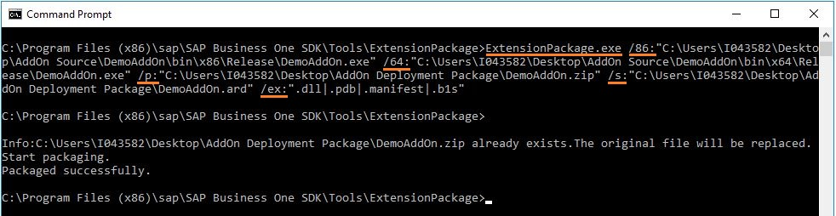
Additional Features: Command Line Example
ExtensionPackage.exe
/v: "1.3“ (version of the Add-On solution)
/86: “..\DemoAddOn\bin\x86\Release\DemoAddOn.exe“ (path to add-on 32 bit executable file)
/64: “..\DemoAddOn\bin\x64\Release\DemoAddOn.exe“ (path to add-on 64 bit executable file)
/p: "C:\temp\Deployment Package\DemoAddOn.zip“ (full path to save the output package)
/s: “..\AddOn Deployment Package\DemoAddOn.ard“ (source ARD file which contains basic information)
/ex: ".dll | .pdb | .manifest | .b1s“ (exclude files with specified suffixes under the packaging directory)
Notes:
This slide shows an example, where we can see the currently supported options. For the full option list and examples, you can use the parameter help for the Extension Package tool.
The option “v” stands for the extension version. By entering the option “86”, we provide the 32-bit add-on executable file. It will include all files and subfolders. If we want to exclude some files from the package, then we have to use the option “ex” and specify the suffix.
The option “64” stands for the 64-bit add-on version. We could use the “ex” option here as well.
To provide the basic extension information, we will need to use the mandatory option “s”, where the ARD file location should be placed.
It is also necessary to use the “p” option to let the tool know the archive to which we want to save the extension content.

Slide 11
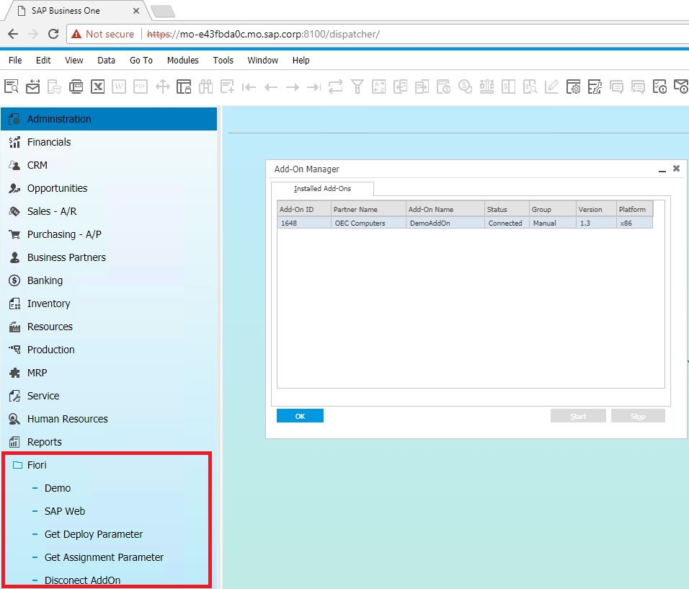
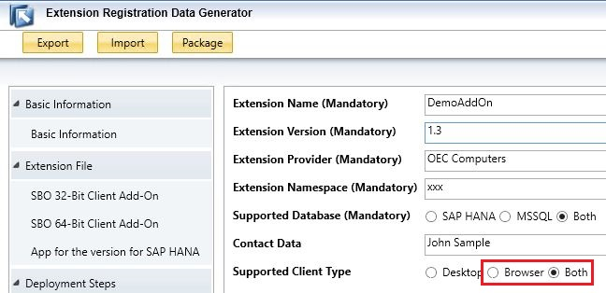
Additional Features: Browser Access
Prerequisite:
The add-on solution must be installed via SAP Business One client, where the BAS is deployed, before it get’s used via Browser Access Service.
https://<server>:<port>/dispatcher
Notes:
The Browser Access Service must be deployed. Then, in the Extension Package tool, you have to set the Support Client Type property to Browser or the Both option on the Basic Information screen. We can then consume the extension in our browser-based SAP Business One client.

Slide 12
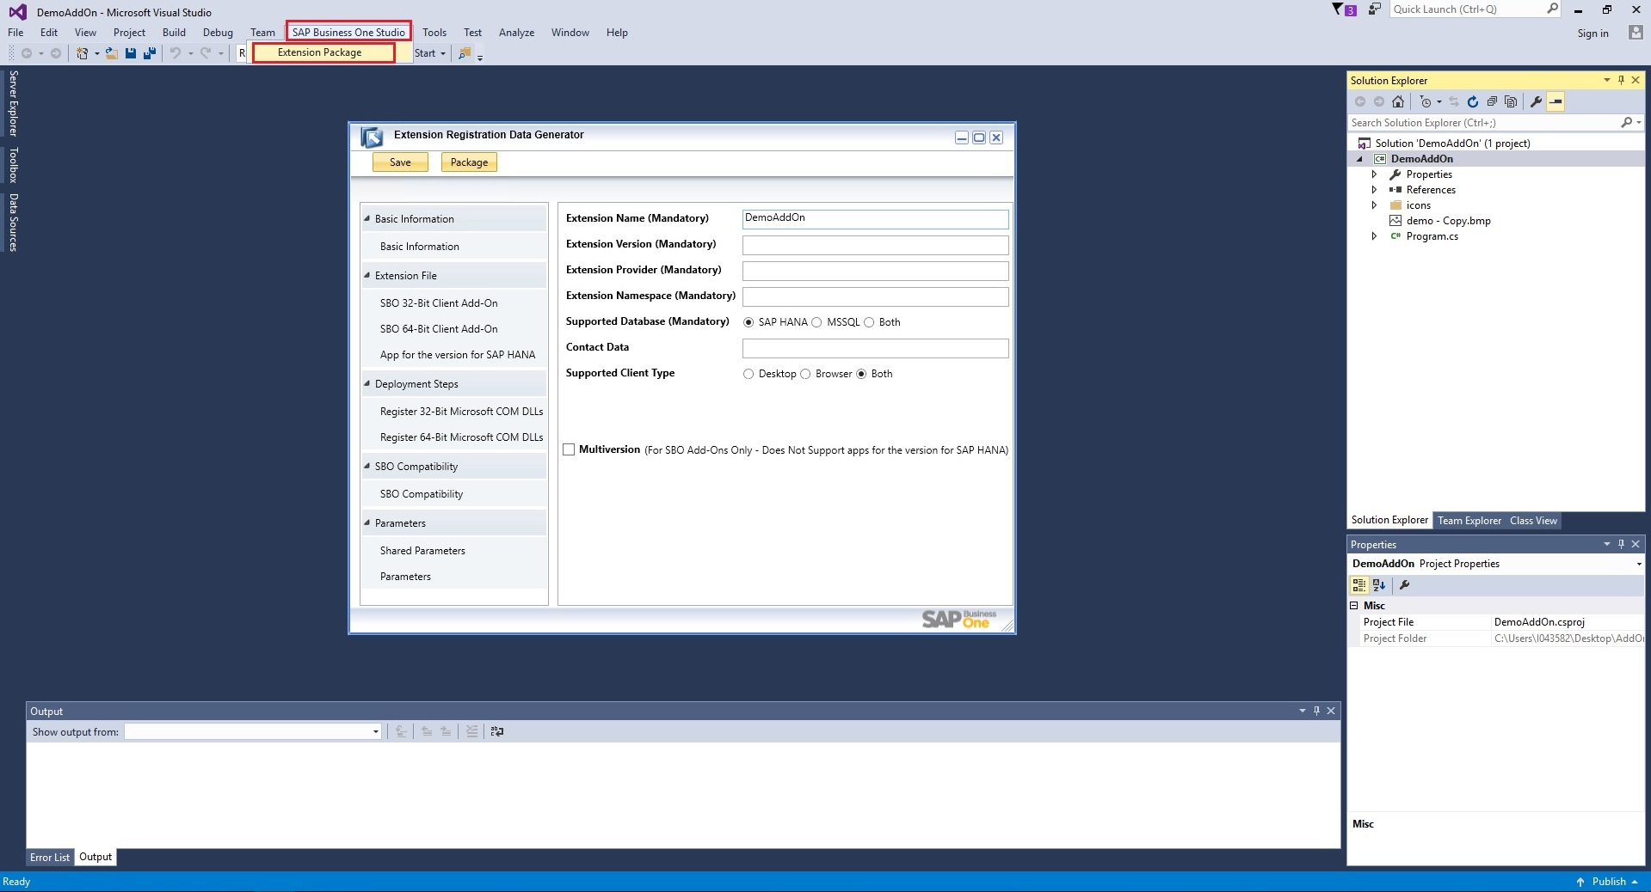
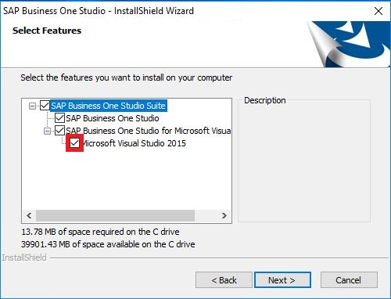
Additional Features: Visual Studio Generate Package
Prerequisites for each Visual Studio versions:
MS VS 2010
MS VS 2012 – B1 9.1 PL3
MS VS 2013 – B1 9.1 PL3
MS VS 2015 – B1 9.3 PL0
Please note as only Visual Studio Professional and Enterprise editions are working together with SAP Business One Studio.
Install SAP Business One Studio Suite with option SAP Business One Studio for Microsoft Visual Studio
Notes:
To use this feature, we have to install the SAP Business One studio package with the option “SAP Business One studio for Microsoft Visual Studio”.
After we open our add-on project in Visual Studio, the Extension Package tools are linked automatically. A new menu option called SAP Business One studio is available in Visual Studio.
Please note that not all versions and editions of Microsoft Visual Studio are supported for SAP Business One studio.

Slide 13
Additional Features: Topic Summary
You should now be able to:
Know the command line option
Check the capabilities on Browser Access service
Use the Visual Studio to prepare the package

Slide 14
Troubleshooting
Notes:
The next topic is the troubleshooting.

Slide 15
Troubleshooting: Topic Objectives
After completing this topic, you will be able to :
Analyze the issues during the packaging and deployment phase
Analyze the SAP HANA Delivery Unit related issues
Analyze the runtime phase related issues
Know the database structures used for Lightweight deployment
Notes:
After completing this topic, you will be able to
Analyze issues during the packaging and deployment phase
Analyze SAP HANA delivery unit-related issues
Analyze runtime phase-related issues
Know the database structures used for Lightweight deployment

Slide 16
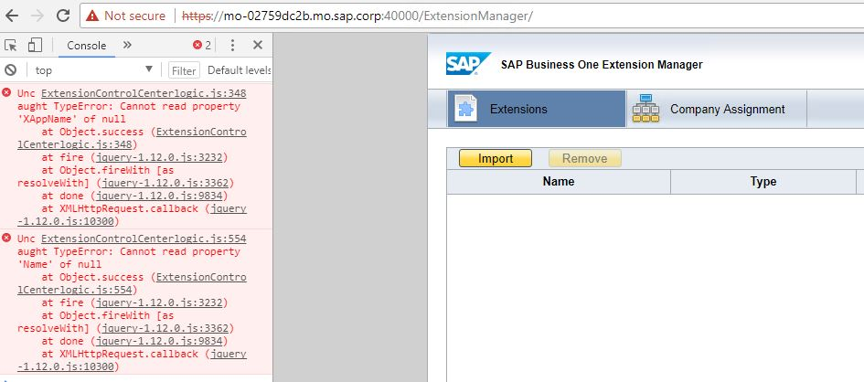
Troubleshooting: Packaging and Deployment Phase
Extension Manager log file:
%USERPROFILE%\Local Settings\Application Data\SAP\SAP Business One\Log\ARDGenerator\ Log.txt
Check the errors on the Extension Manager page using the DevTools
Google Chrome → press Control + Shift + I
Navigate to Console tab
The errors of Extension Manager page are usually referring to SLDDATA database issues. It might be solved by:
New installation of the Server Tools
Incident for component SBO-EXT-MNG
Notes:
The Extension Package tool automatically displays a message box if any mandatory parameters are not filled. If you encounter any other issues in the packaging process, you need to refer to the Extension Manager log file, where you can find more information about the issue.
We might have also some issues in the deployment part. In that case, we can check the SAP Business One Extension Manager site’s Console Log for more details. If we encounter console errors, this usually involves an SLDDATA inconsistency, which you can quickly solve by reinstalling the SAP Business One SLD. Alternatively, we might also contact SAP SME Support, to prepare a specific fix for us.

Slide 17
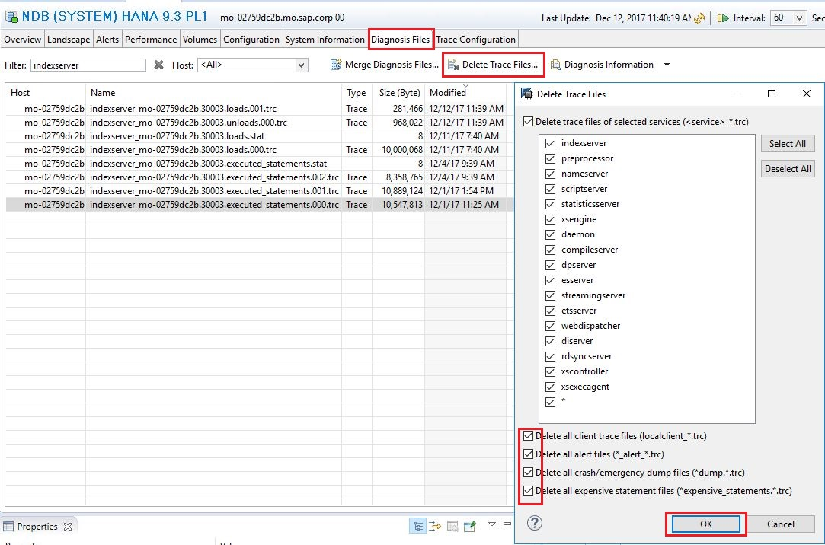
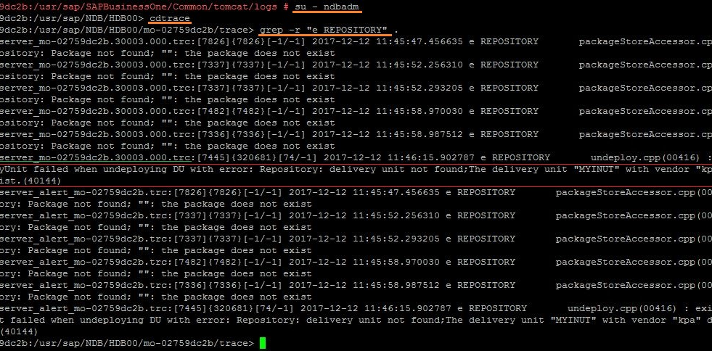
Troubleshooting: HANA xApp Deployment
It’s recommended to clean the HANA traces, to get only the relevant errors before you will start the analyze. Afterwards you can retry the error and check the indexserver trace content
HANA Studio → Administrative perspective → Diagnosis Files page tab → Delete Trace Files
How to search for errors using the command line?
su - <sid>adm (log as system admin user)
cdtrace (change directory to log and trace file location)
grep -r “e REPOSITORY” . (search text “e REPOSITORY” in all trace file within this directory)
Notes:
We might also encounter SAP HANA xApp deployment-related issues. This kind of issue needs to be analyzed in the SAP HANA Indexserver trace. SAP recommends the following best practice:
Clean the trace content in SAP HANA Studio
Reproduce the issue
Log on to the Linux terminal
Log on as the system admin user
Change to the trace directory
Search for repository errors using the grep command

Slide 18
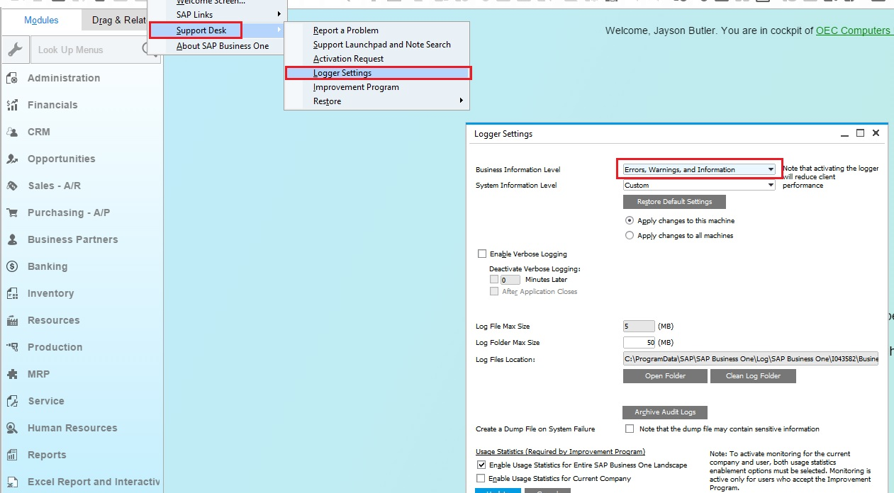
Troubleshooting: Runtime phase
Enable SAP Business One detailed log
B1 Client → Help → Support Desk → Logger Settings
Business Information Level: Errors, Warnings and Information System Information Level: Errors, Warnings and Information
More details in SAP note 2503567.
Add-On installation log file:
%TEMP%\AddOnInstall.log
SAP Business One Client Agent logs \ Extension installation log on Cloud:
C:\ProgramData\SAP\SAP Business One\Log\SAP Business One Client Agent\AutoUpdateServicePidXXXX_DateTime.txt
Add-On runtime UI log files:
C:\ProgramData\SAP\SAP Business One\Log\SAP Business One\%user%\BusinessOne\AddOnName.b1logger.DateTime.pidXXXX.log.csv
Add-On runtime DI log files:
C:\ProgramData\SAP\SAP Business One\Log\SAP Business One\%user%\DIAPI\AddOnName.b1logger.DateTime.pidXXXX.log.csv
Notes:
If we encounter any errors in the runtime phase, then SAP Business One offers a number of log files where we might search.
SAP recommends changing the SAP Business One login level, to get more details for our analysis.

Slide 19

Troubleshooting: Database structure
The extensions related database tables storage:
MSSQL - SLDDATA database
SAP HANA - SLDDATA database schema
Table Name | Description
EXTENSIONS | List of extension
EXTENSIONASSIGNMENTS | Assignment of the extension for company databases
EXTENSIONDEPLOYMENTS | Assignment of the extension for COMMON database
EXTENSIONUSERPREFERENCES | Start up mode user preferences
EXTENSIONVALIDITIES | Extension validation with B1 version
EXTENSIONREPOSITORIES | Extension Repository on Cloud
EXTENSIONINSTALLATIONS | Installation status on Service Unit on Cloud
EXTENSIONSTARTSSTOPLOGS | Execution logs for extension on Cloud
EXTENSIONSYNCHRONIZATIONLOGS | Synchronization log on Cloud
EXTENSIONSYNCHRONIZATIONLOGSDETAILS | Synchronization log details on Cloud
Notes:
The extension-related content is stored in the SLDDATA database on Microsoft SQL Server and in the SLDDATA schema using the SAP HANA database engine.
On this slide, we can see the database tables related to the extensions.
The first five tables are relevant only for the on premise installation.
In the SAP Business One Cloud, all the tables are used.

