Slide 1

TB 1300 – SAP Business One SDK SDK Installation and Support Process
July, 2019
Notes:
Welcome to the SDK Installation and Support Process course topic.

Slide 2

Agenda
SDK installations
Support process
SAP Support Portal
Additional useful sites
Notes:
In this unit, we will cover the main topics:
SDK installations
Support process
SAP Support Portal
Additional useful sites

Slide 3

SDK Installation
Notes:
Let’s start with the topic of SDK installation.

Slide 4

SDK Installation: Topic Objectives
After completing this topic, you will be able to:
List the components of the SAP Business One SDK
Offer some details about DI API installation
Describe what is in the SDK installation
32- and 64-bit support
Notes:
After completing this topic, you will be able to:
List the components of the SAP Business One SDK
Offer some details about DI API installation
Describe what is in the SDK installation
32- and 64-bit support

Slide 5
SDK Installations: SDK Components
Data Interface API (DI API)
Available for all existing versions
Java Connector → Part of server installation
Part of SAP Business One client installation (optional separate installation)
DI Server
Part of server tools installation
User Interface API (UI API)
Part of SAP Business One client installation
User-defined object (UDO)
Built in into SAP Business One itself – no additional requirements
Please note that there is a path for extensions that has to be specified on the “Path” page in the company settings
Service Layer
OData service for business objects available in server tools
Notes:
Let’s briefly review the SDK components:
The DI API is available for all existing versions and is part of the SAP Business One client installation. It contains the Java Connector, as well. If you would like to run a purely DI API-based add-on, it’s not necessary to install the SAP Business One client; you can use a separate installation package that will deploy only the DI API.
The DI Server is part of the SAP Business One server tools installation, which only runs on Windows.
The UI API is delivered with the SAP Business One client.
The UDOs are built into SAP Business One itself; no separate installation is required.
The Service Layer is also built in as part of the server tools.

Slide 6
SDK Installations: Installation DI API and JCo
DI API standard installation path:
C:\Program Files\SAP\SAP Business One DI API (64-bit)
or
C:\Program Files(x86)\SAP\SAP Business One DI API (32-bit)
JCo included in DI API installer:
C:\Program Files\SAP\SAP Business One DI API\JCO\LIB (64-bit)
or
C:\Program Files (x86)\SAP\SAP Business One DI API\JCO\LIB (32-bit)
Notes:
The Data Interface API is installed at the path C:\Program Files\SAP\SAP Business One DI API. The 32-bit version has a different folder. Of course, the folder can be changed during the installation process.
The Java Connector is placed in the DI API’s subfolder.

Slide 7
SDK Installations: What is in it?
The SDK folder contains:
Help & documentation
UDO library & header files
Samples for several platforms
Visual Basic .NET
C#
Samples for most major features
DI API
UI API
DI API + UI API
UDO
DI Server
…
SDK tools
Registration tools
Notes:
If you plan to install the SAP Business One Software Development Kit, the following will be included:
Help & documentation
UDO library & header files
Samples for the Visual Basic .NET and C# programming languages
Samples for most major features (DI API, UI API, DI API + UI API, UDO, and DI Server)
SDK tools such as AddOnRegDataGen and ExtensionPackage

Slide 8
SDK Installations: OBServer Temporary Folder
SAP Business One version 8.8 and lower
ObserverDLL location
%temp%\SM_OBS_DLL
Separate location for each user
ObserverDLL deletion
The terminal session environment (Citrix, for example) might be set to remove the content of the user’s temporary folder.
SAP Business One version 9.0 and higher
ObserverDLL location
SAP\SAP Business One DI API\OBServer\
Common location for all users
ObserverDLL deletion
The terminal environment will not delete the folder, as it’s part of the DI API installation.
Faster DI API connection
Notes:
OBServer contains the business logic for SAP Business One.
Before version 9.0, it was stored in a temporary user folder, but the terminal environment usually removed the temporary folder after finishing the work with SAP Business One.
Since version 9.0, OBServer has been located under the DI API folder, which is common for all users.
This results in a faster connection.

Slide 9
SDK Installations: 64-bit Computing Support
Benefits:
Better performance
More powerful add-ons
Full use of client computer memory
Integration with other 64-bit applications
Notes:
The 64-bit computing support introduced in version 9.0 has come to form more and more of the architectural base because:
It offers better performance
You can build more powerful add-ons
You can use all the memory available in the client computer
It integrates easily with other 64-bit applications
SAP recommends to build the add-on solution in 64-bit.

Slide 10
Support Process
Notes:
The next topic is the support process.

Slide 11
Support Process: Topic Objectives
After completing this topic, you will be able to:
Contact the SAP Business One support organization
Explain the SDK component list
Explain customer incident flows
Explain the Product Continuous Influence process
Notes:
After completing this topic, you will be able to:
Contact the SAP Business One support organization
Explain the SDK component list
Explain customer incident flows
Explain the Product Continuous Influence process

Slide 12
Support Process
Customer incident creation on Support Launchpad for SAP Business One
Before creating an incident, please ensure you have met the following prerequisites:
Perusal of available documentation in Support Cycle Navigator
Adherence to Level 1 and Level 2 support obligations (SAP Note 1167635)
Installation of RSP and availability of the latest system status report for the customer (SAP Note 1733065)
Inclusion of all relevant information in the incident
Dial SAP-B1-Now to call the support hotline
Dial the universal toll-free number for all your telephone support inquiries by selecting your country from the SAP-B1-Now country list
Support Map
The Support Map is a document that was created to give our partners direction on all topics related to SAP Business One support. It’s easy to search and leads you directly to essential support resources, services, and tools.
Notes:
The Support Launchpad for SAP Business One is used for incident creation. Before creating an incident, please ensure you have met the following prerequisites:
Perusal of available documentation
Adherence to Level 1and Level 2 support obligations according to SAP Note 1167635
Installation of RSP and availability of the latest system status report for the customer according to SAP Note 1733065
Inclusion of all relevant information in the incident
In case of urgency, you can contact the SAP-B1-Now support hotline, as well.
An addition please, where you might reach the support is the Support Map, which is a document that was created to give our partners direction on all topics related to SAP Business One Support. Easy-to-search and it leads you directly to essential Support resources, services and tools.

Slide 13
Support Process Component list
When the right component is selected, the incident will immediately be routed to the specialist for the requested area within the GSC organization.
List of the SDK-related components:
SBO-DTW Data Transfer Workbench
SBO-STU SAP Business One Studio
SBO-STU-VSI SAP Business One Studio for Microsoft Visual Studio
SBO-SDK-AA Add-On Administration
SBO-SDK-DEV Development Environment
SBO-SDK-DI Data Interface
SBO-SDK-DIS Data Interface Server
SBO-SDK-EXT Add-on Extension Manager
SBO-SDK-JCO SAP Business One Java Connector
SBO-SDK-SVL Service Layer
SBO-SDK-TLS Tools
SBO-SDK-TNSP SDK Transaction Notification Stored procedure
SBO-SDK-UDO User-Defined Objects
SBO-SDK-UI User Interface
Notes:
When the right component is selected, the incident will immediately be routed to the specialist for the requested area within the Global Support Center organization.
Please refer to the components mainly used in connection with the SDK.

Slide 14
Support Process Typical flows for customer incidents
Case 1
Case 2
Case 3
There is a bug in the feature
The feature does not exist in the version the partner uses
Partner needs help using the feature
Bug is transferred to development for correction.
If the feature does not exist in the latest available version, post a request in the Customer Influence portal.
Support sends sample and documentation.
A request may be considered “consulting” and thus might be billable.
Notes:
Here are some typical customer incident flows.
In case one, an application error is reported. This information would be handled by the GSC, and the development department would correct the issue.
In the second case, the customer requires a function that is currently not implemented in the product. The best place to ask for this functionality is the Customer Influence portal.
The third case is about the usage of some feature. Support sends a sample and documentation. Such requests may be considered “consulting” and thus might be billable.

Slide 15

Partners Support Process: Product Improvements Continuous Influence
SAP Business One uses the Customer Influence sessions for collecting, tracking, and prioritizing requirements.
How to proceed?
Check whether your idea has already been submitted by someone else.
Vote for that idea if it exists.
Otherwise, select the most appropriate category.
Submit your influence request in English.
For more details, please refer to SAP Note 1028874.
Watch this introduction video:
Notes:
SAP Business One uses Customer Influence sessions for collecting, tracking, and prioritizing requirements.
How to proceed?
Check whether your idea has already been submitted by someone else.
Vote for that idea if it exists.
Otherwise, select the most appropriate category.
Submit your influence request in English.
Do not forget to visit the introduction video about the Continuous Influence.

Slide 16
SAP Support Portal
Notes:
The next topic is the SAP Support Portal.

Slide 17
SAP Support Portal: Topic Objectives
After completing this topic, you will be able to:
Provide an overview of the portal features
Create a customer incident
Download SAP Business One software
Order licenses for SAP Business One
Explain development namespaces in greater detail
Search in SAP Business One Notes
Notes:
After completing this topic, you will be able to:
Provide an overview of the portal features
Create a customer incident
Download SAP Business One software
Order licenses for SAP Business One
Explain development namespaces in greater detail
Search in SAP Business One Notes

Slide 18
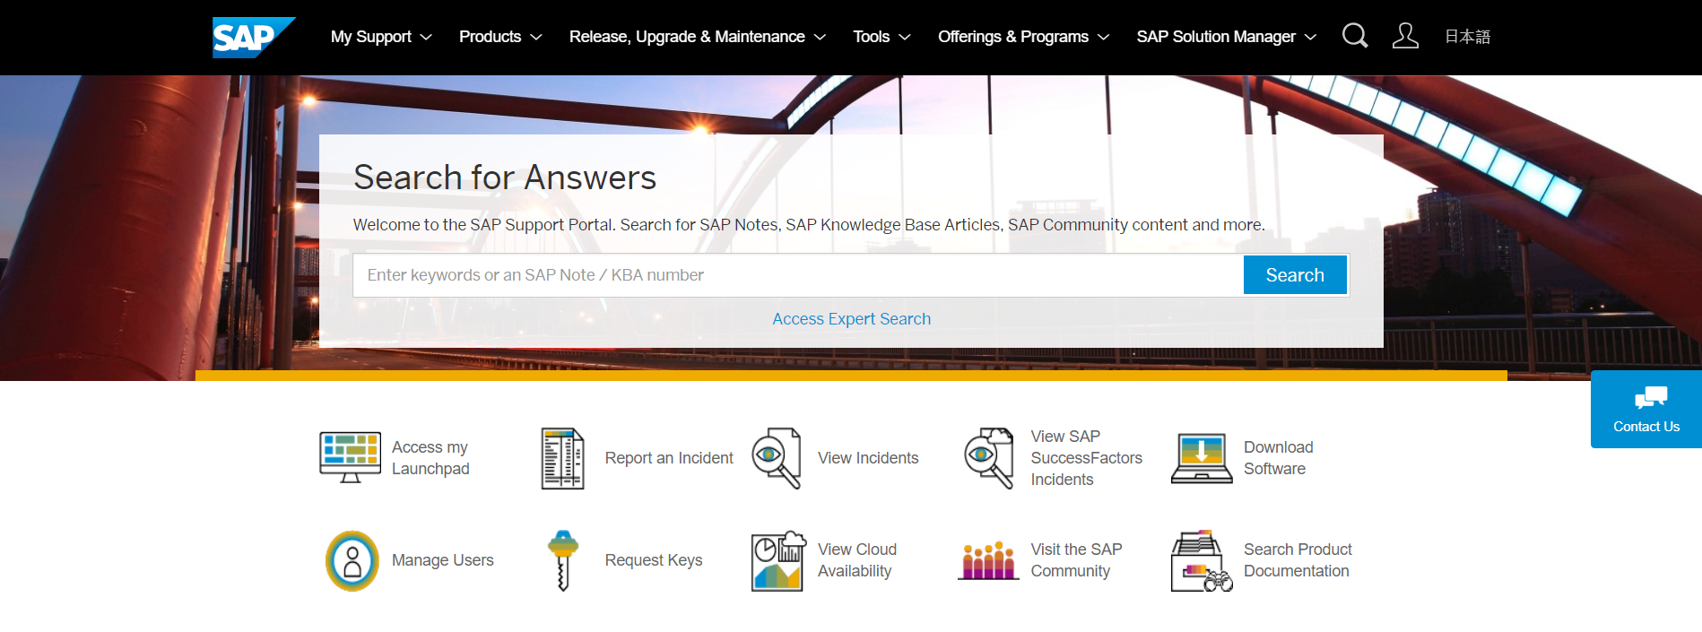
SAP Support Portal
https://support.sap.com
To access the SAP Support Portal, you will need a login or “S number”.
Someone within your organization will be able to create S numbers if you don’t have one yet.
Main features of the portal:
User management within your organization
Access to the SAP Business One Launchpad
Customer incident creation and management
Software downloads
License key requests
Product documentation search
Development namespaces
Notes:
In order to access the SAP Support Portal, you will need a login or “S number”. Someone within your organization will be able to create S numbers if you don’t have one yet.
The main features of the portal are:
User management within your organization
Access to the SAP Business One Launchpad
Customer incident creation and management
Software downloads
License key requests
Product documentation search
Development namespaces

Slide 19
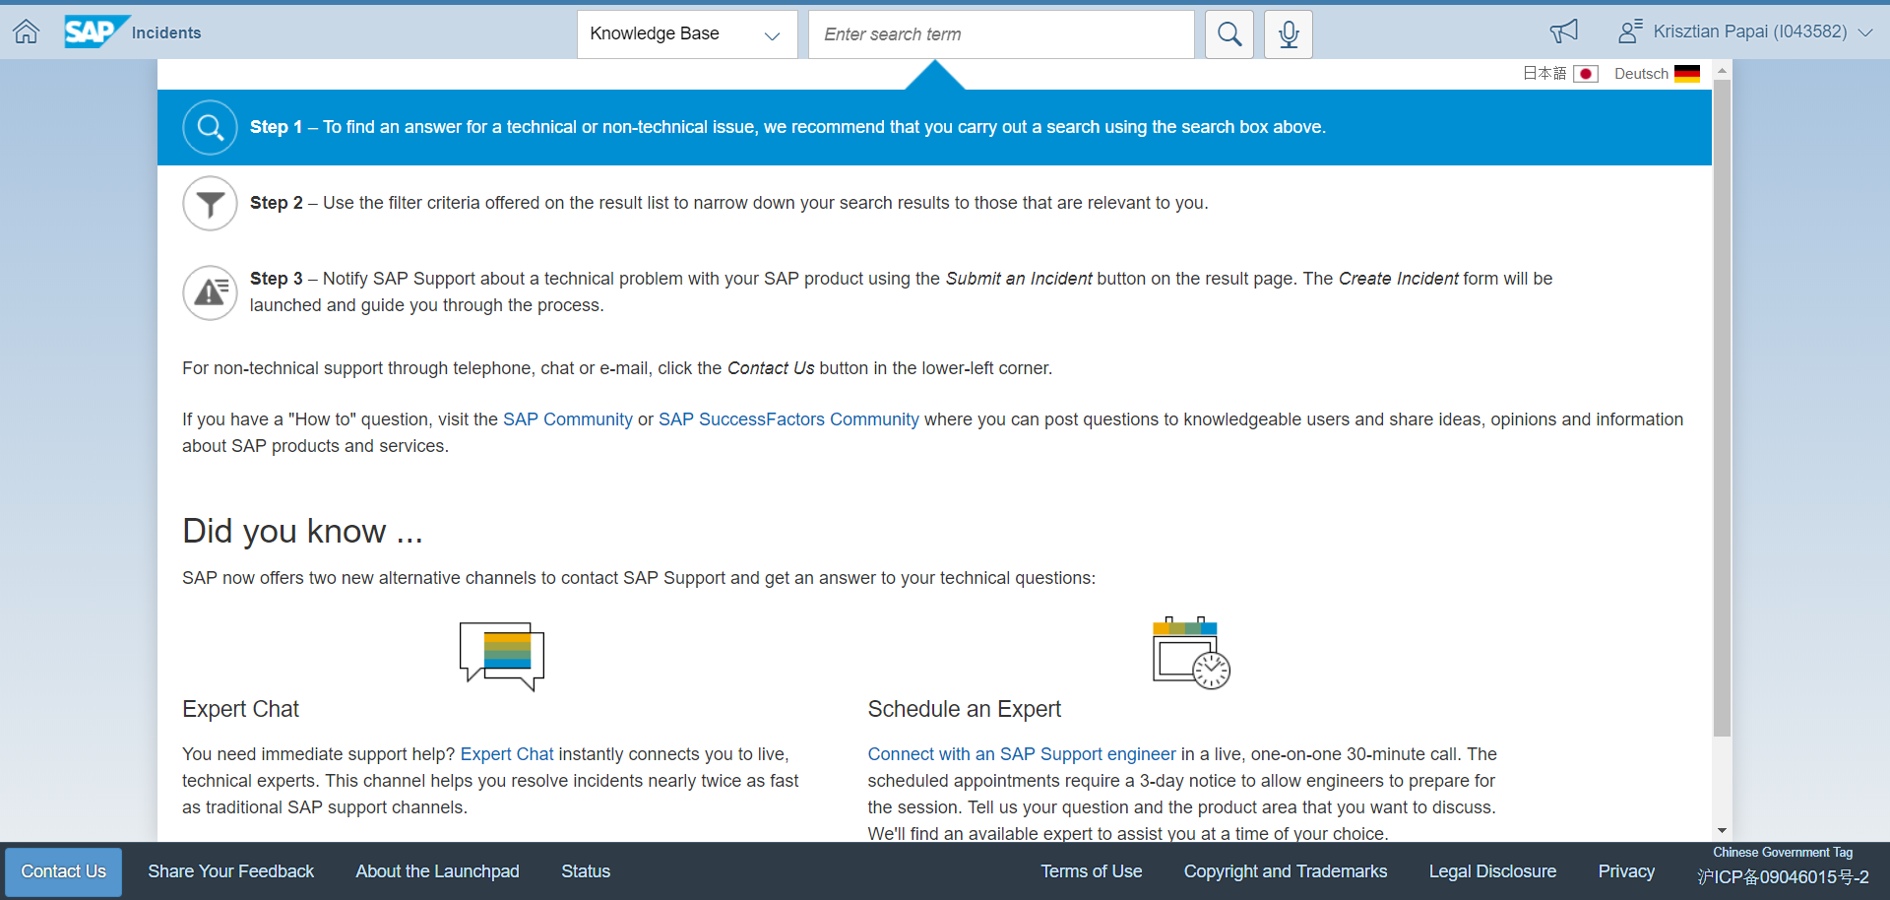
SAP Support Portal Create a customer incident
https://launchpad.support.sap.com/#incident/solution
Notes:
Please refer to the following link to create a new customer incident.
To log into the site, you will need to have an S-user account.
You should then search the knowledge base for a solution to the issue you are planning to report.
If you do not find a solution, click the “Submit an Incident” button.
You will then need to fill in the required fields as accurately as possible.

Slide 20
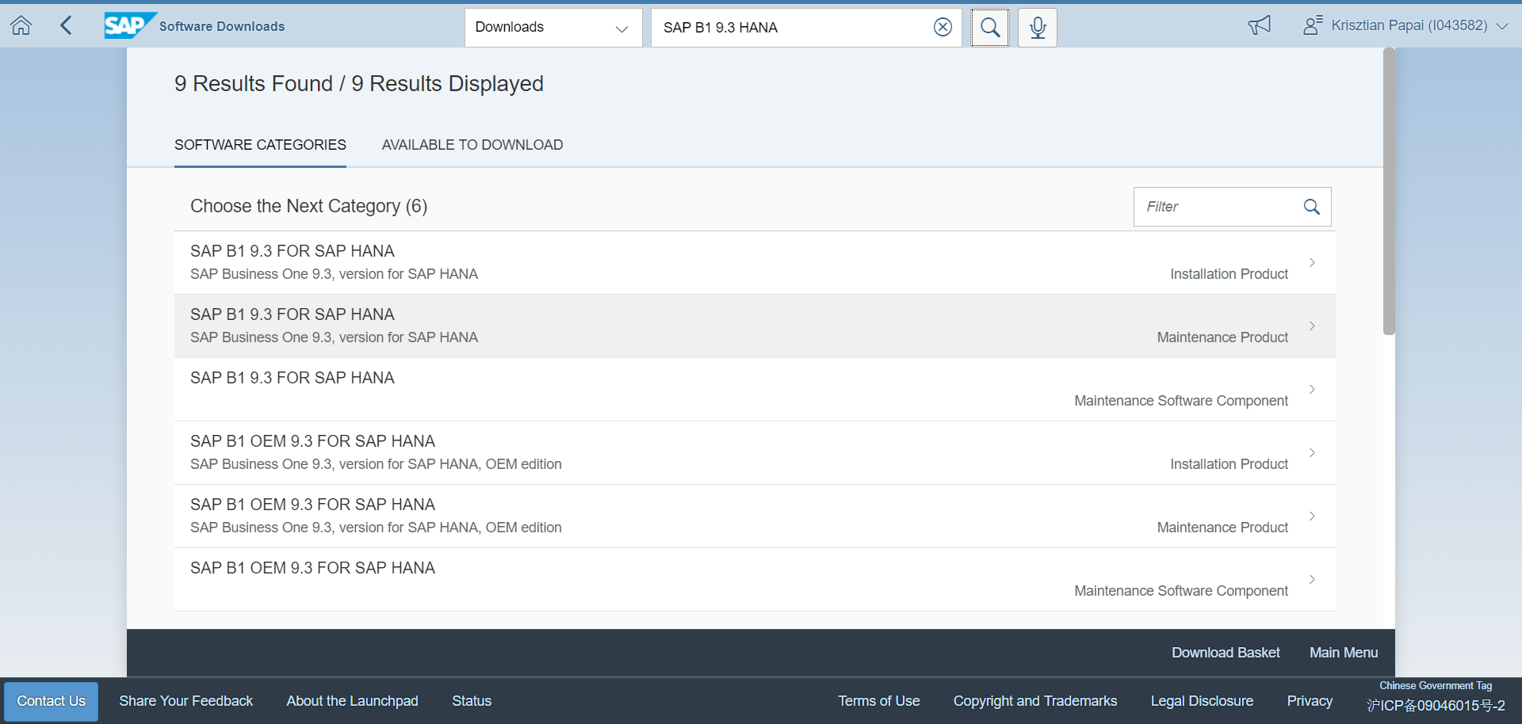
SAP Support Portal Software downloads
https://launchpad.support.sap.com/#/softwarecenter
Notes:
The SAP Support Portal can be used to download product software, as well.
You can go by the product categories or simply search for SAP Business One using a term like “SAP B1 9.3 HANA”.
If you would like to download an installation CD, select the corresponding installation product.
If you would like to download an upgrade CD, select the corresponding maintenance product.

Slide 21
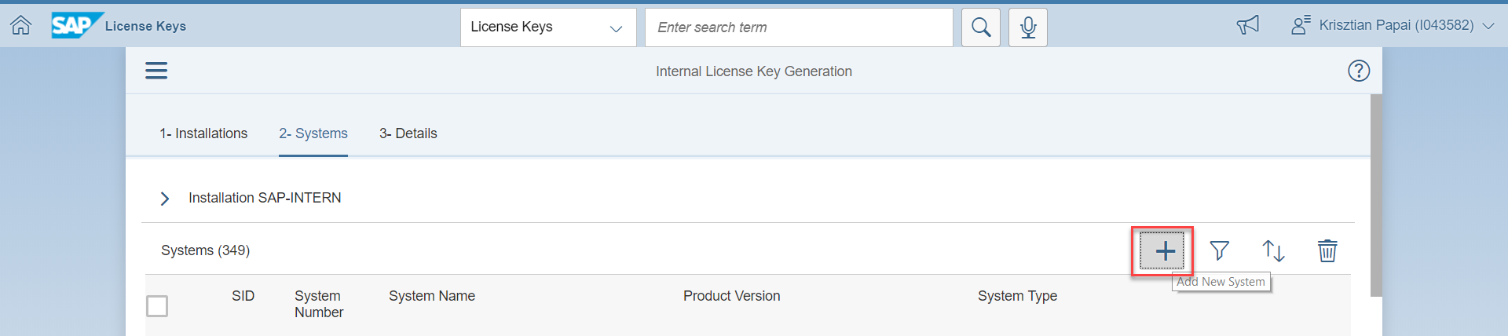
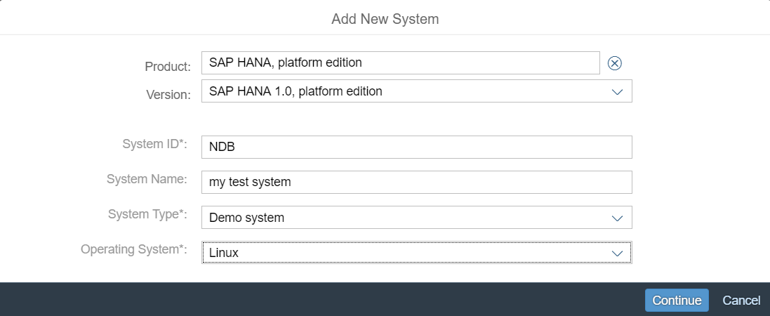
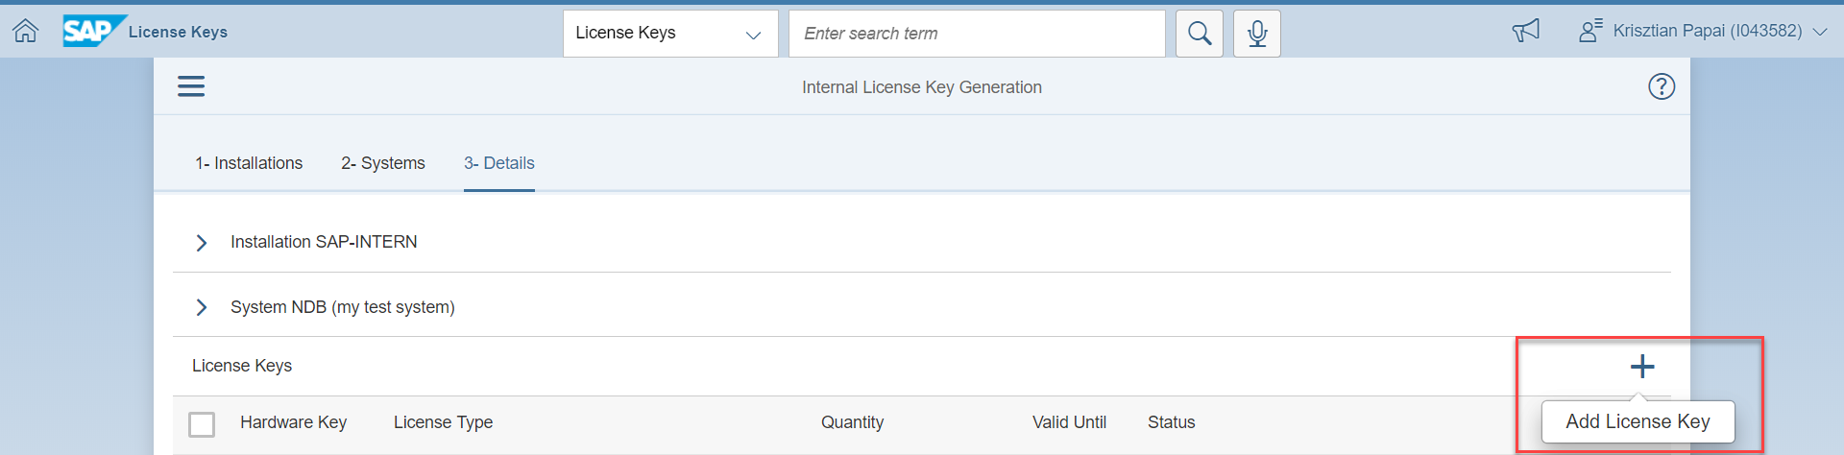
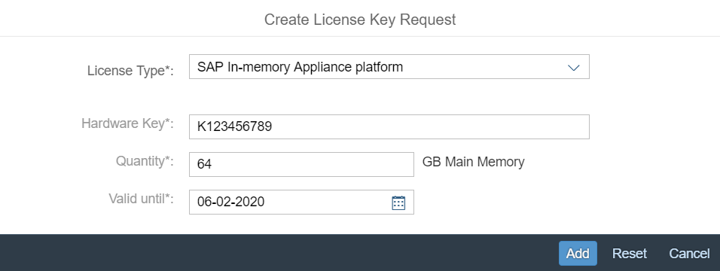
SAP Support Portal: License Ordering SAP HANA Database Engine
https://launchpad.support.sap.com/#/licensekey
Notes:
If you need a license key for SAP HANA Database Engine, the SAP Support Portal is the best place to submit a request.
The process is as follows:
Go to https://launchpad.support.sap.com/#/licensekey
Press the Add New System button
Enter the product SAP HANA, platform edition
Select the SAP HANA version
Type the system ID
Define a name for the system
Choose the system type
Select the operating system – Linux
Press the Continue button
Press the Add License Key button
For the license type, select SAP In-memory Appliance platform
Type the hardware key
Enter the memory quantity based on the contract in question
Finally, press the Generate button to generate and download the newly created license file.

Slide 22
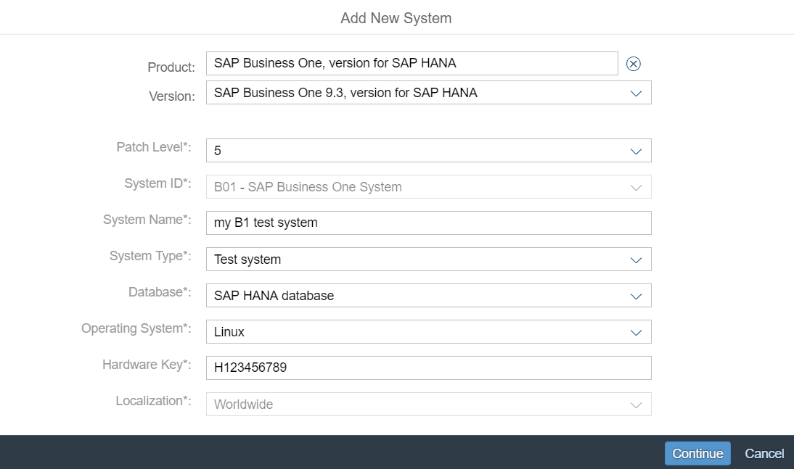
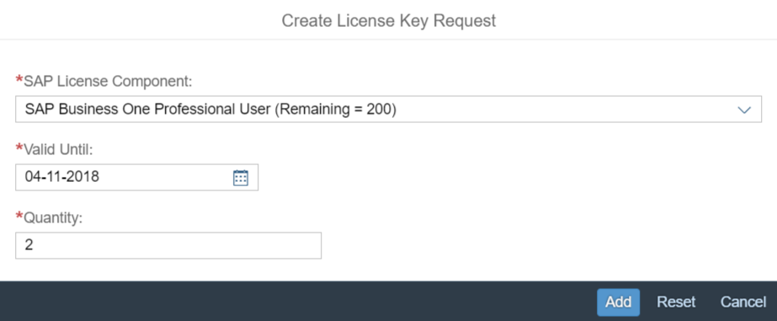
SAP Support Portal: License Ordering SAP Business One, version for SAP HANA
https://launchpad.support.sap.com/#/licensekey
Notes:
If you would like to get an SAP Business One license, the process is as follows:
Go to https://launchpad.support.sap.com/#/licensekey
Press the Add New System button
Enter the product SAP Business One, version for SAP HANA
Select the product version
Choose the patch level
Define a name for the system
Choose the system type
Select the database type – SAP HANA Database
Select the operating system – Linux
Type the hardware key
Choose the localization
Press the Continue button
(The following section may be repeated according to your license component requirements)
Press the Add License Key button
Select the SAP license component, such as SAP Business One Professional User
Type the license validity date (optional)
Enter the license quantity
Finally press the Generate button to generate and download the newly created license file.

Slide 23
SAP Support Portal: Naming Convention Motivation
Partner 1
Customer 1
DoSomething.dll
DoSomething.dll
Partner 2
DoSomething.dll
Notes:
Different solutions that use the SAP Business One APIs that may be installed at a customer site may use the same names for the solution objects (UDT, UDF, a form’s unique ID, an item’s unique ID, EXE files, DLL files, and so on).
This may cause conflicts, and as a result, one or more of the solutions may not work properly.

Slide 24
SAP Support Portal Overview: Naming Convention Solution
Partner 1
Customer 1
XX_DoSomething.dll
XX_DoSomething.dll
YY_DoSomething.dll
Partner 2
Customer 2
YY_DoSomething.dll
XX_DoSomething.dll
YY_DoSomething.dll
Notes:
To prevent conflicts with other solutions that use the SAP Business One APIs that may be installed at a customer site, you must use a name prefix for your solution objects. The name prefix "ROOT" followed by the delimiter "_" ensures unique names (for example, "ROOT_myname").

Slide 25
SAP Support Portal: Naming Convention Why?
To prevent conflicts with other solutions that use the SDK
A tool for setting unique names for forms, items and menu items, user tables, and user fields
Name prefixes define a space of possible names for objects Therefore, name prefixes are commonly called “namespaces”
A namespace must be reserved at SAP to obtain a name prefix that is unique within the world of SAP
Your namespace (OXYZ, for example), followed by the delimiter "_“, ensures unique names – XYZ_myname
The same namespace can be used for more than one solution by using an organizational rule to ensure unique names within the company – XYZ_S1_myname
Notes:
Namespaces are required for the following reasons:
To prevent conflicts with other solutions that use the SDK
To set unique names for forms, items and menu items, user tables, and user fields
To define prefixes for possible names for objects; therefore, name prefixes are commonly called “namespaces”
A namespace must be reserved at SAP to obtain a name prefix that is unique within the world of SAP
Your namespace (OXYZ, for example), followed by the delimiter "_“, ensures unique names – XYZ_myname
The same namespace can be used for more than one solution by using an organizational rule to ensure unique names within the company – XYZ_S1_myname

Slide 26
SAP Support Portal: Naming Convention How?
https://launchpad.support.sap.com/#/namespaces
SAP Business One namespace reservation process:
Allows for automated namespace reservation through SAP Service Marketplace
Provides real-time order processing
Requires prior ordering of an SDK development license
For more details, please refer to SAP Note 647987.
Notes:
The SAP Business One namespace reservation process allows for automated namespace reservation through SAP Service Marketplace.
It provides real-time order processing.
Customers and partners must have a contract relating to an SDK development version; otherwise, the request will not pass the contract check and the namespace will be rejected.
See SAP Note 647987 for more information about name prefixes and how to request them.

Slide 27
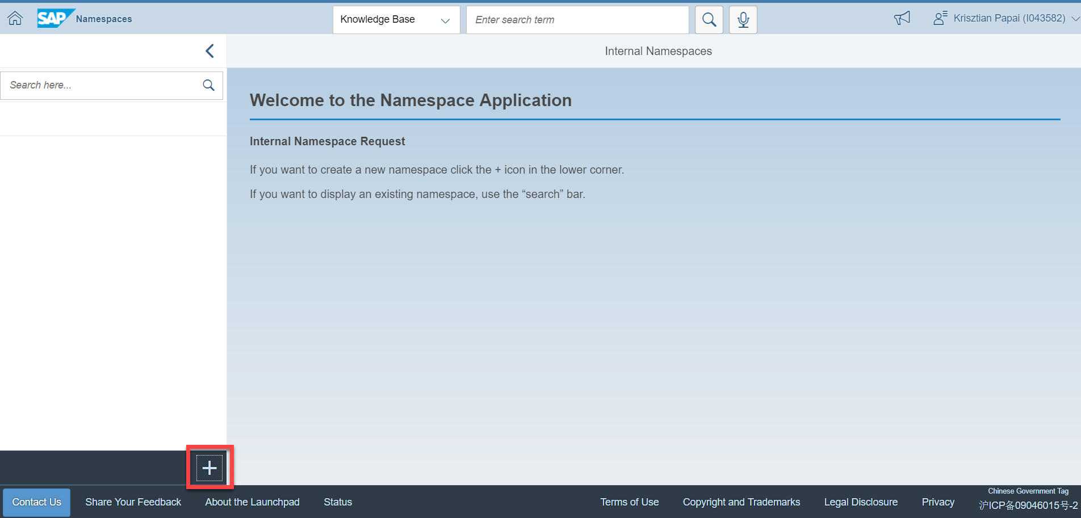
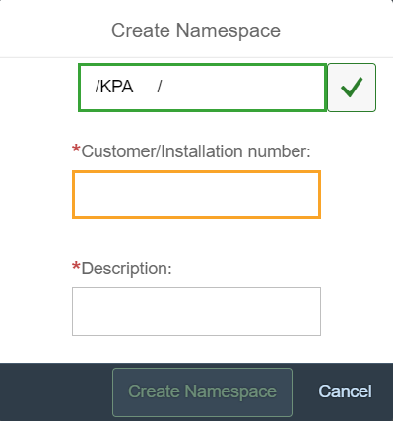
SAP Support Portal : Naming Convention Process
The namespace is entered in the syntax /XYZ/. It must contain alphanumeric characters with a letter as the first character, have a minimum length of five characters, and a maximum length of eight characters (only three characters are recommended, or a maximum of four if possible)
After typing the required namespace:
Error message – the prefix is already reserved
If the namespace is not reserved, it will be assigned to your company
Wait for acceptance from SAP.
Reserve your accepted name prefix in SAP Service Marketplace.
Do not forget to use your namespace in all your SAP Business One solutions (table names, user-defined objects, …).
Notes:
The namespace is entered in the syntax /XYZ/. It must contain alphanumeric characters with a letter as the first character, have a minimum length of five characters, and a maximum length of eight characters.
Only three characters are recommended, or a maximum of four if possible.
After typing the required namespace, you may receive an error message if the prefix is already reserved.
If the namespace is not reserved, it will be assigned to your company.
You will need to wait for the acceptance from SAP. Reserve your accepted name prefix in the SAP Service Market Place
Afterwards don’t forget to use your Namespace in all your SAP Business One solutions (Tables Names, User Defined Objects and so on).

Slide 28
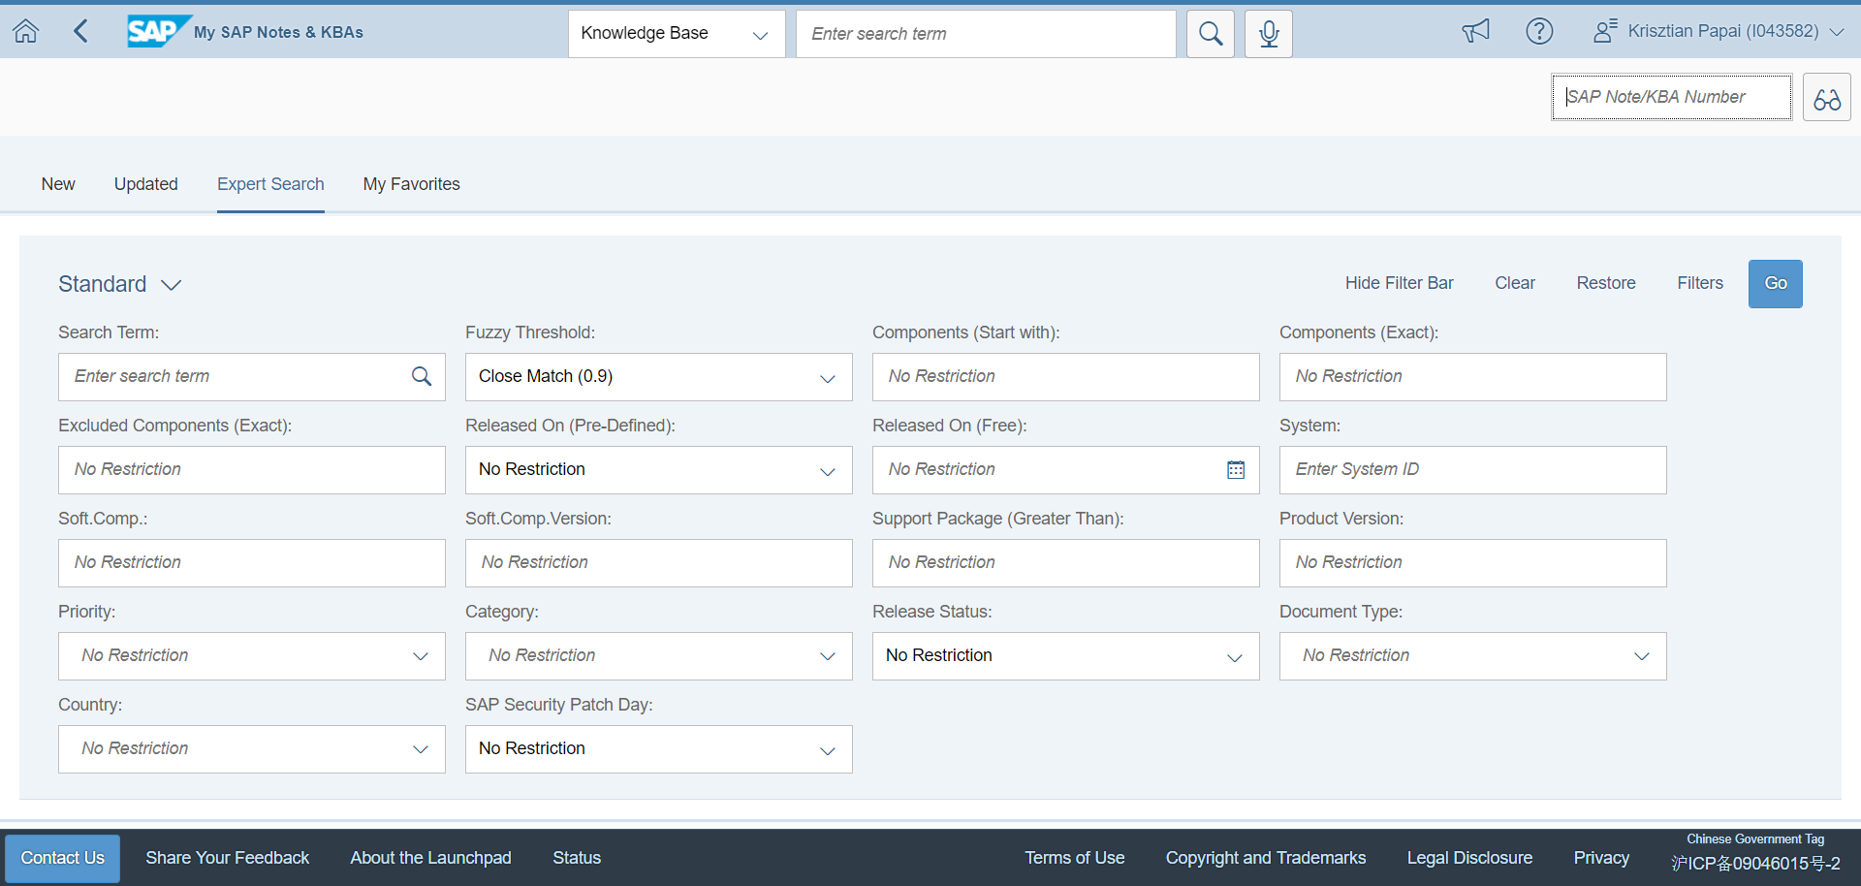
SAP Support Portal: SAP Note Search
https://launchpad.support.sap.com/#/mynotes?tab=Search
Select “Restrict by Software Components”, then enter your selection in the restrictions options. After pressing Select, choose the software component for which you are looking for a note:
SBO-SDK-DI
SBO-SDK-UI
SBO-SDK-DIS
SBO-SDK-SVL
…
Use “SBO*” for all notes related to SAP Business One.
Notes:
The SAP Support Portal also comes with a SAP Note search utility.
You can search for existing knowledge in the notes.
Select “Restrict by Software Components”, then enter your selection in the restrictions options. After pressing Select, choose the software component for which you are looking for a note.
Use “SBO*” for all notes related to SAP Business One.

Slide 29
Additional Useful Sites
Notes:
The next topic is additional useful sites.

Slide 30
SAP Support Portal: Topic Objectives
After completing this topic, you will be familiar with:
SAP Community
SAP Learning Hub
Notes:
After completing this topic, you will be familiar with:
SAP Community
SAP Learning Hub

Slide 31
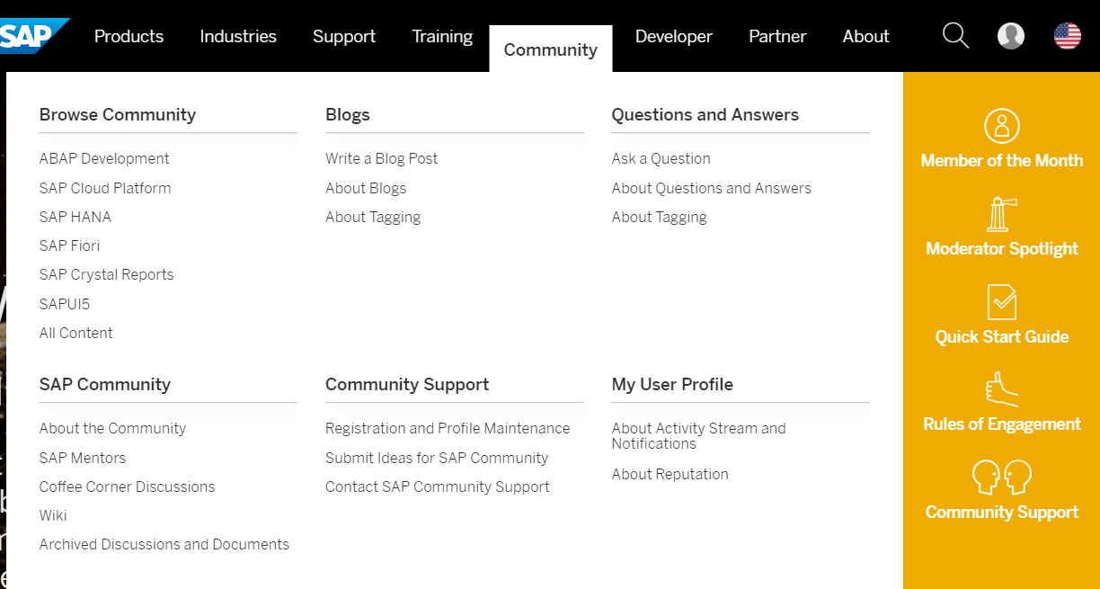
Additional useful sites: SAP Community
https://www.sap.com/ → Community
SAP Community features:
Blogs
Questions and answers
The option to browse for Community content
Direct link to SAP Business One content
Direct link to SAP Business One Cloud content
Notes:
SAP Community is used by people like you. The main features are the blogs, the question and answer section, and a large amount of Community content and materials.

Slide 32
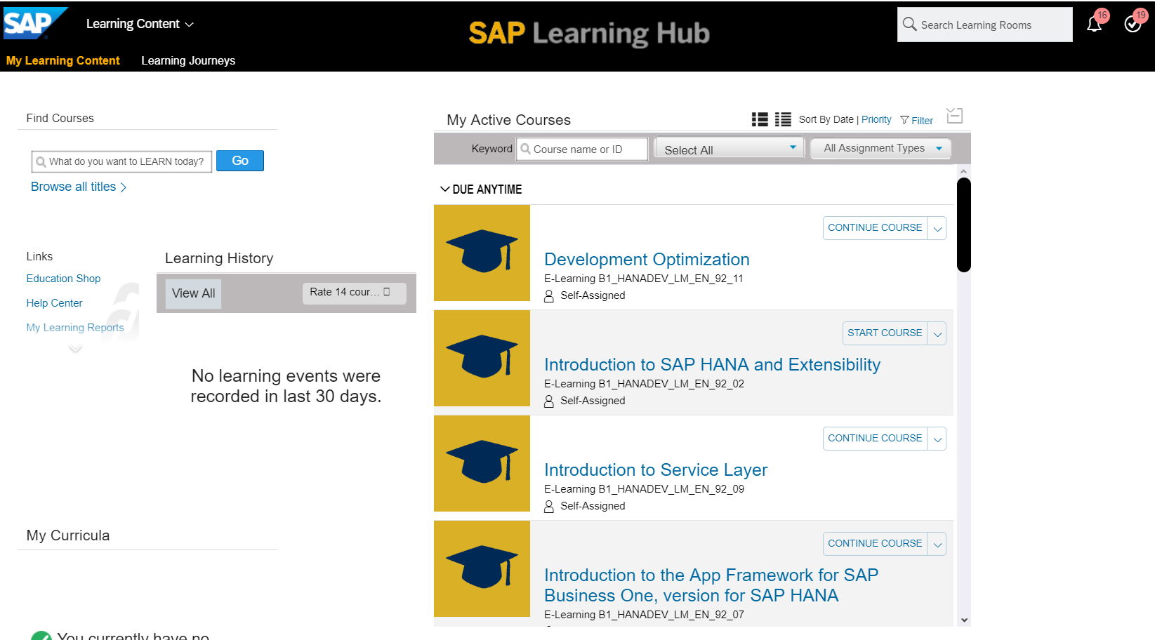
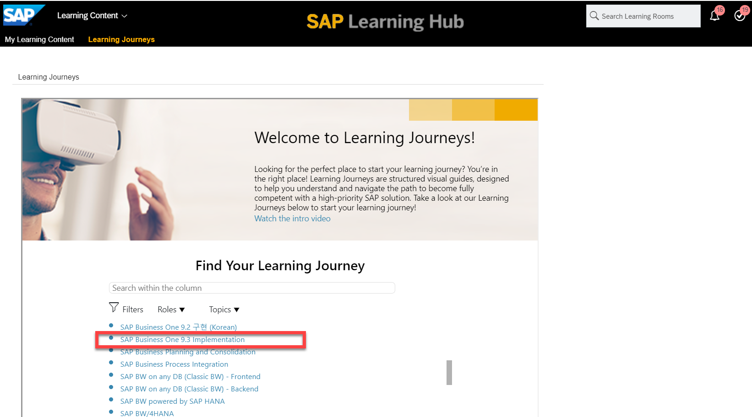
Additional Useful Sites: SAP Learning Hub
Learning Content
Browse all content
Learning Journey
Training based on specific paths
Notes:
Visit SAP Learning Hub to learn in your own way, in your own time, with 24/7 access to training and social learning from SAP that is relevant to your role and level.
Build SAP skills – and keep them up-to-date – with the latest content from SAP Education.
You can search for training based on content or a specific path.

