Slide 1

TB 1300 - SAP Business One SDK SAP Community Tools
July, 2019
Notes:
Welcome to the SAP Community Tools course topic.

Slide 2

Agenda
Add-On Test Tools
Add-On Development Tools
Add-On Test Automation Tool
Dashboard Packaging Tool
Notes:
In this unit we would cover the main topics:
Add-On Test Tools
Add-On Development Tools
Add-On Test Automation Tool
Dashboard Packaging Tool

Slide 3
SAP Business One Community Tools: What is that?
Set of development and testing tools helping partners to develop and test their add-ons. The installation and the source code is shared. If you would like to make supportability for new database environment, you can change the source and build the solution for supporting it.
The same approach can be done for a SAP Business One new release as well.
Notes:
SAP Business One Community Tools are set of development and testing tools helping partners to develop and test their add-ons. The installation and the source code is shared. If you would like to make supportability for new database environment, you can change the source and build the solution for supporting it.
The same approach can be done for a SAP Business One new release as well.

Slide 4
SAP Business One Community Tools: Overview
Add-On Development Tools
B1 Code Generator Wizard
B1 Simple Installer Wizard
B1 Professional Installer Wizard
B1 UDO Form Generator
B1 Event Logger
B1 DB Browser
Add-On Test Tools
B1 DB Browser
B1 .NET Profiler
B1 DB Profiler
B1 DI Logs Reader
B1 Bubble Checker
B1 Form Checker
MSSQL Profiler
Add-On Test Automation Tool
B1 Test Composer
Implementation Tool
Dashboard Packaging Tool
Please refer to the wiki SAP Business One SDK Tools.
Notes:
The SAP Business One Community Tool are spitted into the following categories:
Add-On Development Tools, like B1 Code Generator Wizard, B1 Simple Installer Wizard, B1 Professional Installer Wizard, B1 UDO Form Generator, B1 Event Logger and B1 DB Browser
Add-On Test Tools, like B1 DB Browser, B1 .NET Profiler, B1 DB Profiler, B1 DI Logs Reader, B1 Bubble Checker, B1 Form Checker and MSSQL Profiler
Add-On Test Automation Tool, like B1 Test Composer
Implementation Tool, like Dashboard Packaging Tool

Slide 5

Add-On Test Tools
Notes:
Let’s start with the Add-On Test Tools topic.

Slide 6
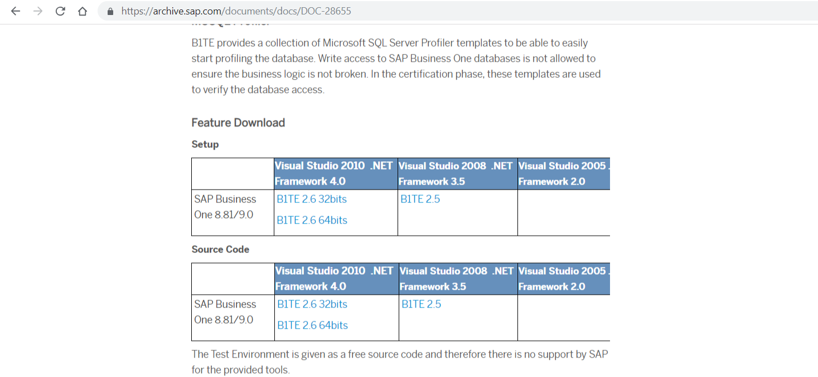
Testing Tools: How to download?
Download link: https://archive.sap.com/documents/docs/DOC-28655
Notes:
The SAP Business One Test Environment (B1TE) is a set of tools that helps profile the usage of the SAP Business One APIs by a solution.
These tools do not require the source code or a development environment (e.g., Visual Studio) and can be helpful in many ways, including:
Profiling the execution in the performance tuning phase of development
Troubleshooting run-time issues in customer installations
Checking possible compatibility breakages in an add-on

Slide 7
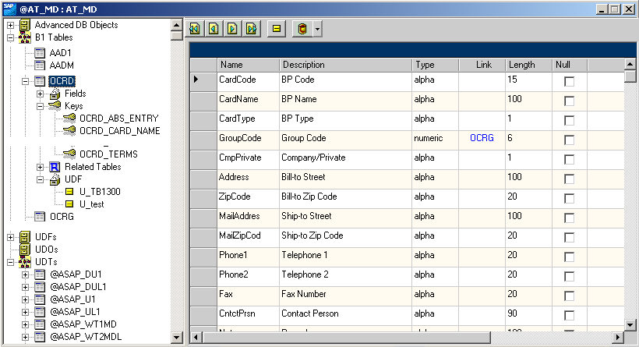
Testing Tools: B1 DB Browser
B1 DB Browser is able to browse the current status of a B1 database in terms of metadata and present a synthetic and navigable view of the table in the database.
Notes:
B1 DB Browser is able to browse the current status of a B1 database in terms of metadata and present a synthetic and navigable view of the table in the database.
This tool visualizes the current state of an SAP Business One database based on its tables, their columns and properties, such as name, type, default values and database constraints.
In the certification phase, this tool is used to verify the changes an add-on makes on the metadata of the SAP Business One database.

Slide 8
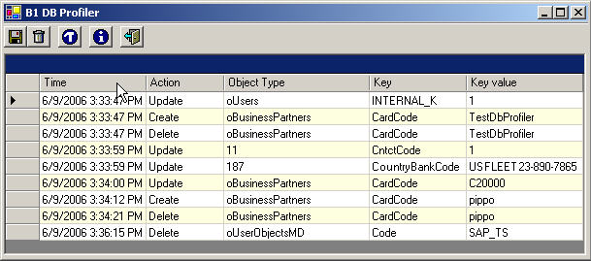
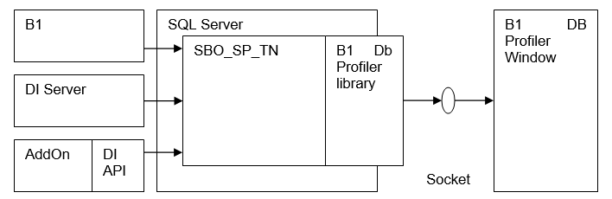
Testing Tools: B1 DB Profiler
B1 DB Profiler is able to profile all the correct accesses to a SAP Business One company DB, where the word “correct” describe here all the accesses that have been mediated by using a DI interface, being this interface DI-API or DI Server. Not correct accesses – as for instance accessing and modifying a B1 company DB through ODBC or direct SQL statements – will not be caught by this tool.
Notes:
B1 DB Profiler keeps track of all changes in a SAP Business One company carried out by a correct execution of a DI interface.
In the certification phase, this tool is used to verify that an add-on accesses the SAP Business One database in the correct and supported way via a DI interface.

Slide 9
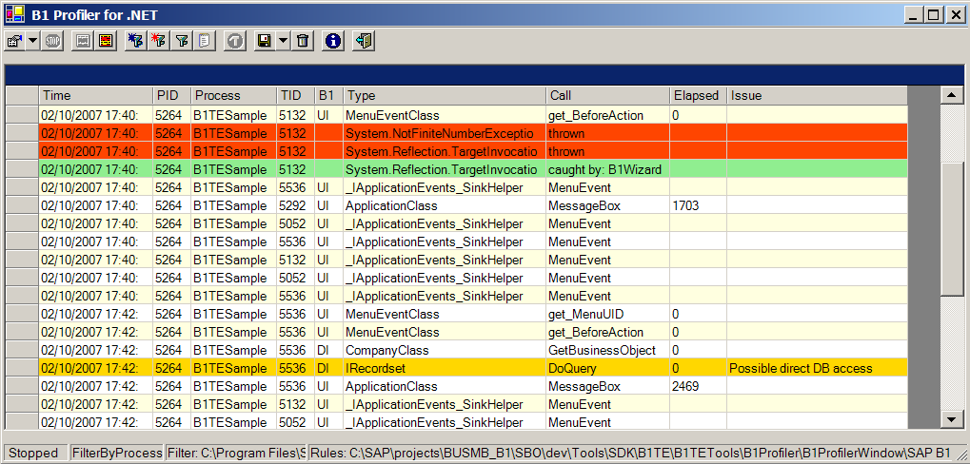
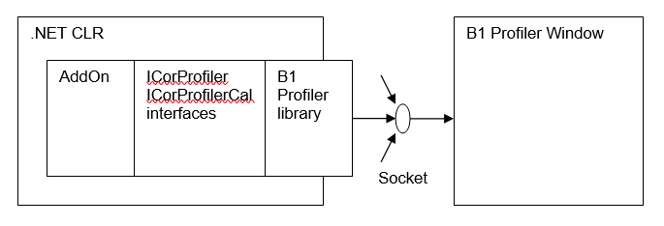
Testing Tools: B1 .NET Profiler
B1 .NET profiler is able to profile all the UI and DI calls executed by a .NET add-on: you can also configure it in order to profile some of the .NET method calls your add-on is executing in order to keep track of its execution. The tool also profile exceptions and possible compatibility breakages.
Notes:
B1 .NET profiler is able to profile all the UI and DI calls executed by a .NET add-on: you can also configure it in order to profile some of the .NET method calls your add-on is executing in order to keep track of its execution.
The tool also profile exceptions and possible compatibility breakages.

Slide 10
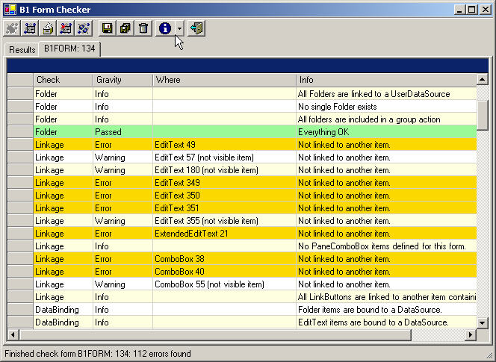
Testing Tools: B1 Form Checker
B1 Form Checker is able to apply a set of checks to a form and list the issues found in a grid.
It is composed of three main parts:
a Windows .NET application called B1 Form Checker able to apply checks on a form coming from file (as XML) or directly from a B1 desktop and display the issues found in a grid,
a class library called B1 Form Checks describing an abstract model for a check on a form,
and a set of concrete checks implementing some programming and look-and-feel guidelines.
Notes:
B1 Form Checker tool checks a form against the SAP Business One programming and look-and-feel guidelines and lists all possible issues.
In the certification phase, this tool is used to prevent a bad user experience or errors in the execution of a form. It is also possible to extend the tool with ad-hoc checks.
B1 Form Checker main parts are:
The main B1 Form Checker application
The class library called describing an abstract model for a check on a form
The set of concrete checks implementing some programming and look-and-feel guidelines

Slide 11
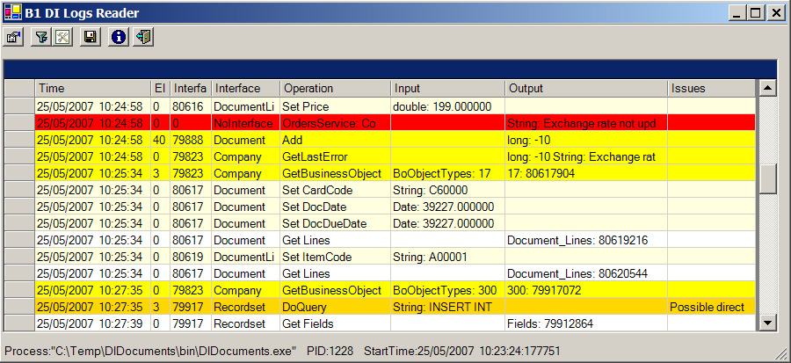
Testing Tools: B1 DI Logs Reader
B1 DI Logs Reader allows you to visualize in a very clear way the logs files produced by the DI API.
The DI API is able to generate log files tracing all calls made from an addon to the DI API. The B1DILogsReader is then able to open the DI API logs files and show the information in a very easy way to read.
DI API log files are xml files named as “<Add-on name> + DILoggerPid + <Process Id> + “_” + <date time>” and with a txt extension. Ex: Addon1.DILoggerPid2435_2007092915262525.txt
Notes:
B1 DI Logs Reader tool provides you a clear view of the XML file logs produced by the DI API.
You can then analyze all DI API calls with detailed information, like interface and command name, elapsed time, input and output types and values.

Slide 12
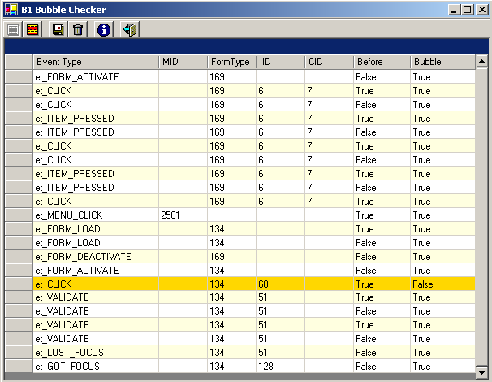
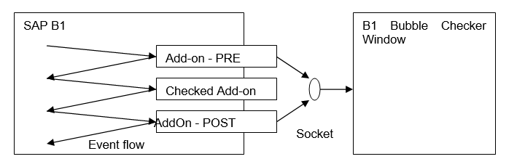
Testing Tools: B1 Bubble Checker
B1 Bubble Checker is able to check all the events bubbled false by an add-on (or a set of several add-ons).
Notes:
B1 Bubble Checker tool checks a form against the SAP Business One programming and look-and-feel guidelines and lists all possible issues.
In the certification phase, this tool is used to prevent a bad user experience or errors in the execution of a form. It is also possible to extend the tool with ad-hoc checks.

Slide 13
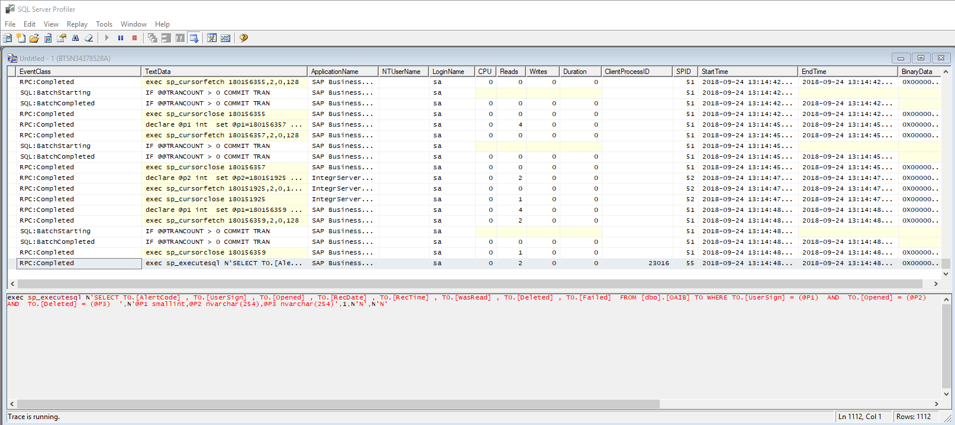
Testing Tools: MSSQL Profiler
Proven usage of DI objects (DI API or DI Server) for write access – instead of DML (i.e. SQL queries) – ensures that the business logic is not broken.
To track all database operations it is recommended to use the Microsoft SQL Server Profiler (this requires MSSQL Client tools to be installed) or the MSDE’s OSQL command line tool.
Notes:
B1TE provides a collection of Microsoft SQL Server Profiler templates to be able to easily start profiling the database.
Write access to SAP Business One databases is not allowed to ensure the business logic is not broken. In the certification phase, these templates are used to verify the database access.

Slide 14
Add-On Development Tools
Notes:
The next topic is the Add-On Development Tools.

Slide 15
Development Tools: How to download?
Download the tool: http://sapassets.edgesuite.net/tools/B1HTE_V1_Setup.zip
Download the source (32-bit): http://sapassets.edgesuite.net/tools/B1TE%202.6%2032bits%20Source%20Code.zip
Download the source (64-bit): http://sapassets.edgesuite.net/tools/B1TE%202.6%2064bits%20Source%20Code.zip
Notes:
The SAP Business One SDK provides several programming interfaces to build powerful and fully integrated add-ons.
In order to make easier and quicker to develop and package add-ons based on the SAP Business One SDK interfaces we created the SAP Business One Development Environment tools.

Slide 16
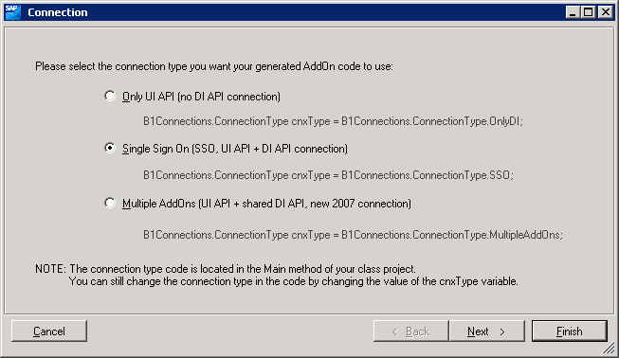
Development Tools: B1 Code Generator Wizard
This represents a template in Microsoft Visual Studio; C# B1 AddOn Wizard or VB B1 AddOn Wizard.
The B1 Code Generator Wizard generates a B1 add-on in form of a Microsoft Visual Studio .NET solution according to the choices of a B1 SDK programmer.
The following panes are available:
Connection pane
Database pane
Menus pane
Forms pane
Events pane
Cockpits pane
Notes:
The B1 Code Generator Wizard represents a template in Microsoft Visual Studio. It can be found under name C# B1 AddOn Wizard or VB B1 AddOn Wizard.
It generates a SAP Business One add-on solution in Microsoft Visual Studio according the selections provided during the wizard.
You can configure the connection, database, menus, forms, events and the cockpits in the wizard.

Slide 17
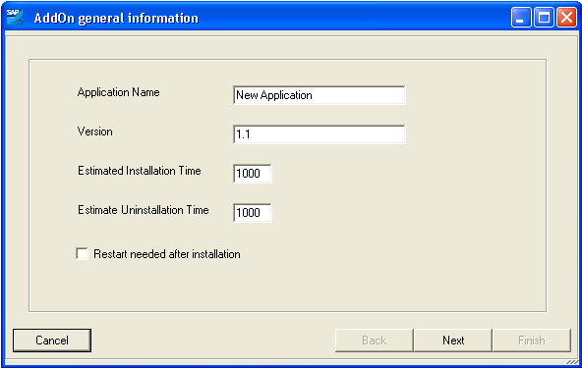
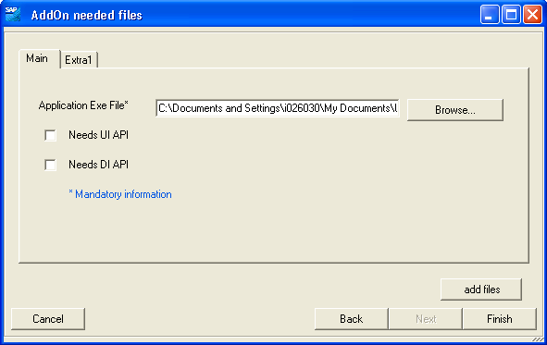
Development Tools: B1 Simple Installer Wizard
This represents a template in Microsoft Visual Studio; VB B1 AddOn Installer .NET Wizard.
The B1 Simple Installer Wizard generates a Microsoft Visual Studio .NET solution ready to register your add-on on a SAP Business One application.
At this point the wizard will present two steps, one to specify general parameters needed for the registration and a second one where to specify the files needed to run the add-on (exe file, DI API and/or UI API references and all the resources files).
Notes:
The B1 Simple Installer Wizard is also represented as a template in Microsoft Visual Studio only for Visual Basic language.
It generates a SAP Business One add-on installer solution in Microsoft Visual.
At this point the wizard will present two steps, one to specify general parameters needed for the registration and a second one where to specify the files needed to run the add-on (exe file, DI API and/or UI API references and all the resources files).

Slide 18
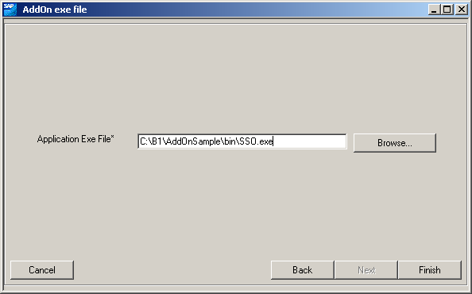
Development Tools: B1 Professional Installer Wizard
This represents a template in Microsoft Visual Studio; VB B1 AddOn Installer Setup .NET.
The B1 Professional Installer Wizard generates a Microsoft Visual Studio .NET solution that will help you to create a .NET Setup and Deployment installer.
At this point the wizard will present two steps: one to specify general parameters needed for the registration and a second one where to specify the exe file of the add-on.
Notes:
The Visual Studio template B1 Professional Installer Wizard enables you to have a much more sophisticated add-on installer using the Visual Basic programming language.
This wizard has two steps. One to specify general parameters needed for the registration and a second one where to specify the exe file of the add-on.

Slide 19
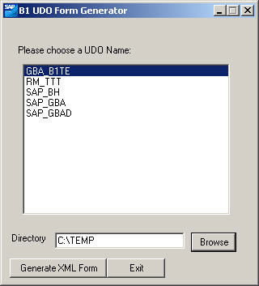
Development Tools: B1 UDO Form Generator
The B1 UDO Form Generator generates a B1 XML form starting from a UDO definition in a B1 DB. The tool can be executed directly or called when attaching a form to a menu.
Notes:
The B1 UDO Form Generator generates a B1 XML form starting from a UDO definition in a B1 DB.
The tool can be executed directly or called when attaching a form to a menu.
The tool just scans the definition of a UDO in terms of fields and children tables.
Based on this information it creates then a B1 XML form, adds items to the form according to a simple layout and binds them to the corresponding fields and tables.
These are the basic rules followed by the tools when generating the form.

Slide 20
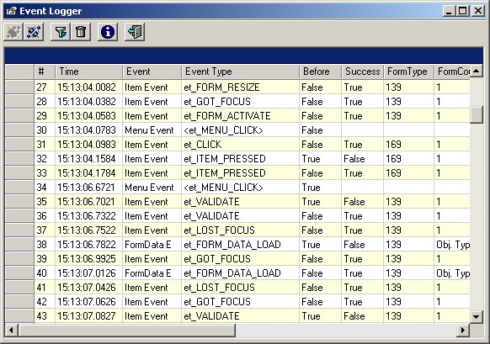
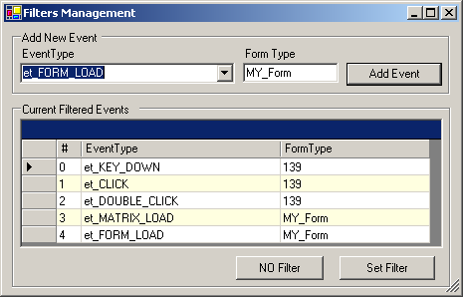
Development Tools: B1 Event Logger
You can add a filter to the Event Logger to show only the events you are interested in per form.
Notes:
The Event Logger tool listens for all events fired by the UI API interface and shows one line per each event in a .NET Grid.
The information shown per each event depends on the event type.
Per all events the same columns are shown, the information will be relevant or not depending on the event type.
You can add a filter to the Event Logger to show only the events you are interested in per form.

Slide 21
Testing Tools: B1 DB Browser
Notes:
B1 DB Browser is able to browse the current status of a B1 database in terms of metadata and present a synthetic and navigable view of the table in the database.

Slide 22
Add-On Test Automation Tool
Notes:
The next topic is the Add-On Test Automation Tool.

Slide 23
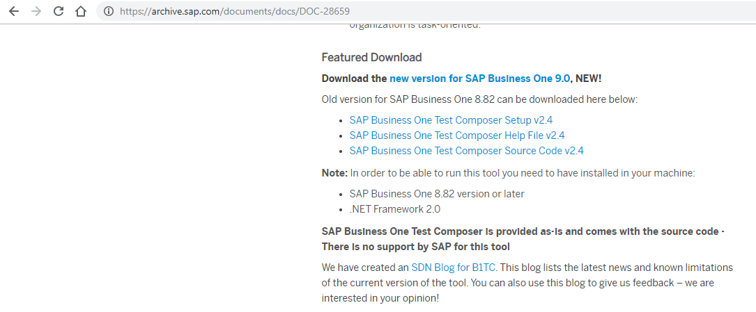
Test Automation Tool: How to download?
Download link: https://archive.sap.com/documents/docs/DOC-28659
Notes:
Please use the provide link in order to access to the blog written about the SAP Business One Test Composer, where you can download the tool itself of the source code.

Slide 24
Test Automation Tool: SAP Business One Test Composer
Motivation
give to partners a simple way to test their add-ons
Core features
record, replay, check values
batching tests, selecting tests in a batch
Independence from 3rd party SW
self consistent and free
No dependency from any licensed tool
Automatic generation of test documentation
want to run tests, not writing test documentation
Notes:
The purpose of this tools is to record the business scenario recorded in the user interface and make automated testing based on the scenario.
The SAP Business One Test Composer can record and execute the scenario. It’s batch capable, then it might be used for performance test as well.
The tool is self consistent and it’s open source. It’s not depending from any licensed tool.
It is able to automatically generate test documentation as well.

Slide 25
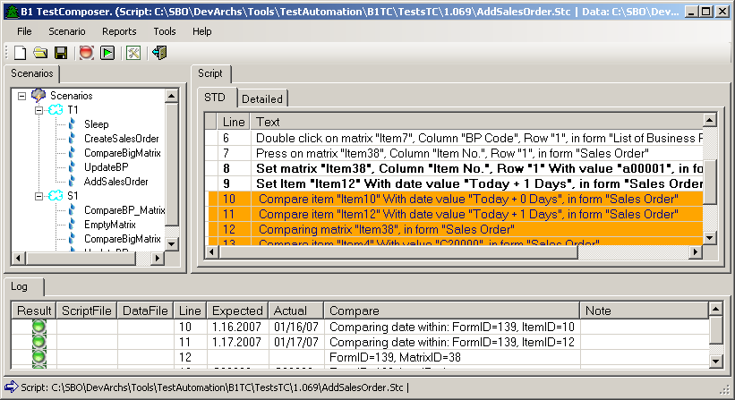
Test Automation Tool: SAP Business One Test Composer Main window
Notes:
On the slide you can see the SAP Business One Test Composer user interface.
The scenario section contains several scenarios executing some specific operation with the SAP Business One or directly on your add-on solution.
The script is a technical representation of the actions, which needs to be performed within a recorded scenario.
The log section is highlighting the result of the execution.

Slide 26

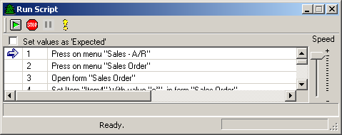
Test Automation Tool: SAP Business One Test Composer Record and Play tests cases
Record window
Play window
Notes:
If you would select the recording option in the main menu, then the record window will pop up.
Basically the Test Composer then would capture all UI based event within the SAP Business One client and will generate a script with multiple operations.
This is how the business scenario can be recorded. Which can be later saved or played.
The second picture on the slide is the playing mode, where you could execute the recorded scenario and all action would be applied directly to the opened SAP Business One client.

Slide 27
Dashboard Packaging Tool
Notes:
The next topic is the Dashboard Packaging Tool.

Slide 28
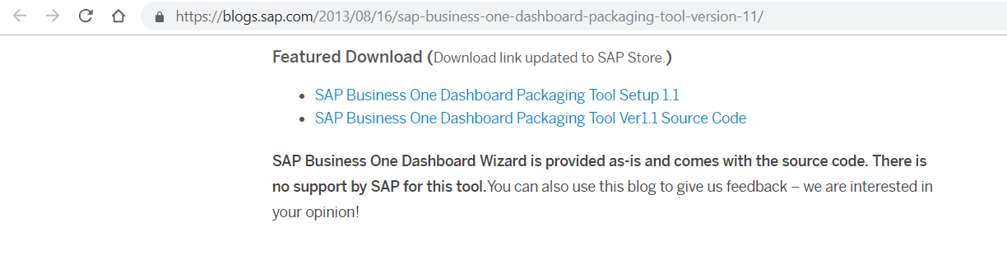
Dashboard Packaging Tool: How to download?
Download link: https://blogs.sap.com/2013/08/16/sap-business-one-dashboard-packaging-tool-version-11/
Notes:
Please use the provide link in order to access to the blog written about the Dashboard Packaging tool, where you can download the tool itself of the source code.

Slide 29
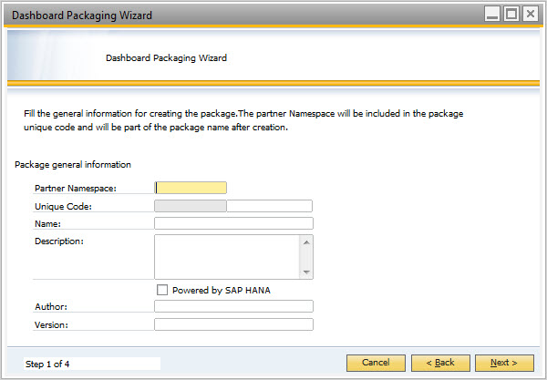
Dashboard Packaging Tool
http://www.sdn.sap.com/irj/scn/go/portal/prtroot/docs/library/uuid/6091ffdd-e1ad-2d10-359f-d644ff7eaa4e?overridelayout=true
Notes:
SAP Business One Dashboard Package Wizard Tool is a tool to create dashboard package for SAP Business One after designing the dashboards with Crystal Dashboard Designer.
The dashboard package will be able to be imported SAP Business One, viewed by end user inside SAP Business One Cockpit.
To learn how to create dashboard package for SAP Business One, you can refer to the document link provided on the slide

