Slide 1



A Comparison of Different Machine Learning Models for Panic Disorder
Diploma Thesis by Abrudan Rebeca-Rafaela
Supervisor: Asistent Universitar, Dr. Mihai Andrei

Slide 2


Contents
•Introduction
•Related work
•Theoretical foundations
•AI models
•SVM
•DT
•XGBoost
•Application
•Conclusions and Future work
Notes:
I-> motivation objectives stated
R-> studies related to pd
AI->dataset, training, comparison
A->models used in a user friendly environment

Slide 3
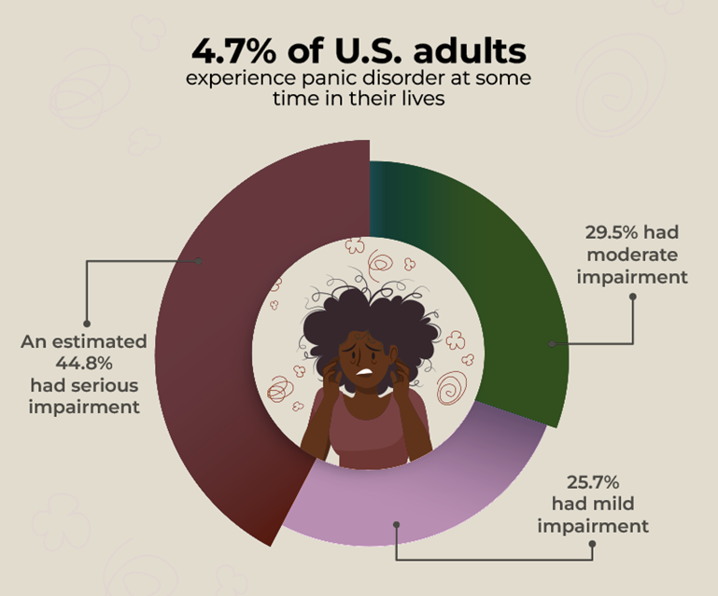

Panic Disorder Detection
Domain: Mental Health and Machine Learning
Why?
Panic disorder leads to phobias, heart attacks.
Diagnosis not accessible for everyone
Solution
Early detection using primary risk factors
Comparing different algorithms for a better prediction
XGBoost accuracy of 99.11%
Notes:
One of the first questions could be why..
in the last years->increase attention for mental health.
What makes pd stand out?
its panic attacks -unexpected -distress
currently d = talkingwith a doctor. -icd 10 protocols -decision
sol=using ai for early det
ai learns to make decision based on primary risk factors

Slide 4

Related work using Machine Learning
Prediction using:
data from wearable devices –Random forest 87.1%
heart rate, sleep patters, activity level
spatiotemporal data –Gaussian SVM 94.5%
location, speed, steps
Notes:
first step: searching other related papers

Slide 5
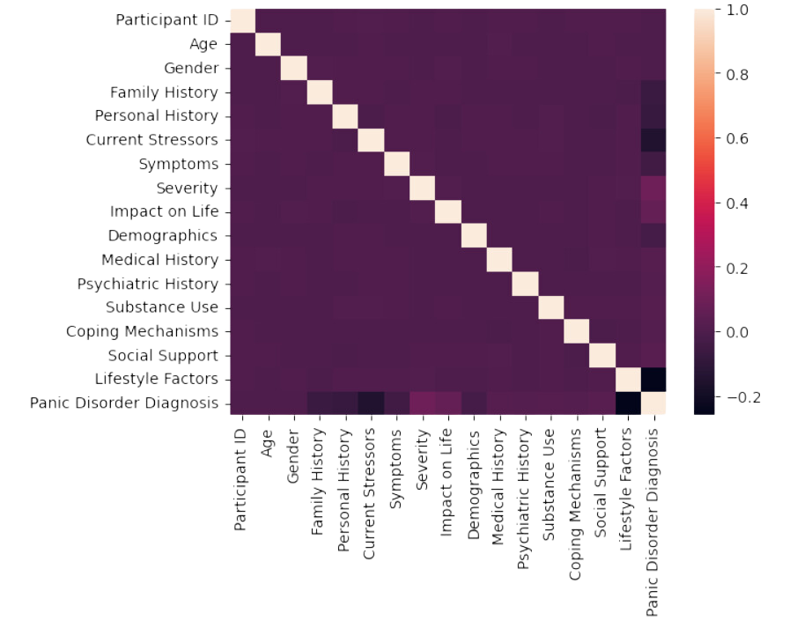
Dataset
100.000 records for training
20.000 records for testing
Notes:
2nd step: relevant dataset

Slide 6
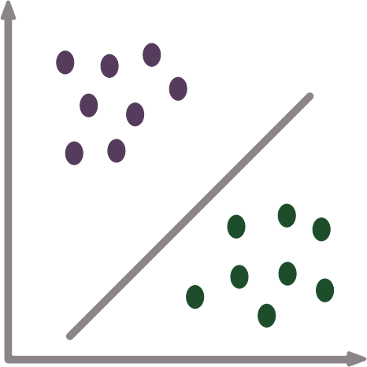
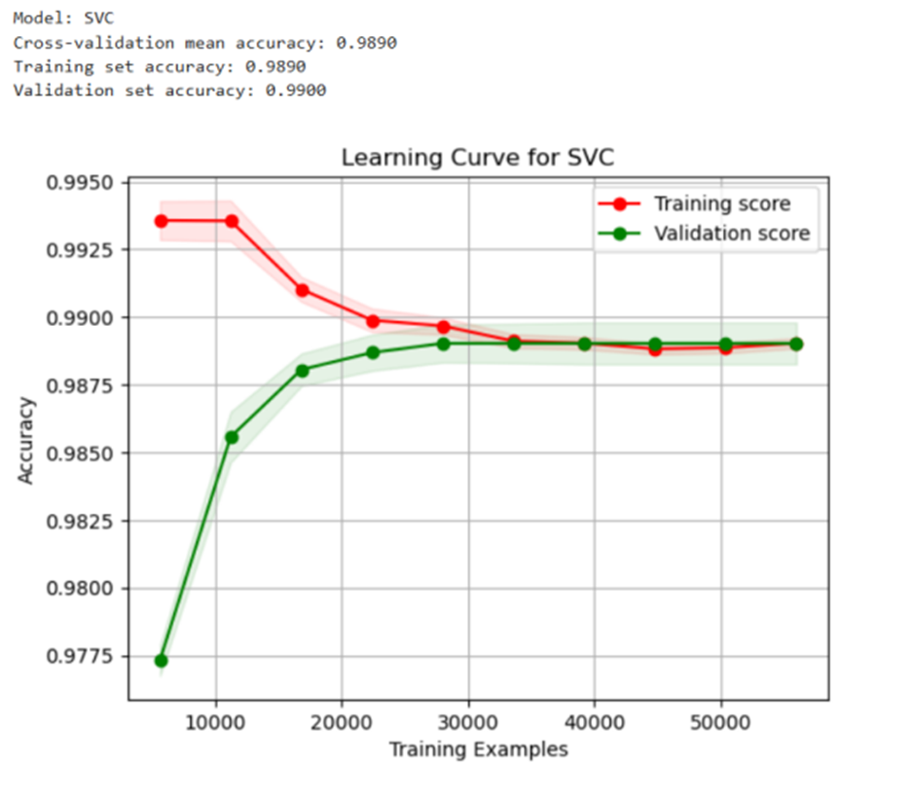
Support Vector Machine
Data preprocessing :
Missing values
predictive imputation
Feature scaling
standardization
One Hot Encoding
Model training
70% training -accuracy 0.98
30% validation -accuracy 0.99
Notes:
then i trained 3 models
missing values-which are important fields => pred imp
in order to fill them as accurate as possible.
categorical columns -> each column into binary columns
cross valid => the model learns as there is new data

Slide 7
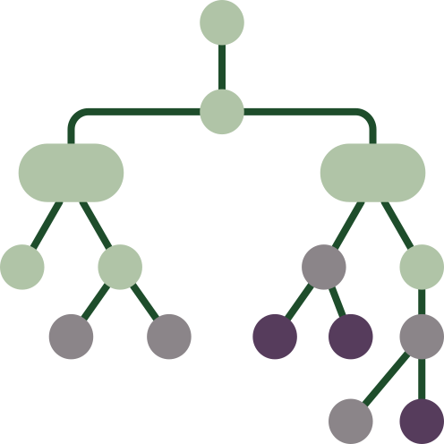
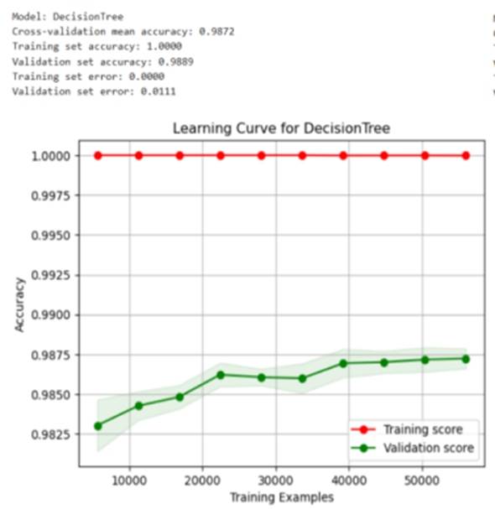
Decision Tree
Data preprocessing :
Missing values
simple imputation
Feature scaling
standardization
Label Encoding
Model training
70% training -accuracy 0.98; -error 0
30% validation -accuracy 0.99; -error 0.01
Notes:
dt prone to overfitting =>miss values treated differently
categorical columns => each category= unique value
after cross v=>overfiting
(val err>training err)

Slide 8
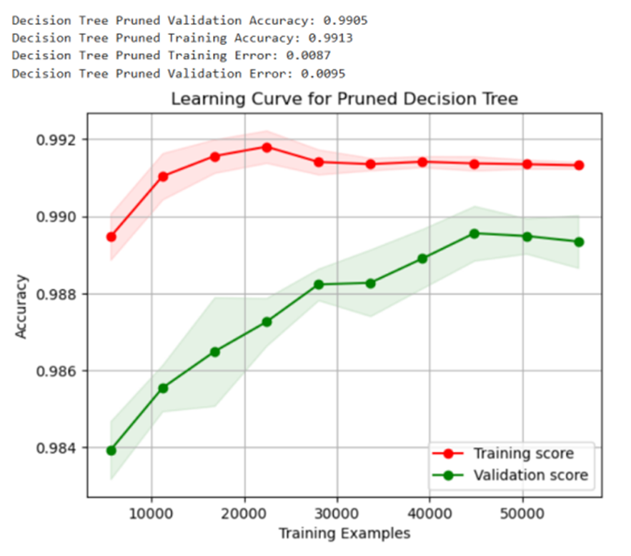
Overfitting in DT
Pruning
Bayesian Optimization for the hyperparameter combination:
’max depth’=10
’min samples leaf’=1
’min samples split’=20
Model training
training -accuracy 0.99; -error 0.008
validation -accuracy 0.99; -error 0.09
Notes:
a common method is pruning, which reduces the size of the tree
hyperpar found with a bayesian opt.
its focus is on the most relevant hyp combination.
It keeps track of the past evaluation results when persofming the probabilistic model

Slide 9
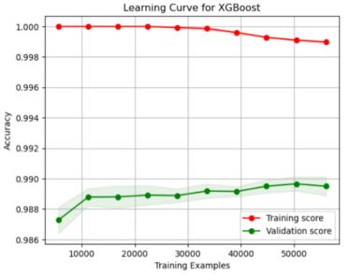
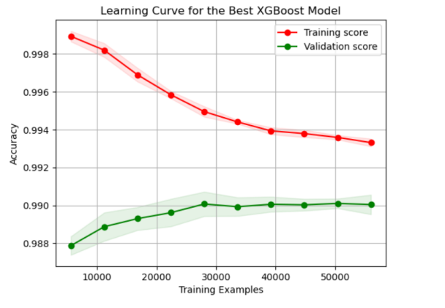
Extreme Gradient Boost
Data preprocessing : similar to DT
Model training
70% training -accuracy 0.98; -error 0.001
30% validation -accuracy 0.99; -error 0.01
Overfitting in XGBoost
Tuning the hyperparameters
Optuna search
’max depth’=4
’learning rate’=0.076
’min child weight’=4
training -accuracy 0.99; -error 0.008
validation -accuracy 0.99; -error 0.009
Notes:
hyperp found using optuna framework
bc it is faster. this framework also uses bayesian opt

Slide 10
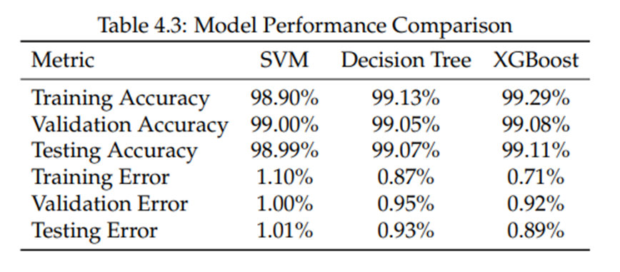

Model Evaluation
The 3 most important features: Lifestyle Factors, Severity, Family History
Featuere challenges: Lifestyle Factors – ‘Sleep Quality’, Severity – ‘Severe’,

Slide 11
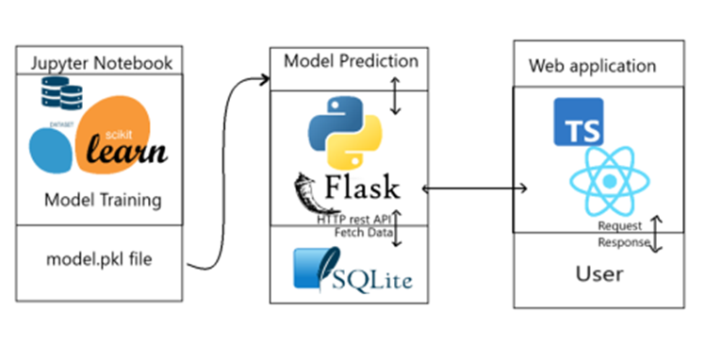
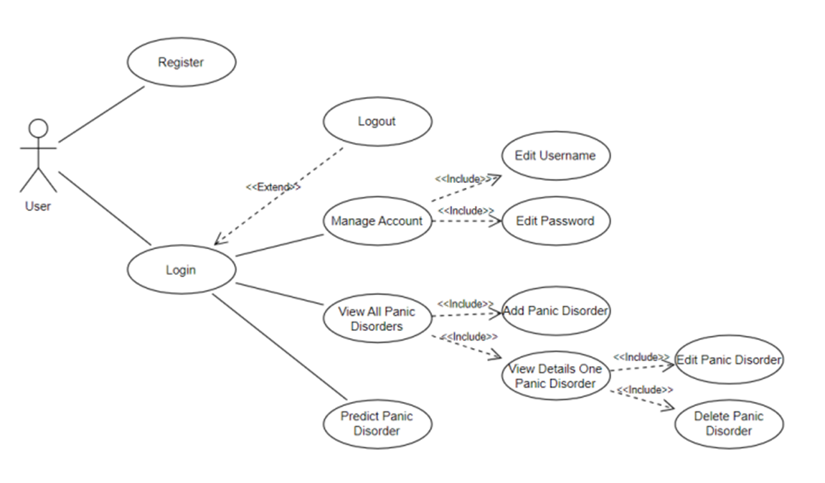
Application
Notes:
the web application allows the person to use the models easily

Slide 12

Conclusions and Future Work
Best accuracy:
XGBoost: 99.29% training, 99.11% testing
Improvements:
Collecting more diverse data
Functionalities for real-time monitoring
Personalized support
panichelp
plan

Slide 13
Thank you for your time
Presented by:
Abrudan Rebeca-Rafaela

