Slide 1
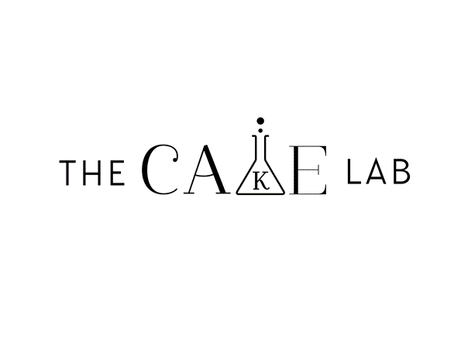


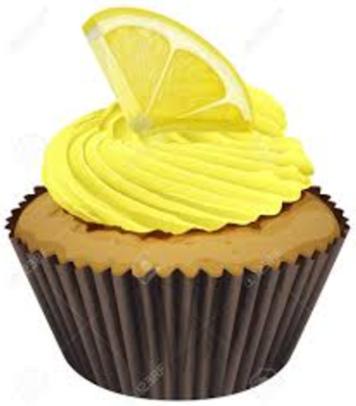


Interchangeable photos
HOME SHOP GALLERY PRODUCTS ABOUT
Embedded video of cake campaign
MOST POPULAR
<
>
CONTACT US
CALL: (02) 743 486
EMAIL: info@thecakelab.co

Slide 2

HOME/SHOP/CUPCAKES
^ REFINE BY CATEORY
Indulgence
Vegan
Lemon Cake
£3.50
Lemon Cake
£3.50
Lemon Cake
£3.50
Lemon Cake
£3.50
Lemon Cake
£3.50
Lemon Cake
£3.50
CONTACT US
CALL: (02) 743 486
EMAIL: info@thecakelab.co

Slide 3
HOME/SHOP/GALLERY
^ REFINE BY CATEORY
CAKES^
Wedding Cakes
Sugar Confectionery
CONTACT US
CALL: (02) 743 486
EMAIL: info@thecakelab.co

Slide 4
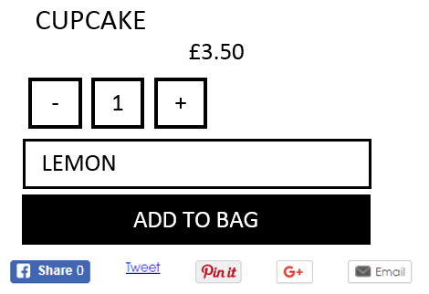
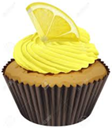
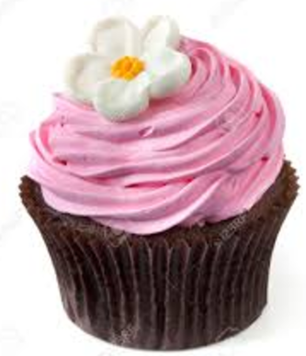
HOME/SHOP/CUPCAKE/LEMON
Experience a delicious lemon cupcake with The Cake Lab.
Dietary & Allergen Advice:
Contains WHEAT/GLUTEN, EGG, and DAIRY. All our products are made in an environment that handles NUTS, SOYA and alcohol and may contain traces. Suitable for vegetarians, but not for vegans.
Please note that all our products are handmade and slight variations may occur.
Lead time:
We require 24 hours lead time for our cupcakes.
Delivery Options:
Our cupcakes are available for central London delivery.
YOU MAY ALSO LIKE
<
>
CONTACT US
CALL: (02) 743 486
EMAIL: info@thecakelab.co

Slide 5
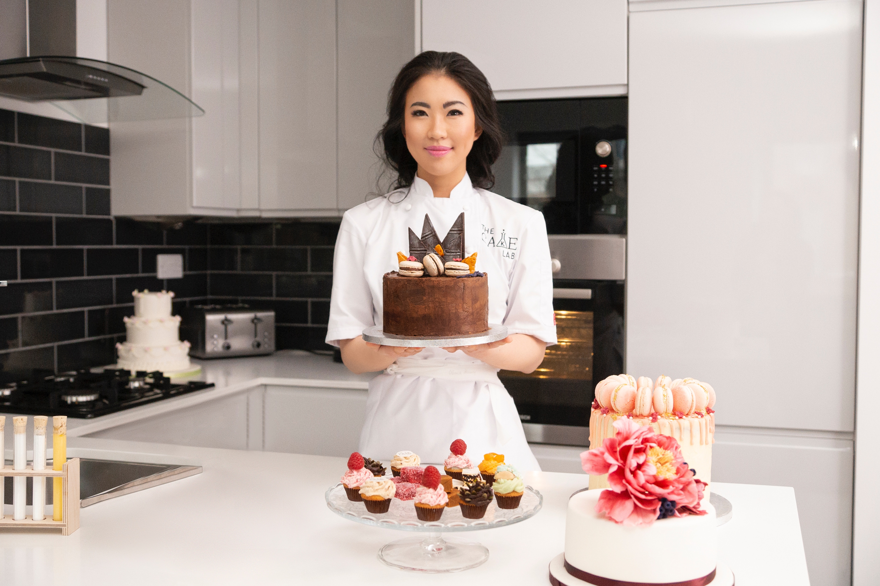
HOME/SHOP/ABOUT
About The Cake Lab
The Cake Lab is a specialist cakes and confectioneries company which focusses on using the science of premium raw ingredients to create innovative, yet delicious products for retail outlets as well as bespoke catering.
Science is core to our philosophy, as all our products are created by scientists who are passionate about good food. Through mixing art and science, we are able to produce beautiful, delicious cakes and confectioneries.
CONTACT US
CALL: (02) 743 486
EMAIL: info@thecakelab.co

