Slide 1

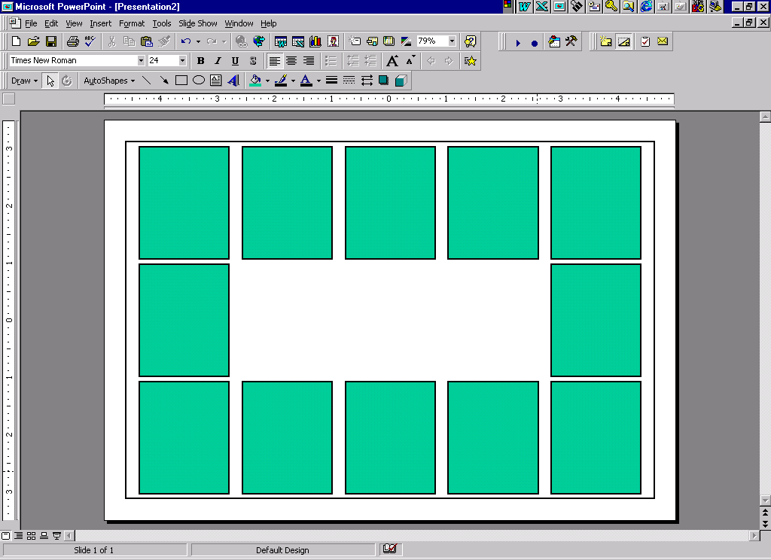
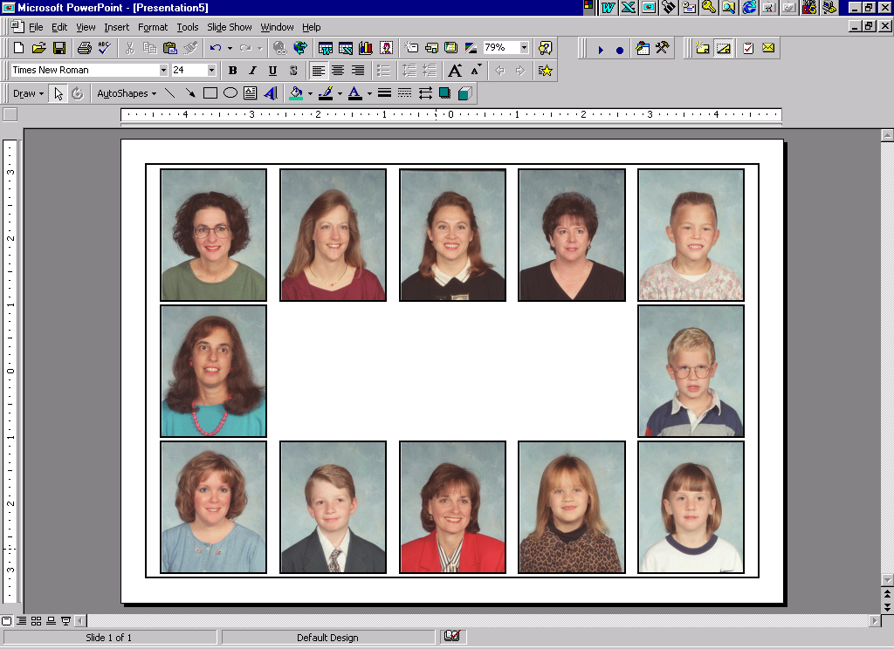

EZ-IMAGE™ automatically creates composite layout proofs and finished composites using Microsoft Powerpoint®. Finished layouts can then be enhanced using the full capabilities of Powerpoint® and printed to any printer supported under Microsoft Windows®.
Redmer Software Company
presents
EZ-IMAGE™
Intelligent Imaging System
P.O. Box 99556
Troy, Mi 48099-9556
248-852-2731 Fax: 248-852-2735
http://www.redmer.com

Slide 2
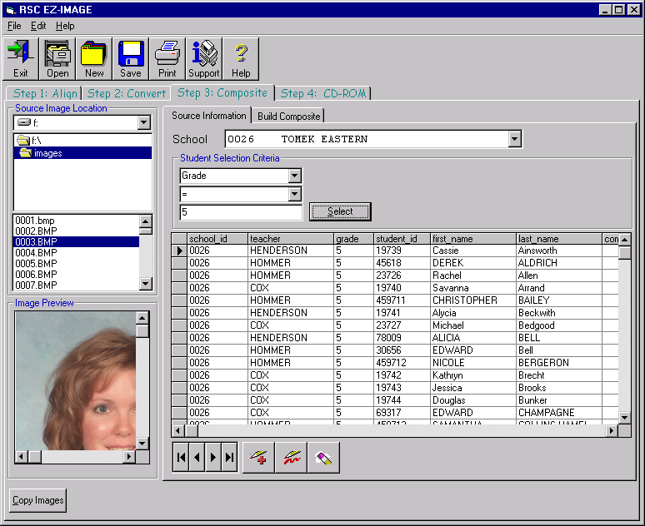
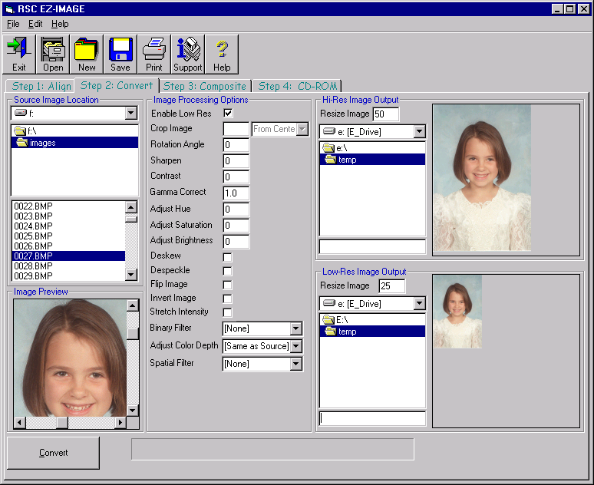
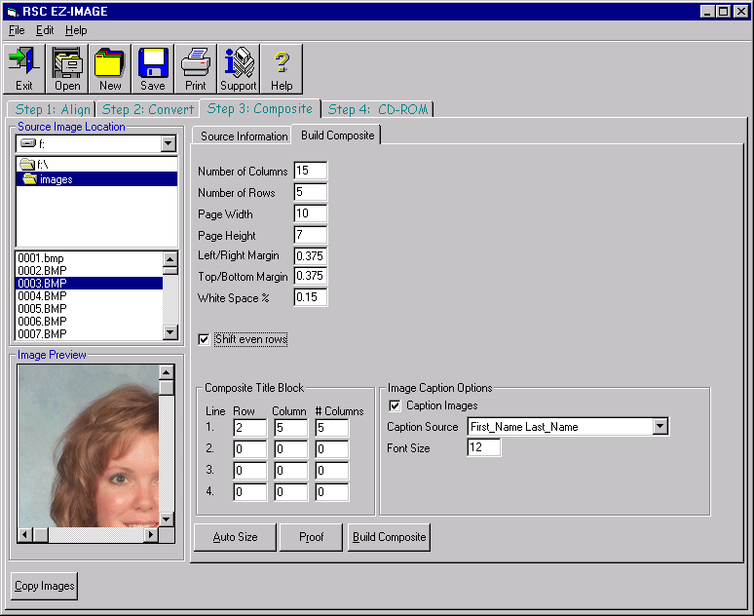
What is EZ-Image™ ?
The EZ-IMAGE™ Composite
EZ-IMAGE™ is a powerful and yet simple to use digital imaging system! It provides powerful features, such as the ability to align scanned images with information from ANY common source. It also provides powerful high-speed batch image processing, image-compositing, and CD Writing in a single inexpensive package.
EZ-IMAGE™ features the unique ability to batch process images from a single source into multiple destinations simultaneously, ideal for CD applications.
EZ-IMAGE™ also features unique composite capabilities including support for “big board” composites containing several hundred images.
The EZ-IMAGE™ Composite process is very simple! Simply locate the images to use, then choose the image selection criteria.
Next, enter the composite page size, rows, columns, spacing, title and caption information. EZ-IMAGE™ provides a unique high-speed proof button to test the layout.

