Slide 1


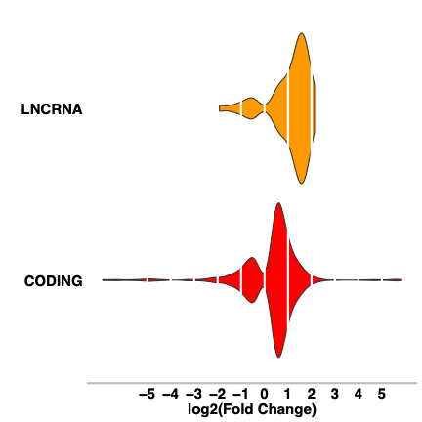
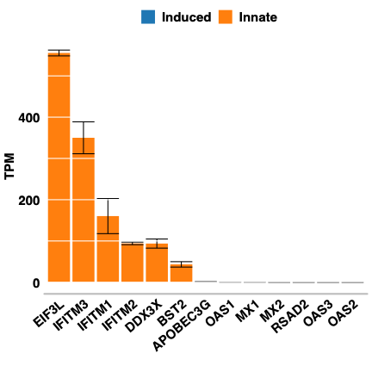
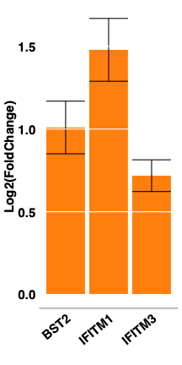
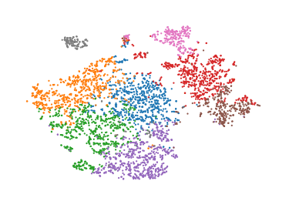
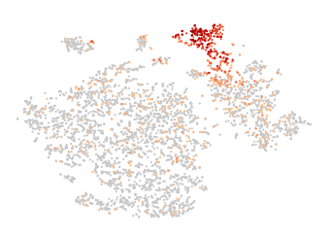
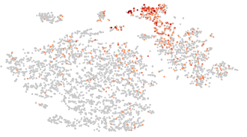


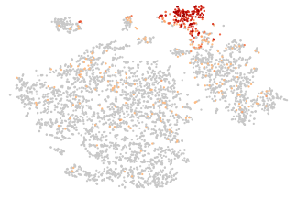
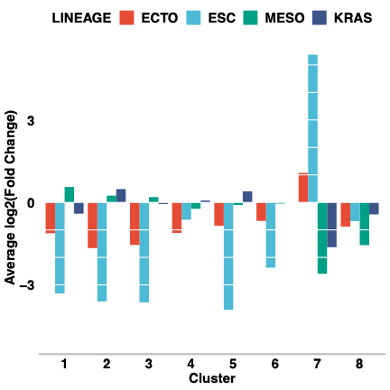
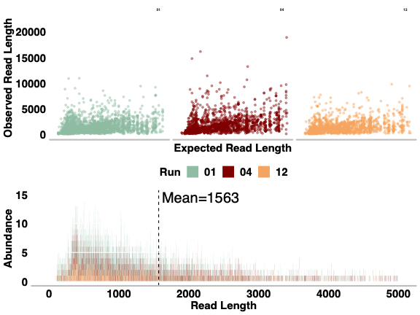
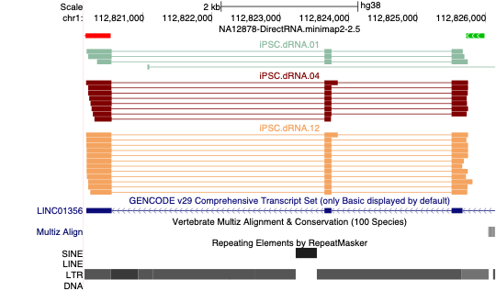
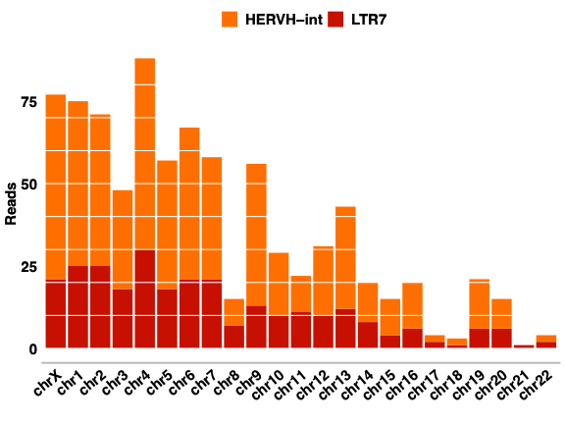
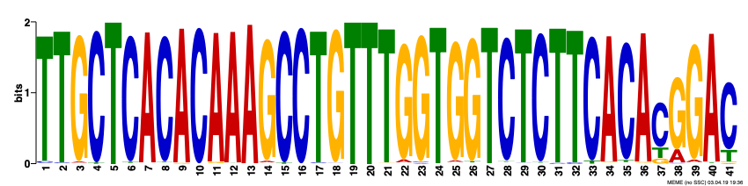
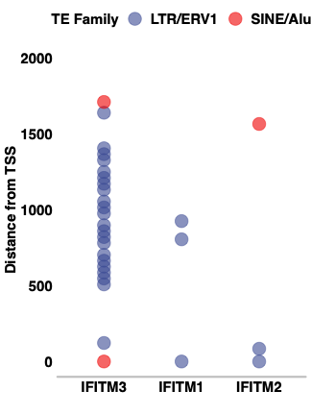
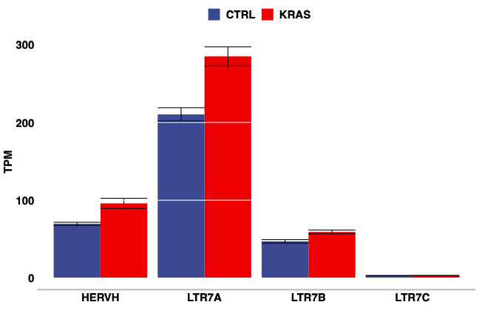
KRAS signaling in pluripotent stem cell differentiation
Roman E. Reggiardo, Sreelakshmi V Maroli, Daniel H. Kim
UC Santa Cruz, Department of Biomolecular Engineering
Overview
Experimental Design
What role does KRAS play in stem cell differentiation?
Day 1
Day 7
Sequence
Multiple signaling pathways contribute to pluripotency in stem cells. Among these, the KRAS signaling pathway functions as a crucial driver of cellular proliferation and stem cell maintenance machinery. To model the impact of KRAS signaling on actively differentiating stem cells, we generated a stable endogenous knock down of KRAS in an induced pluripotent stem cell line (iPSCs) and conducted transcriptomic analysis during undirected differentiation in 3D culture.
GEN1C iPSCs were plated and treated with CRISPRi guides against KRAS, selected, and treated doxycycline
These embryoid bodies (EBs) were grown for 7 days and allowed to differentiate in an undirected manner
The EBs were then disassociated and sequenced using three different techniques with the goal of capturing the heterogeneity and scale of the transcriptomic changes occurring in the absence of KRAS
KRAS
sgRNA
Bulk RNA
Single Cell
Context
GEN1C iPSCs grown in adherent conditions
Nanopore direct RNA
Long non-coding RNA (lncRNA) and Transposable Elements (TEs) in Human embryonic stem cells
- lncRNA are abundant throughout the human genome and many are poorly conserved. The typically hypo-methylated conditions of pluripotent stem cells induce vast expression of lncRNA, many of which remain un-characterized.
- Another abundant class of gene, TEs are also induced in the absence of silencing methylation and have been shown to play influential roles in reprogramming and development. In particular, the endogenous retrovirus 1 (ERV1) family appears to be strongly associated with some transcripts annotated as lncRNA.
Data
Bulk RNA: Illumina
Single Cell: 10x Chromium
- By Day 7, many genes are upregulated, but the heterogeneity across the sample space makes conclusions difficult
- Single cell sequencing captured much of the same transcriptional effects observed in the bulk sequencing data with single cell resolution
- Stem Cells engage a robust innate immune signaling program that persists throughout pluripotency and tapers off close to terminal differentiation
- A minority of the cells are not differentiating and appear to be lacking any appreciable KRAS expression
- The loss of KRAS signaling appears to either abrogate differentiation or inhibit the machinery that normally turns off innate immune signaling
8
7
2
4
KRAS is negatively associated with the most stem-like cluster, the expression of an unannotated lncRNA, and innate immune signaling
3
5
6
Clusters
OCT4
IFITM1
IFITM3
There is no clear lineage preference across the KRAS-expressing clusters but appears to be a bias against endodermal differentiation.
KRAS
LINC01356
Single Molecule: Nanopore direct RNA
- Direct RNA reads capture much of the transcriptionally active loci that are present in the orthogonal approaches. A subset of lncRNA, particularly those expressed in the absence of KRAS, have reads overlapping LTR7 and HERVH inserts.
CRABP2, VIM, MIXL1
LINC01356
OCT4
COL2A1
Analysis
HERVH
LTR7
In the absence of KRAS, the LTR7 family of ERV promoters and their associated HERVH genes are significantly more active in iPSCs
The insertions detected with Nanopore reads and upregulated in the bulk data were compared with those that were not in order to determine a enriched binding motif
These same insertions appear upstream of IFITM family innate immune response genes
GLI3 | Shh mediator, TGF-Beta, embryogenesis
ZNF350 | KRAB Zinc Finger
SOX10 | Embryonic development, cell fate
GRHL2 | Primary neuralation, epithelial development
ZBTB7A | Repressor; proliferation, differentiation
CBFB | Hematopoiesis, Osteogenesis
RUNX1 | Hematopoiesis
MAFB | ETS-1 repressor; hematopoiesis
RUNX3 | Tumor suppressor
ZIC1 | Zinc Finger; neurogenesis

