Slide 1
Continuous Positive Airway Pressure (CPAP)
Sleep apnea therapy and its affect on ahi (don’t worry, we’re going to go over it)

Slide 2
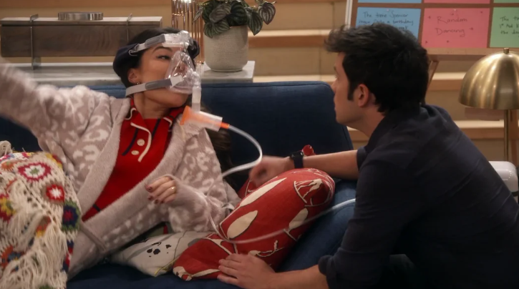
Sleep Apnea, CPAP Therapy, & AHI
Sleep Apnea
Abnormal breathing patterns during sleep
OSA vs CSA
Symptoms
Risk Factors
Diagnosis
CPAP
iCarly
Lifestyle changes
AHI
Notes:
Symptoms of Obstructive Sleep Apnea
Frequent symptoms of obstructive sleep apnea include:
Excessive daytime sleepiness
Loud snoring that is often punctuated by gasping or choking sounds
Headaches in the morning that may persist for several hours after waking up
Dry mouth upon awakening
Restless sleep with periods of wakefulness during the night
Increased need to get up from bed to urinate
Irritability or frustration
Reduced focus
Risk Factors for Obstructive Sleep Apnea
The primary risk factors for obstructive sleep apnea are related to age, sex, body weight, and certain anatomical features of the head and neck area.
Age: The risk of developing obstructive sleep apnea increases with age until a person is in their 60s and 70s.
Sex: Men or people assigned male at birth are generally more likely to have obstructive sleep apnea, especially in the earlier stages of adulthood.
Head and neck anatomy: Obstructive sleep apnea occurs more frequently in people who have specific anatomical features including a larger tongue and a shorter lower jaw.
Body weight: Multiple studies have found a correlation between a higher body mass index (BMI) and an elevated risk of developing obstructive sleep apnea.
Reducing BMI by losing weight
Getting regular exercise, which may decrease OSA symptoms even without weight loss
Altering sleeping position to avoid back sleeping
Reducing alcohol consumption
Apnea-Hypopnea Index (AHI)
When this causes their breathing to completely stop or reduce to 10% of normal levels The National Center for Biotechnology Information advances science and health by providing access to biomedical and genomic information. for at least 10 seconds, it is called an apnea. Hypopneas occur when your airways partially collapse, resulting in shallow breathing. If your airflow decreases by more than 30% for at least 10 seconds, it can be considered a hypopnea.
The apnea-hypopnea index (AHI) represents the average number of apneas and hypopneas you experience each hour during sleep.
Mild: An AHI of at least five events per hour, but fewer than 15.
Moderate: An AHI of at least 15 events per hour, but fewer than 30.
Severe: An AHI of at least 30 events per hour.

Slide 3
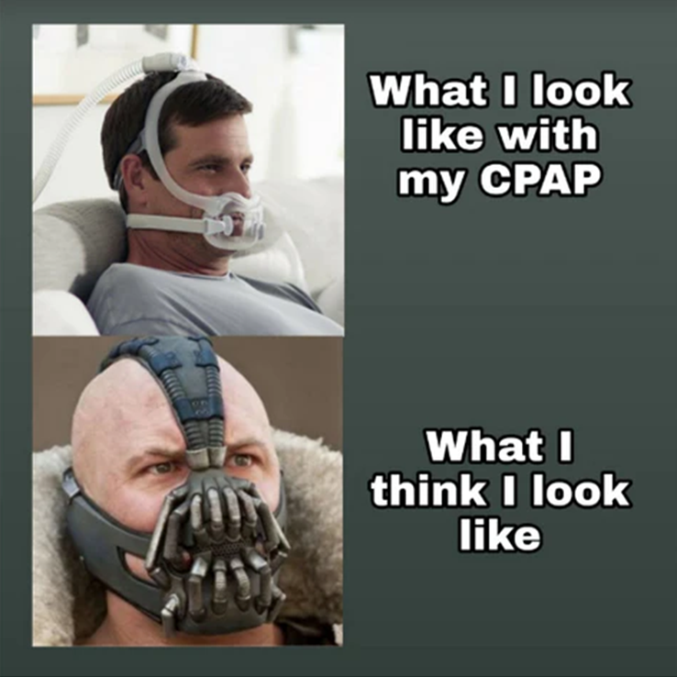
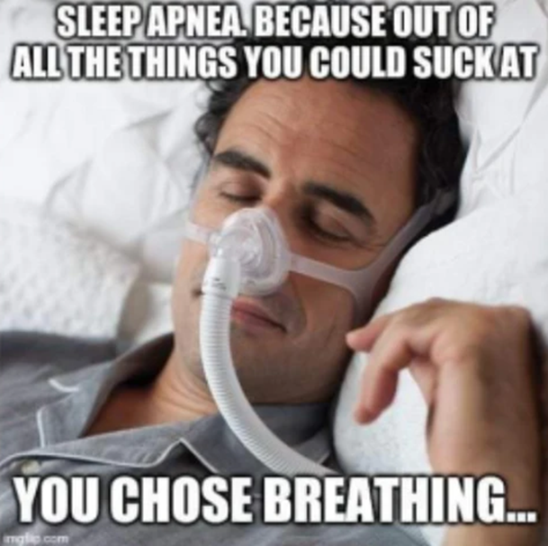
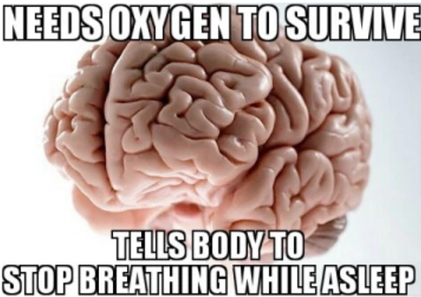
Hilarity

Slide 4
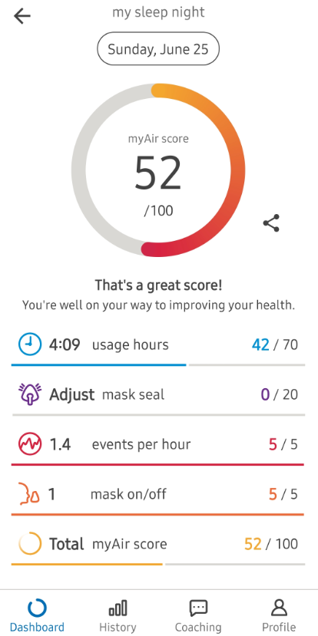
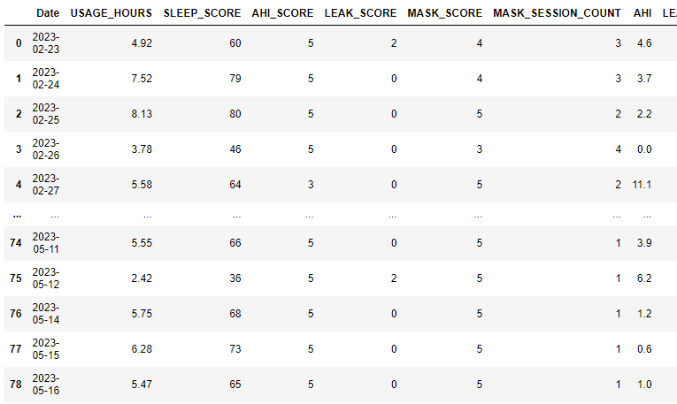
Key Metrics

Slide 5
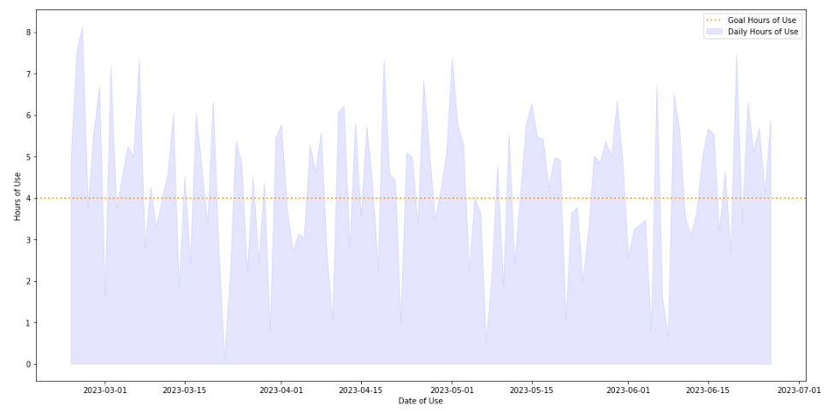
Daily Use Analysis

Slide 6
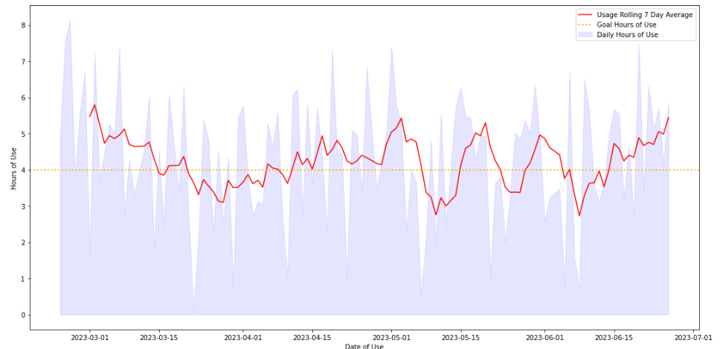
Daily Use Analysis

Slide 7
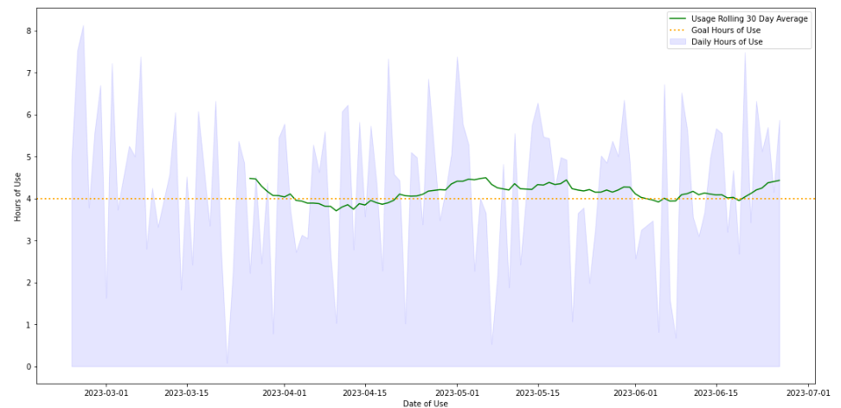
Daily Use Analysis

Slide 8
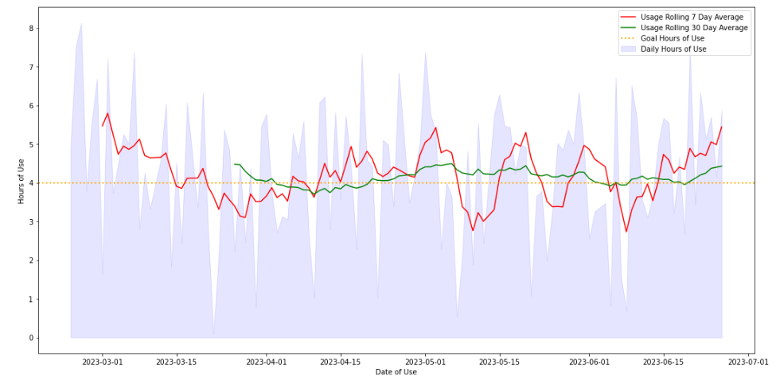
Daily Use Analysis

Slide 9
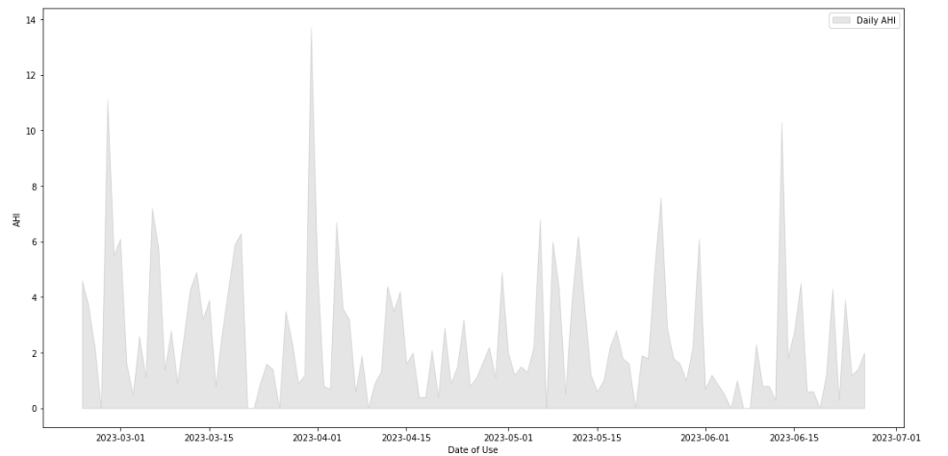
Daily AHI Analysis

Slide 10
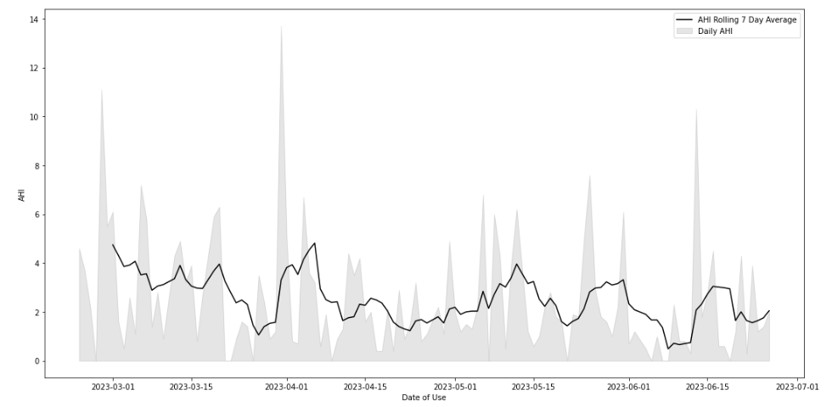
Daily AHI Analysis

Slide 11
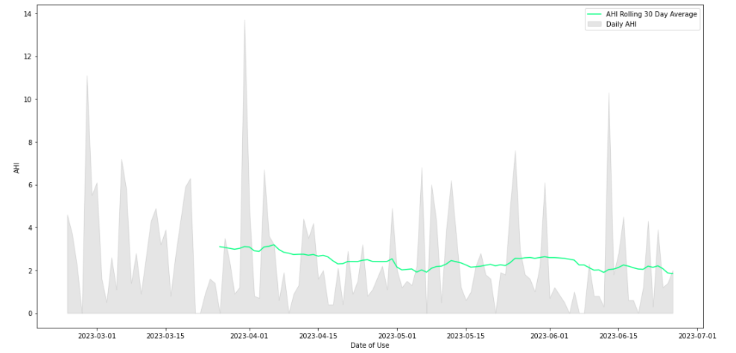
Daily AHI Analysis

Slide 12
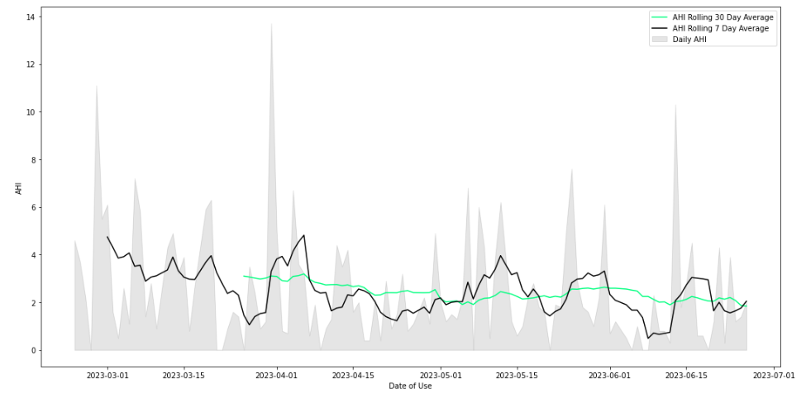
Daily AHI Analysis

Slide 13
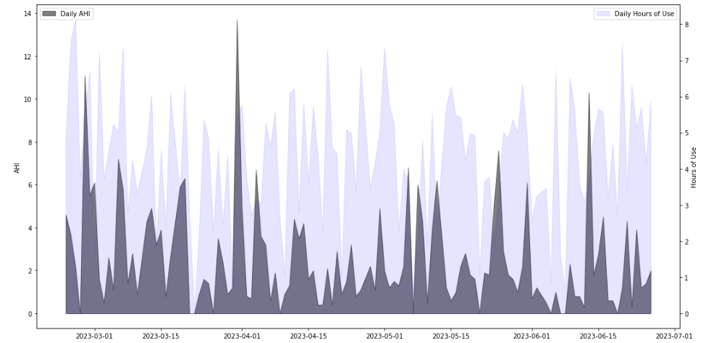
Daily AHI vs Use Analysis

Slide 14
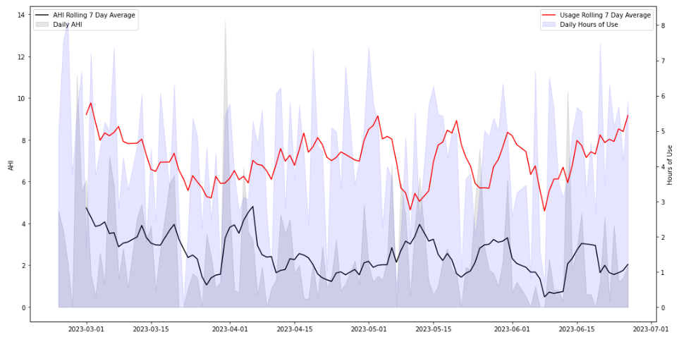
Daily AHI vs Use Analysis

Slide 15
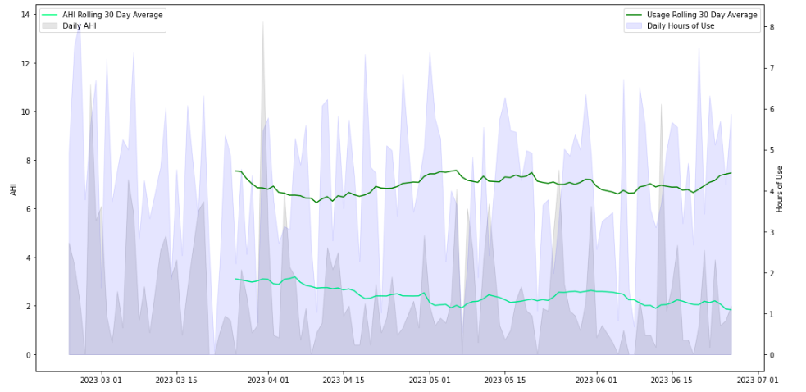
Daily AHI vs Use Analysis

Slide 16
Thank you
https://www.sleepfoundation.org/sleep-apnea

