Slide 1

SALES ANALYSIS

Slide 2
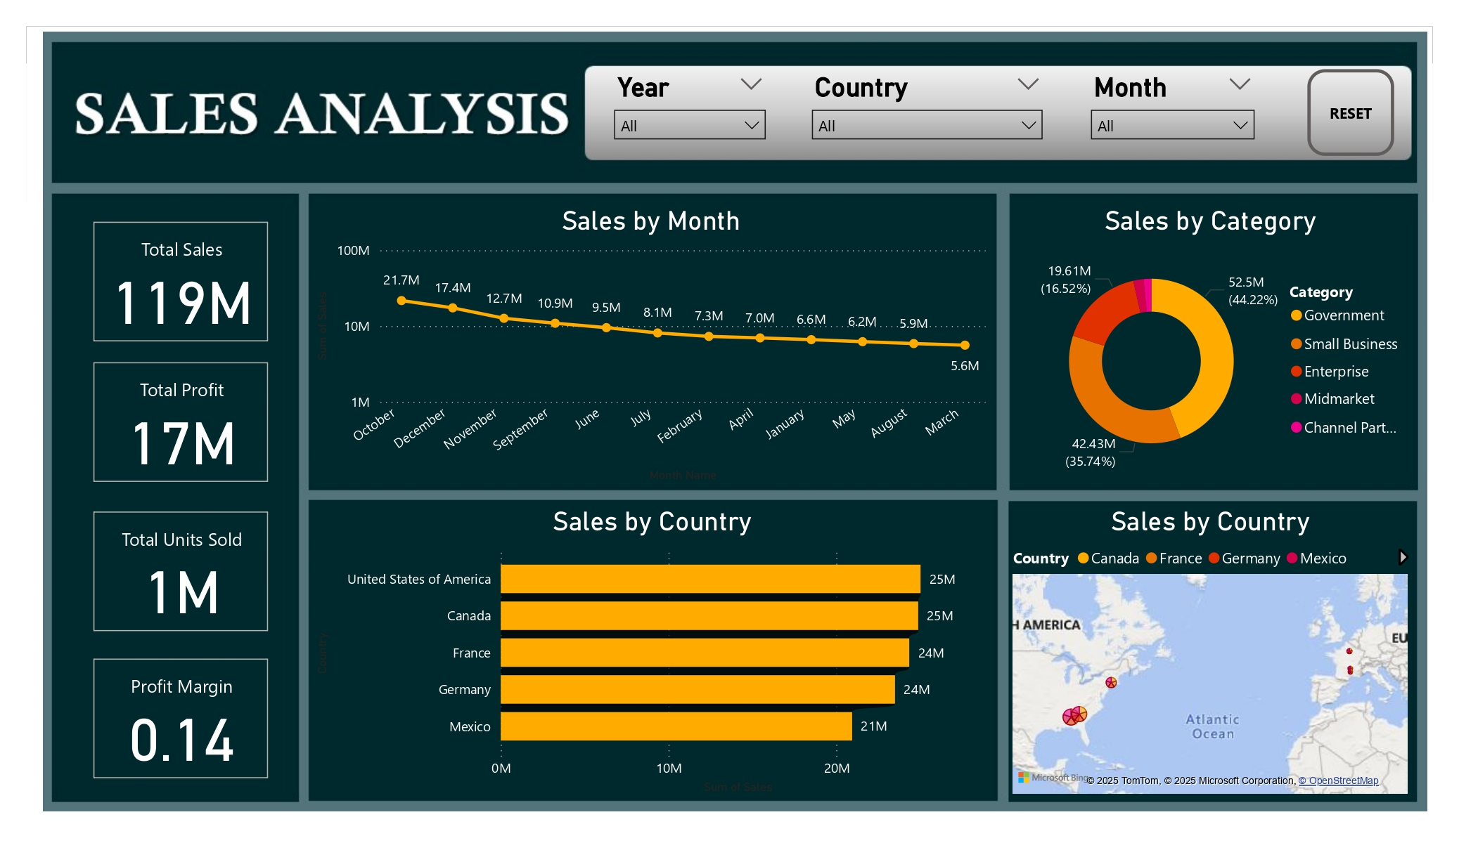

Slide 3
KEY PERFORMANCE INDICATORS
Total Sales: $119M
Total Profit: $17M
Total Units Sold: 1M
Profit Margin: 14% — indicates a moderate margin; there may be room to improve pricing or reduce costs.

Slide 4
SALES TREND (SALES BY MONTH)
Highest sales in October ($21.7M) followed by December ($17.4M).
Steady decline after December, with sales dropping to the lowest in March ($5.6M).
Seasonality seems evident — strong Q4 performance, weaker Q1.

Slide 5
SALES BY CATEGORY
Enterprise dominates with $52.5M (44.22% of total sales).
Small Business is next with $42.43M (35.74%).
Government sales are $19.61M (16.52%).
Midmarket & Channel Partner categories contribute minimally.
Heavy reliance on Enterprise and Small Business segments.

Slide 6
SALES BY COUNTRY
Top countries:
United States & Canada — $25M each.
France & Germany — $24M each.
Mexico — $21M.
North America and Western Europe are the primary markets.

Slide 7
GEOGRAPHIC DISTRIBUTION
The map visualization confirms strong sales concentration in North America and Western Europe.
No significant coverage in Asia, Africa, or other emerging markets potential growth opportunities.

Slide 8
KEY OBSERVATIONS
Seasonal marketing push in Q4 seems to boost sales — leverage similar strategies in weaker months.
Diversify category focus — reduce dependency on Enterprise by growing Government, Midmarket, and Channel Partner segments
Expand into underrepresented regions — especially Asia-Pacific and Latin America beyond Mexico.
Consider profit margin improvement through cost optimization or pricing strategies.

