Slide 1
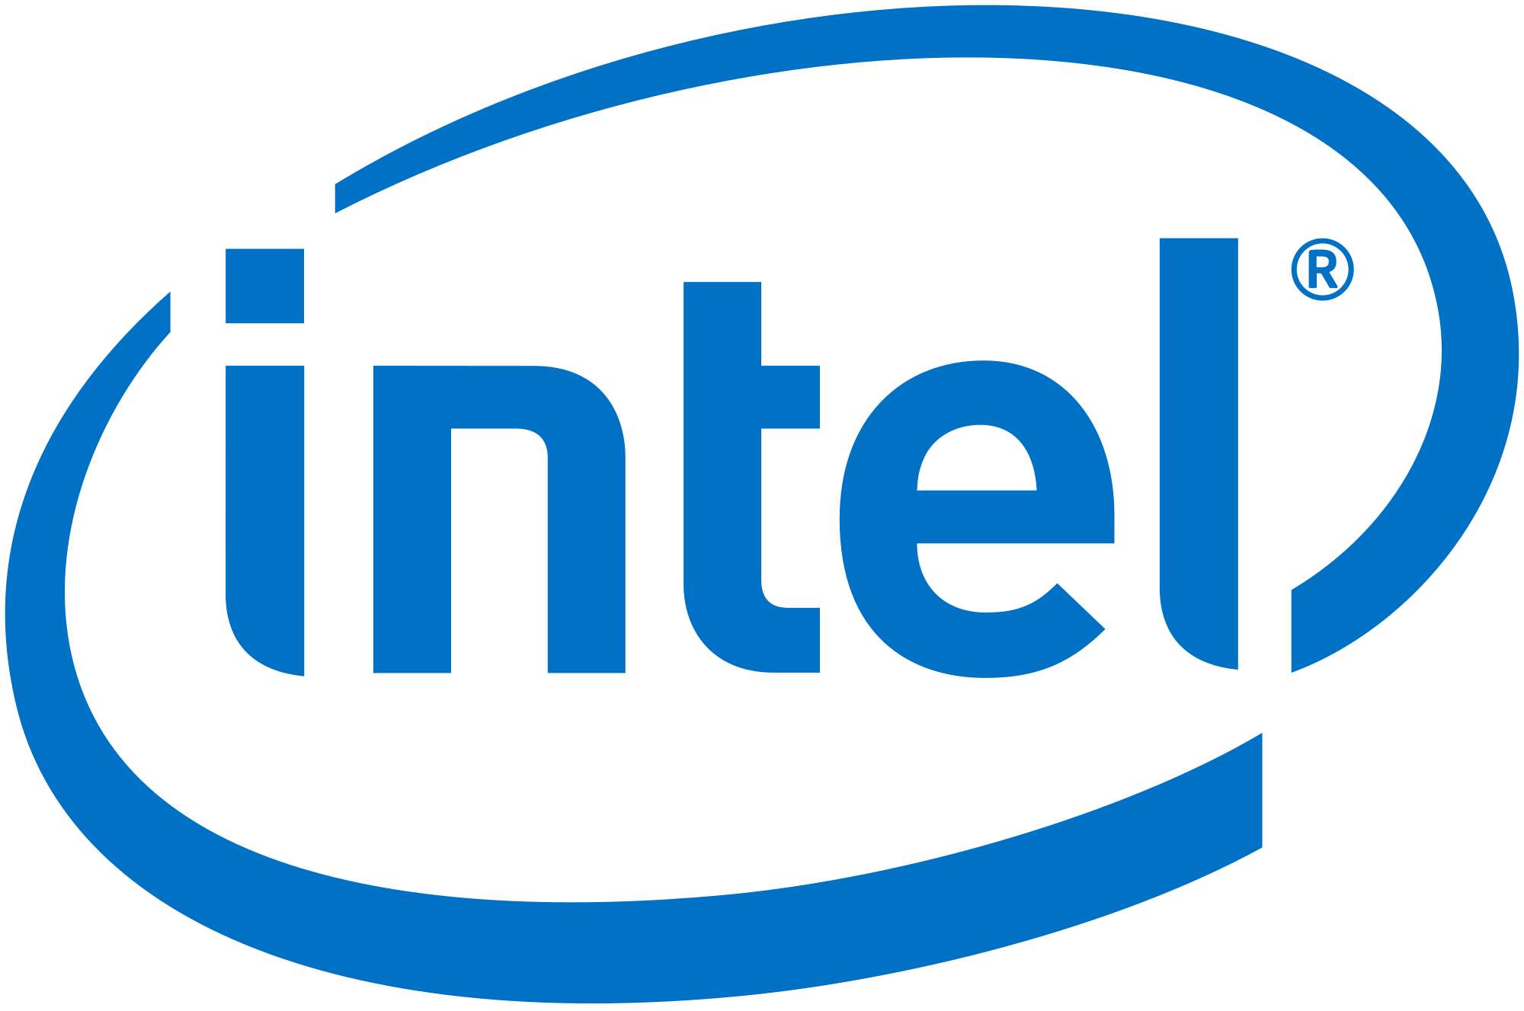
Intel’s Ethics and Privacy Policies
Richard Rennehan
Case 2; ISEC3050-701; Dec 6, 2018

Slide 2
Overview
Ethisphere Top Ethical Companies
Intel Code of Conduct
Ethical Behaviors
Intel Guide to Privacy and Protection of Data
Privacy and Security Implementations
Intel Corporate Privacy Rules
Collection and Usage of Personal Information
Quick Review of Meltdown and Spectre
Quiz
Conclusion

Slide 3

Ethisphere’s World’s Most Ethical Companies 2017

Slide 4
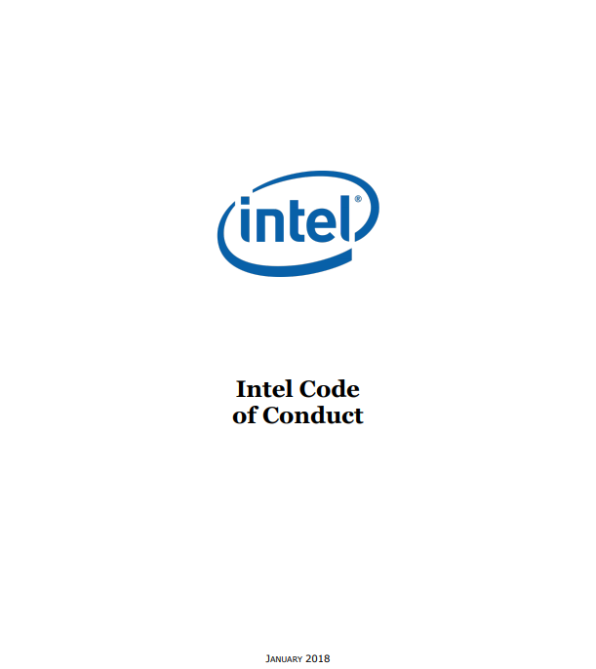
Intel Code of Conduct

Slide 5
Ethical Behaviors
Complying with laws of all countries Intel does business in
Complying with antitrust laws
Complying with anti-corruption laws

Slide 6
Ethical Behaviors
Open and honest communication
Equal employment opportunities and diversity
Safety
Anti-human trafficking/forced labor
Anti-harassment
Anti-workplace violence

Slide 7
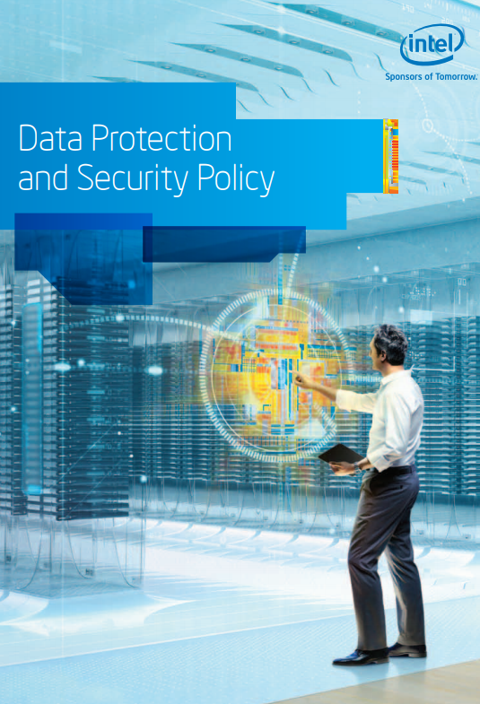
Intel’s Guide to Privacy and Protection of Data

Slide 8
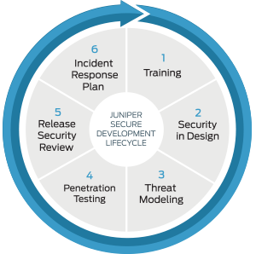
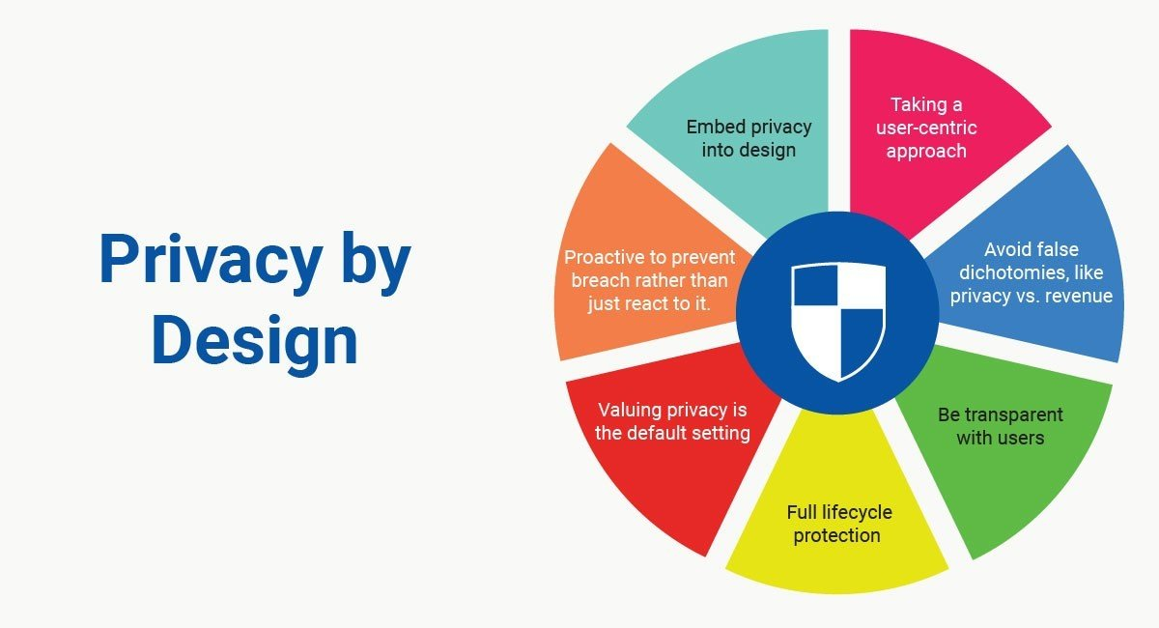
Privacy and Security Implementations

Slide 9
(Termsfeed, 2018)

Slide 10
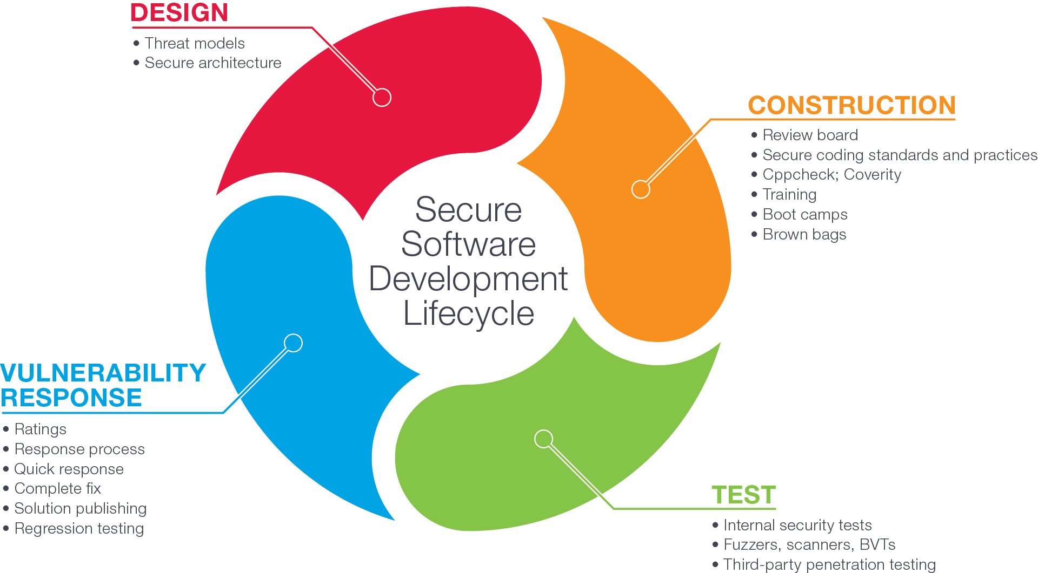
(F5, 2016)

Slide 11
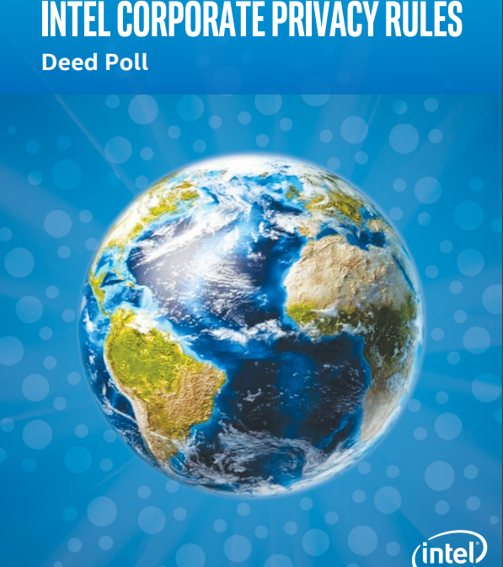
Intel Corporate Privacy Rules

Slide 12
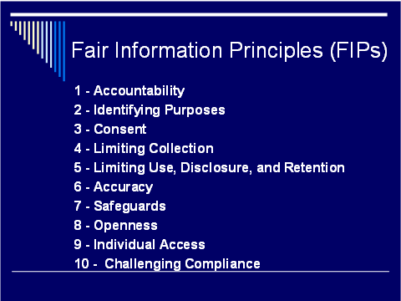
Collection and Usage of Personal Information

Slide 13
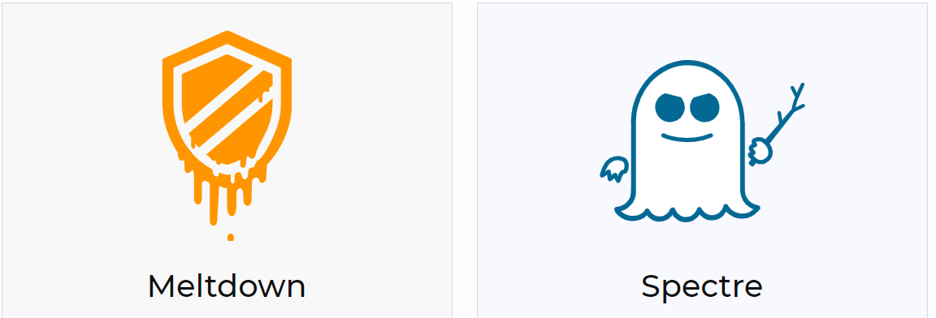
A Quick Review of Meltdown and Spectre

Slide 14
Quiz Time!

Slide 15
Question 1
Which of these was not in the Privacy by Design graphic?
A. Taking a user-centric approach
B. Embed privacy into design
C. Develop optional privacy settings
D. Be transparent with users

Slide 16

Question 1
Which of these was not in the Privacy by Design graphic?
A. Taking a user-centric approach
B. Embed privacy into design
C. Develop optional privacy settings
D. Be transparent with users

Slide 17
Question 2
How many Fair Information Principles are there?
A. 6
B. 8
C. 10
D. 12

Slide 18
Question 2
How many Fair Information Principles are there?
A. 6
B. 8
C. 10
D. 12

Slide 19
Concluding Remarks

Slide 20
References
F5. (2016, July 29). F5 BIG-IP Platform Security. Retrieved from https://www.f5.com/services/resources/white-papers/f5-big-ip-platform-security
Intel. (2012). Data Protection and Security Policy. Retrieved fromhttps://www.f5.com/services/resources/white-papers/f5-big-ip-platform-security
Intel. (2012). Data Protection and Security Policy. Retrieved from https://blogs.intel.com/policy/files/2012/01/Intel_Priv_Sec_Guide.pdf
Intel. (2018, January). Intel Code of Conduct. Retrieved from https://www.intel.com/content/dam/www/public/us/en/documents/corporate-information/2018-intel-code-of-conduct.pdf
Kauflin, J. (2017, March 14). The World's Most Ethical Companies 2017. Retrieved from https://www.forbes.com/sites/jeffkauflin/2017/03/14/the-worlds-most-ethical-companies-2017/#3f09408d7bc3
Termsfeed. (2018, January 09). Privacy by Design. Retrieved from https://termsfeed.com/blog/privacy-design/

