Slide 1

UK Road Accidents 2016 Report
Richard Rennehan
NSCC Institute of Technology

Slide 2
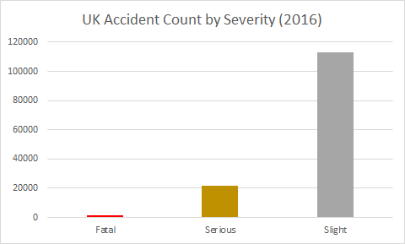

Introduction
In 2016, there were 136,621 recorded road accidents in the UK. Out of these, 1695 were considered fatal.
This means that there were on average, 374.30 accidents each day in the UK. Out of these, around 4.64 were considered fatal.
So what can be done to reduce accidents?

Slide 3
Background
The data for this report was taken from the 2016 Road Safety Accidents dataset from: https://data.gov.uk/dataset/cb7ae6f0-4be6-4935-9277-47e5ce24a11f/road-safety-data
Fields included in this presentation include accident count, accident hour, accident month, accident severity, highway districts, urban or rural, and road type.

Slide 4
Research Questions
What were the largest causes of road accidents in the UK for 2016?
What could be done to prevent similar accidents in the future?

Slide 5
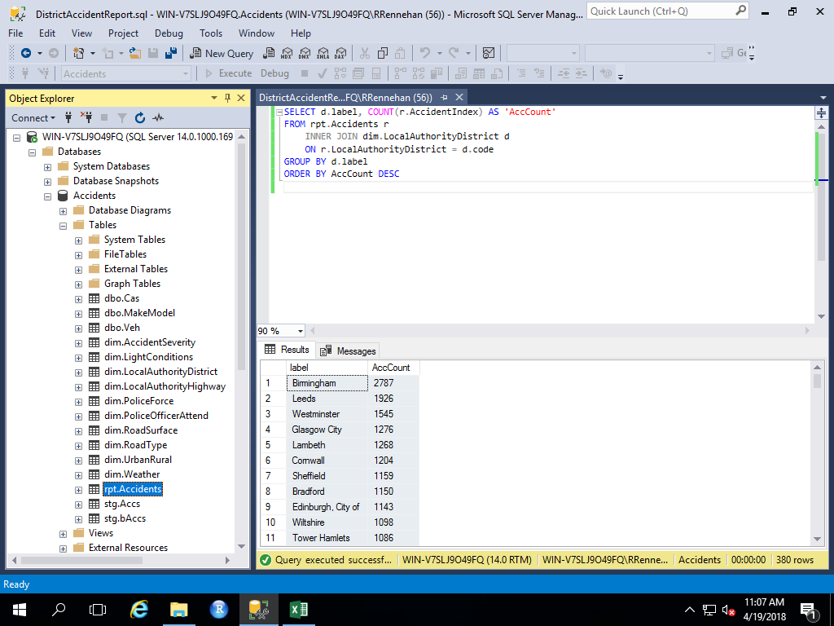
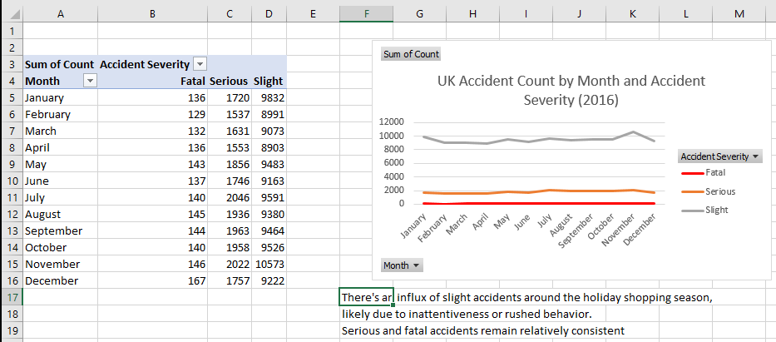
Research Methods

Slide 6
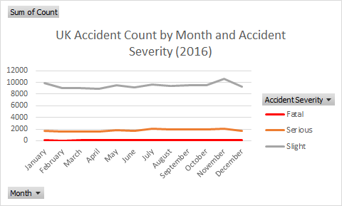
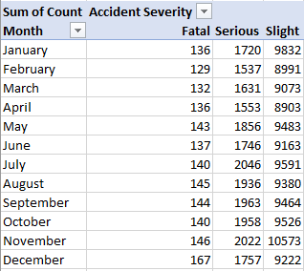
Findings/Data
An influx in slight accidents occurs during the holiday shopping season. Fatal and serious accidents remain relatively consistent

Slide 7
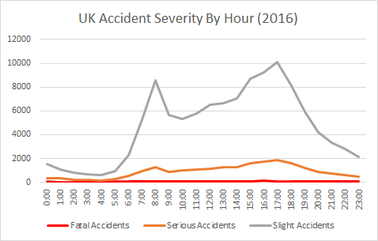
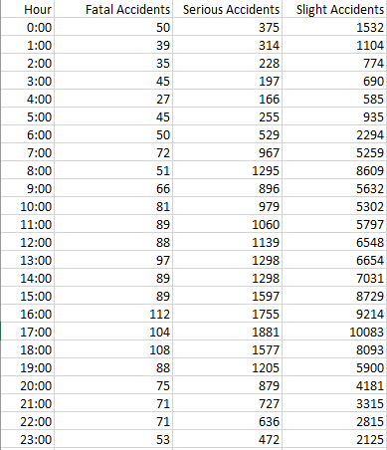
Findings/Data
A higher percentage of accidents at night are either serious or fatal. Slight and serious accidents reach their peaks during the rush hours.

Slide 8
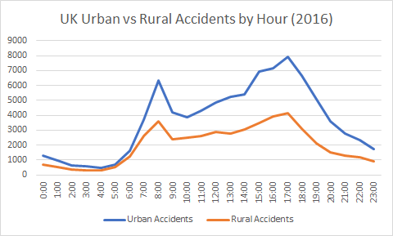
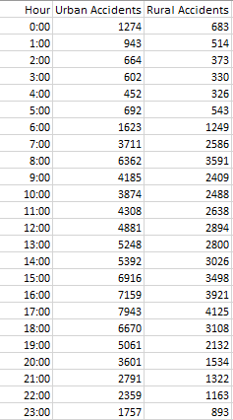
Findings/Data
The gap between urban and rural accidents significantly decreases at night and is the furthest apart during the rush hours.

Slide 9
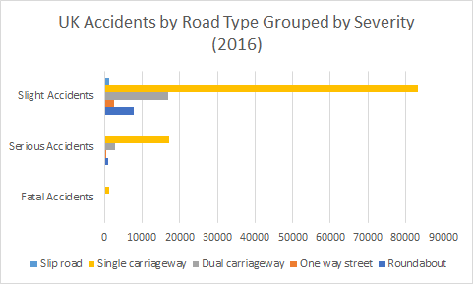
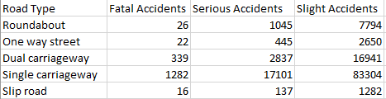
Findings/Data
Single carriageways dominate in all three accident types. Roundabouts have more accidents than one way streets

Slide 10
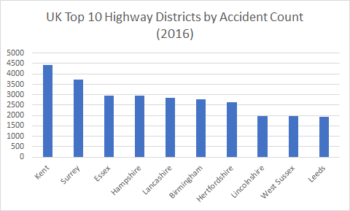
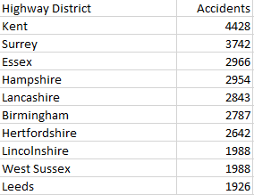
Findings/Data
The Kent highway district leads by accident count. The channel tunnel, which connects two countries that drive on opposite sides of the road, could be a major reason.

Slide 11
Conclusions
More policing on highways at night is a must.
Accident heavy zones like Kent and the channel tunnel could use more policing and signage to reduce accidents.
Having more policing around parking lots during the holiday shopping season can reduce the amount of slight accidents and the chances of pedestrians getting hit.

Slide 12
References
Road Safety Data – Accidents 2016. (2017, October 31). Retrieved April 19, 2018, from https://data.gov.uk/dataset/cb7ae6f0-4be6-4935-9277-47e5ce24a11f/road-safety-data

