Slide 1
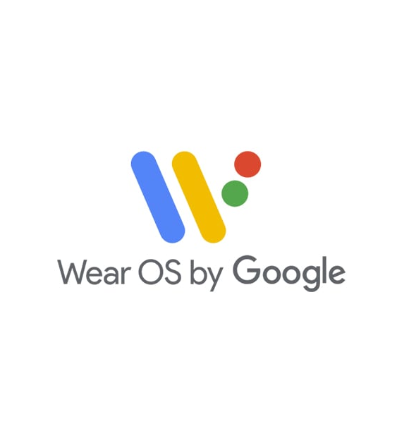

Sending and Receiving Messages Over the Wearable Data Layer
Bi-directional Communication Between a Handheld and Wearable
public class Student extends JuniorDeveloper{
String name = PaulDuerr;
String github = github.com/rrep;
String project = FISHPUNCH;
DateTime date = 07-10-2019;
String school = NAIT;
String course = DMIT2504;
}

Slide 2
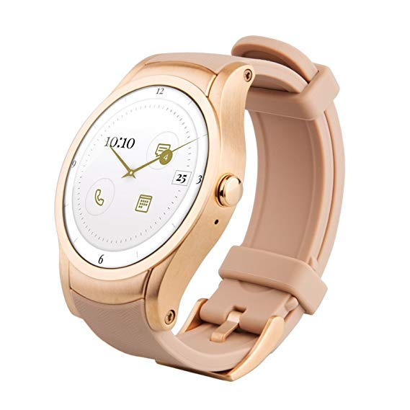
Devices Used
Quanta/Verizon Wear24
About ~$50 for a refurb.
No USB port (Debug over WIFI)
Android 7.1.1
Has a SIM card in it (sealed)
Seems to have at least one or two bands for Canadian carriers
if you’re into that

Slide 3
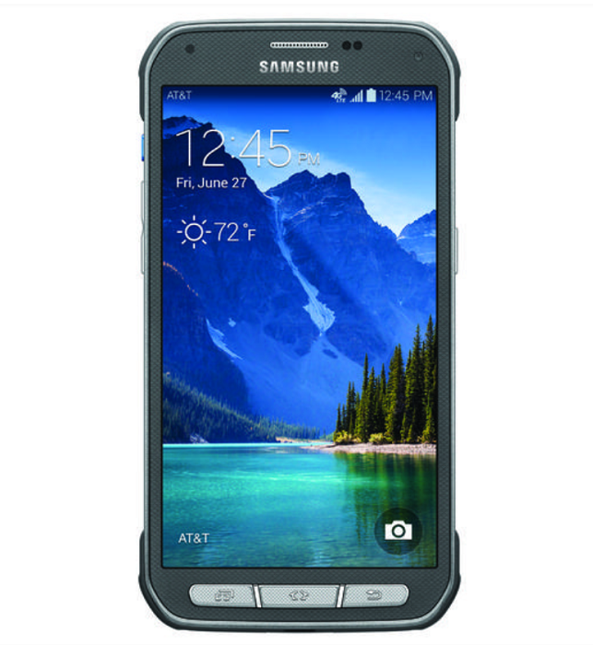
Devices Used
Samsung Galaxy S5 Active
In case I accidently threw it when initially testing the accelerometer
Android 6.0

Slide 4
Topics Reviewed
Topic of this project:
Sending and receiving messages over the wearable data layer.
The original tutorial includes:
Threading, Handlers, MessageQueues
Topics that made my life way easier after doing additional research: Threading, Handlers, Loopers, MessageQueues
Additional functionality used for FISHPUNCH:
Accelerometer, SensorEvents, CountDownTimer

Slide 5
Important Lessons
Additional areas:
Use ADB (Android Debug Bridge)
Don’t trust Google.
AndroidX dependency overlap wasted 3 hours of my life I’ll never get back.
Trust Google.
Not believing I couldn’t pair a watch AVD with a phone AVD
wasted 3 hours of my life I’ll never get back.

Slide 6


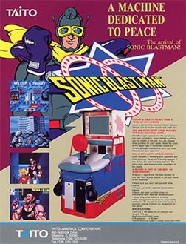
INSPIRATION Once Upon a Time In the Arcades of the Early 90’s

Slide 7
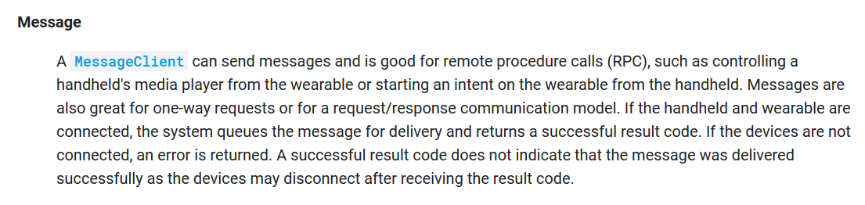
What is the Wearable Data Layer?
An API that’s a part of Google Play Services that provides another communication channel for apps. Includes several data objects.. But our most important one is:
https://developer.android.com/training/wearables/data-layer/

Slide 8
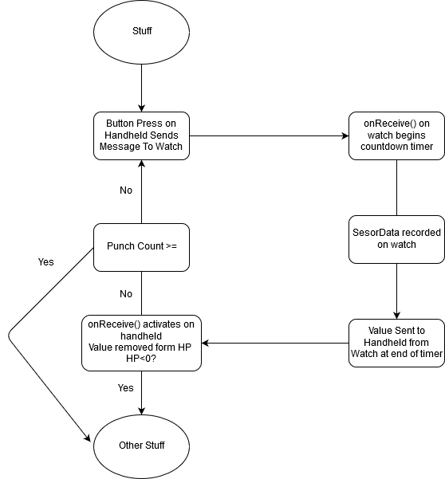
FISHPUNCH Implementation

Slide 9

Step-by-Step (SENDING)
It all starts with .start() –ing a new thread.
.start() will run the parcel of work that exists in the run() method of the Thread class.
In this example SendMessage is just the name of the class that was created by extending the Java Thread class, and is taking 2 strings as constructor parameters – 1) the PATH we discussed earlier, and 2) the value we’re sending.

Slide 10
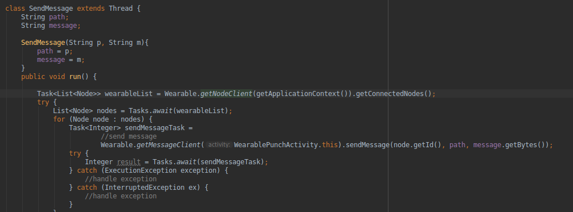
Step-by-Step (SENDING)
Gets a list of all nodes
A node is a device connected via the wearable data layer
Remember the 2 parameters from the last slide?
For every node it sends the message via the message client to that node, with our PATH, and our message
We’ve only got one connected though.

Slide 11
Step-by-Step (SENDING)
Success! Now it’s been released into the ether!
One issue with the MessageClient API is that just sending it to the data layer itself will be a success.. So you won’t be able to confirm if the other device got it by default.

Slide 12
Step-by-Step (RECEIVING)
STEP 1)
- Make a service by creating a class that extends WearableListenerService & register it in your manifest
- Override onMessageReceived(MessageEvent) in that class since that’s how we’ll get messages
In this method we will:
A) check the “path” – a string we use on both ends to make sure it’s what we want
B) get the message from the MessageEvent (somewhat like how we .getExtras() from an intent)
C) Put that Message in a bundle with key value for the intent’s key-value pair, and put the intent type we will be listening for on our Receiver.
D) Pass it to the LocalBroadcastManager to be passed over to the other Activity in the UI thread.

Slide 13
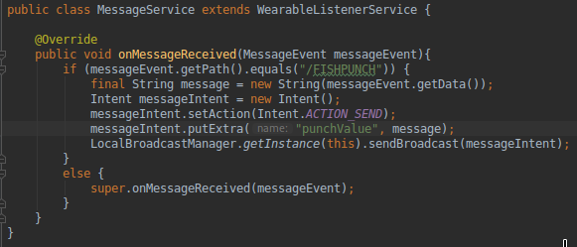
Step-by-Step (RECEIVING)
STEP 1)
When we received the message, we:
A
Make sure it’s what we want
B
Get the value
C
Pack it back up for the Receiver
D
Ship it over to the Main Activity

Slide 14

Step-by-Step (RECEIVING)
Step 2)
LocalBroadcastManager is registered in the onCreate function of our main activity. This allows our Receiver class to get the bundle we just made in our class that extended WearableListenerService.
We have registered a Receiver that has an onReceive(Context, Intent)method and is looking for intents with ACTION_SEND, which we had set with intent.SetAction() on the previous slide.

Slide 15
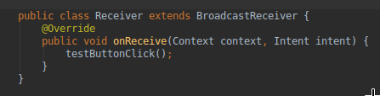
Step-by-Step (RECEIVING)
Since our receiver is about to receive JUST THE KIND OF INTENT WE WERE LISTENING FOR (ACTION_SEND), The Receiver in your Main Activity gets the Broadcast and runs onReceive()! Huzzah!
Now you can get the values from the intent that came as in a parameter, (or just use it as an event to run a method like in the shown code).

Slide 16
FISHPUNCH Implementation Revisited
Thread.start()
BroadcastReceiver
WearableListenerService
Thread.start()
WearableDataLayer MessageClientAPI
WearableDataLayer MessageClientAPI
WearableListenerService
BroadcastReceiver
WearableListenerService
BroadcastReceiver
Thread.start()
Unidirectional
+ Unidirectional
= Bidirectional!

Slide 17
Ready to punch some fish? Keep in mind:
AndroidX is a new (2018) way Google packages their dependencies, and it has overlap with old packages that will cause compile errors in Android studio. Select “include AndroidX artifacts” or refactor to AndroidX after creating a new project.
If you follow Jessica Thornsby’s tutorial, remove the autogenerated Service entries added to your manifest when you add a service to your wear and mobile modules (thanks Sam!) and make sure to remember to AndroidX caveat
You CANNOT pair a phone AVD with a watch AVD. You’ll need to port forward your phone through adb or telnet to pair to the watch AVD.
https://developer.android.com/training/wearables/apps/creating#pair-phone-with-avd

Slide 18
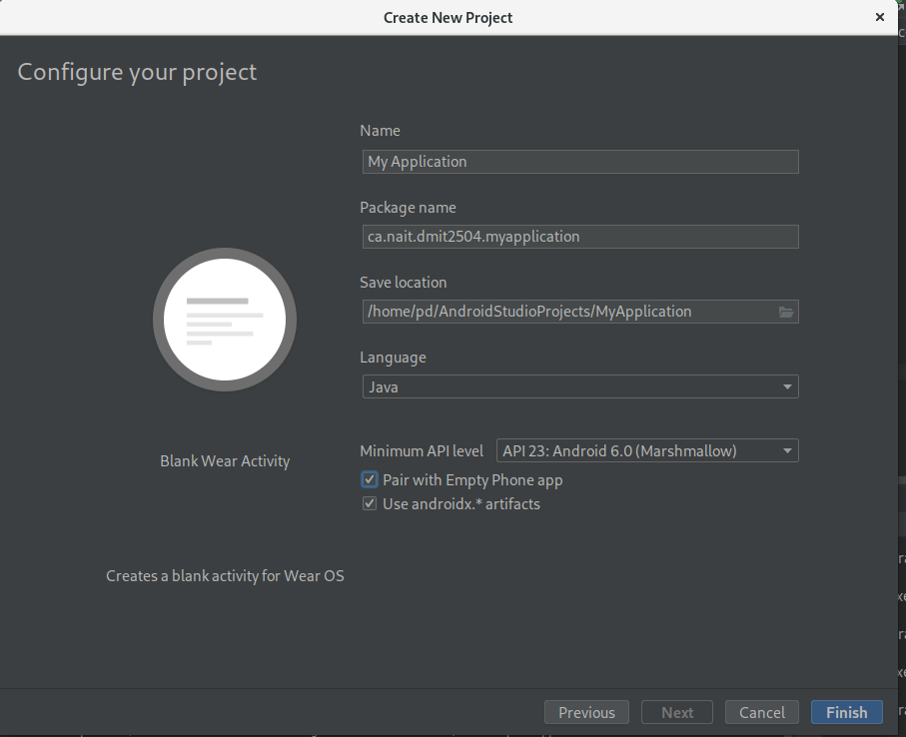
Start your project
Both a wear app and a mobile
app in your project
Use androidx

Slide 19
Pair your real phone to your virtual watch
Download WearOS companion app on your phone
Download sdk platform tools from Google to use adb
https://developer.android.com/studio/releases/platform-tools
Make sure your phone is connected & enable USB debugging via developer tools (click on the version in your About section a bunch of times)
Go into the folder that has platform tools
ENTER THE COMMAND LINE
Type in “adb –d forward tcp:5601 tcp:5601” to forward your localhost port 5601 to your phone’s (so it hears the watch)

Slide 20
Make it work
Main tutorial – Send and receive messages via Button Click.
https://code.tutsplus.com/tutorials/get-wear-os-and-android-talking-exchanging-information-via-the-wearable-data-layer--cms-30986
Code in Flow Threading Playlist (HIGHLY RECOMMENDED)
https://www.youtube.com/watch?v=QfQE1ayCzf8&list=PLrnPJCHvNZuD52mtV8NvazNYIyIVPVZRa
Android Performance Patterns, Understanding Threading:
https://www.youtube.com/watch?v=0Z5MZ0jL2BM
Create and Run a Wearable App
https://developer.android.com/training/wearables/apps/creating#setting-up-a-phone
Send and Sync Data on WearOS
https://developer.android.com/training/wearables/data-layer/index.html

