Slide 1
B7 – Industry Tools
Revit Dynamo Practice
By Francesco Nacci

Slide 2
Basis and Objectives
Working experience of the student is in construction management for Oil&Gas capital project. No Architecture background.
The 3D model used is the built-in reference model in Revit.
The routine is a simplified case of construction status report.
Many software are involved in a construction management to calculate progress, maintain schedules, prepare weekly workplan. This Routine will interface data resulting from different programs and integrated into an excel file. This specific routine will import these data from excel and visualize them in a dedicated 3D model view.
The routine will be expanded to create weekly plans and job packs and it will be the base to implement an AWP (Advanced Work Packaging) methodology through Revit.
Although the same can be achieved through Navisworks Simulate/Manage, the process is quite slow for real projects and it will imply several steps which can be avoided integrating the activities directly in Revit.

Slide 3

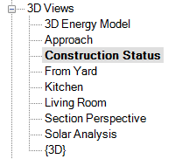
Preparatory actions
Before execution of the routine the following action must be taken:
Create 3 project parameters under Text category involving all categories:
Construction Progress (numeric data to explain on going activities)
Construction Status (to filter not started/on going/completed elements)
Standard Manhours (to execute a summary of expected construction manhours)
Create a dedicated 3D view named “Construction Status”. This view must be active during the execution of the routine.
Ensure the following software are installed:
Revit 2018
Dynamo 2.0.2
Springs Nodes 110.0.2 for Dynamo
Microsoft Excel
Locate the ProgressInfoImport.xlsx file at the beginning of the routing before running.
Open the routing in Manual mode in order to select the import file first.

Slide 4
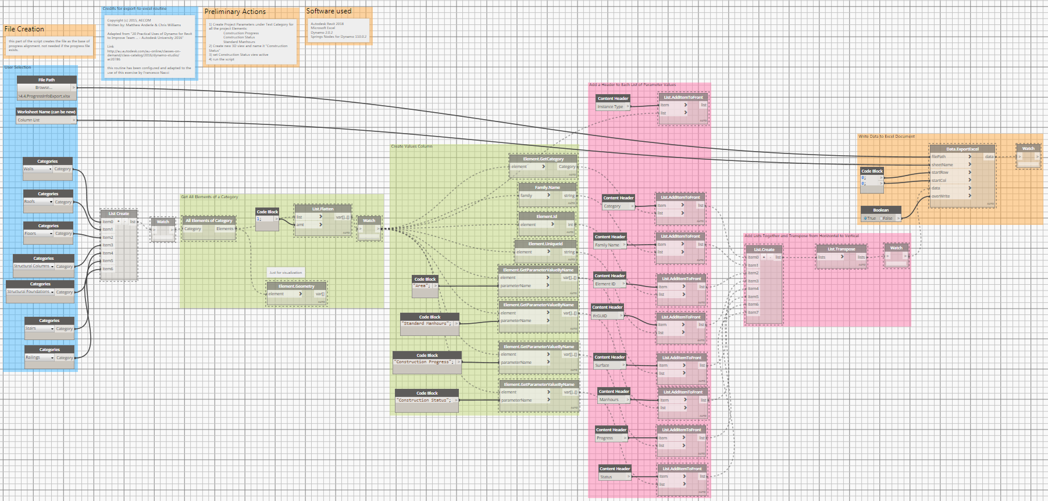
Export model data
The first part of the routine is used only to export the element in the current 3D model.
An Excel file is generated and it will be used as the base to interface 3D model element to various software, in this case the progress calculation software.
The file to be used as export is 4.4.ProgressInfoExport.xlsx
The technicalities of the 3rd party software are not part of this exercise.
The export routine has been adapted from an existing script to the needs of this exercise.

Slide 5
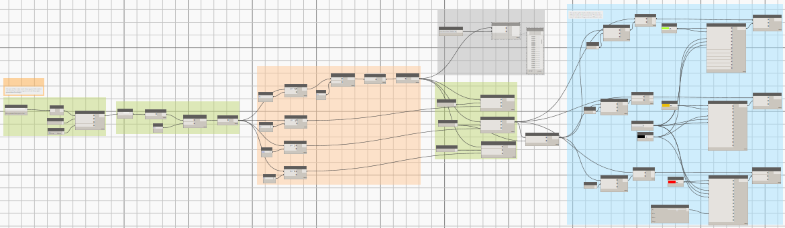
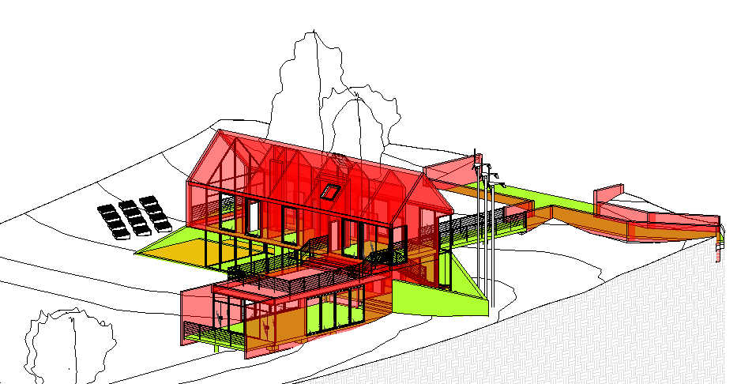
Import data into revit model
The second script will import the data from the excel file and update the element parameters and visualize the progress in the 3D view.
The file to be imported is ProgressInfoImport.xlsx

