Slide 1


BREMEN EXCHANGE PROGRAM
Taufiquar Khan
Department of Mathematical Sciences
Clemson University
khan@clemson.edu
February 22, 2012
Mathematical
Sciences

Slide 2
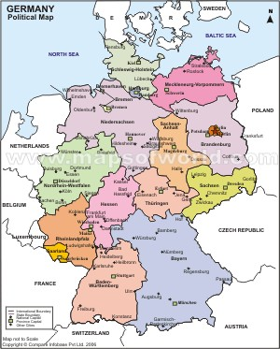
BREMEN LOCATION
Bremen, Germany
State of Bremen (North)
Near Bremerhaven Port (2 Hrs)
Near Hamburg (1 Hr by Train)
Berlin ( < 3 Hrs by Train (?))
Mathematical
Sciences

Slide 3
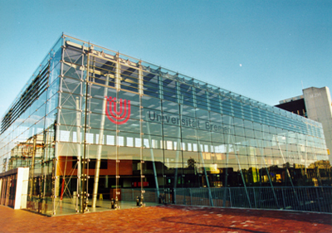
ZeTeM AT BREMEN
Center of Industrial Mathematics (ZeTeM)
http://www.math.uni-bremen.de/zetem/
Professor Peter Maass
Optimal Control
Mathematical Modeling
Numerical PDEs
Industrial Mathematics
Numerical Analysis
Mathematical
Sciences

Slide 4
ZeTeM AND BREMEN FACTS
ZeTeM has 16 Professors
30-40 Students
Faculty of Math and CS
Bremen has 18K Student
Mathematical
Sciences

Slide 5
EXCHANGE ARRANGEMENT
Summer Exchange Program for Clemson Students
  10 Weeks from May – August (4 weeks of course for Clemson credit, 4 weeks for project, and 2 weeks for write up)
2 Clemson Students Chosen for the Program
  Admission to the Program is Recommendation of Clemson Faculty
  Clemson 1st Year Graduate Students Eligible
  Student Must be Enrolled in Master’s Thesis Option (Preferably En Route to PhD)
The Program Emphasis is Applied Analysis/Industrial Mathematics
Mathematical
Sciences

Slide 6
FINANCIAL AID
  No Academic or Tuition Fees at Bremen
  Only cost is Living Expenses and Airfare
  Clemson & NSF Will Provide $ 2500 per Summer
  Bremen will Provide Euro 800 for the summer
  Airfare is Clemson Student’s Responsibility
  Bremen will Assist in Finding Housing
  We Have Hosted Two Bremen Visitors
  Two Clemson Students Have Visited Bremen
Mathematical
Sciences

Slide 7
Application Process
  Curriculum Vita – Paper Copy
  A Statement of Interest
  Copy of Transcripts – Undergraduate and Clemson
  Deadline March 2, 2012
Mathematical
Sciences

