Slide 1
Algebra, Discrete Mathematics, and number theory
Clemson University

Slide 2
What is algebra?
“Algebra can essentially be considered as doing computations similar to that of arithmetic with non-numerical mathematical objects”
~The Wikipedia gods

Slide 3
What is algebra?
“Algebra can essentially be considered as doing computations similar to that of arithmetic with non-numerical mathematical objects”
~The Wikipedia gods
What the what?!

Slide 4
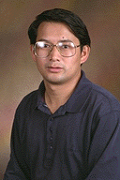
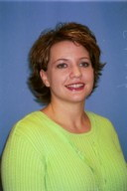
Research areas
Coding Theory and Cryptography
Problems: discrete logarithm problem, factoring integers and polynomials, Grobner bases, algebraic geometry codes, low-density parity-check codes
Dr. Gao | Dr. Matthews

Slide 5
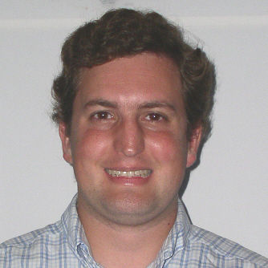
Research areas
Applied Algebraic Geometry
Problems: algebraic geometry, algebraic topology, algorithms, and computational and discrete geometry
Dr. Burr

Slide 6
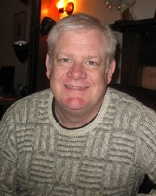
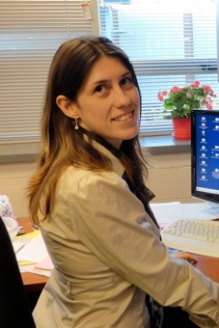
Research areas
Combinatorics
Problems: combinatorial and probabilistic methods (especially in number theory), enumerative and algebraic combinatorics, discrete mathematical biology
Dr. Calkin | Dr. Poznanovik

Slide 7
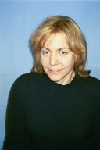
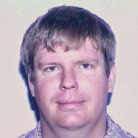
Research areas
Graph Theory
Problems: domination digraphs, network algorithms, algebraic graph theory, binary matroids and codes, closure systems
Dr. Goddard | Dr. Novick

Slide 8
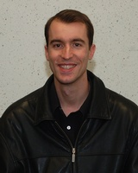
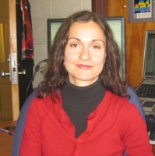
Research areas
Mathematical Biology
Problems: graph dynamical systems, combinatorial aspects of Coxeter groups, Boolean networks, finite deterministic and stochastic dynamical systems, Grobner bases
Dr. Macauley | Dr. Dimitrova

Slide 9
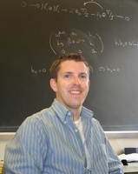
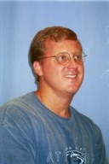
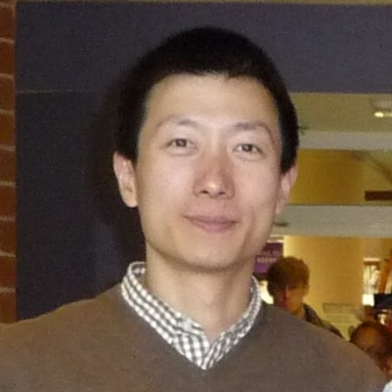
Research Areas
Number Theory
Problems: special values of L-functions, Iwasawa theory, Galois representations, arithmetic theory of modular forms, elliptic curves,
Dr. Brown | Dr. James | Dr. Xue

Slide 10
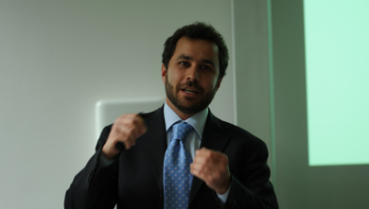

New Players
Dr. Manganiello | Dr. Coykendall
Dr. Manganiello – coding theory and network coding
Dr. Coykendall - commutative algebra and algebraic number theory

Slide 11
Life After grad School
Industry Positions:
NSA
MIT Lincoln Laboratory
CAN’s Center for Naval Analysis
Teaching Positions:
University of Central Arkansas
King’s College
Furman University
North Greenville
Postdoc Positions:
Davidson College
Nanyang Technological University
Duke University

Slide 12
What To Do Now
Classes
851, 852, 853
Graph Theory: 854 & 954
Combinatorics: 855
Coding Theory: 856
Cryptography: 857
Number Theory: 858, 951, 952
Special Topics Classes: Coding Theory, Lie Groups, Algebraic Geometry I and II, Mathematical Biology, ….

Slide 13
What To Do Now
Seminars:
ADM Seminar:
Thursdays 3:30 - 4:30, M-102 Martin Hall
Contact: Dr. Novick & Dr. Poznanovik
Algebraic Geometry & Number Theory Seminar:
Wednesdays 3:30 - 4:30, M-102 Martin Hall
Contact: Dr. Brown, Dr. James, or Dr. Xue
Graph Theory Seminar:
Fridays 3:30 – 4:40, 0 – 10 Martin Hall
Contact: Dr. Hedetniemi (hedet@clemson.edu)
Conferences:
Clemson Mini-Conference on Discrete Mathematics and Algorithms
The Palmetto Number Theory Series (PANTS)

Slide 14
Where To Find More Information
Algebra Department:
http://www.clemson.edu/ces/math/graduate/areas/algebra.html
Applicable and Computational Algebra Lab:
http://www.math.clemson.edu/~sgao/WEB/
Number Theory:
http://www.math.clemson.edu/~jimlb/NumberTHeoryGroup/numbertheorygroup.html

Slide 15
Be sure to sign-up for AWM!!

