Slide 1
“Do”s and “Don’t”s of a talk
Jeffrey Beyerl
January 18, 2012

Slide 2
Part 1: “Do”s

Slide 3
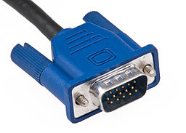

Before the talk
Find your VGA connection
Have your slides proofread
Know what your slides say
Ask for funding
Organizers, department, student government

Slide 4
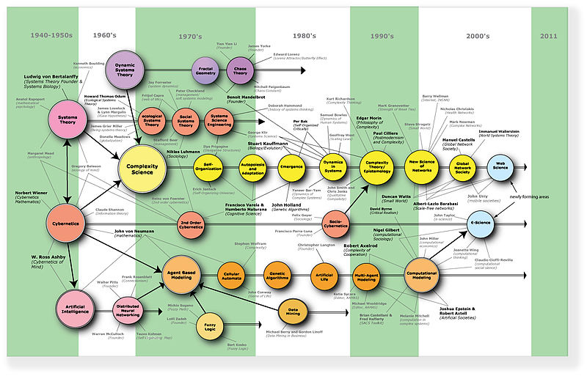

During the talk (Colloquia)
Expect a broad audience
Give enough detail for everybody to follow
Expect very general questions

Slide 5
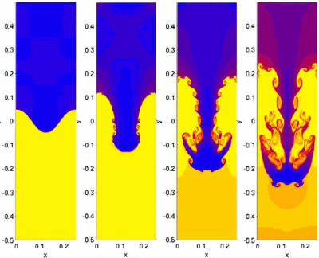
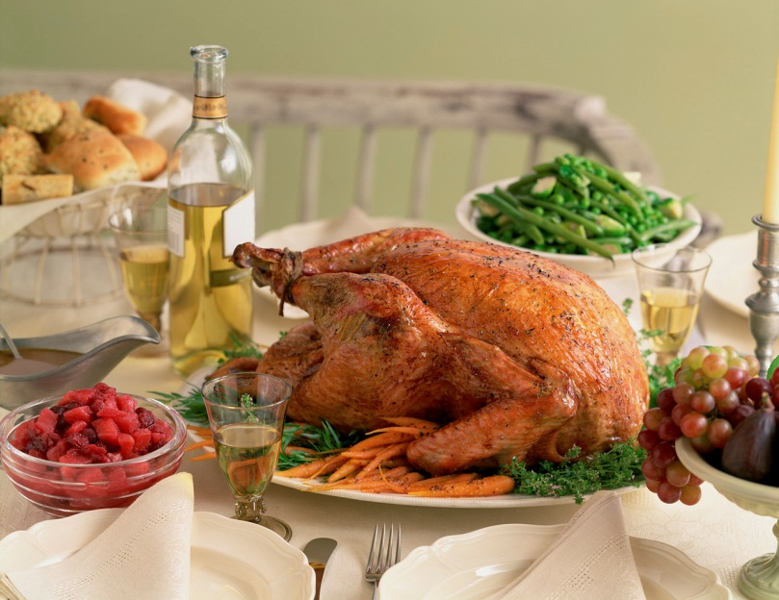
During the talk (Seminar)
Expect a specialized audience
Non-experts will get lost
This is OK
Give a “big picture” early in the talk
Expect some technical questions
Often over dinner

Slide 6

During the talk (Defense)
Expect your committee
Other grad students may attend
…varies based on popularity
Expect lots of questions

Slide 7
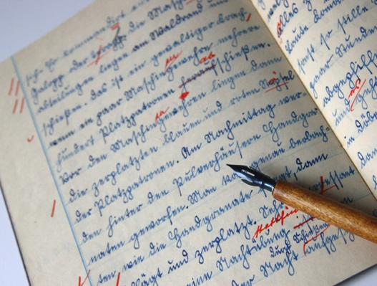

After the talk
Thank the audience
Let the moderator ask for questions
Know whether or not you have preprints
Record your talk in your CV
Keep a list of everyone you met nontrivially

Slide 8
Part 2: “Don’t”s

Slide 9
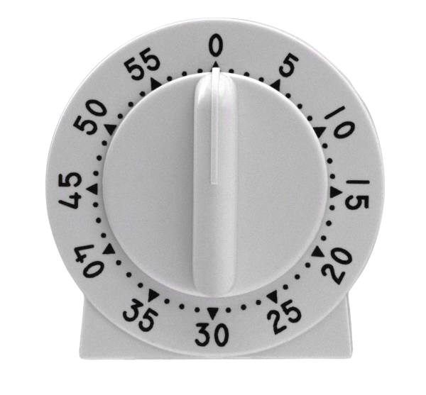
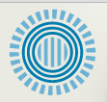

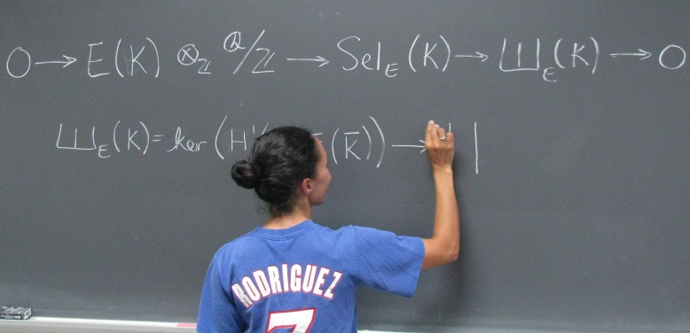

“Don’t”s
Run over
Run out of material early
Use inappropriate tools.
Assume there will be a board
Be afraid to table questions
Use too much eye candy
Forget to cite people where credit is due
Put too much text on a single slide. People tend not to read all of the text on a slide anyway, I bet you’re not reading this, so make sure you know what to say to add to the written slides.
$Σ$1=π²
n 6

Slide 10
Part 3: Submitting a thesis
Download LaTeX template
Write thesis
Get advisors to OK it
Get committee to OK it
Submit it online
Fix formatting problems and resubmit
There shouldn’t be any unless if you tried to format it yourself

Slide 11
Publishing Options: Traditional
Available online from Clemson’s Library
You retain the copyright
No cost to you, others can buy a copy
10% royalties for 25 years
(on the zero copies of your thesis that will ever be sold)

Slide 12
Publishing Options: Open Access
Pay $95
Compare with: Journals charge thousands
Available to everyone online for free forever
“Forever” = as long as the Library of Congress exists

