Slide 1
Graph-Based Energy Budget Computation in Wireless Sensor Networks
Roman Riazanov
Prof. Dr.-Ing. Jürgen Teich
Pierre-Louis Sixdenier
Friedrich-Alexander-Universität Erlangen-Nürnberg 28.11.2025

Slide 2

Problem Description
Wireless Sensor Networks (WSN) and Energy Harvesting
Sensors in WSNs have to supply themselves with energy, some use a battery, which is however eventually depleted
therefore they often use energy harvesting (e.g. collecting solar energy) to extend their lifetime
lifetime is unlimited if energy use is such that the energy at the beginning of a time intervall is the same (or less) as at the end
energy neutral operation:
Sensor has to perform certain tasks that use energy

Slide 3




Problem Description
Task Model
tasks in our model do not have a specific functionality
we have a set of tasks
every task has a specific
energy consumption (cost):
quality of result:

Slide 4




Problem Description
divide up time, over which the sensor should be energy neutral into K timeslots
battery also discretely divided up into slots with
start value:
maximum:
minimum:
specific amount of incoming energy per timeslot (needs to be predicted):

Slide 5
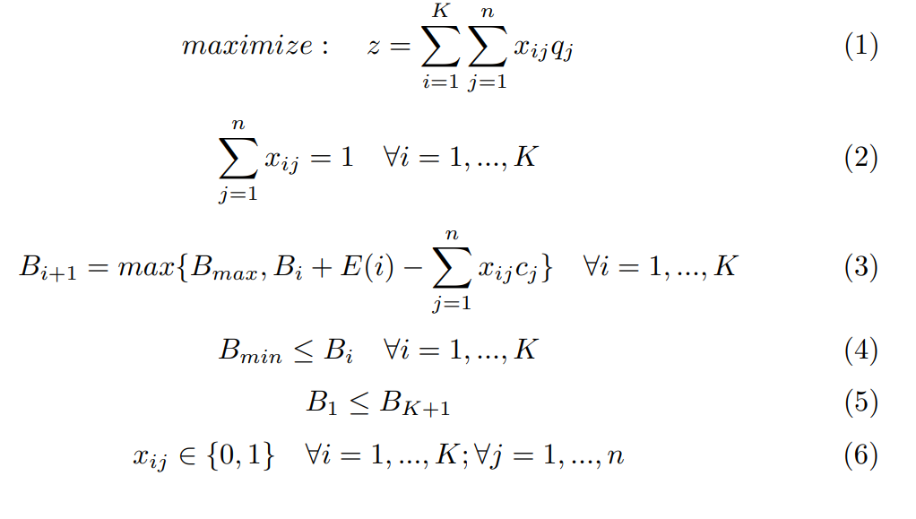
Problem Description
Problem formulated as ILP
source for ILP:
Caruso, A., Chessa, S., Escolar, S., Del Toro, X., & López, J. C. (2018). A dynamic programming algorithm for high-level task scheduling in energy harvesting IoT. IEEE Internet of Things Journal, 5(3), 2234-2248.
there is already a dynamic programming algorithm for this problem, which iterates over each timeslot and each energy level
idea: explore problem in a graph-based model and find an approximate solution to gain an advantage (e.g. save time)

Slide 6
Research Questions
RQ 1: What are the most suitable graph traversal heuristics to compute an approximate solution to the energy budget computation problem?
RQ 2: How do the proposed graph-based approaches compare to existing methods in terms of computation time, memory footprint, and quality of the computed energy budget?

Slide 7
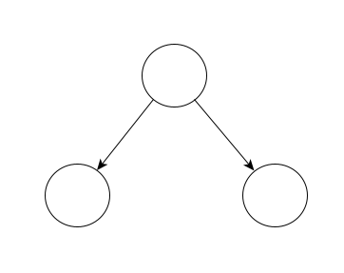
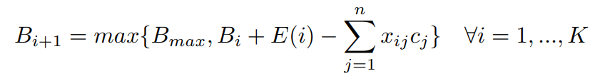
Graph Model
nodes are distinguished by:
timeslot t
battery level b
edges contain the tasks
Battery level formula:
harvested energy: 3
t = i
b = 20
task 1:
cost: 5
task 2:
cost: 2
t = i+1
b = 18
t = i+1
b = 21

Slide 8
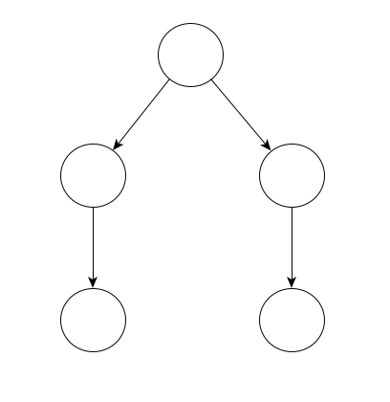
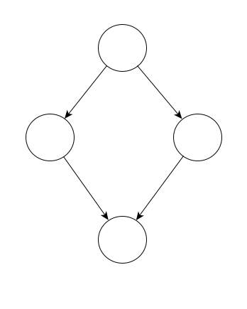
Graph Model
dealing with transpositions
t = i
b = 20
t = i
b = 20
t = i+1
b = 19
t = i+1
b = 22
t = i+1
b = 19
t = i+1
b = 22
t = i+2
b = 20
t = i+2
b = 20
t = i+2
b = 20

Slide 9
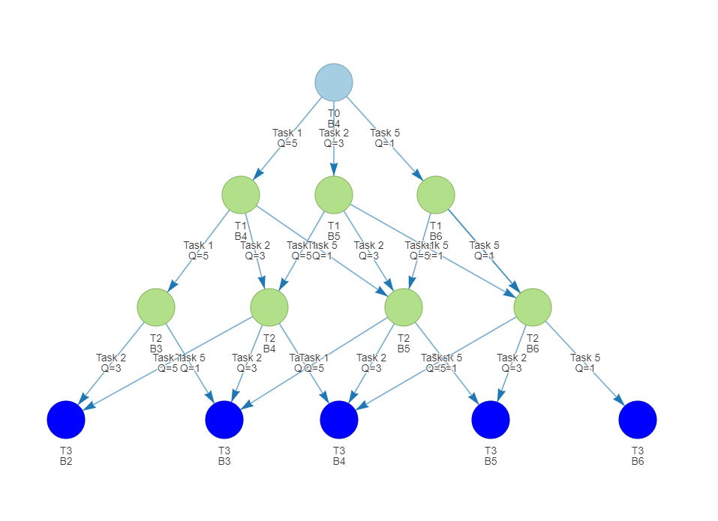
Graph Model
Problem:
find path from root (timeslot 0) to a leaf (timeslot K) with highest sum of quality of tasks on the path
use topological sorting to get the same result as dynamic programming
but: building the graph also takes time

Slide 10
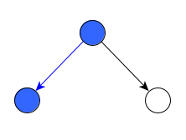
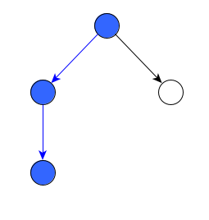
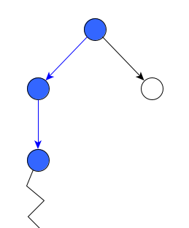
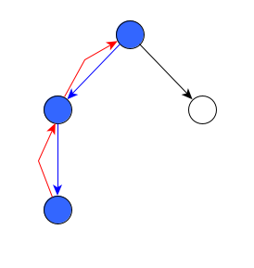
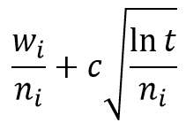
Monte Carlo Tree Search (MCTS)
random sampling based algorithm for building a game tree and finding good paths/nodes
Selection
Expansion
Simulation
Backpropagation
4
6
3
2
5
2
UCT(i) =
2
2

Slide 11
Monte Carlo Tree Search (MCTS)
Problem Specific Adaptation
Model is a DAG, not a tree -> memorize the path taken in selection/expansion and backpropagate along it
Final solution is taken from a selection/expansion/simulation path -> always save the best full path that was explored
Simulation results are quality values, when path is not energy neutral there are 2 options:
„discard path“ and backpropagate 0
penalize quality value and backpropagate it
No nodes with battery values below minimum can be created

Slide 12

Simulation Results
Amount of Iterations and Quality
Results of 100 iterations:
average quality >95% of linear programming
average battery remaining ~2% higher than necessary
Simulation setup:
K = 24 timeslots
= 10, = 20,
= 30
exponential penalty, UCT formula for selection,
100 repetitions / data point

Slide 13
Simulation Results
Amount of Iterations needed for full solution
increasing graph depth (timeslots K)
= 30
increasing branching factor (battery slots, more tasks, energy input)
K = 24

Slide 14
Occuring Problems
Problems related to the UCT Formula
Problem 1: Exploration part was developed for simulation results between 0 and 1 -> not sufficient for quality scores
Solution: scaling qualities or using another exploration method
Problem 2: Square Root and Logarithm are very slow, especially on targeted microcontroller (nRF52)
Solutions: avoid them, or use lookup tables
UCT(i) =
exploitation
exploration

Slide 15
Completed Tasks & Next Steps
Completed Tasks
research on WSN energy algorithms
research on MCTS
develop MCTS algorithm for WSN
conduct first performance tests
Remaining Tasks:
explore further performance optimizations
reduce required iterations
reduce time of one iteration
try method for probabilistic energy harvesting values
MCTS supports unknown input parameters
explore other graph-based algorithms
write final thesis

Slide 16
Thank You
for listening!

Slide 17
Appendix

Slide 18
Time taken in n-th iteration

Slide 19


Penalties compared
over 10000 repetitions, K=24, Bmax=30
No penalty
Maximum quality: 91.49
Linear penalty (with factor 2)
Maximum quality: 92.07
formula:
Exponential penalty
Maximum quality: 92.42
formula:

Slide 20
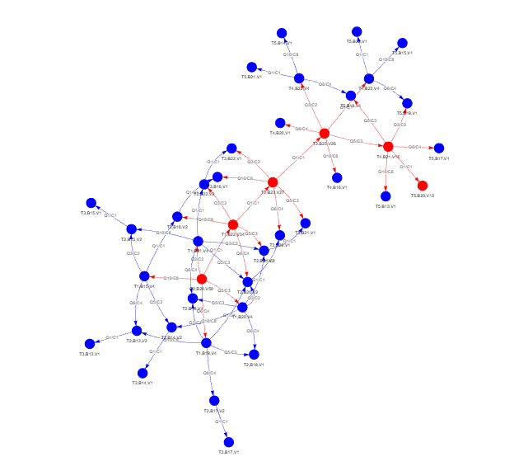
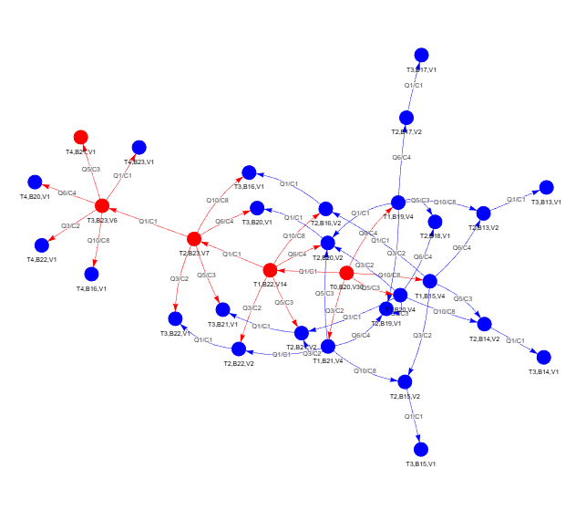
MCTS Graph Visualization
K=5, Bmax=30, 50 Iterations
MCTS graph after 30 iterations
MCTS graph after 50 iterations

