Slide 1
Minors in Information System
Dr. Feng Liu
Department of Mathematics, Sciences and Information System

Slide 2

INSY minor for business major
Decision Making on budgeting
Sale forecasting
Cost cut
Marketing
performance
Image credit: http://www.utroninc.com/

Slide 3
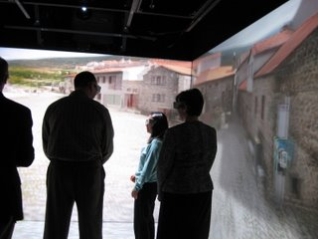

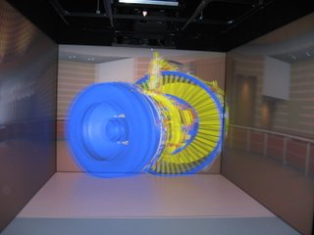
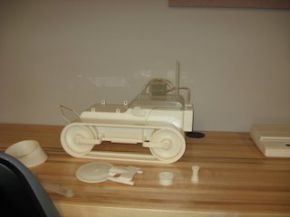
For Engineer major

Slide 4
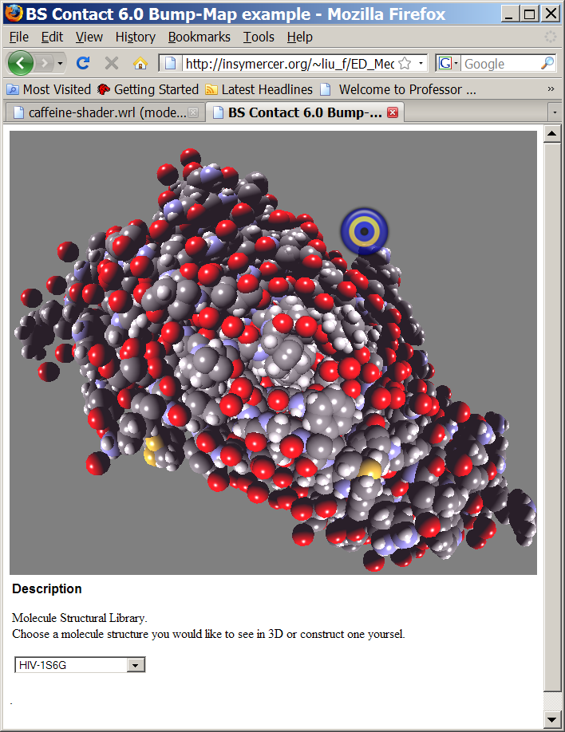
For Biology major, Pharmacy major and Education major – molecule visualization
http://insymercer.org/~liu_f/ED_Media08/MoleculeLib.html

Slide 5

For Art and design major, History major …
Video and sound process
3D sculpture
Virtual reality, 3D scanning, 3D printing
Image credit: www.archimuse.com/.../tecchia/tecchia.html

Slide 6
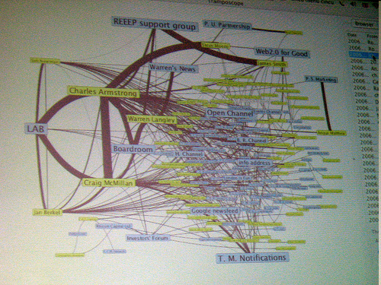
For social science and human services, Criminal Justice majors
Social network
  Privacy issues – under watched
Wireless network in the community level
  VOIP application
  Security issue
Digital forensic
  Digital criminal
  Criminal investigation

Slide 7
For marketing purpose
Information system used as a presentation tool
  Hit rate/ return rate
Human Computer Interface evaluation is core component to ensure the success of the firm
  Usability analysis

Slide 8
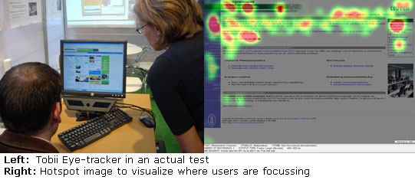

Slide 9
Minor in information system
Required courses:
  INSY115
  INSY211
  Other four 300 level courses in information system area
  Cross-listed courses are accepted.
    INSY387/ INSY391
    Management class may accepted
All the students in INSY minor are required to see the INSY advisor before they register the class

Slide 10
Minor in Web Development
-- on the way
Courses requirement
  INSY211 : web design & tools
  INSY212 : web programming
  INSY162 or INSY230 : programming Lanuage
  INSY312 : Database Design
  INSY320 : Client-server Programming
  INSY420 : Human Computer Interaction

Slide 15
What INSY teach?
Transform data → information
How to interpret information
How to use those information correctly and efficiently
How to set up a secure network
Use information system as a presentation media
Use information system as Evaluation Tool

